Slide 1
DML
Chapter 5

Slide 2
Quick review of chapter 4 (Retrieval)
SQL allows a table (relation) to have two or more tuples that are identical in all their attribute values.
Hence, in general, an SQL table is not a set of tuples, because a set does not allow two identical members; rather, it is a multiset (sometimes called a bag) of tuples. Some SQL relations are constrained to be sets because a key constraint has been declared or because the DISTINCT option has been used with the SELECT statement

Slide 3
SELECT <attribute list>
FROM <table list>
WHERE <condition>;
where
■ <attribute list> is a list of attribute names whose values are to be retrieved by
the query.
■ <table list> is a list of the relation names required to process the query.
■ <condition> is a conditional (Boolean) expression that identifies the tuples
to be retrieved by the query.
Operators in where clause : =, <, <=, >, >=, and <>.

Slide 4
SELECT Bdate, Address Projection attributes
FROM EMPLOYEE Boolean condition
WHERE Fname=‘John’ AND Minit=‘B’ AND Lname=‘Smith’;
SELECT Fname, Lname, Address
FROM EMPLOYEE, DEPARTMENT
WHERE Dname=‘Research’ AND Dnumber=Dno

Slide 5
Aliasing to avoid ambiguity:
Query . For each employee, retrieve the employee’s first and last name and
the first and last name of his or her immediate supervisor.
SELECT E.Fname, E.Lname, S.Fname, S.Lname
FROM EMPLOYEE AS E, EMPLOYEE AS S
WHERE E.Super_ssn=S.Ssn;

Slide 6
Union
Query 8. For each employee, retrieve the employee’s first and last name and
the first and last name of his or her immediate supervisor.
SELECT E.Fname, E.Lname, S.Fname, S.Lname
FROM EMPLOYEE AS E, EMPLOYEE AS S
WHERE E.Super_ssn=S.Ssn;
Order By:
Retrieve a list of employees and the projects they are working on,
ordered by department and, within each department, ordered alphabetically by
last name, then first name.
SELECT D.Dname, E.Lname, E.Fname, P.Pname
FROM DEPARTMENT D, EMPLOYEE E, WORKS_ON W,
PROJECT P
WHERE D.Dnumber= E.Dno AND E.Ssn= W.Essn AND
W.Pno= P.Pnumber
ORDER BY D.Dname, E.Lname, E.Fname;

Slide 7
INSERt, DELETE and UPDATE
Simple insert:
INSERT INTO EMPLOYEE
VALUES (‘Richard’, ‘K’, ‘Marini’, ‘653298653’, ‘1962-12-30’, ’98 Oak Forest, Katy, TX’, ‘M’, 37000, ‘653298653’, 4 );
Specific column values insert:
INSERT INTO EMPLOYEE (Fname, Lname, Dno, Ssn)
VALUES (‘Richard’, ‘Marini’, 4, ‘653298653’);

Slide 8
inserts multiple tuples into a relation in conjunction with creating the relation and loading it with the result of a query.
CREATE TABLE WORKS_ON_INFO
( Emp_name VARCHAR(15),
Proj_name VARCHAR(15),
Hours_per_week DECIMAL(3,1) );
INSERT INTO WORKS_ON_INFO ( Emp_name, Proj_name, Hours_per_week )
SELECT E.Lname, P.Pname, W.Hours
FROM PROJECT P, WORKS_ON W, EMPLOYEE E
WHERE P.Pnumber=W.Pno AND W.Essn=E.Ssn;

Slide 9
DELETE FROM EMPLOYEE
WHERE Lname=‘Brown’;
To delete all records
DELETE FROM EMPLOYEE;

Slide 10
Update
UPDATE EMPLOYEE
SET Salary = Salary * 1.1
WHERE Dno = 5;

Slide 11
Complex Queries, Triggers,Views and schema modification
Chapter 5

Slide 12
Comparisons Involving NULL and Three-Valued Logic
1. Unknown value. A person’s date of birth is not known, so it is represented
by NULL in the database.
2. Unavailable or withheld value. A person has a home phone but does not
want it to be listed, so it is withheld and represented as NULL in the database.
3. Not applicable attribute. An attribute LastCollegeDegree would be NULL for
a person who has no college degrees because it does not apply to that person.

Slide 13
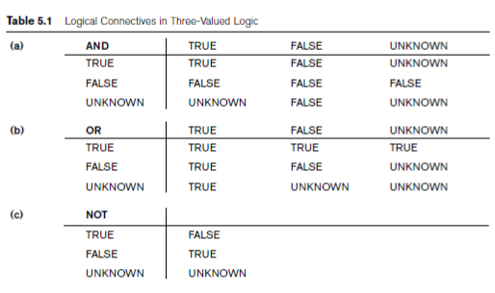
results (or truth values) of three-valued logical expressions for the logical connectives AND, OR, and NOT

Slide 14
In select queries, combinations of tuples that evaluate the logical expression in the WHERE clause of the query to TRUE are selected.
That evaluate to FALSE or UNKNOWN are not selected.
SQL allows queries that check whether an attribute value is NULL using the comparison operators IS or IS NOT. Each NULL value is being distinct from
every other NULL value, so equality comparison is not appropriate.
It follows that when a join condition is specified, tuples with NULL values for the join attributes are not included in the result (unless it is an OUTER JOIN)

Slide 15
Nested queries
Some queries require that existing values in the database be fetched and then used in a comparison condition. Such queries can be conveniently formulated by using nested queries.
SELECT DISTINCT Pnumber
FROM PROJECT
WHERE Pnumber IN
( SELECT Pnumber
FROM PROJECT, DEPARTMENT, EMPLOYEE
WHERE Dnum=Dnumber AND
Mgr_ssn=Ssn AND Lname=‘Smith’ )
OR
Pnumber IN
( SELECT Pno
FROM WORKS_ON, EMPLOYEE
WHERE Essn=Ssn AND Lname=‘Smith’ )

Slide 16
Retrieve the name of each employee who has a dependent with the same first name and is the same sex as the employee.
SELECT E.Fname, E.Lname
FROM EMPLOYEE AS E
WHERE E.Ssn IN ( SELECT Essn
FROM DEPENDENT AS D
WHERE E.Fname=D.Dependent_name
AND E.Sex=D.Sex );

Slide 17
Correlated Nested Queries
Whenever a condition in the WHERE clause of a nested query references some attribute of a relation declared in the outer query, the two queries are said to be correlated. We can understand a correlated query better by considering that the nested query is evaluated once for each tuple (or combination of tuples) in the outer query.

Slide 18

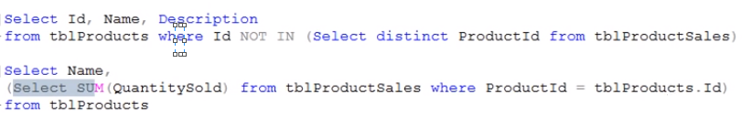
tblproducts
tbl productsales
Subquery
Correlated subquery

Slide 19
Book example
For each EMPLOYEE tuple, evaluate the nested query, which retrieves the Essn values for all DEPENDENT tuples with the same sex and name as that EMPLOYEE tuple; if the Ssn value of the EMPLOYEE tuple is in the result of the nested query, then select that EMPLOYEE tuple.
SELECT E.Fname, E.Lname
FROM EMPLOYEE AS E, DEPENDENT AS D
WHERE E.Ssn=D.Essn AND E.Sex=D.Sex
AND E.Fname=D.Dependent_name;

Slide 20
The EXISTS and UNIQUE Functions in SQL
The EXISTS function in SQL is used to check whether the result of a correlated nested query is empty (contains no tuples) or not. The result of EXISTS is a Boolean value TRUE if the nested query result contains at least one tuple, or FALSE if the nested query result contains no tuples. EXISTS and NOT EXISTS are typically used in conjunction with a correlated nested query
SELECT E.Fname, E.Lname
FROM EMPLOYEE AS E
WHERE EXISTS ( SELECT *
FROM DEPENDENT AS D
WHERE E.Ssn=D.Essn AND E.Sex=D.Sex
AND E.Fname=D.Dependent_name);

