Slide 1
DIGITAL LOGIC DESIGN
EE(109)
LECTURE-14
DATE: 20TH FEB, 2018

Slide 2
Chapter No:4
Boolean Algebra and logic Simplification

Slide 3
CHAPTER OUTLINE
Boolean Operations and Expressions
Laws and Rules of Boolean Algebra
DeMorgan’s Theorems
Boolean Analysis of Logic Circuits
Logic Simplification Using Boolean Algebra
Standard Forms of Boolean Expressions
Boolean Expressions and Truth Tables
The Karnaugh Map
Karnaugh Map SOP Minimization
Karnaugh Map POS Minimization

Slide 4
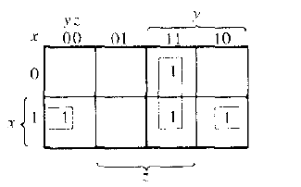


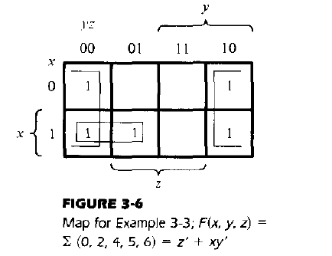




Slide 5








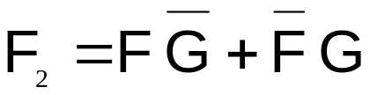
EXAMPLE : 3 VARIABLE K-MAP
Example:
  After labeling and transferring the truth table data into the K-Map, write the simplified sum-of-products (SOP) logic expression for the logic function F₂.
Solution:
E | F | G | F₂
0 | 0 | 0 | 0
0 | 0 | 1 | 1
0 | 1 | 0 | 1
0 | 1 | 1 | 0
1 | 0 | 0 | 0
1 | 0 | 1 | 1
1 | 1 | 0 | 1
1 | 1 | 1 | 0
 |  | V
 | 0 | 1
 | 1 | 0
 | 1 | 0
 | 0 | 1
Notes:
Here is the solution. If you print handouts, do not print this page.
Karnaugh Mapping
Digital Electronics™
2.2 Intro to NAND & NOR Logic
Project Lead The Way, Inc.
Copyright 2009

Slide 6








TRUTH TABLE TO K-MAP MAPPING
Four Variable K-Map
 | W | X | Y | Z | F_{WXYZ}
Minterm – 0 | 0 | 0 | 0 | 0 | 0
Minterm – 1 | 0 | 0 | 0 | 1 | 1
Minterm – 2 | 0 | 0 | 1 | 0 | 1
Minterm – 3 | 0 | 0 | 1 | 1 | 0
Minterm – 4 | 0 | 1 | 0 | 0 | 1
Minterm – 5 | 0 | 1 | 0 | 1 | 1
Minterm – 6 | 0 | 1 | 1 | 0 | 0
Minterm – 7 | 0 | 1 | 1 | 1 | 1
Minterm – 8 | 1 | 0 | 0 | 0 | 0
Minterm – 9 | 1 | 0 | 0 | 1 | 0
Minterm – 10 | 1 | 0 | 1 | 0 | 1
Minterm – 11 | 1 | 0 | 1 | 1 | 0
Minterm – 12 | 1 | 1 | 0 | 0 | 1
Minterm – 13 | 1 | 1 | 0 | 1 | 0
Minterm – 14 | 1 | 1 | 1 | 0 | 1
Minterm – 15 | 1 | 1 | 1 | 1 | 1
Only one variable changes for every column change
 |  | V
 | 0 | 1 | 3 | 2
 | 4 | 5 | 7 | 6
 | 12 | 13 | 15 | 14
 | 8 | 9 | 11 | 10
0
1
0
1
1
1
1
0
Only one
variable changes
for every row
change
1
0
1
1
0
0
0
1
Notes:
Demonstrate how the minterms of a four variable truth table are mapped to a K-Map.
Karnaugh Mapping
Digital Electronics™
2.2 Intro to NAND & NOR Logic
Project Lead The Way, Inc.
Copyright 2009

Slide 7















FOUR VARIABLE K-MAP GROUPINGS
Groups of One – 16 (not shown)
Groups of Two – 32 (not shown)
Groups of Four – 24 (seven shown)
 |  | V
 | 0 | 0 | 0 | 0
 | 0 | 0 | 0 | 0
 | 0 | 0 | 0 | 0
 | 0 | 0 | 0 | 0
1
1
1
1
1
1
1
1
1
1
1
1
1
1
1
1
1
1
1
1
1
1
1
1
1
1
1
1
Notes:
Four Variable K-Map:
There are 16 groups of one that are not shown because they are obvious.
There are 32 groups of two that are not shown because they are obvious.
There are 24 groups of four. Seven are show, the other 17 are obvious.
Karnaugh Mapping
Digital Electronics™
2.2 Intro to NAND & NOR Logic
Project Lead The Way, Inc.
Copyright 2009

Slide 8


FOUR VARIABLE K-MAP GROUPINGS
Groups of Eight – 8 (two shown)
 |  | V
 | 0 | 0 | 0 | 0
 | 0 | 0 | 0 | 0
 | 0 | 0 | 0 | 0
 | 0 | 0 | 0 | 0
1
1
1
1
1
1
1
1
1
1
1
1
1
1
1
1
Notes:
Four variable K-Map: There are 8 groups of eight. Two are shown, the other 6 are obvious.
Karnaugh Mapping
Digital Electronics™
2.2 Intro to NAND & NOR Logic
Project Lead The Way, Inc.
Copyright 2009

Slide 9

FOUR VARIABLE K-MAP GROUPINGS
Group of Sixteen – 1
 |  | V
 | 1 | 1 | 1 | 1
 | 1 | 1 | 1 | 1
 | 1 | 1 | 1 | 1
 | 1 | 1 | 1 | 1
Notes:
Four variable K-Map, group of 16.
Karnaugh Mapping
Digital Electronics™
2.2 Intro to NAND & NOR Logic
Project Lead The Way, Inc.
Copyright 2009

Slide 10
EXAMPLE : 4 VARIABLE K-MAP
Example:
  After labeling and transferring the truth table data into the K-Map, write the simplified sum-of-products (SOP) logic expression for the logic function F₃.
 |  | V
R | S | T | U | F₃
0 | 0 | 0 | 0 | 0
0 | 0 | 0 | 1 | 1
0 | 0 | 1 | 0 | 0
0 | 0 | 1 | 1 | 1
0 | 1 | 0 | 0 | 0
0 | 1 | 0 | 1 | 1
0 | 1 | 1 | 0 | 1
0 | 1 | 1 | 1 | 1
1 | 0 | 0 | 0 | 0
1 | 0 | 0 | 1 | 1
1 | 0 | 1 | 0 | 0
1 | 0 | 1 | 1 | 0
1 | 1 | 0 | 0 | 1
1 | 1 | 0 | 1 | 0
1 | 1 | 1 | 0 | 1
1 | 1 | 1 | 1 | 1
Notes:
Pause the presentation and allow students to complete the example. The solution is on the next slide.
Karnaugh Mapping
Digital Electronics™
2.2 Intro to NAND & NOR Logic
Project Lead The Way, Inc.
Copyright 2009

Slide 11










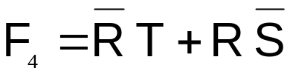
EXAMPLE : DON’T CARE CONDITIONS
Example:
  After labeling and transferring the truth table data into the K-Map, write the simplified sum-of-products (SOP) logic expression for the logic function F₄. Be sure to take advantage of the don’t care conditions.
 |  | V
 | X | 0 | X | 1
 | 0 | X | 1 | X
 | X | 0 | 0 | 0
 | 1 | 1 | X | 1
Solution:
R | S | T | U | F₄
0 | 0 | 0 | 0 | X
0 | 0 | 0 | 1 | 0
0 | 0 | 1 | 0 | 1
0 | 0 | 1 | 1 | X
0 | 1 | 0 | 0 | 0
0 | 1 | 0 | 1 | X
0 | 1 | 1 | 0 | X
0 | 1 | 1 | 1 | 1
1 | 0 | 0 | 0 | 1
1 | 0 | 0 | 1 | 1
1 | 0 | 1 | 0 | 1
1 | 0 | 1 | 1 | X
1 | 1 | 0 | 0 | X
1 | 1 | 0 | 1 | 0
1 | 1 | 1 | 0 | 0
1 | 1 | 1 | 1 | 0
Notes:
Here is the solution. If you print handouts, do not print this page.
Karnaugh Mapping
Digital Electronics™
2.2 Intro to NAND & NOR Logic
Project Lead The Way, Inc.
Copyright 2009

