Slide 1
DIGITAL LOGIC DESIGN
EE(109)
LECTURE-17
DATE: 6TH MARCH, 2018

Slide 2
Chapter No:4
Boolean Algebra and logic Simplification

Slide 3
CHAPTER OUTLINE
Boolean Operations and Expressions
Laws and Rules of Boolean Algebra
DeMorgan’s Theorems
Boolean Analysis of Logic Circuits
Logic Simplification Using Boolean Algebra
Standard Forms of Boolean Expressions
Boolean Expressions and Truth Tables
The Karnaugh Map
Karnaugh Map SOP Minimization
Karnaugh Map POS Minimization

Slide 4
DON’T CARE CONDITIONS
A don’t care condition, marked by (X) in the truth table, indicates a condition where the design doesn’t care if the output is a (0) or a (1).
A don’t care condition can be treated as a (0) or a (1) in a K-Map.
Treating a don’t care as a (0) means that you do not need to group it.
Treating a don’t care as a (1) allows you to make a grouping larger, resulting in a simpler term in the SOP equation.
Notes:
Karnaugh Mapping
Digital Electronics™
2.2 Intro to NAND & NOR Logic
Project Lead The Way, Inc.
Copyright 2009

Slide 5







Don’t Care Conditions
This don’t care condition was treated as a (1). This allowed the grouping of a single one to become a grouping of two, resulting in a simpler term.
 |  | V
 | X | 0
 | 1 | 0
 | 0 | 0
 | X | 0
There was no advantage in treating this don’t care condition as a (1), thus it was treated as a (0) and not grouped.
Notes:
Explain that you include don’t care conditions only if it allows you to make a grouping larger.
Karnaugh Mapping
Digital Electronics™
2.2 Intro to NAND & NOR Logic
Project Lead The Way, Inc.
Copyright 2009

Slide 6
EXAMPLE : DON’T CARE CONDITIONS
Example:
  After labeling and transferring the truth table data into the K-Map, write the simplified sum-of-products (SOP) logic expression for the logic function F₄. Be sure to take advantage of the don’t care conditions.
 |  | V
R | S | T | U | F₄
0 | 0 | 0 | 0 | X
0 | 0 | 0 | 1 | 0
0 | 0 | 1 | 0 | 1
0 | 0 | 1 | 1 | X
0 | 1 | 0 | 0 | 0
0 | 1 | 0 | 1 | X
0 | 1 | 1 | 0 | X
0 | 1 | 1 | 1 | 1
1 | 0 | 0 | 0 | 1
1 | 0 | 0 | 1 | 1
1 | 0 | 1 | 0 | 1
1 | 0 | 1 | 1 | X
1 | 1 | 0 | 0 | X
1 | 1 | 0 | 1 | 0
1 | 1 | 1 | 0 | 0
1 | 1 | 1 | 1 | 0
Notes:
Pause the presentation and allow students to complete the example. The solution is on the next slide.
Karnaugh Mapping
Digital Electronics™
2.2 Intro to NAND & NOR Logic
Project Lead The Way, Inc.
Copyright 2009

Slide 7










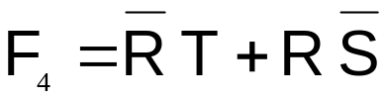
EXAMPLE : DON’T CARE CONDITIONS
Example:
  After labeling and transferring the truth table data into the K-Map, write the simplified sum-of-products (SOP) logic expression for the logic function F₄. Be sure to take advantage of the don’t care conditions.
 |  | V
 | X | 0 | X | 1
 | 0 | X | 1 | X
 | X | 0 | 0 | 0
 | 1 | 1 | X | 1
Solution:
R | S | T | U | F₄
0 | 0 | 0 | 0 | X
0 | 0 | 0 | 1 | 0
0 | 0 | 1 | 0 | 1
0 | 0 | 1 | 1 | X
0 | 1 | 0 | 0 | 0
0 | 1 | 0 | 1 | X
0 | 1 | 1 | 0 | X
0 | 1 | 1 | 1 | 1
1 | 0 | 0 | 0 | 1
1 | 0 | 0 | 1 | 1
1 | 0 | 1 | 0 | 1
1 | 0 | 1 | 1 | X
1 | 1 | 0 | 0 | X
1 | 1 | 0 | 1 | 0
1 | 1 | 1 | 0 | 0
1 | 1 | 1 | 1 | 0
Notes:
Here is the solution. If you print handouts, do not print this page.
Karnaugh Mapping
Digital Electronics™
2.2 Intro to NAND & NOR Logic
Project Lead The Way, Inc.
Copyright 2009

Slide 8
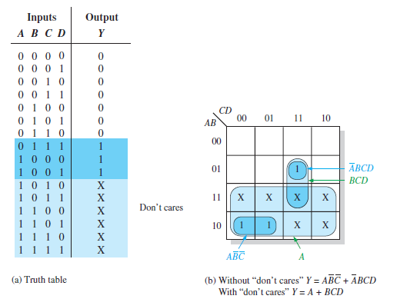

Slide 9
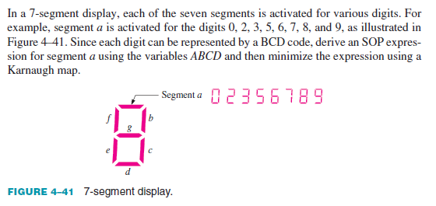
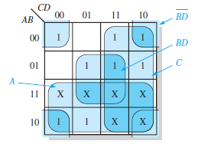




Slide 10
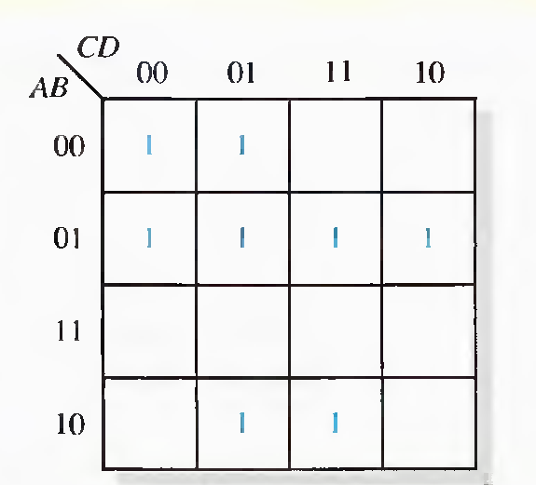
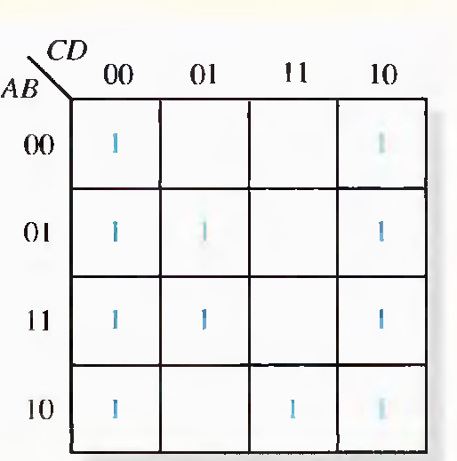
KARNAUGH MAPS (EXAMPLES)
F(A,B,C,D)=Σm(0,1,4,5,6,7,9,11)
F(A,B,C,D)=Σm(0,2,4,5,6,8,10,11,12,13,14,)

Slide 11
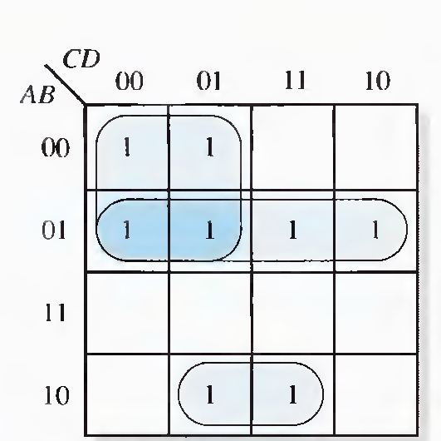
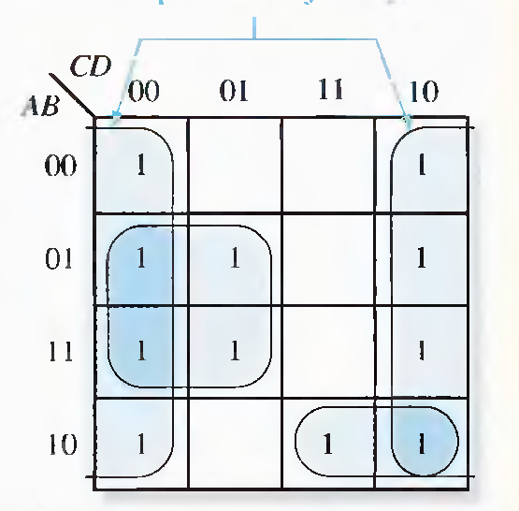
X = A’B + A’C’ + AB’D X = D’ + BC’ + AB’C

Slide 12
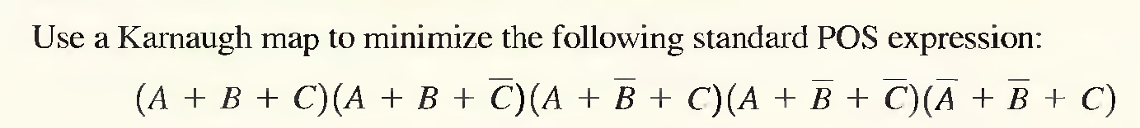
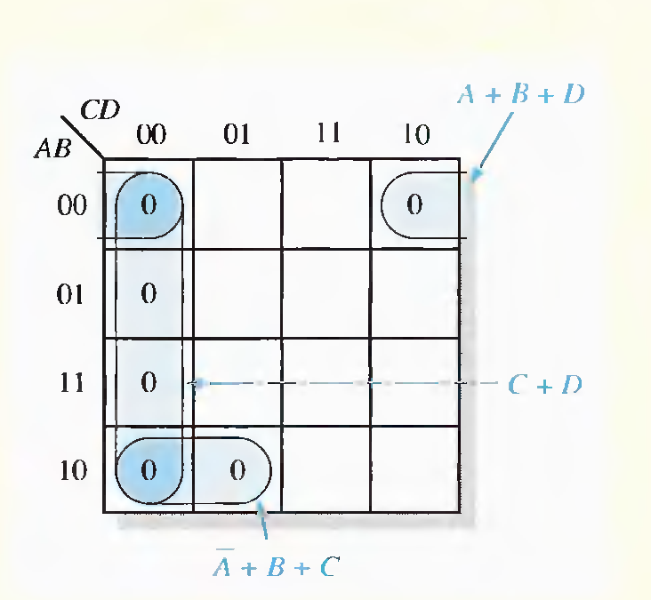
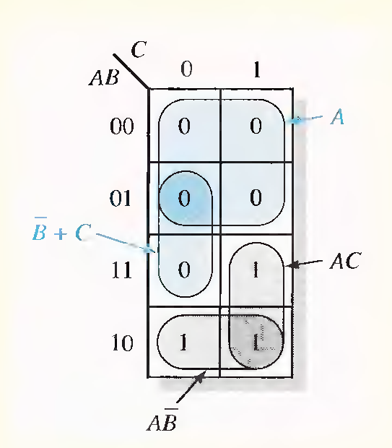



Slide 13
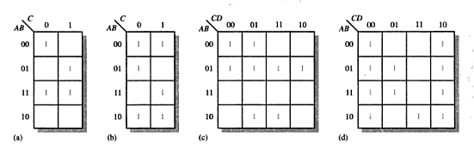
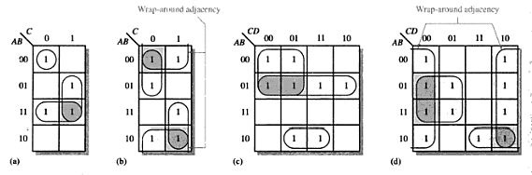

Slide 14
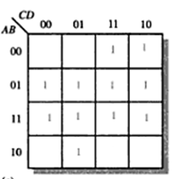
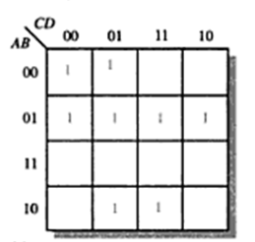

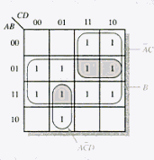
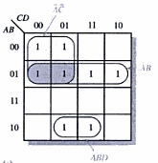

Slide 15
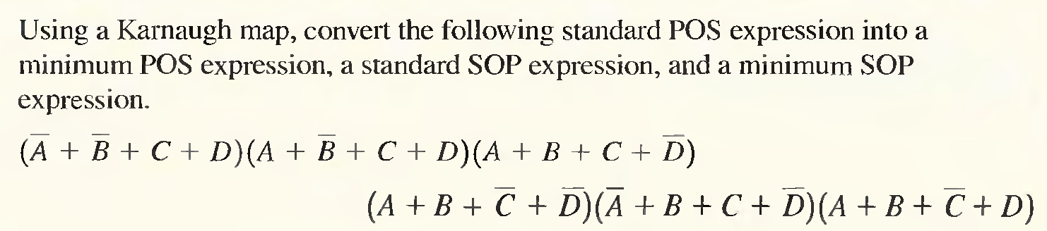
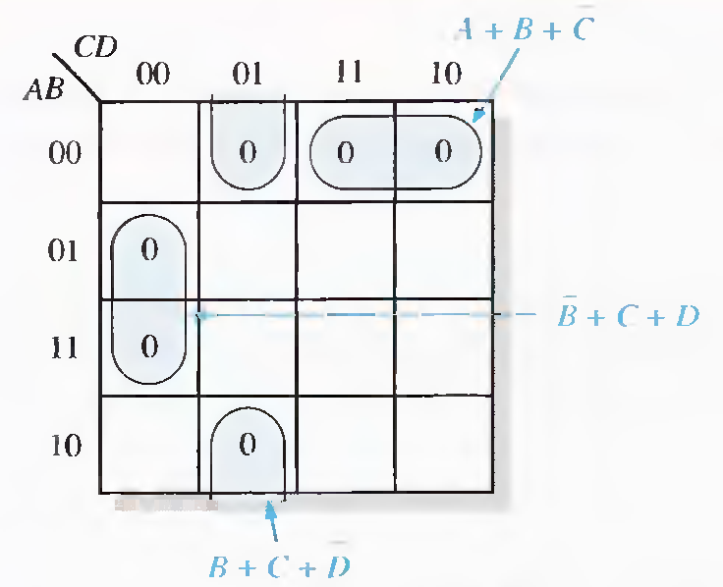
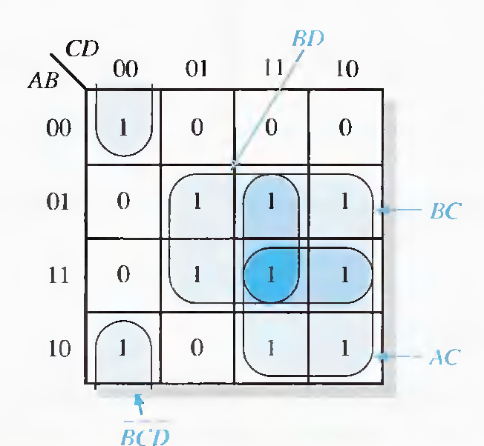


Slide 16
FIVE VARIABLE K-MAP
Use two four variable K-maps
A=1
A=0

Slide 17
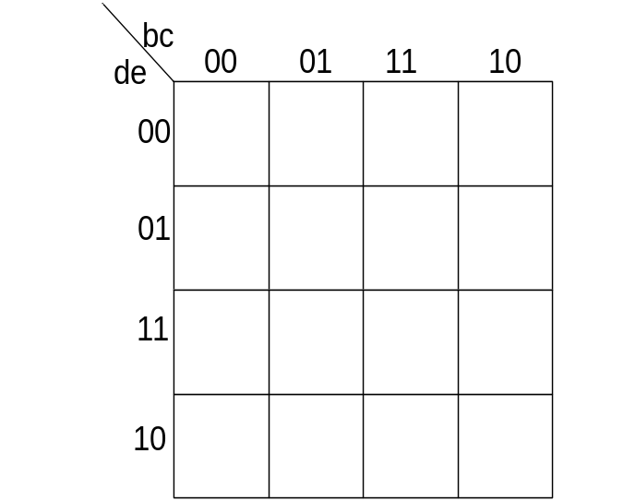
USE TWO FOUR-VARIABLE K-MAPS
A=0 map
A=1 map

Slide 18
USE TWO FOUR-VARIABLE K-MAPS
A=0 map
A=1 map
1
1
1
1
1
1
1
1

