Slide 1
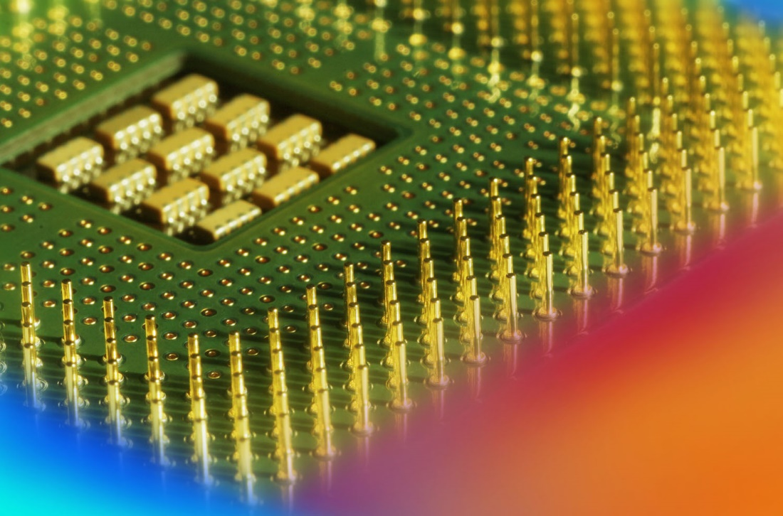
Digital Fundamentals
Tenth Edition
Floyd
Chapter 2
© 2008 Pearson Education

Slide 2
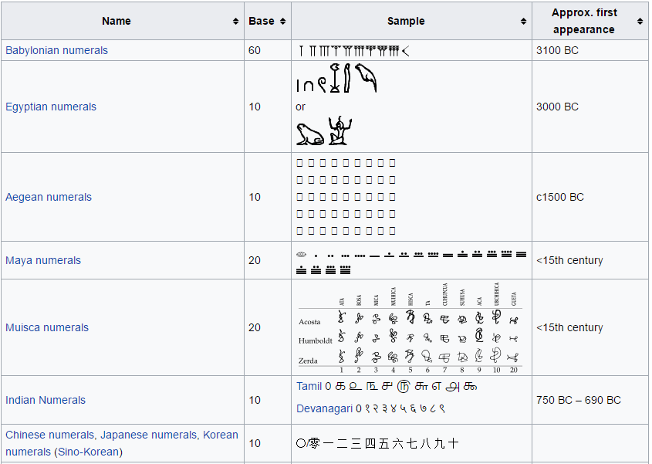

Slide 3
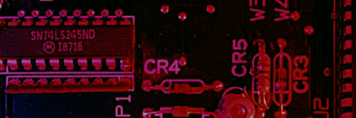
Summary
Decimal Numbers
The position of each digit in a weighted number system is assigned a weight based on the base or radix of the system. The radix of decimal numbers is ten, because only ten symbols (0 through 9) are used to represent any number.
The column weights of decimal numbers are powers of ten that increase from right to left beginning with 10⁰ =1:
…10⁵ 10⁴ 10³ 10² 10¹ 10⁰.
For fractional decimal numbers, the column weights are negative powers of ten that decrease from left to right:
10² 10¹ 10⁰. 10⁻¹ 10⁻² 10⁻³ 10⁻⁴ …
https://en.wikipedia.org/wiki/List_of_numeral_systems

Slide 4

Summary
Decimal Numbers
Decimal numbers can be expressed as the sum of the products of each digit times the column value for that digit. Thus, the number 9240 can be expressed as
(9 x 10³) + (2 x 10²) + (4 x 10¹) + (0 x 10⁰)
or
9 x 1,000 + 2 x 100 + 4 x 10 + 0 x 1
Example
Express the number 480.52 as the sum of values of each digit.
Solution
480.52 = (4 x 10²) + (8 x 10¹) + (0 x 10⁰) + (5 x 10⁻¹) +(2 x 10⁻²)

Slide 5
Summary
Binary Numbers
For digital systems, the binary number system is used. Binary has a radix of two and uses the digits 0 and 1 to represent quantities.
The column weights of binary numbers are powers of two that increase from right to left beginning with 2⁰ =1:
…2⁵ 2⁴ 2³ 2² 2¹ 2⁰.
For fractional binary numbers, the column weights are negative powers of two that decrease from left to right:
2² 2¹ 2⁰. 2⁻¹ 2⁻² 2⁻³ 2⁻⁴ …

Slide 6
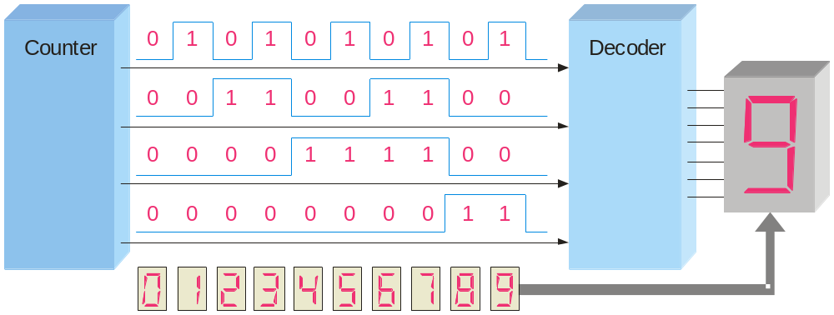
Summary
Decimal Number
Binary Number
Binary Numbers
0 0 0 0 0
1 0 0 0 1
2 0 0 1 0
3 0 0 1 1
4 0 1 0 0
5 0 1 0 1
6 0 1 1 0
7 0 1 1 1
8 1 0 0 0
9 1 0 0 1
10 1 0 1 0
11 1 0 1 1
12 1 1 0 0
13 1 1 0 1
14 1 1 1 0
15 1 1 1 1
A binary counting sequence for numbers from zero to fifteen is shown.
Notice the pattern of zeros and ones in each column.
Digital counters frequently have this same pattern of digits:

Slide 7
Summary
Binary Conversions
The decimal equivalent of a binary number can be determined by adding the column values of all of the bits that are 1 and discarding all of the bits that are 0.
Example
Convert the binary number 100101.01 to decimal.
Solution
Start by writing the column weights; then add the weights that correspond to each 1 in the number.
2⁵ 2⁴ 2³ 2² 2¹ 2⁰. 2⁻¹ 2⁻²
32 16 8 4 2 1 . ½ ¼
1 0 0 1 0 1. 0 1
32 +4 +1 +¼ =
37¼

Slide 8
Summary
Binary Conversions
You can convert a decimal whole number to binary by reversing the procedure. Write the decimal weight of each column and place 1’s in the columns that sum to the decimal number.
Example
Convert the decimal number 49 to binary.
Solution
The column weights double in each position to the right. Write down column weights until the last number is larger than the one you want to convert.
2⁶ 2⁵ 2⁴ 2³ 2² 2¹ 2⁰.
64 32 16 8 4 2 1.
0 1 1 0 0 0 1.

Slide 9
Summary
Binary Conversions
You can convert a decimal fraction to binary by repeatedly multiplying the fractional results of successive multiplications by 2. The carries form the binary number.
Example
Convert the decimal fraction 0.188 to binary by repeatedly multiplying the fractional results by 2.
Solution
0.188 x 2 = 0.376 carry = 0
MSB
0.376 x 2 = 0.752 carry = 0
0.752 x 2 = 1.504 carry = 1
0.504 x 2 = 1.008 carry = 1
0.008 x 2 = 0.016 carry = 0
Answer = .00110 (for five significant digits)

Slide 10
Summary
Binary Conversions
You can convert decimal to any other base by repeatedly dividing by the base. For binary, repeatedly divide by 2:
Example
Convert the decimal number 49 to binary by repeatedly dividing by 2.
Solution
You can do this by “reverse division” and the answer will read from left to right. Put quotients to the left and remainders on top.
Answer:
1
1
0
0
0
1
remainder
0
1
3
6
12
24
49 2
Continue until the last quotient is 0
Decimal number
base
Quotient

Slide 11
Summary
Binary Addition
The rules for binary addition are
0 + 0 = 0 Sum = 0, carry = 0
0 + 1 = 0 Sum = 1, carry = 0
1 + 0 = 0 Sum = 1, carry = 0
1 + 1 = 10 Sum = 0, carry = 1
When an input carry = 1 due to a previous result, the rules are
1 + 0 + 0 = 01 Sum = 1, carry = 0
1 + 0 + 1 = 10 Sum = 0, carry = 1
1 + 1 + 0 = 10 Sum = 0, carry = 1
1 + 1 + 1 = 10 Sum = 1, carry = 1

Slide 12
Summary
Binary Addition
Example
Add the binary numbers 00111 and 10101 and show the equivalent decimal addition.
Solution
0
1
1
1
00111 7
10101 21
1
1
1
0
0
=
28

Slide 13
Summary
Binary Subtraction
The rules for binary subtraction are
0 − 0 = 0
1 − 1 = 0
1 − 0 = 1
10 − 1 = 1 with a borrow of 1
Example
Subtract the binary number 00111 from 10101 and show the equivalent decimal subtraction.
Solution
/¹
/¹
/¹
10101 21
00111 7
0
1
1
1
0
=
14

Slide 14
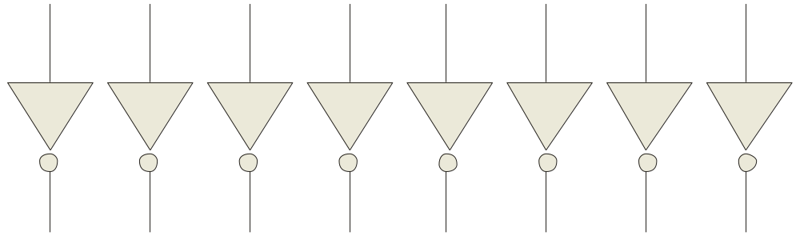
Summary
1’s Complement
The 1’s complement of a binary number is just the inverse of the digits. To form the 1’s complement, change all 0’s to 1’s and all 1’s to 0’s.
For example, the 1’s complement of 11001010 is
00110101
In digital circuits, the 1’s complement is formed by using inverters:
1 1 0 0 1 0 1 0
0 0 1 1 0 1 0 1

Slide 15
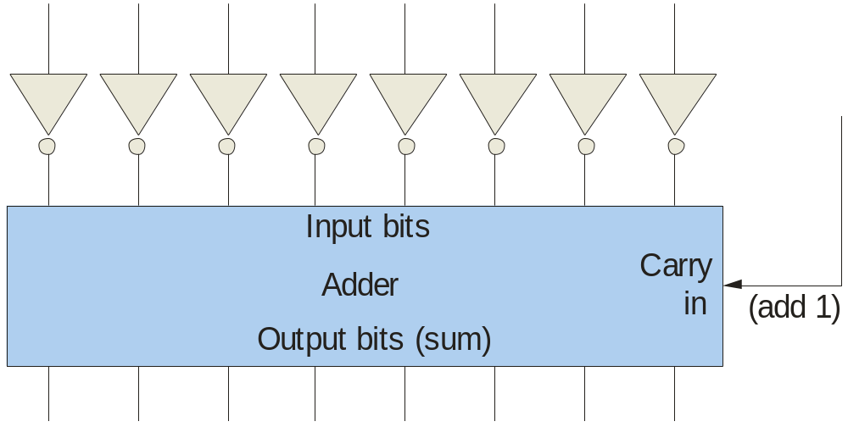
Summary
2’s Complement
The 2’s complement of a binary number is found by adding 1 to the LSB of the 1’s complement.
Recall that the 1’s complement of 11001010 is
00110101 (1’s complement)
To form the 2’s complement, add 1:
+1
00110110 (2’s complement)
1 1 0 0 1 0 1 0
1
0 0 1 1 0 1 0 1
0 0 1 1 0 1 1 0

Slide 16
Summary
Signed Binary Numbers
There are several ways to represent signed binary numbers. In all cases, the MSB in a signed number is the sign bit, that tells you if the number is positive or negative.
Computers use a modified 2’s complement for signed numbers. Positive numbers are stored in true form (with a 0 for the sign bit) and negative numbers are stored in complement form (with a 1 for the sign bit).
For example, the positive number 58 is written using 8-bits as 00111010 (true form).
Sign bit
Magnitude bits

Slide 17
Summary
Signed Binary Numbers
Negative numbers are written as the 2’s complement of the corresponding positive number.
The negative number −58 is written as:
−58 = 11000110 (complement form)
Sign bit
Magnitude bits
An easy way to read a signed number that uses this notation is to assign the sign bit a column weight of −128 (for an 8-bit number). Then add the column weights for the 1’s.
Example
Assuming that the sign bit = −128, show that 11000110 = −58 as a 2’s complement signed number:
Solution
Column weights: −128 64 32 16 8 4 2 1.
1 1 0 0 0 1 1 0
−128 +64 +4 +2 = −58

Slide 18
Summary
Floating Point Numbers
Floating point notation is capable of representing very large or small numbers by using a form of scientific notation. A 32-bit single precision number is illustrated.
S E (8 bits) F (23 bits)
Sign bit
Biased exponent (+127)
Magnitude with MSB dropped
Example
Express the speed of light, c, in single precision floating point notation. (c = 0.2998 x 10⁹)
Solution
In binary, c = 0001 0001 1101 1110 1001 0101 1100 0000₂.
In scientific notation, c = 1.001 1101 1110 1001 0101 1100 0000 x 2²⁸.
S = 0 because the number is positive. E = 28 + 127 = 155₁₀ = 1001 1011₂. F is the next 23 bits after the first 1 is dropped.
In floating point notation, c =
0 10011011 001 1101 1110 1001 0101 1100

Slide 19
Summary
Arithmetic Operations with Signed Numbers
Using the signed number notation with negative numbers in 2’s complement form simplifies addition and subtraction of signed numbers.
Rules for addition: Add the two signed numbers. Discard any final carries. The result is in signed form.
Examples:
00011110 = +30
00001111 = +15
00001110 = +14
11101111 = −17
11111111 = −1
11111000 = −8
00101101
= +45
11111101
= −3
1
11110111
= −9
Discard carry

Slide 20
Summary
Arithmetic Operations with Signed Numbers
Note that if the number of bits required for the answer is exceeded, overflow will occur. This occurs only if both numbers have the same sign. The overflow will be indicated by an incorrect sign bit.
Two examples are:
01000000 = +128
01000001 = +129
10000001 = −127
10000001 = −127
10000001
= −126
Discard carry
100000010
= +2
Wrong! The answer is incorrect and the sign bit has changed.

Slide 21
Summary
Arithmetic Operations with Signed Numbers
Rules for subtraction: 2’s complement the subtrahend and add the numbers. Discard any final carries. The result is in signed form.
Repeat the examples done previously, but subtract:
00011110
00001111
(+30)
–(+15)
00001110
11101111
11111111
11111000
(+14)
–(−17)
(−1)
–(−8)
−
−
−
2’s complement subtrahend and add:
00011110 = +30
11110001 = −15
00001110 = +14
00010001 = +17
11111111 = −1
00001000 = +8
1
00001111
= +15
00011111
= +31
1
00000111
= +7
Discard carry
Discard carry

Slide 22

Summary
Decimal
Hexadecimal
Binary
Hexadecimal Numbers
0 1 2 3 4 5 6 7 8 9 10 11 12 13 1415
0 1 2 3 4 5 6 7 8 9 A B C D E F
0000 0001 0010 0011 0100 0101 0110 0111 1000 1001 1010 1011 1100 1101 1110 1111
Hexadecimal uses sixteen characters to represent numbers: the numbers 0 through 9 and the alphabetic characters A through F.
Large binary number can easily be converted to hexadecimal by grouping bits 4 at a time and writing the equivalent hexadecimal character.
Example
Express 1001 0110 0000 1110₂ in hexadecimal:
Solution
Group the binary number by 4-bits starting from the right. Thus, 960E

Slide 23
Summary
Decimal
Hexadecimal
Binary
Hexadecimal Numbers
0 1 2 3 4 5 6 7 8 9 10 11 12 13 1415
0 1 2 3 4 5 6 7 8 9 A B C D E F
0000 0001 0010 0011 0100 0101 0110 0111 1000 1001 1010 1011 1100 1101 1110 1111
Hexadecimal is a weighted number system. The column weights are powers of 16, which increase from right to left.
{
16³ 16² 16¹ 16⁰
.
Column weights
4096 256 16 1
.
Example
Express 1A2F₁₆ in decimal.
Solution
Start by writing the column weights:
4096 256 16 1
1 A 2 F₁₆
1(4096) + 10(256) +2(16) +15(1) =
6703₁₀

Slide 24
Summary
Decimal
Octal
Binary
Octal Numbers
0 1 2 3 4 5 6 7 8 9 10 11 12 13 1415
0 1 2 3 4 5 6 7 10 1112 13 14 15 16 17
0000 0001 0010 0011 0100 0101 0110 0111 1000 1001 1010 1011 1100 1101 1110 1111
Octal uses eight characters the numbers 0 through 7 to represent numbers. There is no 8 or 9 character in octal.
Binary number can easily be converted to octal by grouping bits 3 at a time and writing the equivalent octal character for each group.
Example
Express 1 001 011 000 001 110₂ in octal:
Solution
Group the binary number by 3-bits starting from the right. Thus, 113016₈

Slide 25
Summary
Decimal
Octal
Binary
Octal Numbers
0 1 2 3 4 5 6 7 8 9 10 11 12 13 1415
0 1 2 3 4 5 6 7 10 1112 13 14 15 16 17
0000 0001 0010 0011 0100 0101 0110 0111 1000 1001 1010 1011 1100 1101 1110 1111
Octal is also a weighted number system. The column weights are powers of 8, which increase from right to left.
{
8³ 8² 8¹ 8⁰
.
Column weights
512 64 8 1
.
Example
Express 3702₈ in decimal.
Solution
Start by writing the column weights:
512 64 8 1
3 7 0 2₈
3(512) + 7(64) +0(8) +2(1) =
1986₁₀

Slide 26
Summary
Decimal
Binary
BCD
BCD
0 1 2 3 4 5 6 7 8 9 10 11 12 13 1415
0000 0001 0010 0011 0100 0101 0110 0111 1000 1001 1010 1011 1100 1101 1110 1111
0000 0001 0010 0011 0100 0101 0110 0111 1000 1001 0000 0001 0010 0011 0100 0101
Binary coded decimal (BCD) is a weighted code that is commonly used in digital systems when it is necessary to show decimal numbers such as in clock displays.
The table illustrates the difference between straight binary and BCD. BCD represents each decimal digit with a 4-bit code. Notice that the codes 1010 through 1111 are not used in BCD.
0001 0001 0001 0001 0001 0001

Slide 27
Summary
BCD
You can think of BCD in terms of column weights in groups of four bits. For an 8-bit BCD number, the column weights are: 80 40 20 10 8 4 2 1.
Question:
What are the column weights for the BCD number 1000 0011 0101 1001?
Answer:
8000 4000 2000 1000 800 400 200 100 80 40 20 10 8 4 2 1
Note that you could add the column weights where there is a 1 to obtain the decimal number. For this case:
8000 + 200 +100 + 40 + 10 + 8 +1 = 8359₁₀

Slide 28
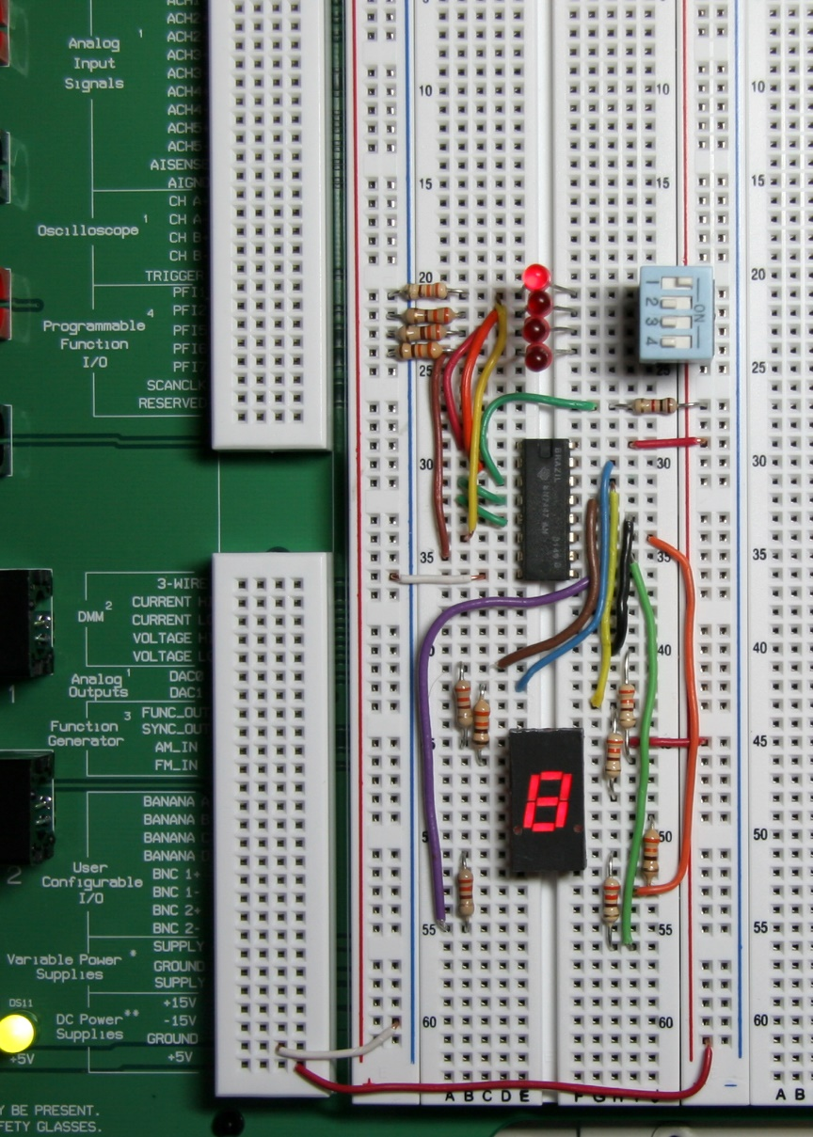
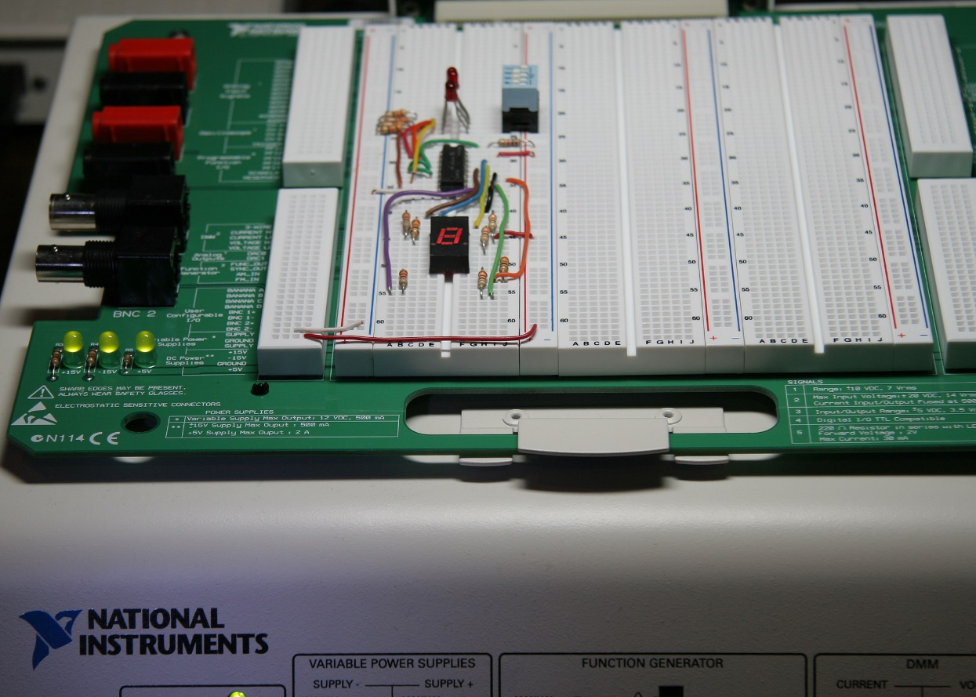
Summary
BCD
A lab experiment in which BCD is converted to decimal is shown.

Slide 29
Summary
Decimal
Binary
Gray code
Gray code
0 1 2 3 4 5 6 7 8 9 10 11 12 13 1415
0000 0001 0010 0011 0100 0101 0110 0111 1000 1001 1010 1011 1100 1101 1110 1111
0000 0001 0011 0010 0110 0111 0101 0100 1100 1101 1111 1110 1010 1011 1001 1000
Gray code is an unweighted code that has a single bit change between one code word and the next in a sequence. Gray code is used to avoid problems in systems where an error can occur if more than one bit changes at a time.

Slide 30
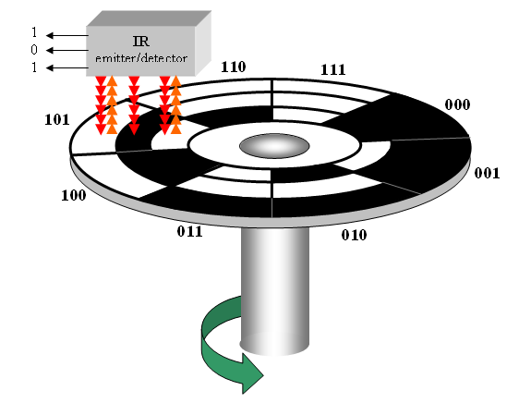
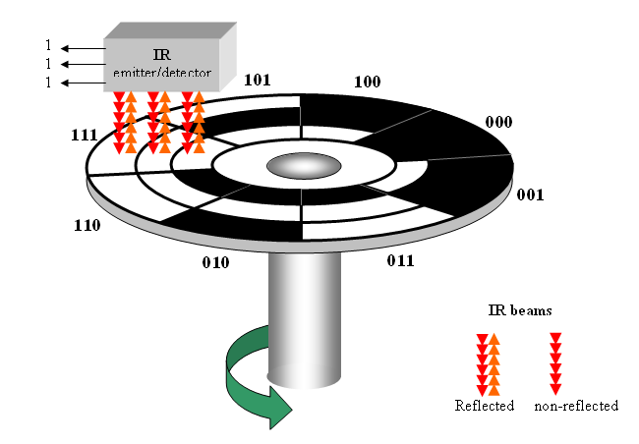
Summary
Gray code
A shaft encoder is a typical application. Three IR emitter/detectors are used to encode the position of the shaft. The encoder on the left uses binary and can have three bits change together, creating a potential error. The encoder on the right uses gray code and only 1-bit changes, eliminating potential errors.
Binary sequence
Gray code sequence

Slide 31
Summary
ASCII
ASCII is a code for alphanumeric characters and control characters. In its original form, ASCII encoded 128 characters and symbols using 7-bits. The first 32 characters are control characters, that are based on obsolete teletype requirements, so these characters are generally assigned to other functions in modern usage.
In 1981, IBM introduced extended ASCII, which is an 8-bit code and increased the character set to 256. Other extended sets (such as Unicode) have been introduced to handle characters in languages other than English.

Slide 32
Summary
Parity Method
The parity method is a method of error detection for simple transmission errors involving one bit (or an odd number of bits). A parity bit is an “extra” bit attached to a group of bits to force the number of 1’s to be either even (even parity) or odd (odd parity).
Example
The ASCII character for “a” is 1100001 and for “A” is 1000001. What is the correct bit to append to make both of these have odd parity?
Solution
The ASCII “a” has an odd number of bits that are equal to 1; therefore the parity bit is 0. The ASCII “A” has an even number of bits that are equal to 1; therefore the parity bit is 1.

Slide 33
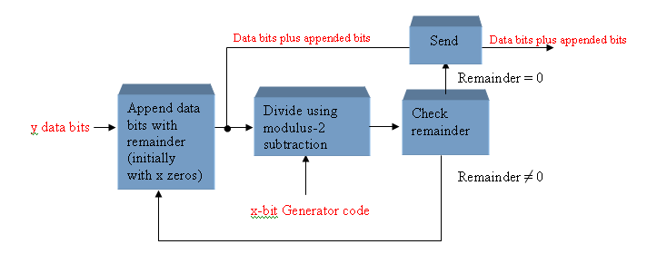
Summary
Cyclic Redundancy Check
The cyclic redundancy check (CRC) is an error detection method that can detect multiple errors in larger blocks of data. At the sending end, a checksum is appended to a block of data. At the receiving end, the check sum is generated and compared to the sent checksum. If the check sums are the same, no error is detected.

Slide 34
Selected Key Terms
Byte
Floating-point number
Hexadecimal
Octal
BCD
A group of eight bits
A number representation based on scientific notation in which the number consists of an exponent and a mantissa.
A number system with a base of 16.
A number system with a base of 8.
Binary coded decimal; a digital code in which each of the decimal digits, 0 through 9, is represented by a group of four bits.

Slide 35
Selected Key Terms
Alphanumeric
ASCII
Parity
Cyclic redundancy check (CRC)
Consisting of numerals, letters, and other characters
American Standard Code for Information Interchange; the most widely used alphanumeric code.
In relation to binary codes, the condition of evenness or oddness in the number of 1s in a code group.
A type of error detection code.

Slide 36

Quiz
1. For the binary number 1000, the weight of the column with the 1 is
a. 4
b. 6
c. 8
d. 10
© 2008 Pearson Education

Slide 37
Quiz
2. The 2’s complement of 1000 is
a. 0111
b. 1000
c. 1001
d. 1010
© 2008 Pearson Education

Slide 38
Quiz
3. The fractional binary number 0.11 has a decimal value of
a. ¼
b. ½
c. ¾
d. none of the above
© 2008 Pearson Education

Slide 39
Quiz
4. The hexadecimal number 2C has a decimal equivalent value of
a. 14
b. 44
c. 64
d. none of the above
© 2008 Pearson Education

Slide 40
Quiz
5. Assume that a floating point number is represented in binary. If the sign bit is 1, the
a. number is negative
b. number is positive
c. exponent is negative
d. exponent is positive
© 2008 Pearson Education

Slide 41
Quiz
6. When two positive signed numbers are added, the result may be larger that the size of the original numbers, creating overflow. This condition is indicated by
a. a change in the sign bit
b. a carry out of the sign position
c. a zero result
d. smoke
© 2008 Pearson Education

Slide 42
Quiz
7. The number 1010 in BCD is
a. equal to decimal eight
b. equal to decimal ten
c. equal to decimal twelve
d. invalid
© 2008 Pearson Education

Slide 43
Quiz
8. An example of an unweighted code is
a. binary
b. decimal
c. BCD
d. Gray code
© 2008 Pearson Education

Slide 44
Quiz
9. An example of an alphanumeric code is
a. hexadecimal
b. ASCII
c. BCD
d. CRC
© 2008 Pearson Education

Slide 45
Quiz
10. An example of an error detection method for transmitted data is the
a. parity check
b. CRC
c. both of the above
d. none of the above
© 2008 Pearson Education

Slide 46
Quiz
Answers:
1. c
2. b
3. c
4. b
5. a
6. a
7. d
8. d
9. b
10. c

