Slide 1

What’s an Attitude?
How do I get one?

Slide 2

Persuasive Communication
Changes in attitudes can result in the absence or presence of rewards.
Acceptance or resistance to an attitude or opinion is dependent on the incentives/rewards that are offered in communication with those involved.
(Hovland, Janis & Kelly, 1953)

Slide 3
Balance Theory
When beliefs are unbalanced, the is a disruption in equilibrium of a system and then pressure to change attitudes.
(Heider, 1958)

Slide 4
Consistency/Dissonance
People will try to maintain consistency among their beliefs and make changes when this does not occur.
(Abelson, 1968)
Attitude change is caused by conflict among beliefs.

Slide 5
Planned Behavior
Attitudes influence behavior along with two other factors:
  - Perceptions of social norms
  - Beliefs about one’s personal ability to perform a specific behavior.
  (Diclemente and Crosby, 2002)

Slide 6
Congruity Theory
Assumes attitudes are simplistic and tend toward extremes (proven false).
Assumes that if a liked and disliked object become related, the feeling toward both will become more neutral.
(Osgood and Tannen, 1960)

Slide 7
What Can You Do?
1. First and foremost-be honest with yourself.
2. Recognize warning signs (negative thoughts, blaming behavior, pessimism).
3. Use positive affirmations.
4. Visualize your day before it begins.
5. Write down your goals.
6. Put your head in the game and focus.
Notes:
Generalize to family.

Slide 8
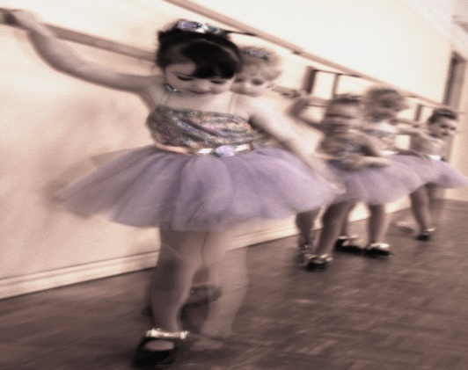
What Can You Do? (con’t)
7. Think about a successful person you admire.
8. Avoid naysayers who shoot you down.
9. Practice, practice, practice.

