Slide 1

emotional intelligence (EQ) http://www.businessballs.com/howardgardnermultipleintelligences.htm

Slide 2
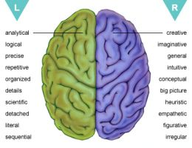
category of intelligence into two
Our brains are structurally/ physically split into two separate halves by the corpus callosum.

Slide 3
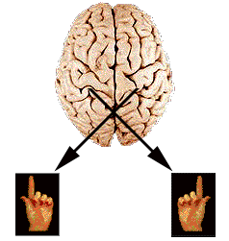
hemisphere (right and left),
Left
logical
sequential
rational
analytical
objective
looks at parts
systematic
symbolic
linear
factual
abstract
digital

Slide 4
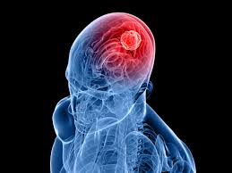
hemisphere (right and left),
Right
Random
Intuitive
Holistic
Synthesizing
Subjective
Looks at wholes
Non-verbal
Casual
Concrete
Visual
Sensory
Spatial
emotional

Slide 5
Definition of intelligence
aggregate or global
capacity of the individual to Act purposefully,
Think rationally,
Deal effectively with his environment.

Slide 6
The Seven points of Intelligence
1. Verbal – the ability to use words
2. Visual – the ability to imagine things in your mind
3. Physical – the ability to use your body in various situations
4. Musical - the ability to use and understand music
5. Mathematical – the ability to apply logic to systems and numbers
6. Introspective – the ability to understand your inner thoughts
7. Interpersonal – the ability to understand other people, and relate well to them

Slide 7
Gender Differences in Intelligence
most studies show that there are no significant differences in general intelligence on standardized tests, some argue that each gender has distinct differences in brain structure and makeup that result in differences in sub-topics of intelligence, and even differences in the way we problem solve. It is important for these statistics to be taken with a grain of salt, knowing that although there might be some differences it should not be used for stereotyping genders.

Slide 8
Emotions
Emotion is the subjective experience associated with personality, mood,
temperament and disposition.
An emotion has been defined as “a complex feeling state with
psychic, somatic and behavioral components that are related to affect mood”

Slide 9
Emotional intelligence
Abilities to accurately perceive emotions, to access and generate emotions so as to assist thought, to promote emotional and intellectual growth.
Emotional intelligence concerns the improvement of thinking via emotion and emotional knowledge.

Slide 10
emotionally intelligent people
who are able to recognize and express their emotions,
who potential capacities and lead fairly happy lives.
They are able to understand the way others feel and are capable of making relationships

Slide 11
Conti,,,,,
maintaining mutually satisfying and responsible interpersonal relationships, without becoming dependent on others.
people are generally optimistic, flexible, realistic,
successful in solving problems ,coping with stress, without losing control.”

Slide 12

two aspects
Intra-personal+Inter-personal
Understanding yourself, your goals, intentions, responses, behavior and all.
Understanding others, and their feelings.

Slide 13
Key 5 Domains of Emotional Intelligence:
Knowing One’s Emotions or Self-Awareness
aware of his own and others’ feelings and emotions in order to have accurate data and information about the world around him. An individual’s ability to monitor feelings from moment to moment.
2. Managing or Controlling Emotions
Emotionally intelligent people must be able to
monitor, discriminate, and label their feelings accurately, can improve or otherwise modify these feelings, employ strategies that will alter their feelings. able to handle uncomfortable emotions.

Slide 14
Conti,,,,
3. Motivating Oneself
Positive motivation – the marshalling of feelings of enthusiasm, zeal and confidence – is paramount for achievement. To motivate oneself for any achievement requires clear goals and an optimistic ‘can-do’ attitude.
4. Recognizing Emotions of Others or Empathy
recognize emotions in oneself and realizes her/his own emotional weather systems, s/he will be able to sense them in others more accurately

Slide 15
Conti,,,,,
5. Handling Relationships or Social Skills
People who excel in these skills do well at anything that relies in interacting smoothly with others. EI gives the ability to have' grace under fire' and to act with integrity and courage like,,,, Communication, Conflict management, Leadership, Team capabilities, Collaboration and co-optation, Building bonds

Slide 16
Thank you

