Slide 1
How many ways of selecting y does each of the three cases from last class represent [these are given as x (y) z]:
Case 1: a^{i} (a^{j} ) a^{r-i-j} b^{r} j ≥ 1
Case 2: a^{r} b^{i} (b^{j} ) b^{r-i-j} j ≥ 1
Case 3: a^{r-i} ( a^{i} b^{j} ) b^{r-j} i, j ≥ 1

Slide 2
Using The Pumping Lemma
The Pumping Lemma is a statement about regular languages whose main utility is in creating proofs that languages are not regular (by contradiction).
The aim of this lecture is to analyze what it is saying and to discover what it takes to get a contradiction.

Slide 3
The Pumping Lemma for Regular Languages:
If L is a language accepted by a DFA with k
states, and w∈ L, |w| ≥ k, then ∃ x, y, z such that
w = x y z,
y ≠ ε,
| x y | ≤ k, and
x y^{n} z is in L for all n ≥ 0.

Slide 4
L= { a^{n} b ^{n} : n ≥ 0 } is not a regular language.
The proof is a proof by contradiction.
We assume L is regular.
Then L is a language accepted by some DFA M with k states for some integer k.
You must use a variable for the number of states so that the proof works no matter how many states some adversary is claiming for a purported DFA.
Since L is accepted by a DFA M with k states, the pumping lemma holds.

Slide 5
If L is a language accepted by a DFA with k
states, and w∈ L, |w| ≥ k, then ∃ x, y, z such that
w = x y z,
y ≠ ε,
| x y | ≤ k, and
x y^{n} z is in L for all n ≥ 0.
The statement is true for ALL w such that |w| ≥k.
To get a contradiction it suffices to show a counterexample with ONE w with |w| ≥ k but as noted before, using a variable is necessary to ensure the proof works for all k.

Slide 6
If L is a language accepted by a DFA with k
states, and w∈ L, |w| ≥ k, then ∃ x, y, z such that
w = x y z,
y ≠ ε,
| x y | ≤ k, and
x y^{n} z is in L for all n ≥ 0.
The statement says that there exists x, y, and z.
To show that this is not true, we must try all possible choices for x, y, and z with w = xyz, y ≠ ε, and |xy| ≤ k.

Slide 7
If L is a language accepted by a DFA with k
states, and w∈ L, |w| ≥ k, then ∃ x, y, z such that
w = x y z,
y ≠ ε,
| x y | ≤ k, and
x y^{n} z is in L for all n ≥ 0.
Pump n times is the phrase we use when getting this contradiction by arguing that x y^{n} z is not in L.
The statement is true for ALL n ≥ 0.
To get a contradiction it suffices to show a counterexample with ONE n such that x y ^{n} z is not in L
for each choice of y.

Slide 8
L= { a^{n} b ^{n} : n ≥ 0 } is not a regular language.
Proof (by contradiction)
Assume L is regular.
Then L is accepted by a DFA M with k states for some integer k.
Since L is accepted by a DFA M with k states, the pumping lemma holds.

Slide 9
The pumping lemma holds for ALL w such that |w| ≥k. So we pick one string w with length at least k.
Let w = a^{r} b^{r} where r = ⌈ k/2⌉ .
|w| = k when k is even or
k+1 if k is odd so
|w|≥k as required.
Note that |w| depends on k.

Slide 10
We must try all possible choices for x, y, and z with
w = xyz, y ≠ ε, and |xy| ≤ k.
Case 1: a^{i} (a^{j} ) a^{r-i-j} b^{r} j ≥ 1
Case 2: a^{r} b^{i} (b^{j} ) b^{r-i-j} j ≥ 1
Case 3: a^{r-i} ( a^{i} b^{j} ) b^{r-j} i, j ≥ 1
(i=0 is case 2 and j=0 is case 1)
Note: we will show later how to better exploit the condition that |xy| ≤k.

Slide 11
Case 1: a^{i} (a^{j} ) a^{r-i-j} b^{r} j ≥ 1
Case 2: a^{r} b^{i} (b^{j} ) b^{r-i-j} j ≥ 1
Case 3: a^{r-i} ( a^{i} b^{j} ) b^{r-j} i, j ≥ 1
w= a a b b, 10 choices for y
Case 1:
(a) a b b i=0, j=1
(aa) b b i=0, j=2
a (a) b b i=1, j=1
Case 2:
a a (b) b i=0, j=1
a a (b b) i=0, j=2
a a b (b) i=1, j=1
Case 3:
a (a b ) b i=1, j=1
a (a b b) i=1, j=2
(a a b) b i=2, j=1
(a a b b) i=2, j=2

Slide 12
For each choice of y, we need to find ONE n such that x y ^{n} z is not in L.
Case 1: a^{i} (a^{j} ) a^{r-i-j} b^{r} j ≥ 1
Pump zero times:
This means set n=0 in a^{i} (a^{j} )^{n} a^{r-i-j} b^{r}.
a^{i} (a^{j} )⁰ a^{r-i-j} b^{r =} a^{i} a^{r-i-j} b^{r} = a^{r-j} b^{r}
But a^{r-j} b^{r} is not in L= { a^{n} b ^{n} : n ≥ 0 }
since r-j < r because j ≥ 1.

Slide 13
For each choice of y, we need to find ONE n such that x y ^{n} z is not in L.
Case 2: a^{r} b^{i} (b^{j} ) b^{r-i-j} j ≥ 1
Pump zero times:
This means set n=0 in a^{r} b^{i} (b^{j} )^{n} b^{r-i-j}
a^{r} b^{i} (b^{j} )⁰ b^{r-i-j =} a^{r} b^{i} b^{r-i-j =} a^{r} b^{r-j}
But a^{r} b^{r-j} is not in L= { a^{n} b ^{n} : n ≥ 0 } since r-j < r because j≥ 1.

Slide 14
For each choice of y, we need to find ONE n such that x y ^{n} z is not in L.
Case 3: a^{r-i} ( a^{i} b^{j} ) b^{r-j} i, j ≥ 1
Note: pumping zero times does not work for all of these cases!
If we pump 0 times we get:
a^{r-i} b^{r-j} and for all the cases with i=j, this is in L= { a^{n} b ^{n} : n ≥ 0 }.

Slide 15
When r=5, i=2, j=2:
w= xyz= a a a ( a a b b ) b b b
Pumping 0 times gives a a a b b b which is in L. But if we pump two times instead:
a a a ( a a b b ) ( a a b b ) b b b
= a a a a a b b a a b b b b b
which is not in L since it is not of the form a* b *(a necessary but not sufficient condition for being in L= { a^{n} b ^{n} : n ≥ 0 }).

Slide 16
For each choice of y, we need to find ONE n such that x y ^{n} z is not in L.
Case 3: a^{r-i} ( a^{i} b^{j} ) b^{r-j} i, j ≥ 1
Pump two times to get:
a^{r-i} ( a^{i} b^{j} ) ( a^{i} b^{j} ) b^{r-j}
which is not in L= { a^{n} b ^{n} : n ≥ 0 }
because i and j ≥ 1 means it is not of the form a* b*.

Slide 17
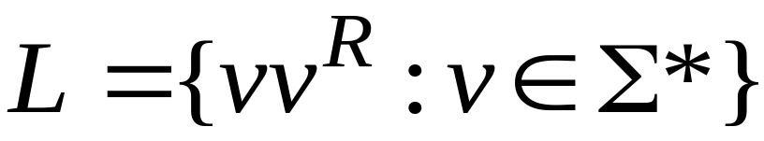
Non-regular languages
Regular languages
Courtesy Costas Busch - RPI

Slide 18

Theorem:
The language
is not regular
Proof:
Use the Pumping Lemma
Courtesy Costas Busch - RPI

Slide 19

Assume for contradiction
that is a regular language
Since is infinite
we can apply the Pumping Lemma
Courtesy Costas Busch - RPI

Slide 20




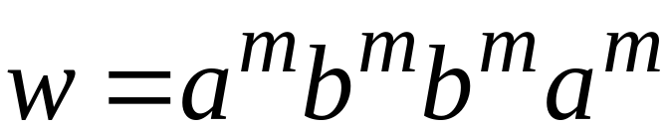
Let be the integer in the Pumping Lemma
Pick a string such that:
and
length
We pick
Courtesy Costas Busch - RPI

Slide 21
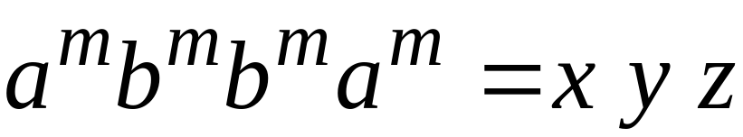




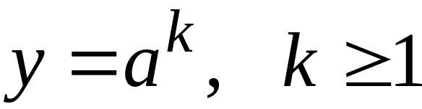
Write
From the Pumping Lemma
it must be that length
Thus:
Courtesy Costas Busch - RPI

Slide 22
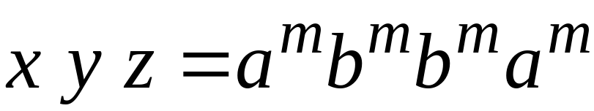



From the Pumping Lemma:
Thus:
Courtesy Costas Busch - RPI

Slide 23

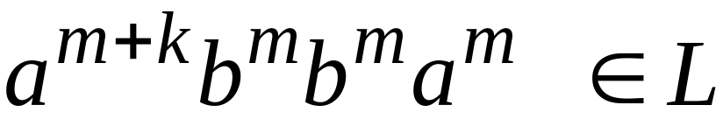
From the Pumping Lemma:
Thus:
Courtesy Costas Busch - RPI

Slide 24

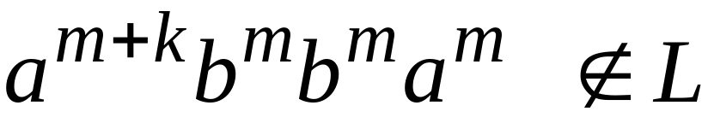
BUT:
CONTRADICTION!!!
Courtesy Costas Busch - RPI

Slide 25
Therefore:
Our assumption that
is a regular language is not true
Conclusion:
is not a regular language
Courtesy Costas Busch - RPI

Slide 26

Non-regular languages
Regular languages
Courtesy Costas Busch - RPI

Slide 27
Theorem:
The language
is not regular
Proof:
Use the Pumping Lemma
Courtesy Costas Busch - RPI

Slide 28
Assume for contradiction
that is a regular language
Since is infinite
we can apply the Pumping Lemma
Courtesy Costas Busch - RPI

Slide 29
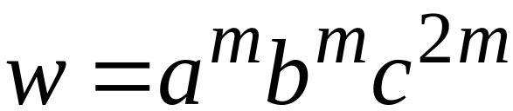
Let be the integer in the Pumping Lemma
Pick a string such that:
and
length
We pick
Courtesy Costas Busch - RPI

Slide 30
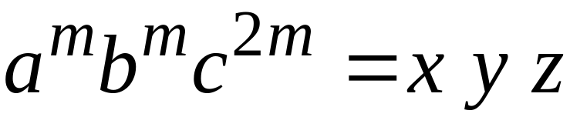

Write
From the Pumping Lemma
it must be that length
Thus:
Courtesy Costas Busch - RPI

Slide 31
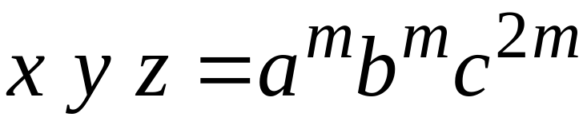
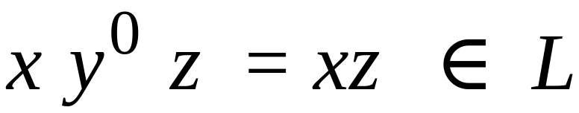
From the Pumping Lemma:
Thus:
Courtesy Costas Busch - RPI

Slide 32
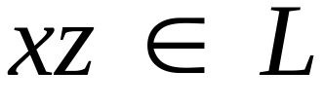

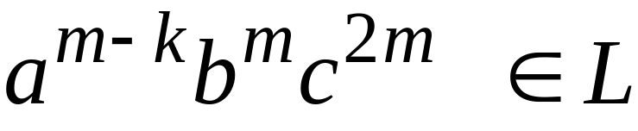
From the Pumping Lemma:
Thus:
Courtesy Costas Busch - RPI

Slide 33
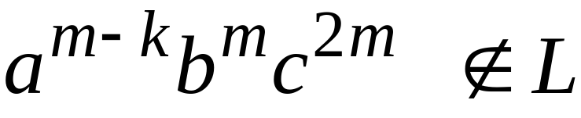
BUT:
CONTRADICTION!!!
Courtesy Costas Busch - RPI

Slide 34
Therefore:
Our assumption that
is a regular language is not true
Conclusion:
is not a regular language
Courtesy Costas Busch - RPI

Slide 35
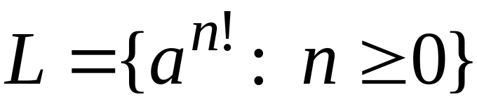
Non-regular languages
Regular languages
Courtesy Costas Busch - RPI

Slide 36
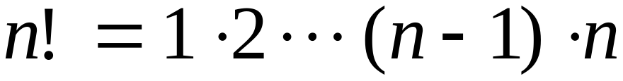
Theorem:
The language
is not regular
Proof:
Use the Pumping Lemma
Courtesy Costas Busch - RPI

Slide 37
Assume for contradiction
that is a regular language
Since is infinite
we can apply the Pumping Lemma
Courtesy Costas Busch - RPI

Slide 38
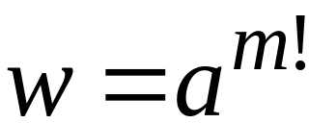
Let be the integer in the Pumping Lemma
Pick a string such that:
length
We pick
Courtesy Costas Busch - RPI

Slide 39
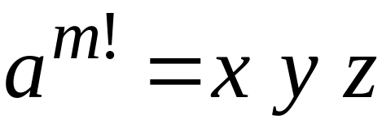

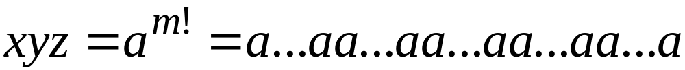
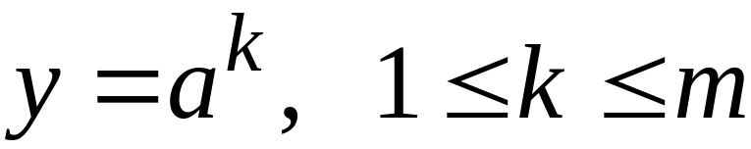
Write
From the Pumping Lemma
it must be that length
Thus:
Courtesy Costas Busch - RPI

Slide 40
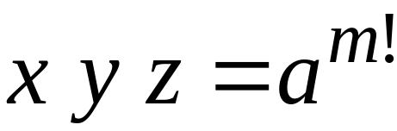
From the Pumping Lemma:
Thus:
Courtesy Costas Busch - RPI

Slide 41

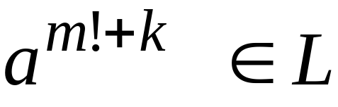
From the Pumping Lemma:
Thus:
Courtesy Costas Busch - RPI

Slide 42
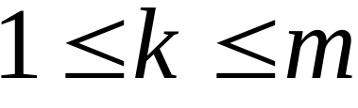

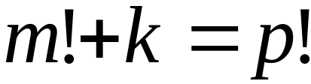
Since:
There must exist such that:
Courtesy Costas Busch - RPI

Slide 43

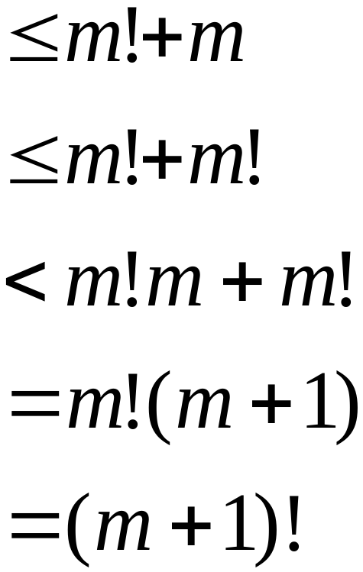

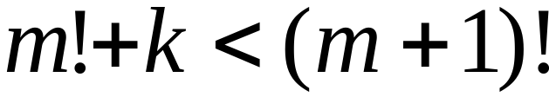
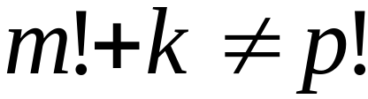
However:
for
for any
Courtesy Costas Busch - RPI

Slide 44
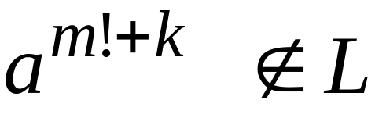
BUT:
CONTRADICTION!!!
Courtesy Costas Busch - RPI

Slide 45
Therefore:
Our assumption that
is a regular language is not true
Conclusion:
is not a regular language
Courtesy Costas Busch - RPI

