Slide 1
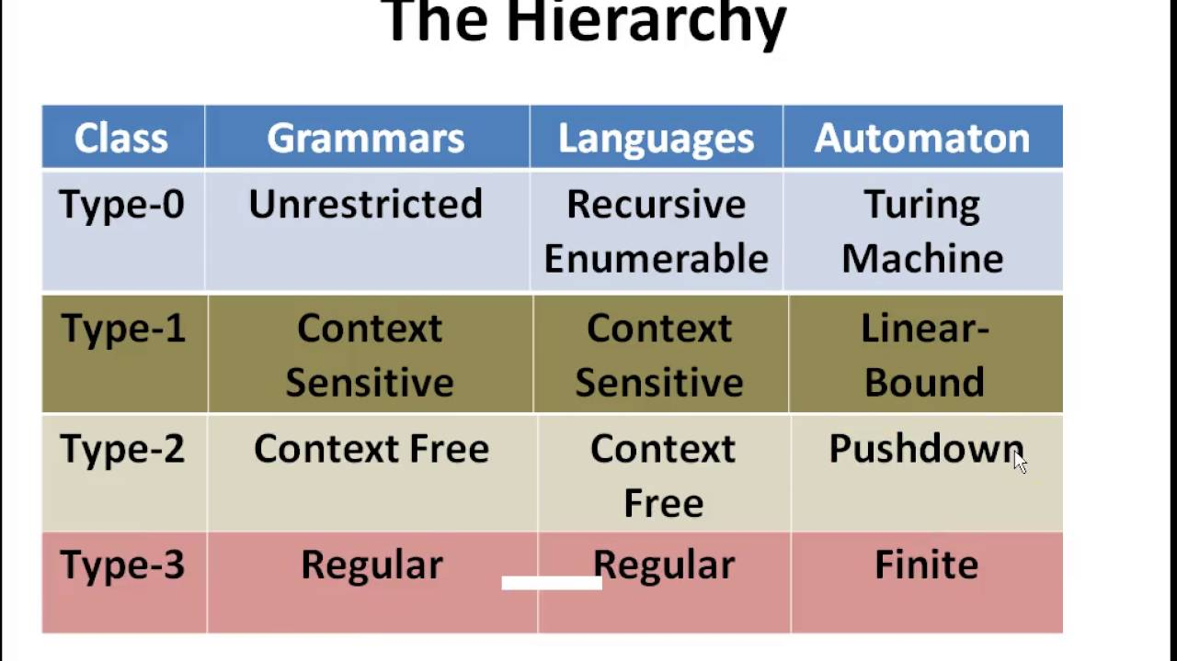
Courtesy Costas Busch - RPI

Slide 2
Grammars

Slide 3

Grammars
Grammars express/specify languages
Example: Grammar of English language
Courtesy Costas Busch - RPI

Slide 4
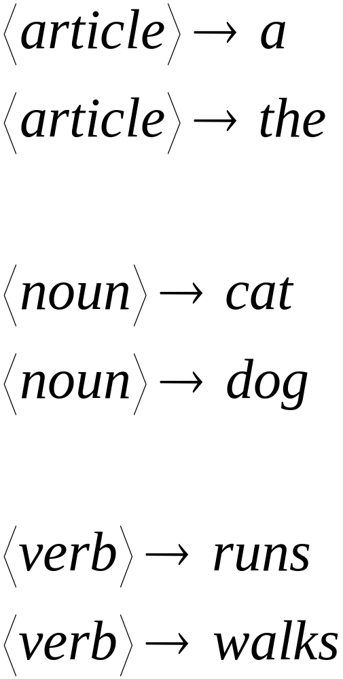
Courtesy Costas Busch - RPI

Slide 5
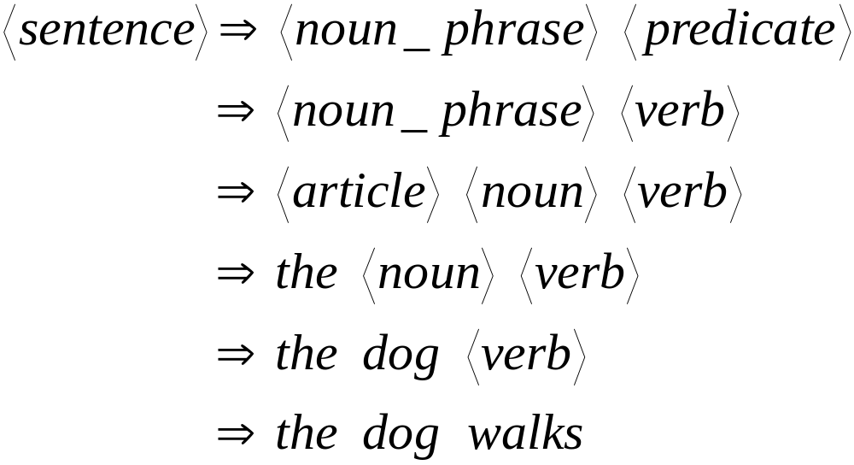
A derivation of string “the dog walks”:
Courtesy Costas Busch - RPI

Slide 6
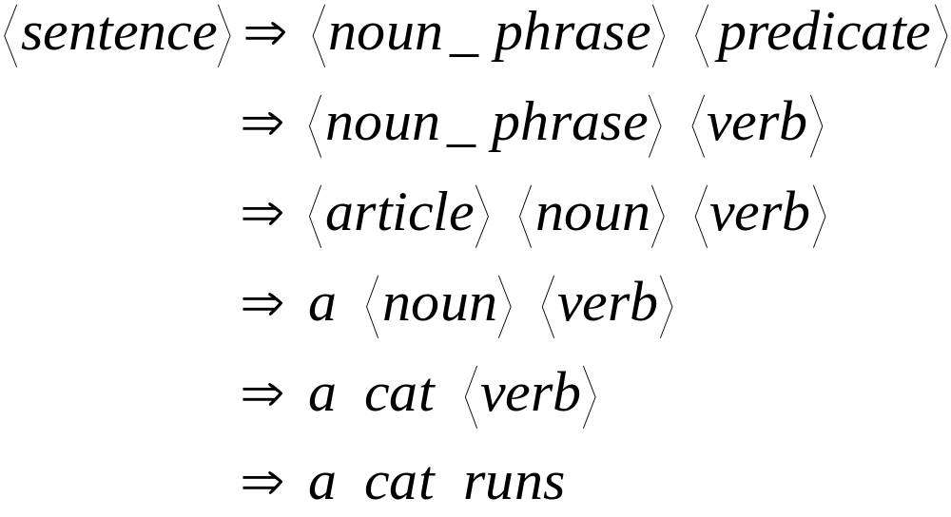
A derivation of string “a cat runs”:
Courtesy Costas Busch - RPI

Slide 7
Subset of Language produced by the English grammar:
L = { “a cat runs”,
“a cat walks”,
“the cat runs”,
“the cat walks”,
“a dog runs”,
“a dog walks”,
“the dog runs”,
“the dog walks” }
Courtesy Costas Busch - RPI

Slide 8
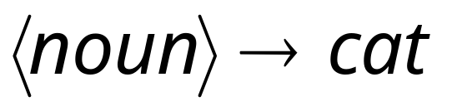
Notation
Productions
Sequence of
Terminals / Alphabets
Variables
Sequence of Variables
Courtesy Costas Busch - RPI

Slide 9
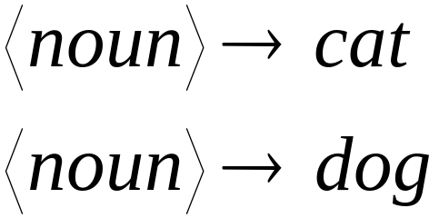
Notation
Production Rules
Variable
Sequence of
Terminals
Courtesy Costas Busch - RPI

Slide 10


Another Example
Sequence of
terminals and variables
Grammar:
Variable
The right side
may be
Courtesy Costas Busch - RPI

Slide 11



Grammar:
Derivation of sentence :
Courtesy Costas Busch - RPI

Slide 12

Other derivations:
Courtesy Costas Busch - RPI

Slide 13
Grammar:
Other derivations:
Courtesy Costas Busch - RPI

Slide 14

Language of the grammar
Courtesy Costas Busch - RPI

Slide 15





More Notation
Grammar
Set of variables
Set of terminal symbols
Start variable
Set of Production rules
Courtesy Costas Busch - RPI

Slide 16




Example
Grammar :
Courtesy Costas Busch - RPI

Slide 17
More Notation
Sentential Form:
A sentence that contains
variables and terminals
Example:
Sentential Forms
sentence
Courtesy Costas Busch - RPI

Slide 18

We write:
Instead of:
for zero or more derivation steps
Courtesy Costas Busch - RPI

Slide 19

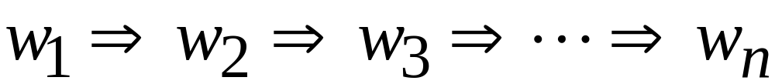
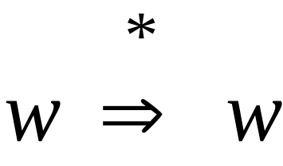
In general we write:
If:
in zero or more derivation steps
Trivially:
Courtesy Costas Busch - RPI

Slide 20
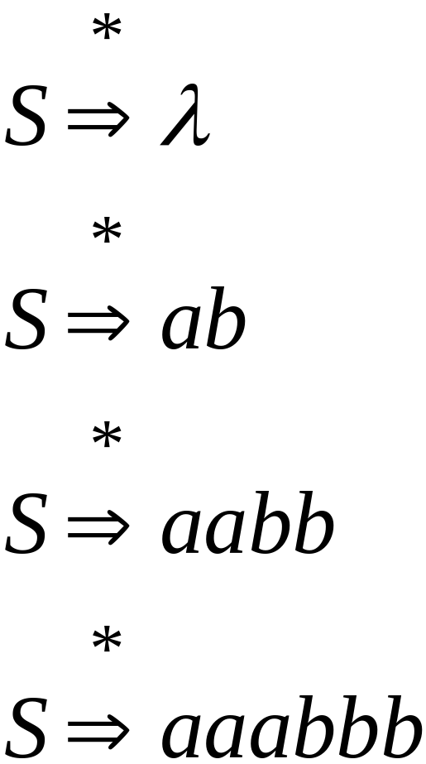
Example
Grammar
Derivations
Courtesy Costas Busch - RPI

Slide 21
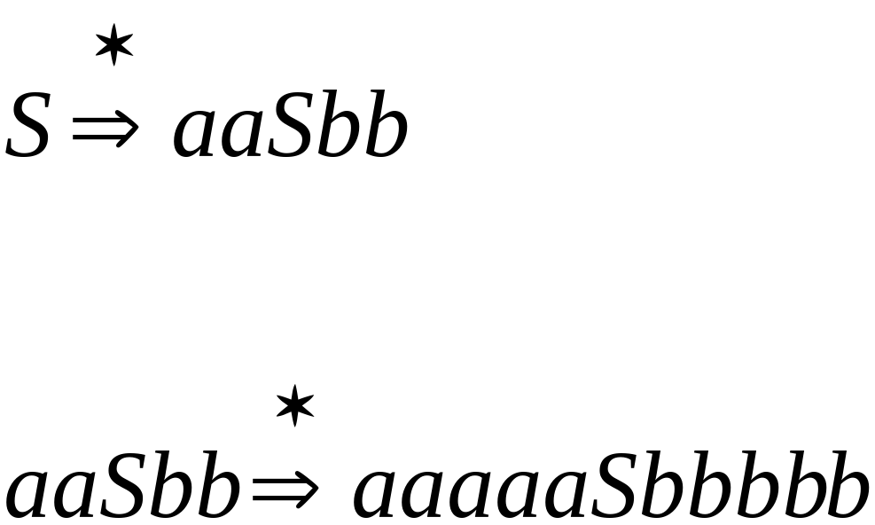
Example
Grammar
Derivations
Courtesy Costas Busch - RPI

Slide 22
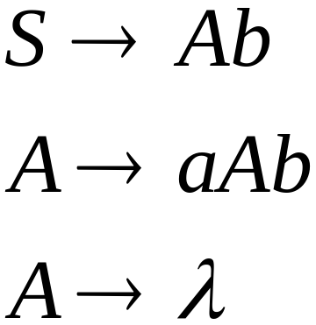
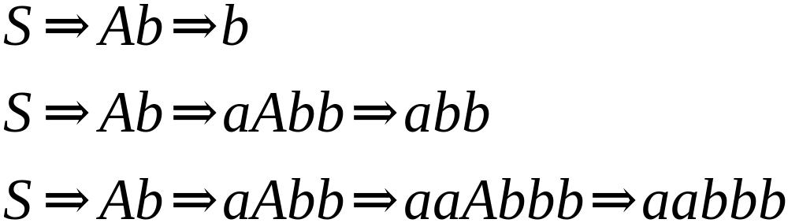
Another Grammar Example
Grammar :
Derivations:
Courtesy Costas Busch - RPI

Slide 23
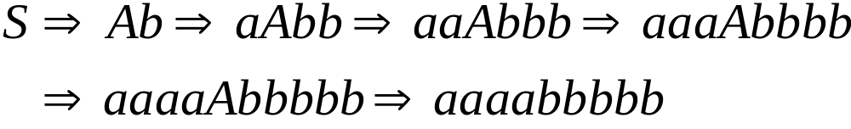
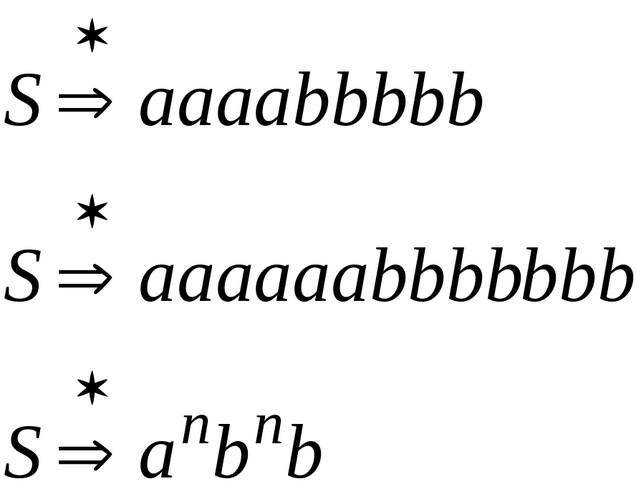
More Derivations
Courtesy Costas Busch - RPI

Slide 24



Language of a Grammar
For a grammar
with start variable :
String of terminals or
Courtesy Costas Busch - RPI

Slide 25

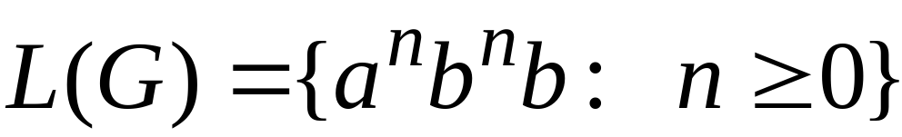
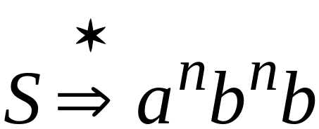
Example
For grammar :
Since:
Courtesy Costas Busch - RPI

Slide 26
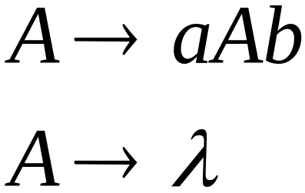
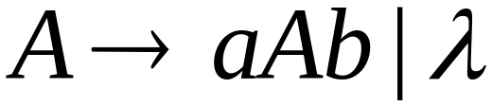
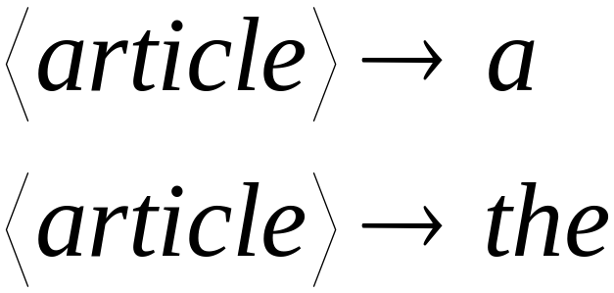
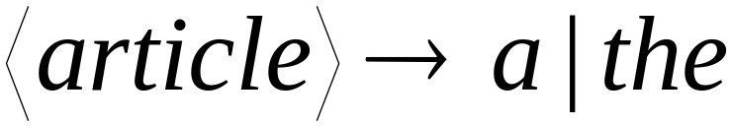
A Convenient Notation
Courtesy Costas Busch - RPI

Slide 27
Linear Grammars

Slide 28
Linear Grammars
Grammars with
at most one variable at the right side
of a production
Examples:
Courtesy Costas Busch - RPI

Slide 29
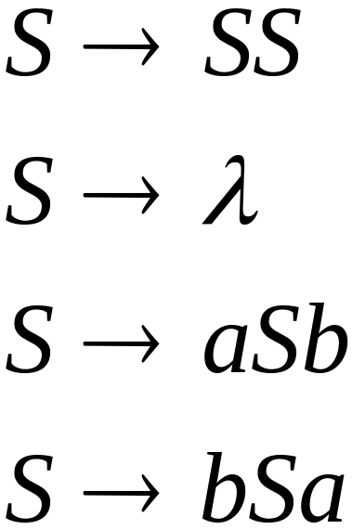
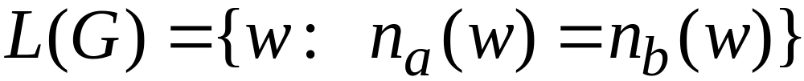


A Non-Linear Grammar
Grammar :
Number of in string
Courtesy Costas Busch - RPI

Slide 30
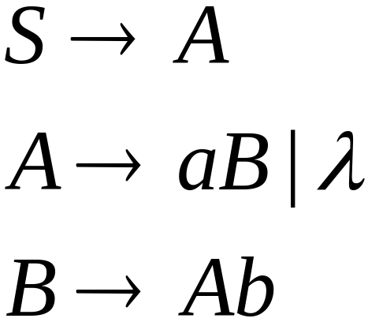
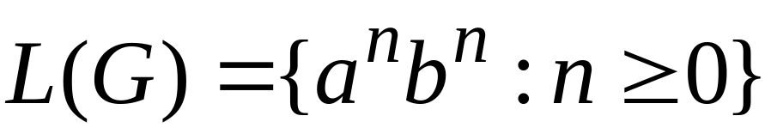
Another Linear Grammar
Grammar :
Courtesy Costas Busch - RPI

Slide 31


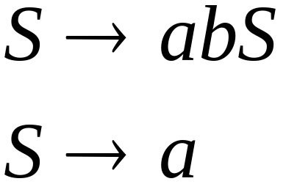
Right-Linear Grammars
All productions have form:
Example:
or
string of
terminals
Courtesy Costas Busch - RPI

Slide 32

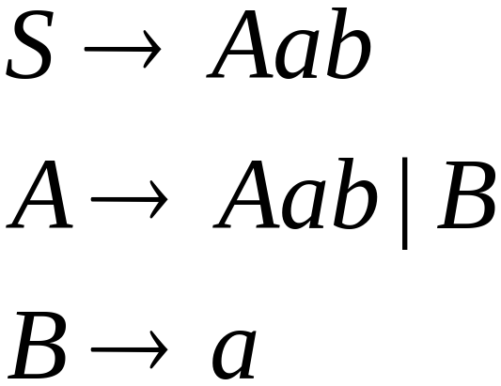
Left-Linear Grammars
All productions have form:
Example:
or
string of
terminals
Courtesy Costas Busch - RPI

Slide 33
Regular Grammars
Courtesy Costas Busch - RPI

Slide 34
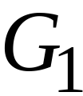
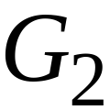
Regular Grammars
A regular grammar is any
right-linear or left-linear grammar
Examples:
Courtesy Costas Busch - RPI

Slide 35
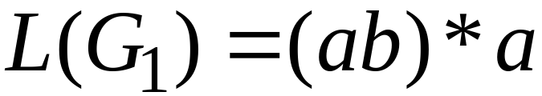
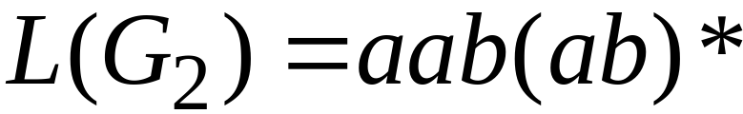
Observation
Regular grammars generate regular languages
Examples:
Courtesy Costas Busch - RPI

Slide 36
Regular Grammars
Generate only and all
Regular Languages
Courtesy Costas Busch - RPI

Slide 37

Theorem
Languages
Generated by
Regular Grammars
Regular
Languages
Courtesy Costas Busch - RPI

Slide 38

Theorem - Part 1
Languages
Generated by
Regular Grammars
Regular
Languages
Any regular grammar generates
a regular language
Courtesy Costas Busch - RPI

Slide 39

Theorem - Part 2
Languages
Generated by
Regular Grammars
Regular
Languages
Any regular language is generated
by a regular grammar
Courtesy Costas Busch - RPI

Slide 40
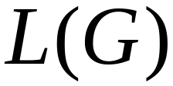
Proof – Part 1
Languages
Generated by
Regular Grammars
Regular
Languages
The language generated by
any regular grammar is regular
Courtesy Costas Busch - RPI

Slide 41

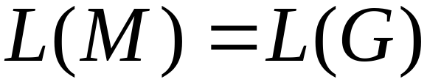
The case of Right-Linear Grammars
Let be a right-linear grammar
We will prove: is regular
Proof idea: We will construct NFA
with
Courtesy Costas Busch - RPI

Slide 42
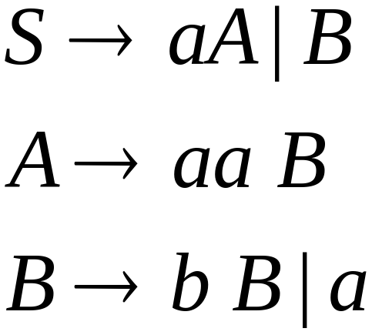
Grammar is right-linear
Example:
Courtesy Costas Busch - RPI

Slide 43



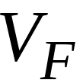

Construct NFA such that
every state is a grammar variable:
special
final state
Courtesy Costas Busch - RPI

Slide 44


Add edges for each production:
Courtesy Costas Busch - RPI

Slide 45

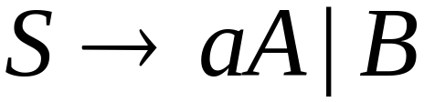
Courtesy Costas Busch - RPI

Slide 46
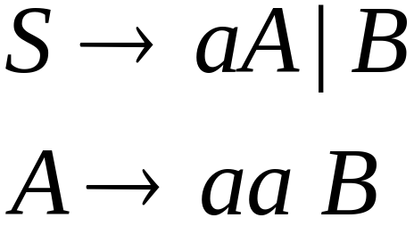
Courtesy Costas Busch - RPI

Slide 47
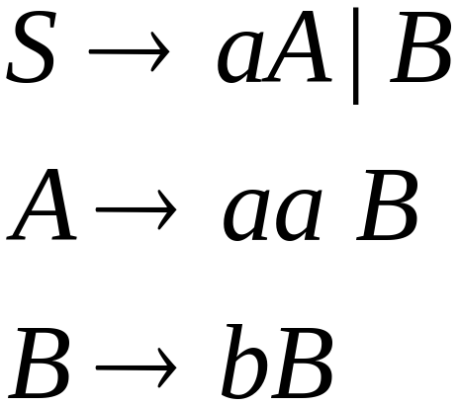

Courtesy Costas Busch - RPI

Slide 48
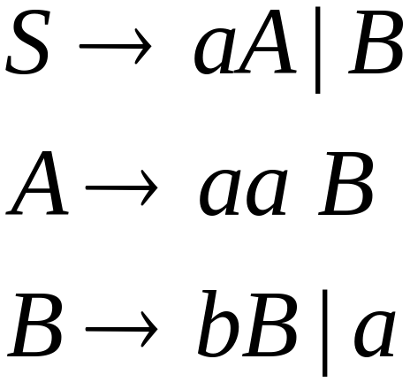
Courtesy Costas Busch - RPI

Slide 49
Courtesy Costas Busch - RPI

Slide 50
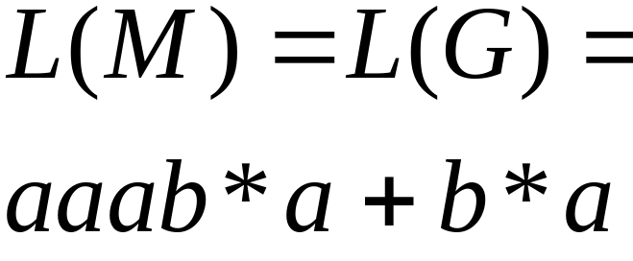
NFA
Grammar
Courtesy Costas Busch - RPI

Slide 51
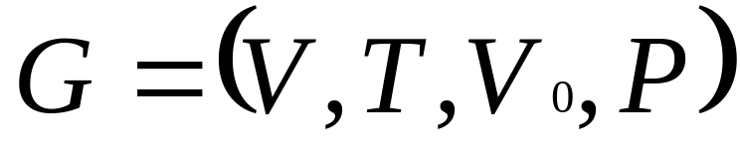
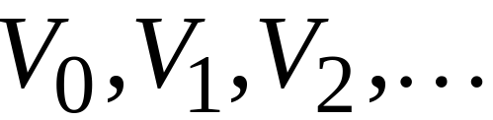
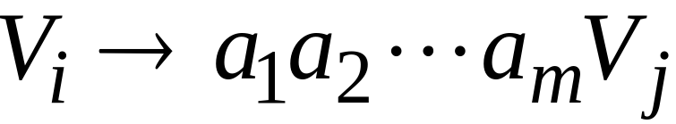
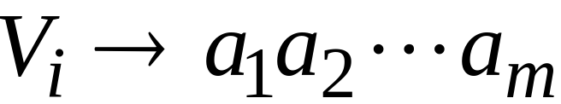
In General
A right-linear grammar
has variables:
and productions:
or
Courtesy Costas Busch - RPI

Slide 52







We construct the NFA such that:
each variable corresponds to a state, and is final state
Courtesy Costas Busch - RPI

Slide 53


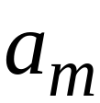


For each production:
we add transitions and intermediate nodes
………
Courtesy Costas Busch - RPI

Slide 54
For each production:
we add transitions to final node
………
Courtesy Costas Busch - RPI

Slide 55







Resulting NFA looks like this:
It holds that:
Courtesy Costas Busch - RPI

Slide 56
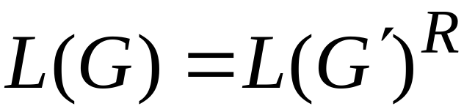

The case of Left-Linear Grammars
Let be a left-linear grammar
We will prove: is regular
Proof idea:
We will construct a right-linear
grammar with
Courtesy Costas Busch - RPI

Slide 57
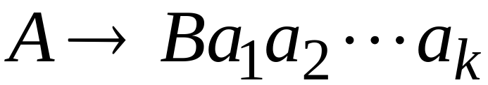
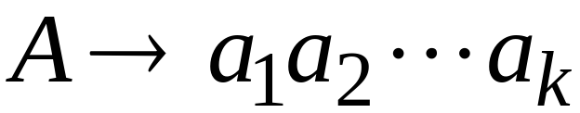
Since is left-linear grammar
the productions look like:
Courtesy Costas Busch - RPI

Slide 58

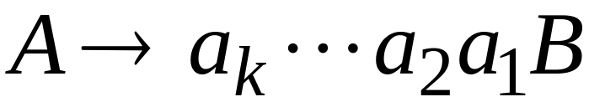
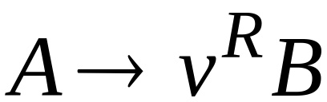
Construct right-linear grammar
Left
linear
Right
linear
Courtesy Costas Busch - RPI

Slide 59

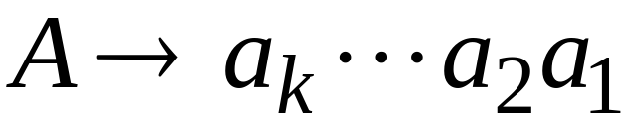

Construct right-linear grammar
Left
linear
Right
linear
Courtesy Costas Busch - RPI

Slide 60


It is easy to see that:
Since is right-linear, we have:
Regular
Language
Regular
Language
Regular
Language
Courtesy Costas Busch - RPI

Slide 61

Proof - Part 2
Languages
Generated by
Regular Grammars
Regular
Languages
Any regular language is generated
by some regular grammar
Courtesy Costas Busch - RPI

Slide 62

Any regular language is generated
by some regular grammar
Proof idea:
Let be the NFA with .
Construct from a regular grammar
such that
Courtesy Costas Busch - RPI

Slide 63





Since is regular
there is an NFA such that
Example:
Courtesy Costas Busch - RPI

Slide 64




Convert to a right-linear grammar
Courtesy Costas Busch - RPI

Slide 65

Courtesy Costas Busch - RPI

Slide 66

Courtesy Costas Busch - RPI

Slide 67


Courtesy Costas Busch - RPI

Slide 68



In General
For any transition:
Add production:
variable
terminal
variable
Courtesy Costas Busch - RPI

Slide 69


For any final state:
Add production:
Courtesy Costas Busch - RPI

Slide 70
Since is right-linear grammar
is also a regular grammar
with
Courtesy Costas Busch - RPI

