Slide 1
CSCE430/830 Computer Architecture
Pipeline: Exceptions & Control
Lecturer: Prof. Hong Jiang
Courtesy of Yifeng Zhu, U. of Maine
Fall, 2006
Portions of these slides are derived from:
Dave Patterson © UCB

Slide 2
Pipelining Outline
Introduction
  Defining Pipelining
  Pipelining Instructions
Hazards
  Structural hazards
  Data Hazards
  Control Hazards
Exceptions 
Performance
Controller implementation

Slide 3
Exceptions - “Stuff Happens”
Exceptions definition: “unexpected change in control flow”
Another form of control hazard.
For example:
add $1, $2, $1; causing an arithmetic overflow
sw $3, 400($1);
add $5, $1, $2;
Invalid $1 contaminates other registers or memory locations!

Slide 4
Two Types of Exceptions: Interrupts and Traps
Interrupts
  Caused by external events:
    Network, Keyboard, Disk I/O, Timer
    Page fault - virtual memory
    System call - user request for OS action
  Asynchronous to program execution
  May be handled between instructions
  Simply suspend and resume user program
Traps
  Caused by internal events
    Exceptional conditions (overflow)
    Undefined Instruction
    Hardware malfunction
  Usually Synchronous to program execution
  Condition must be remedied by the handler
  Instruction may be retried or simulated and program continued or program may be aborted

Slide 5
Synchronous vs Asynchronous
Definition: If the event occurs at the same place every time the program is executed with the same data and memory allocation, the event is synchronous. Otherwise asynchronous.
Except for hardware malfunctions, asynchronous events are caused by devices external to the CPU and memory.
Asynchronous events usually are easier to handled because asynchronous events can be handled after the completion of the current instruction.

Slide 6
Exceptions in Simple five-stage pipeline
Instruction Fetch, & Memory stages
  Page fault on instruction/data fetch
  Misaligned memory access
  Memory-protection violation
Instruction Decode stage
  Undefined/illegal opcode
Execution stage
  Arithmetic exception
Write-Back stage
  No exceptions!

Slide 7
What happens during an exception
In The Hardware
The pipeline has to
  stop executing the offending instruction in midstream,
  let all preceding instructions complete,
  flush all succeeding instructions,
  set a register to show the cause of the exception,
  save the address of the offending instruction, and
  then jump to a prearranged address (the address of the exception handler code)
In The Software
The software (OS) looks at the cause of the exception and “deals” with it
Normally OS kills the program
Notes:
For undefined instrs, hardware failure, or arith overflow – the OS normally kills the program and returns an indication of the reason to the user
For an I/O device request or an OS service call – the OS saves the state of the program, performs the desired task and, at some point in the future, restores the program to continue execution

Slide 8
Exceptions
System
Exception
Handler
user program
Exception:
return from
exception
normal control flow:
sequential, jumps, branches, calls, returns
Exception = non-programmed control transfer
  system takes action to handle the exception
    must record the address of the offending instruction
    record any other information necessary to return afterwards
  returns control to user
  must save & restore user state

Slide 9
Additions to MIPS ISA to support Exceptions
EPC (Exceptional Program Counter)
  A 32-bit register
  Hold the address of the offending instruction
Cause
  A 32-bit register in MIPS (some bits are unused currently.)
  Record the cause of the exception
Status - interrupt mask and enable bits and determines what exceptions can occur.
Control signals to write EPC , Cause, and Status
Be able to write exception address into PC, increase mux set PC to exception address (MIPS uses 8000 00180_{hex} ).
May have to undo PC = PC + 4, since want EPC to point to offending instruction (not its successor); PC = PC – 4
What else?
flush all succeeding instructions in pipeline

Slide 10
Flush instructions in Branch Hazard
sub $10, $4, $8
beq $1, $3, 7 # taget = 40 + 4 + 7*4 = 72
and $12, $2, $5
or $13, $2, $6
52 ….
….
72 lw $4, 50($7)

Slide 11
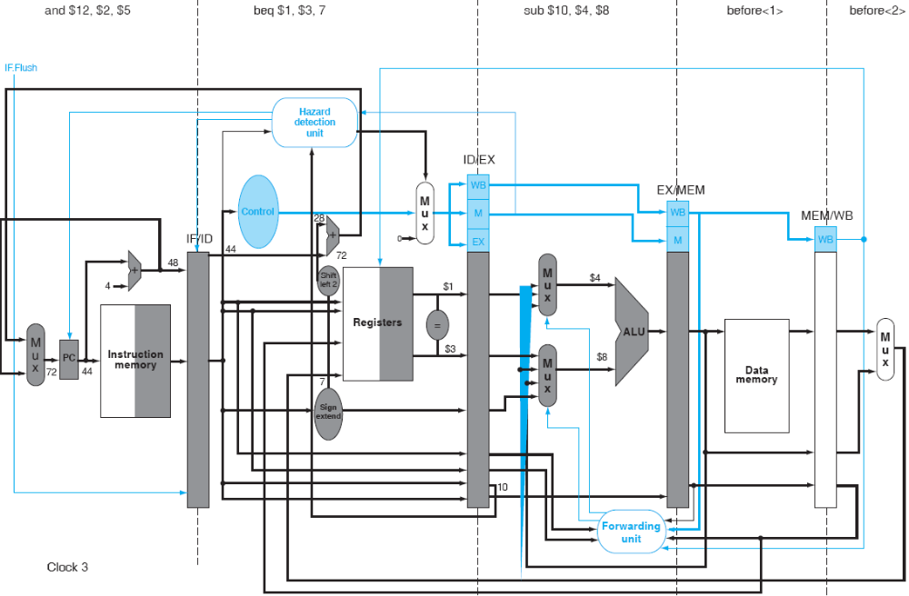
Flush instructions at IF stage in Branch Hazard
Turn the instructions at IF stage into nop.

Slide 12
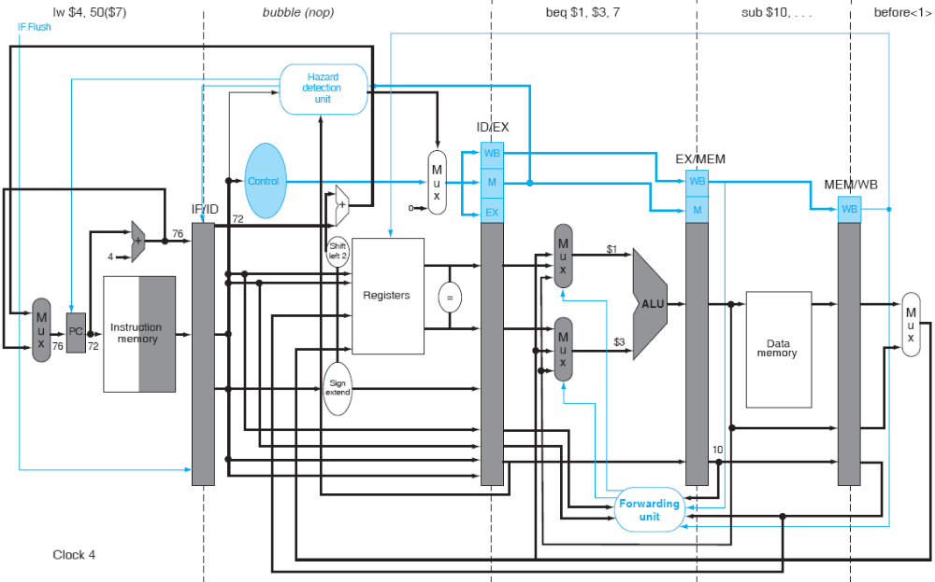
Flush instructions at IF stage in Branch Hazard
2
zero control signals

Slide 13
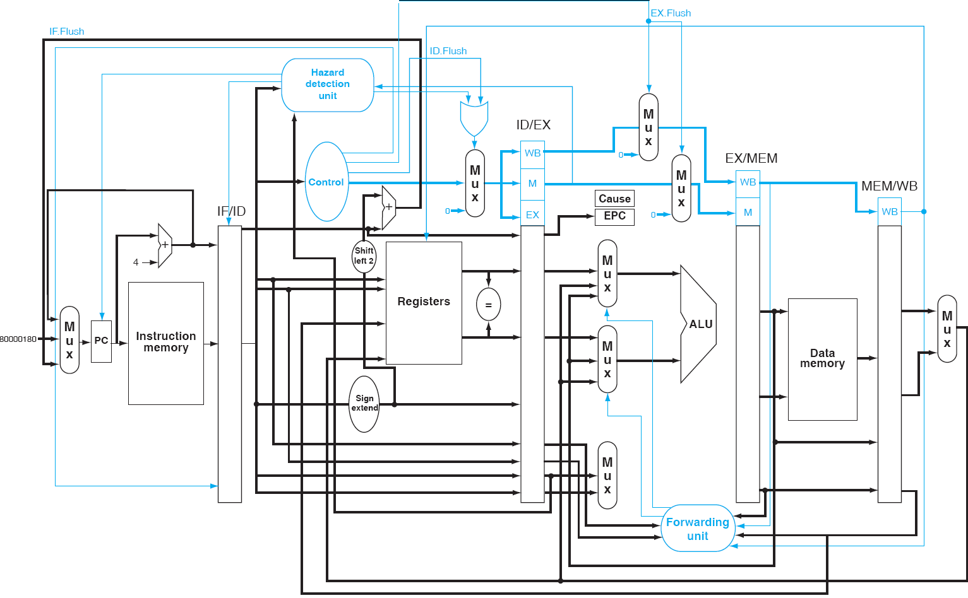
Additions to MIPS ISA to support Exceptions

Slide 14
Exceptions Example
40hex sub $11, $2, $4
44hex and $12, $2, $5
48hex or $13, $2, $6
4Chex add $1, $2, $1; // arithmetic overflow
50hex stl $15, %6, $7
54hex lw $16, 50($7)
Exception handling program:
40000040hex sw $25, 1000($0)
40000044hex sw $12, 1004($0)

Slide 15
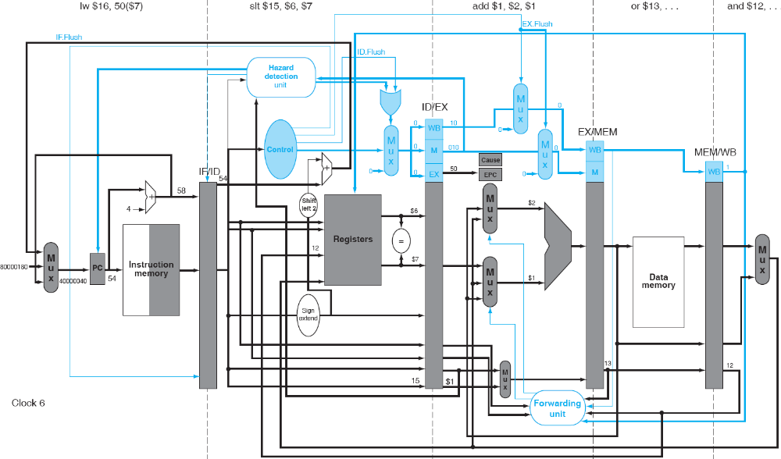
Exceptions Example

Slide 16
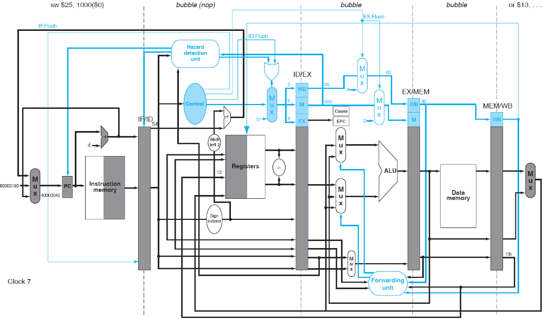
Exceptions Example

Slide 17
Summary
Exceptions
  Interrupts
  Traps
Exceptions in five-stage pipeline
Exception detection (not covered)
Exception handling
  Stop the offending instruction
  Flush instructions following the offending instructions
  Save the address of the offending instruction, and
  Jump to a prearranged exception handler code

Slide 18
Pipelining Outline
Introduction
  Defining Pipelining
  Pipelining Instructions
Hazards
  Structural hazards
  Data Hazards
  Control Hazards
Exceptions
Performance
Controller implementation 

Slide 19
Pipelining in MIPS
MIPS architecture was designed to be pipelined
  Simple instruction format (makes IF, ID easy)
    Single-word instructions
    Small number of instruction formats
    Common fields in same place (e.g., rs, rt) in different formats
  Memory operations only in lw, sw instructions
  (simplifies EX)
  Memory operands aligned in memory (simplifies MEM)
  Single value for Write-Back (limits forwarding)
Pipelining is harder in CISC architectures

Slide 20
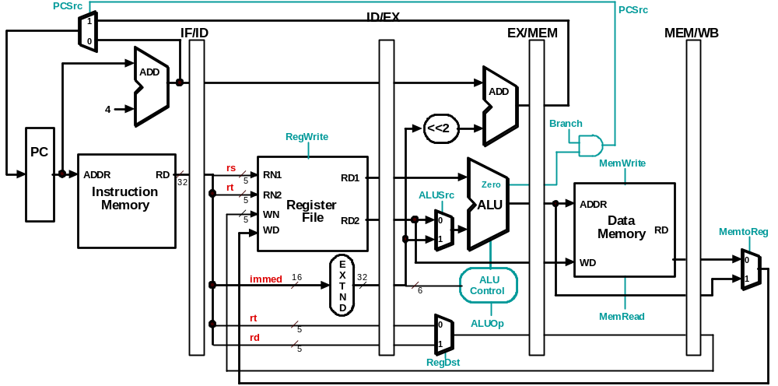
Pipelined Datapath with Control Signals

Slide 21
Next Step: Adding Control
Basic approach: build on single-cycle control
  Place control unit in ID stage
  Pass control signals to following stages
Later: extra features to deal with:
  Data forwarding
  Stalls
  Exceptions

Slide 22
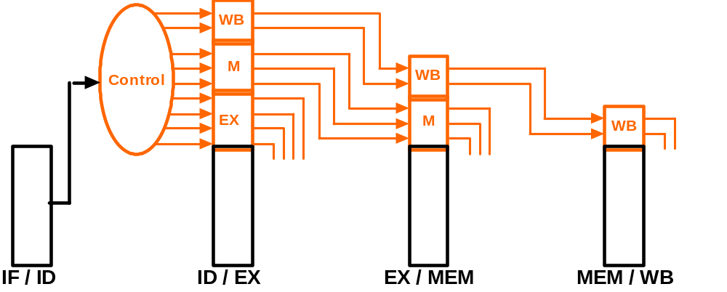
Control for Pipelined Datapath
RegDst
ALUOp[1:0]
ALUSrc
MemRead
MemWrite
Branch
RegWrite
MemtoReg

Slide 23
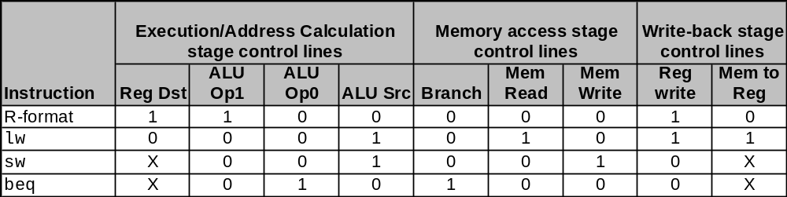
Control for Pipelined Datapath

Slide 24
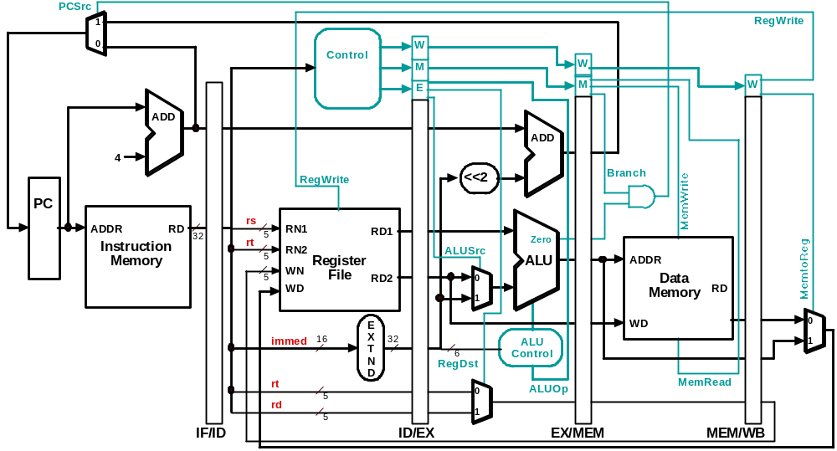
Datapath and Control Unit

Slide 25
Tracking Control Signals - Cycle 1
LW

Slide 26
Tracking Control Signals - Cycle 2
SW
LW

Slide 27
Tracking Control Signals - Cycle 3
1
0
01
ADD
SW
LW

Slide 28
Tracking Control Signals - Cycle 4
0
0
1
SUB
ADD
SW
LW

Slide 29
Tracking Control Signals - Cycle 5
1
1
SUB
ADD
SW
LW

Slide 30
Class Exercise
Consider the following code segment
LW R1, 0(R4)
LW R2, 0(R5)
ADD R3, R1, R2
BNZ R3, L
LW R4, 100(R1)
LW R5, 100(R2)
SUB R3, R4, R5
L: SW R3, 50(R1)
Assuming that
there is no forwarding,
zero testing is being resolved during ID, and
registers can be written in the first half of the WB cycle and also be read in the send half of the same WB cycle,
Question: identify the resources of various hazards in the above code sequence.

Slide 31
Class Exercise
Consider the following code segment
LW R1, 0(R4)
LW R2, 0(R5)
ADD R3, R1, R2
BNZ R3, L
LW R4, 100(R1)
LW R5, 100(R2)
SUB R3, R4, R5
L: SW R3, 50(R1)
Assuming that
there is no forwarding,
zero testing is being resolved during ID, and
registers can be written in the first of the WB cycle and also be read in the send half of the same WB cycle,
Question: identify the resources of various hazards in the above code sequence.

Slide 32
Class Exercise
Consider the following code segment
LW R1, 0(R4)
LW R2, 0(R5)
ADD R3, R1, R2
BNZ R3, L
LW R4, 100(R1)
LW R5, 100(R2)
SUB R3, R4, R5
L: SW R3, 50(R1)
Use compiler techniques to reshuffle/rewrite the code (without changing the meaning of the program) as to minimize data hazards as far as possible. Assume that no other general purpose registers other than those used in the code, are available.

Slide 33
Class Exercise
Consider the following code segment
LW R1, 0(R4)
LW R2, 0(R5)
ADD R3, R1, R2
BNZ R3, L
LW R4, 100(R1)
LW R5, 100(R2)
SUB R3, R4, R5
L: SW R3, 50(R1)
LW R1, 0(R4)
LW R2, 0(R5)
LW R4, 100(R1)
LW R5, 100(R2)
ADD R3, R1, R2
BNZ R3, L
SUB R3, R4, R5
L: SW R3, 50(R1)
Use compiler techniques to reshuffle/rewrite the code (without changing the meaning of the program) as to minimize data hazards as far as possible. Assume that no other general purpose registers other than those used in the code, are available.

