Slide 1
CS252
Graduate Computer Architecture
Lecture 6
Tomasulo Scheduling for
Out-Of-Order Execution
September 20, 2000
Prof. John Kubiatowicz

Slide 2
Review:
Exceptions and Compiler Scheduling
Careful compiler scheduling can remove stalls and speed up code. Dependencies must be maintained.
  Dependence: intended flow of data from instruction to instruction.
  First instruction writes data to register, second reads it.
  Anti-Dependence: reuse of register name - no flow of information!
  First instruction reads register, then second instruction writes it
  Output-Dependence: reuse of register name - no flow of information!
  First instruction writes register, then second instruction writes it
Compiler must respect dependencies, schedule to avoid stall from RAW hazards.
Loop unrolling:
  multiple iterations per loop - all instructions from all iterations
  Involves compiler-based register renaming
Software pipelining:
  multiple iterations per loop - one instruction from each iteration
  Turns Dependencies into Anti-Dependencies!
  Often used for floating-point which has long latencies.

Slide 3
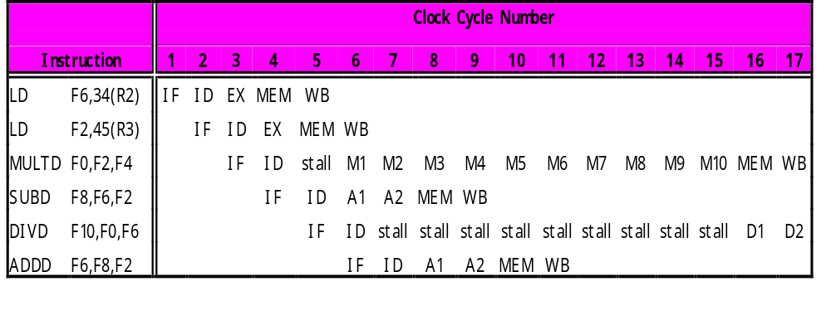
Review: Issues with general Scheduling
How do we prevent WAR and WAW hazards?
How do we deal with variable latency?
  Forwarding for RAW hazards harder.
RAW
WAR

Slide 4
Review:
Scoreboard from CDC 6600
Scoreboard (ala CDC 6600 in 1963)
  Centralized control structure
  Many independent functional units (not necessarily pipelined)
Key idea of Scoreboard: Allow instructions behind stall to proceed (Decode => Issue instr & read operands)
  Enables out-of-order execution => out-of-order completion
  Original version didn’t handle forwarding.
  No automatic register renaming
  Pipeline stalls for WAR and WAW hazards.
  Are these fundamental limitations???

Slide 5
Review: Scoreboard Architecture
(CDC 6600)
FP Mult
FP Mult
FP Divide
Registers
Functional Units
FP Add
Integer
SCOREBOARD
Memory

Slide 6
Review:
Four Stages of Scoreboard Control
Issue—decode instructions & check for structural hazards (ID1)
  Instructions issued in program order (for hazard checking)
  Don’t issue if structural hazard
  Don’t issue if instruction is output dependent on any previously issued but uncompleted instruction (no WAW hazards)
Read operands—wait until no data hazards, then read operands (ID2)
  All real dependencies (RAW hazards) resolved in this stage, since we wait for instructions to write back data.
  No forwarding of data in this model!

Slide 7
Review:
Four Stages of Scoreboard Control
Execution—operate on operands (EX)
  The functional unit begins execution upon receiving operands. When the result is ready, it notifies the scoreboard that it has completed execution.
Write result—finish execution (WB)
  Stall until no WAR hazards with previous instructions:
  Example: DIVD F0,F2,F4
  ADDD F10,F0,F8
  SUBD F8,F8,F14
  CDC 6600 scoreboard would stall SUBD until ADDD reads operands

Slide 8
Another Dynamic Algorithm: Tomasulo’s Algorithm
For IBM 360/91 about 3 years after CDC 6600 (1966)
Goal: High Performance without special compilers
Differences between IBM 360 & CDC 6600 ISA
  IBM has only 2 register specifiers/instr vs. 3 in CDC 6600
  IBM has 4 FP registers vs. 8 in CDC 6600
  IBM has memory-register ops
Small number of floating point registers prevented interesting compiler scheduling of operations
  This led Tomasulo to try to figure out how to get more effective registers — renaming in hardware!
Why Study? The descendants of this have flourished!
  Alpha 21264, HP 8000, MIPS 10000, Pentium II, PowerPC 604, …

Slide 9
Tomasulo Algorithm vs. Scoreboard
Control & buffers distributed with Function Units (FU) vs. centralized in scoreboard;
  FU buffers called “reservation stations”; have pending operands
Registers in instructions replaced by values or pointers to reservation stations(RS); called register renaming ;
  avoids WAR, WAW hazards
  More reservation stations than registers, so can do optimizations compilers can’t
Results to FU from RS, not through registers, over Common Data Bus that broadcasts results to all FUs
Load and Stores treated as FUs with RSs as well
Integer instructions can go past branches, allowing
FP ops beyond basic block in FP queue

Slide 10
Tomasulo Organization
From Mem
FP Op
Queue
FP Registers
Load Buffers
Load1
Load2
Load3
Load4
Load5
Load6
Store
Buffers
Add1
Add2
Add3
Mult1
Mult2
Reservation
Stations
To Mem
FP adders
FP multipliers
Common Data Bus (CDB)
Notes:
Resolve RAW memory conflict? (address in memory buffers)
Integer unit executes in parallel

Slide 11
Reservation Station Components
Op: Operation to perform in the unit (e.g., + or –)
Vj, Vk: Value of Source operands
  Store buffers has V field, result to be stored
Qj, Qk: Reservation stations producing source registers (value to be written)
  Note: No ready flags as in Scoreboard; Qj,Qk=0 => ready
  Store buffers only have Qi for RS producing result
Busy: Indicates reservation station or FU is busy
Register result status—Indicates which functional unit will write each register, if one exists. Blank when no pending instructions that will write that register.
Notes:
What you might have thought
1. 4 stages of instruction executino
2.Status of FU: Normal things to keep track of (RAW & structura for busyl):
Fi from instruction format of the mahine (Fi is dest)
Add unit can Add or Sub
Rj, Rk - status of registers (Yes means ready)
Qj,Qk - If a no in Rj, Rk, means waiting for a FU to write result; Qj, Qk means wihch FU waiting for it
3.Status of register result (WAW &WAR)s:
which FU is going to write into registers
Scoreboard on 6600 = size of FU
6.7, 6.8, 6.9, 6.12, 6.13, 6.16, 6.17
FU latencies: Add 2, Mult 10, Div 40 clocks

Slide 12
Three Stages of Tomasulo Algorithm
1. Issue—get instruction from FP Op Queue
  If reservation station free (no structural hazard),
  control issues instr & sends operands (renames registers).
2. Execute—operate on operands (EX)
  When both operands ready then execute;
  if not ready, watch Common Data Bus for result
3. Write result—finish execution (WB)
  Write on Common Data Bus to all awaiting units;
  mark reservation station available
Normal data bus: data + destination (“go to” bus)
Common data bus: data + source (“come from” bus)
  64 bits of data + 4 bits of Functional Unit source address
  Write if matches expected Functional Unit (produces result)
  Does the broadcast

Slide 13
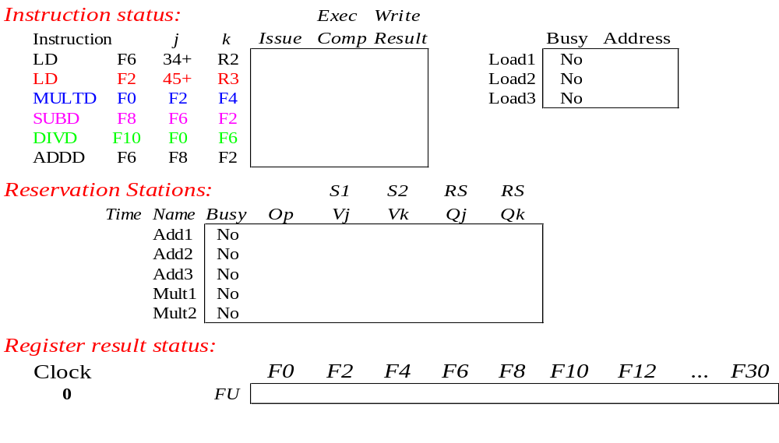
Tomasulo Example

Slide 14
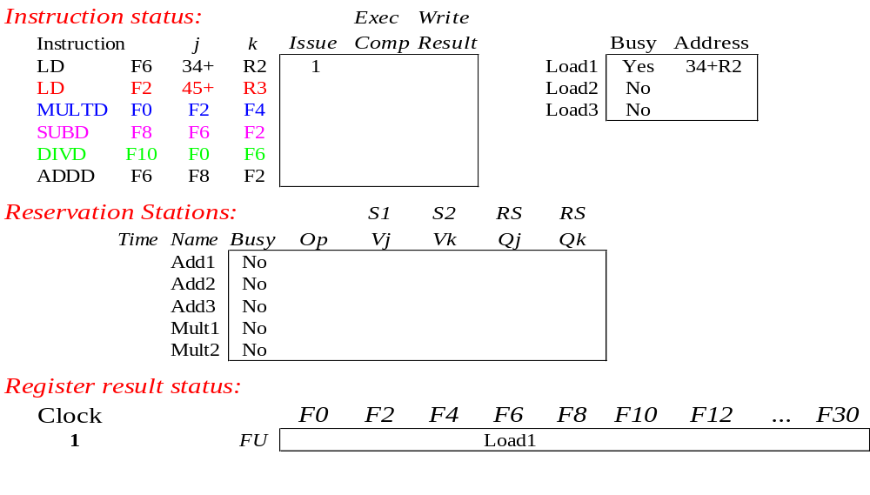
Tomasulo Example Cycle 1

Slide 15
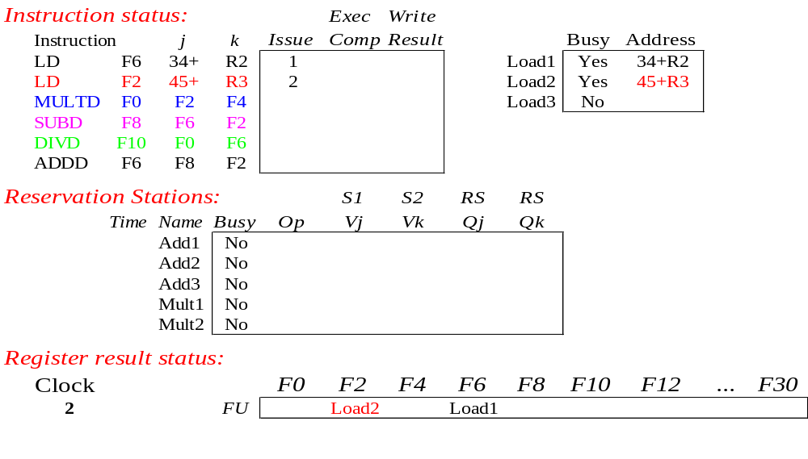
Tomasulo Example Cycle 2
Note: Unlike 6600, can have multiple loads outstanding
(This was not an inherent limitation of scoreboarding)

Slide 16
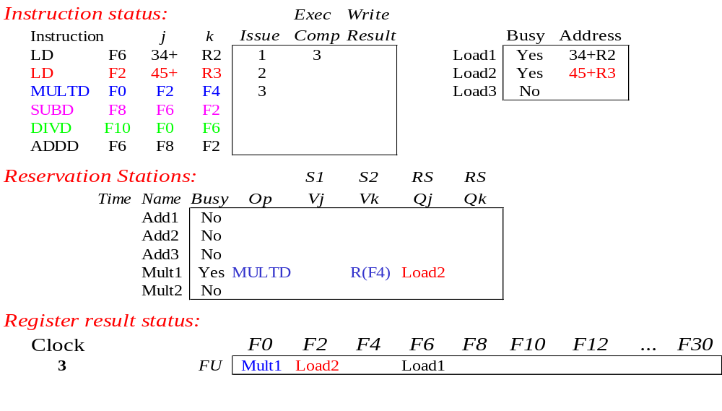
Tomasulo Example Cycle 3
Note: registers names are removed (“renamed”) in Reservation Stations; MULT issued vs. scoreboard
Load1 completing; what is waiting for Load1?

Slide 17
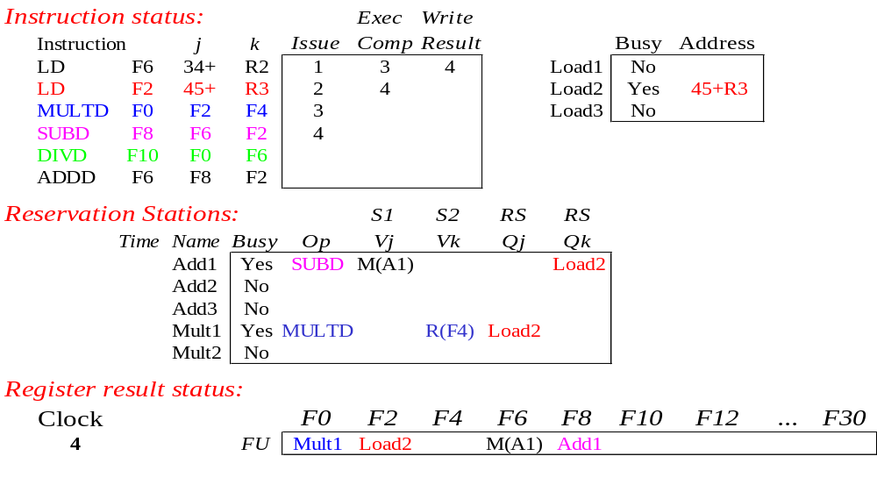
Tomasulo Example Cycle 4
Load2 completing; what is waiting for Load1?

Slide 18
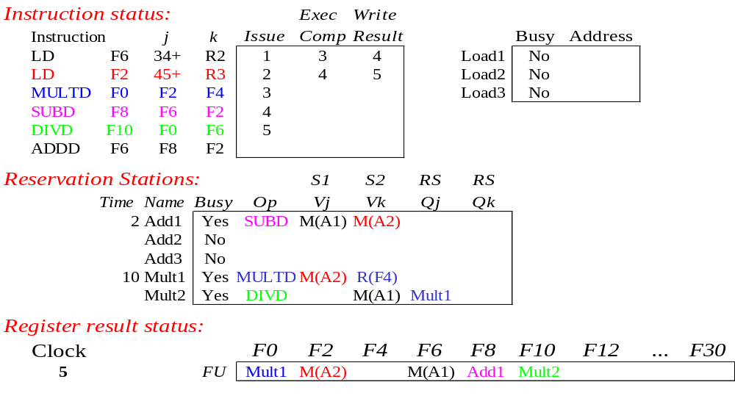
Tomasulo Example Cycle 5

Slide 19
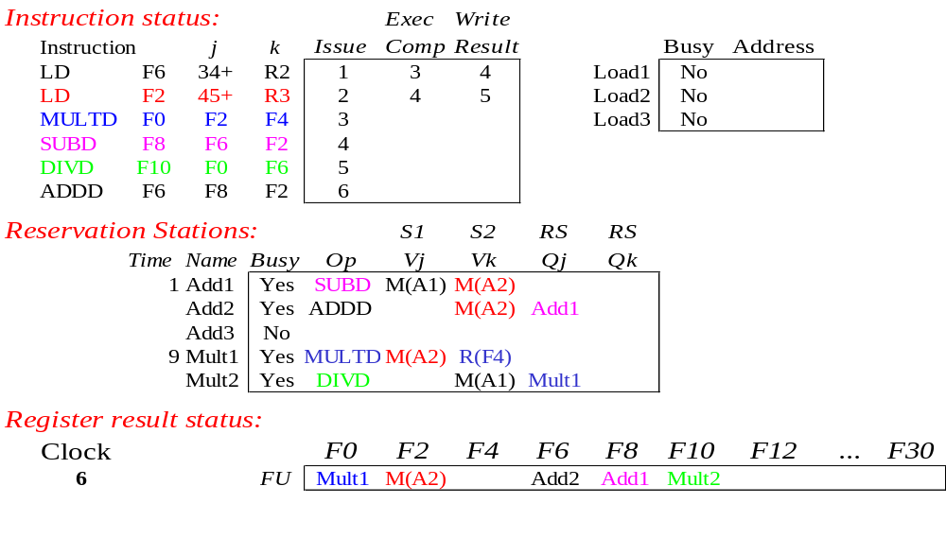
Tomasulo Example Cycle 6
Issue ADDD here vs. scoreboard?

Slide 20

Tomasulo Example Cycle 7
Add1 completing; what is waiting for it?

Slide 21
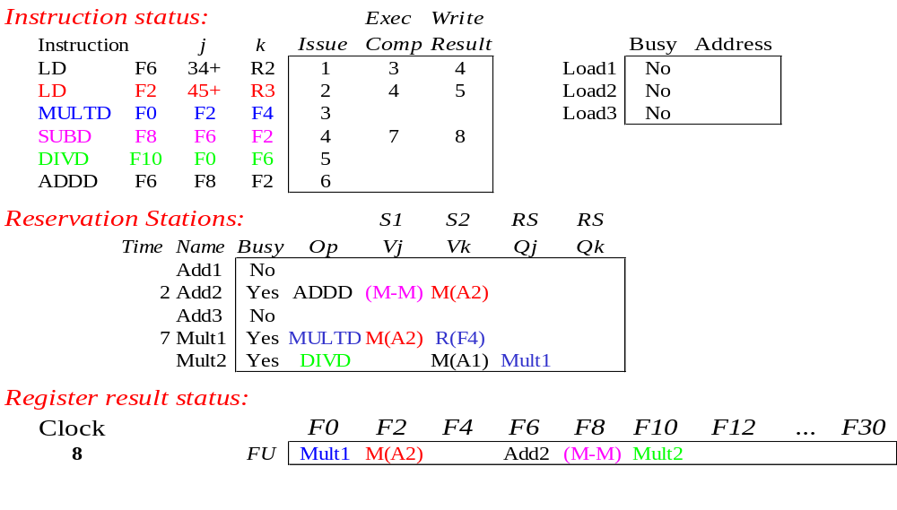
Tomasulo Example Cycle 8

Slide 22

Tomasulo Example Cycle 9

Slide 23

Tomasulo Example Cycle 10
Add2 completing; what is waiting for it?

Slide 24
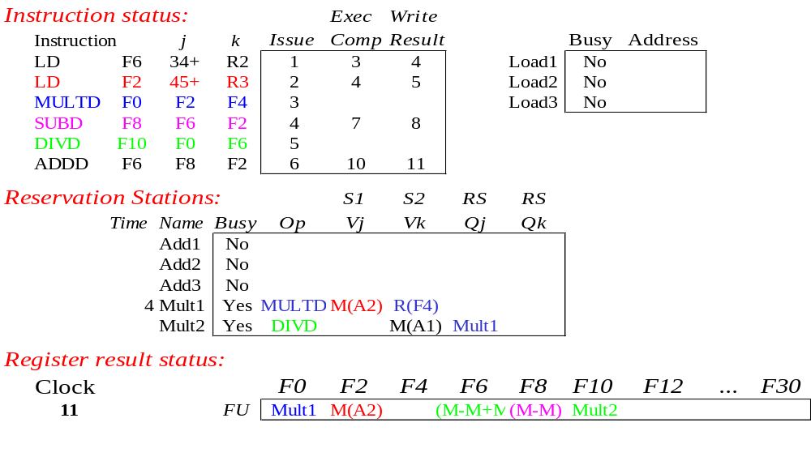
Tomasulo Example Cycle 11
Write result of ADDD here vs. scoreboard?
All quick instructions complete in this cycle!

Slide 25

Tomasulo Example Cycle 12

Slide 26

Tomasulo Example Cycle 13

Slide 27

Tomasulo Example Cycle 14

Slide 28
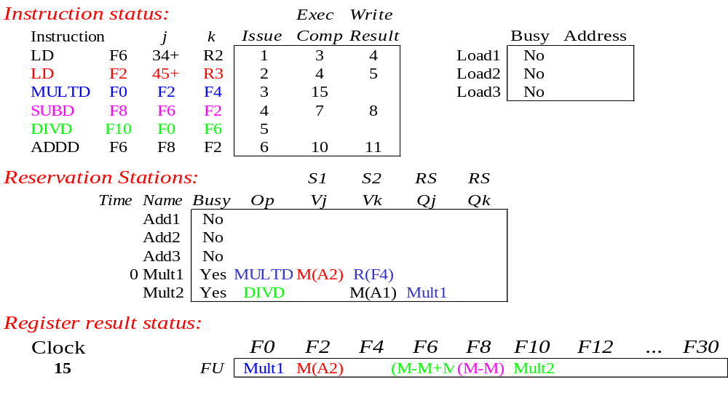
Tomasulo Example Cycle 15

Slide 29
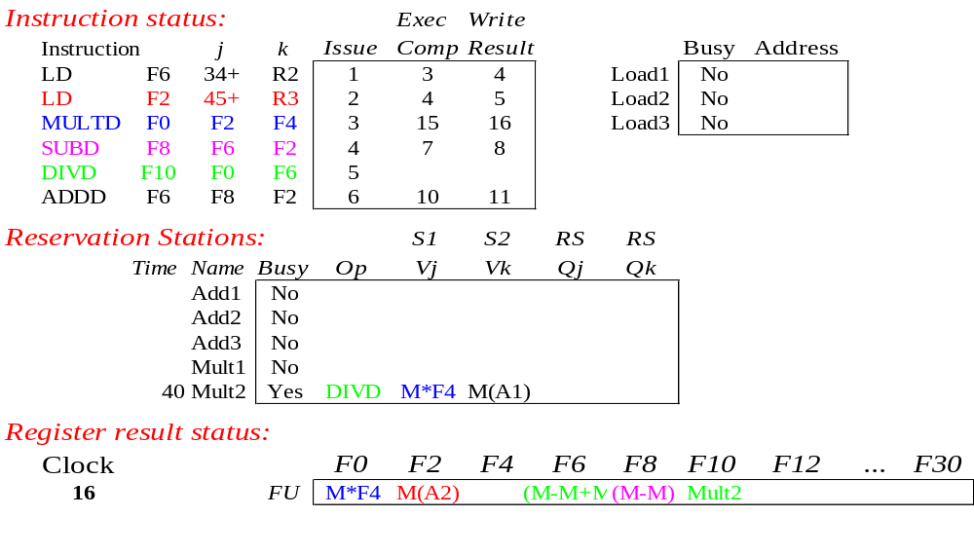
Tomasulo Example Cycle 16

Slide 30
Faster than light computation
(skip a couple of cycles)

Slide 31
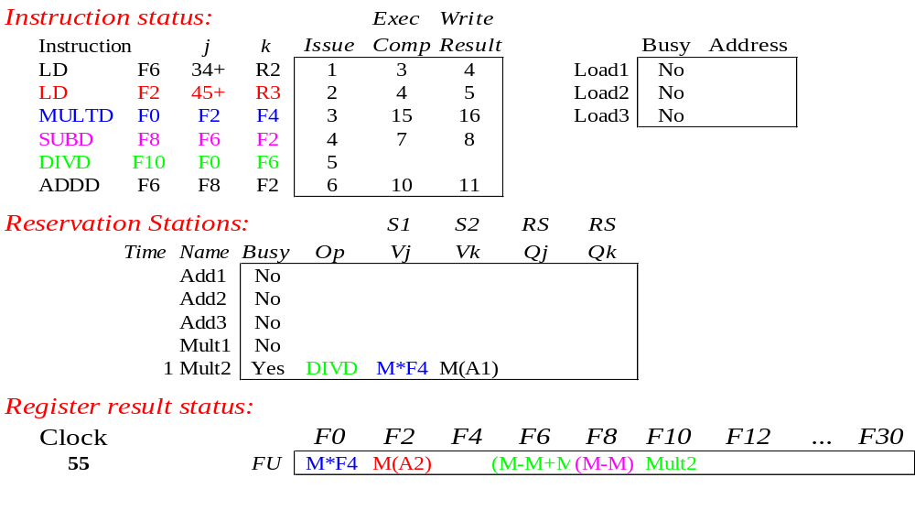
Tomasulo Example Cycle 55

Slide 32
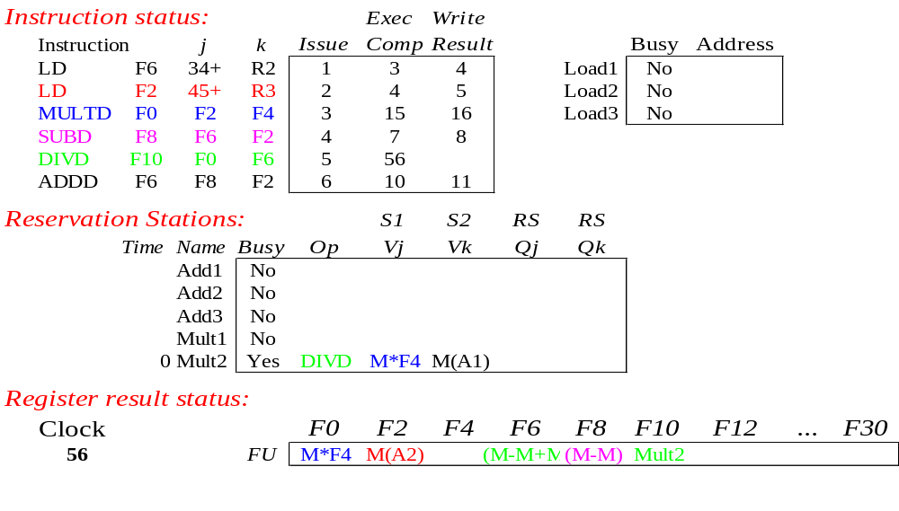
Tomasulo Example Cycle 56
Mult2 is completing; what is waiting for it?

Slide 33
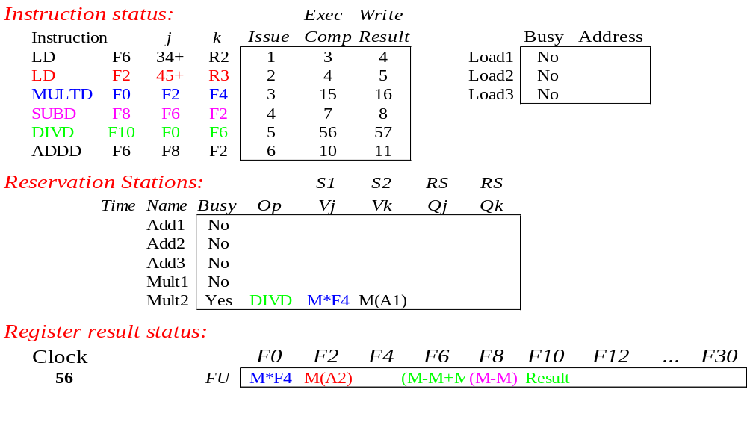
Tomasulo Example Cycle 57
Once again: In-order issue, out-of-order execution and completion.

Slide 34
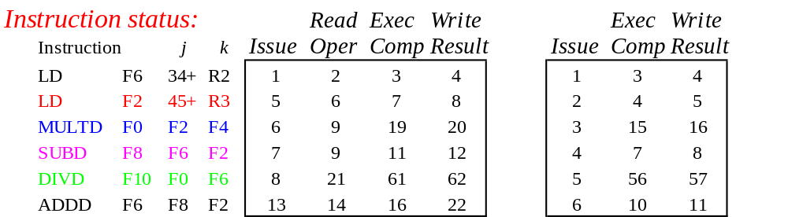
Compare to Scoreboard Cycle 62
Why take longer on scoreboard/6600?
  Structural Hazards
  Lack of forwarding

Slide 35
Tomasulo v. Scoreboard
(IBM 360/91 v. CDC 6600)
Pipelined Functional Units Multiple Functional Units
(6 load, 3 store, 3+, 2x/÷) (1 load/store, 1+, 2x, 1÷)
window size: ≤ 14 instructions ≤ 5 instructions
No issue on structural hazard same
WAR: renaming avoids stall completion
WAW: renaming avoids stall issue
Broadcast results from FU Write/read registers
Control: reservation stations central scoreboard

Slide 36
Tomasulo Drawbacks
Complexity
  delays of 360/91, MIPS 10000, IBM 620?
Many associative stores (CDB) at high speed
Performance limited by Common Data Bus
  Each CDB must go to multiple functional units ⇒high capacitance, high wiring density
  Number of functional units that can complete per cycle limited to one!
    Multiple CDBs ⇒ more FU logic for parallel assoc stores
Non-precise interrupts!
  We will address this later

Slide 37
CS 252 Administrivia
Check Class List and Telebears and make sure that you are (1) in the class and (2) officially registered.
Textbook Reading for Lectures 6 to 8
  Computer Architecture: A Quantitative Approach, Chapter 4, Appendix B
Assignment from book coming up soon….

Slide 38
Tomasulo Loop Example
Loop: LD F0 0 R1
MULTD F4 F0 F2
SD F4 0 R1
SUBI R1 R1 #8
BNEZ R1 Loop
Assume Multiply takes 4 clocks
Assume first load takes 8 clocks (cache miss), second load takes 1 clock (hit)
To be clear, will show clocks for SUBI, BNEZ
Reality: integer instructions ahead

Slide 39
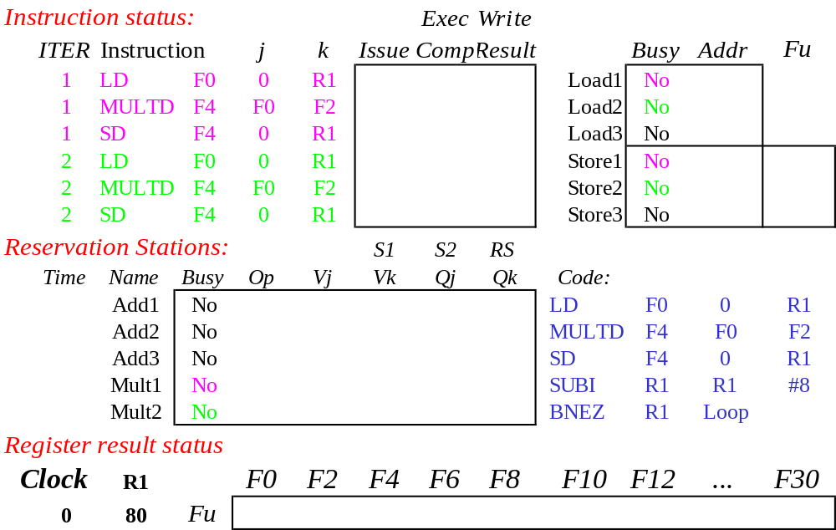
Loop Example

Slide 40
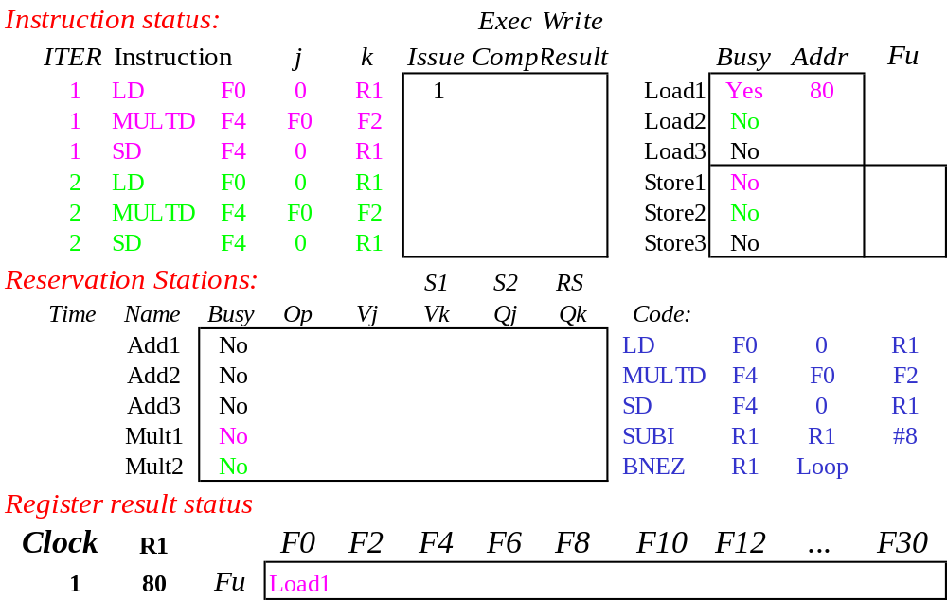
Loop Example Cycle 1

Slide 41
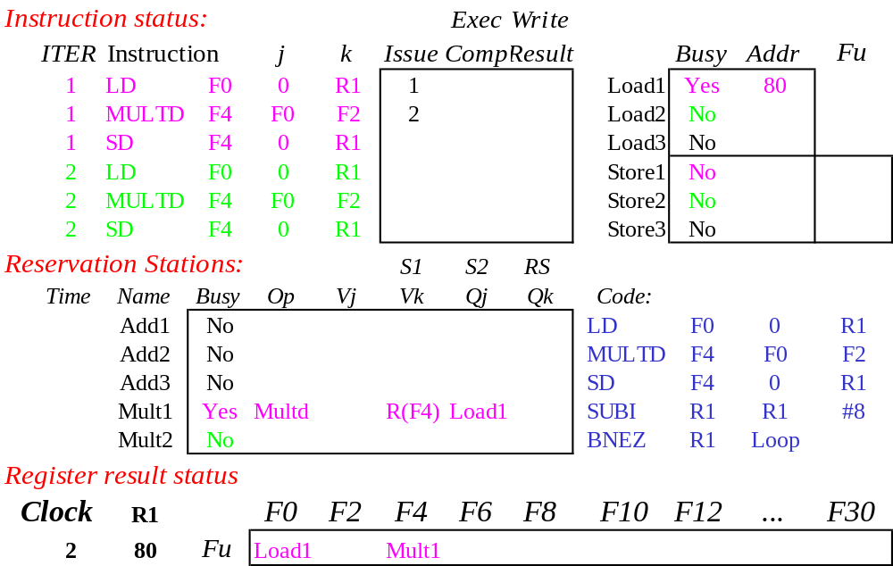
Loop Example Cycle 2

Slide 42
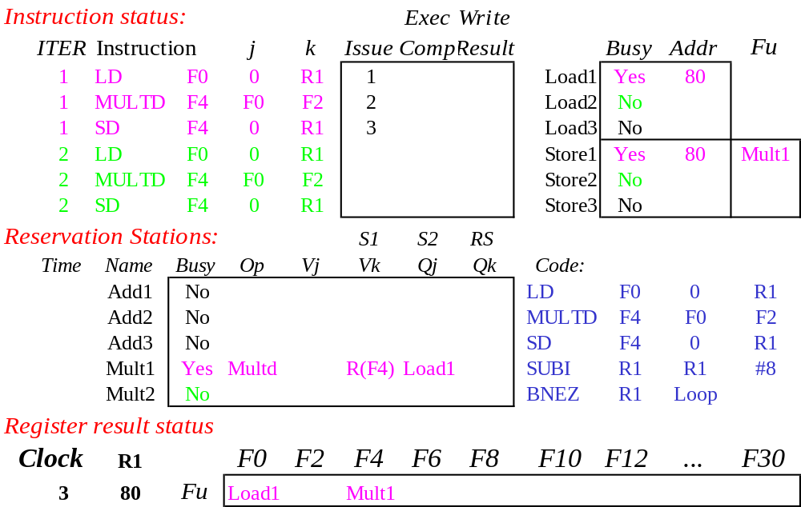
Loop Example Cycle 3
Implicit renaming sets up “DataFlow” graph

Slide 43

Loop Example Cycle 4
Dispatching SUBI Instruction

Slide 44

Loop Example Cycle 5
And, BNEZ instruction

Slide 45
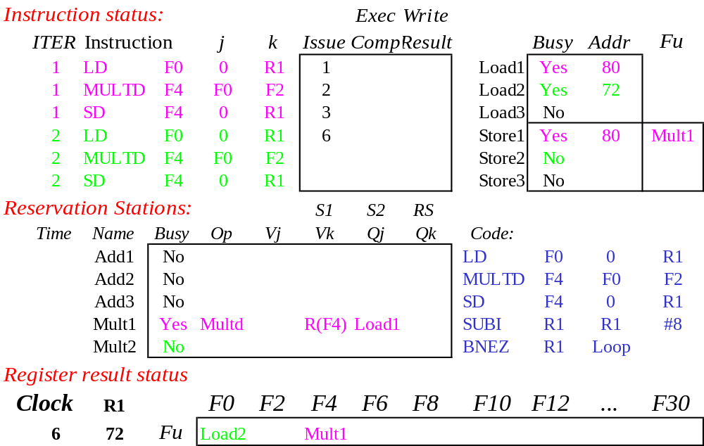
Loop Example Cycle 6
Notice that F0 never sees Load from location 80

Slide 46
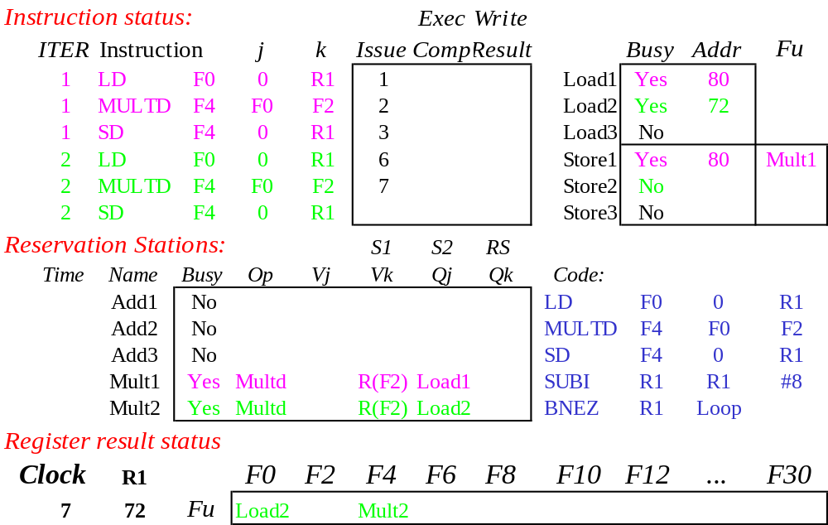
Loop Example Cycle 7
Register file completely detached from computation
First and Second iteration completely overlapped

Slide 47
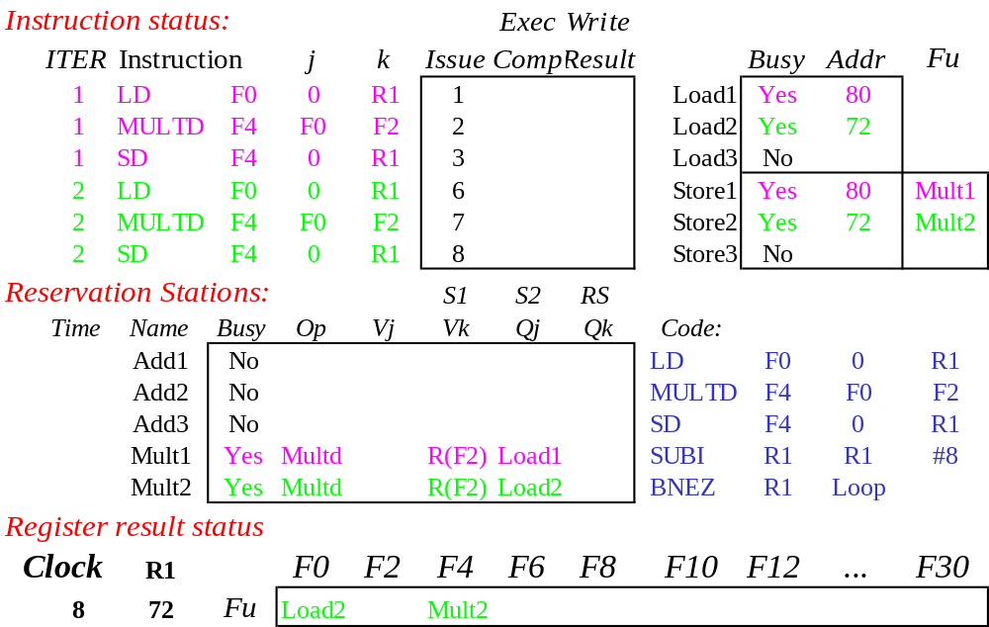
Loop Example Cycle 8

Slide 48

Loop Example Cycle 9
Load1 completing: who is waiting?
Note: Dispatching SUBI

Slide 49
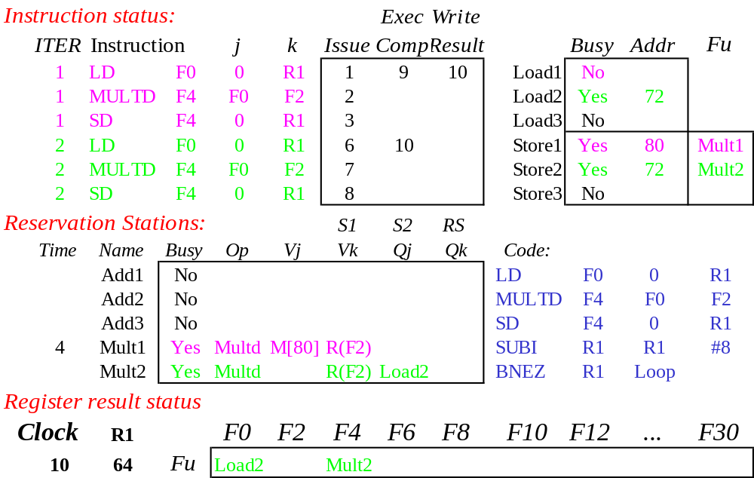
Loop Example Cycle 10
Load2 completing: who is waiting?
Note: Dispatching BNEZ

Slide 50
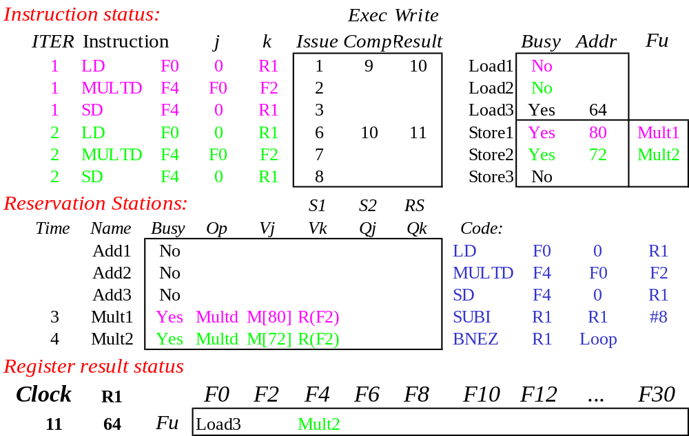
Loop Example Cycle 11
Next load in sequence

Slide 51

Loop Example Cycle 12
Why not issue third multiply?

Slide 52

Loop Example Cycle 13

Slide 53
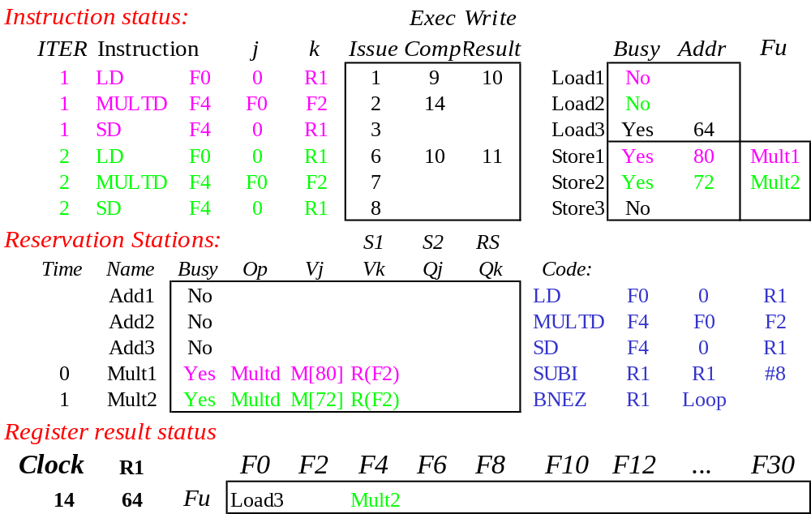
Loop Example Cycle 14
Mult1 completing. Who is waiting?

Slide 54
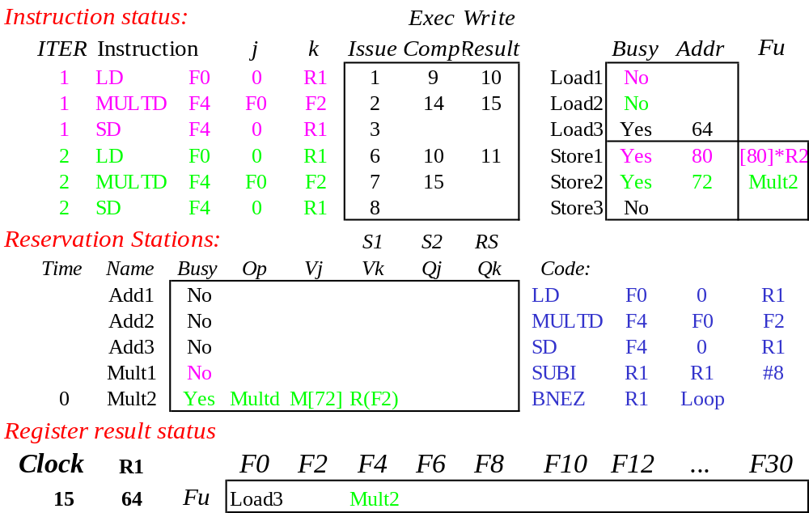
Loop Example Cycle 15
Mult2 completing. Who is waiting?

Slide 55
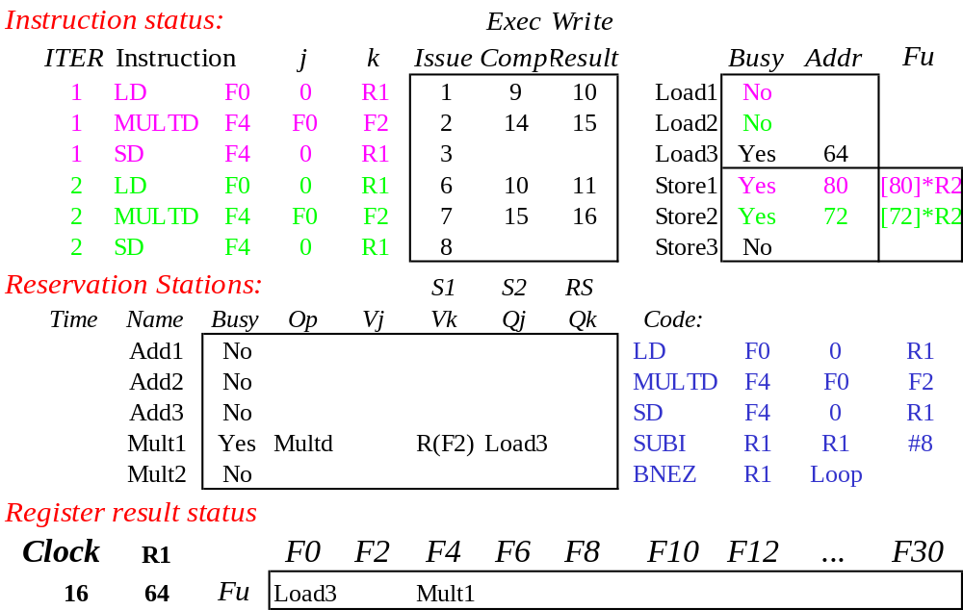
Loop Example Cycle 16

Slide 56
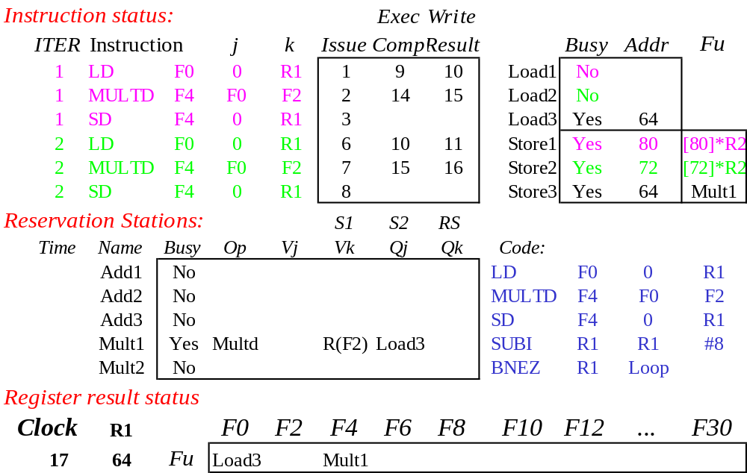
Loop Example Cycle 17

Slide 57

Loop Example Cycle 18

Slide 58
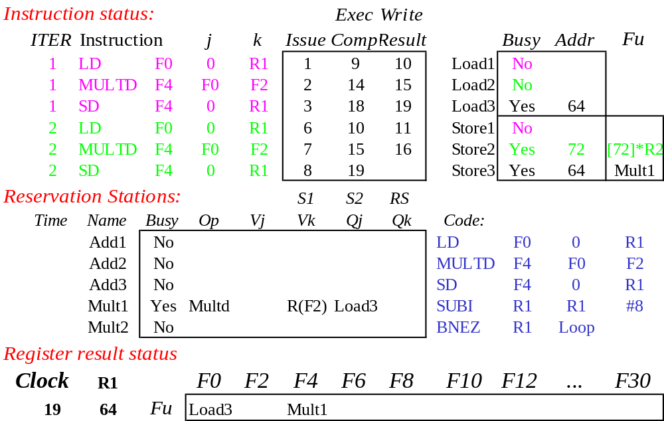
Loop Example Cycle 19

Slide 59
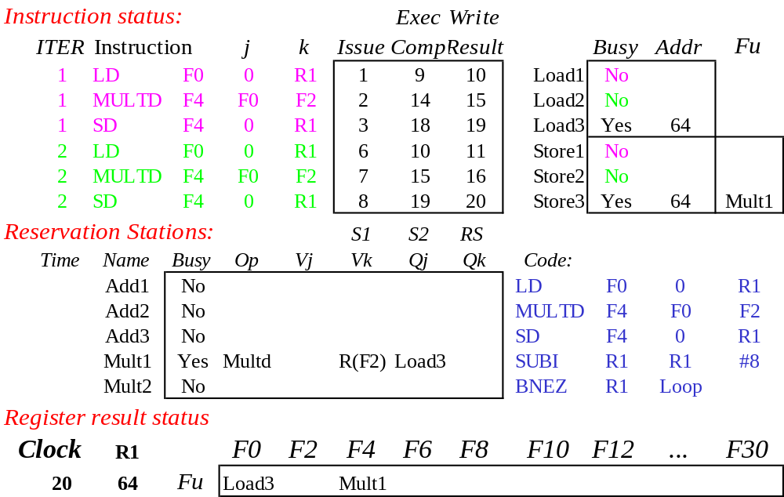
Loop Example Cycle 20

Slide 60
Why can Tomasulo overlap iterations of loops?
Register renaming
  Multiple iterations use different physical destinations for registers (dynamic loop unrolling).
Reservation stations
  Permit instruction issue to advance past integer control flow operations
  Also buffer old values of registers - totally avoiding the WAR stall that we saw in the scoreboard.
Other idea: Tomasulo building “DataFlow” graph on the fly.

Slide 61
Data-Flow Architectures
Basic Idea: Hardware respresents direct encoding of compiler dataflow graphs:
Data flows along arcs in
“Tokens”.
When two tokens arrive at
compute box, box “fires” and
produces new token.
Split operations produce copies
of tokens
Input: a,b
y:= (a+b)/x
x:= (a*(a+b))+b
output: y,x
A
B
+
*
/
+
X(0)
Y
X

Slide 62
Paper by Dennis and Misunas
Operation
Unit 0
Operation
Unit m-1
Instruction Cell
Instruction
Instruction
Cell 0
Operand 1
Operation
Packet
Instruction
Cell 1
Data Packets
Operand 2
Memory
Instruction
Cell n-1
“Reservation Station?”

Slide 63
Brief, In-class discussion of
Monsoon

Slide 64
What about Precise Interrupts?
Both Scoreboard and Tomasulo have:
In-order issue, out-of-order execution, and out-of-order completion
Need to “fix” the out-of-order completion aspect so that we can find precise breakpoint in instruction stream.

Slide 65
Relationship between precise interrupts and specultation:
Speculation is a form of guessing.
Important for branch prediction:
  Need to “take our best shot” at predicting branch direction.
  If we issue multiple instructions per cycle, lose lots of potential instructions otherwise:
    Consider 4 instructions per cycle
    If take single cycle to decide on branch, waste from 4 - 7 instruction slots!
If we speculate and are wrong, need to back up and restart execution to point at which we predicted incorrectly:
  This is exactly same as precise exceptions!
Technique for both precise interrupts/exceptions and speculation: in-order completion or commit

Slide 66
HW support for precise interrupts
Need HW buffer for results of uncommitted instructions: reorder buffer
  3 fields: instr, destination, value
  Reorder buffer can be operand source => more registers like RS
  Use reorder buffer number instead of reservation station when execution completes
  Supplies operands between execution complete & commit
  Once operand commits,
  result is put into register
  Instructions commit
  As a result, easy to undo speculated instructions
  on mispredicted branches
  or on exceptions
Reorder
Buffer
FP
Op
Queue
FP Regs
Res Stations
Res Stations
FP Adder
FP Adder

Slide 67
Four Steps of Speculative Tomasulo Algorithm
1. Issue—get instruction from FP Op Queue
  If reservation station and reorder buffer slot free, issue instr & send operands & reorder buffer no. for destination (this stage sometimes called “dispatch”)
2. Execution—operate on operands (EX)
  When both operands ready then execute; if not ready, watch CDB for result; when both in reservation station, execute; checks RAW (sometimes called “issue”)
3. Write result—finish execution (WB)
  Write on Common Data Bus to all awaiting FUs
  & reorder buffer; mark reservation station available.
4. Commit—update register with reorder result
  When instr. at head of reorder buffer & result present, update register with result (or store to memory) and remove instr from reorder buffer. Mispredicted branch flushes reorder buffer (sometimes called “graduation”)

Slide 68
What are the hardware complexities with reorder buffer (ROB)?
Compar network
Reorder
Buffer
FP
Op
Queue
Program Counter
Exceptions?
Dest Reg
FP Regs
Result
Valid
Reorder Table
Res Stations
Res Stations
FP Adder
FP Adder
How do you find the latest version of a register?
  As specified by Smith paper, need associative comparison network
  Could use future file or just use the register result status buffer to track which specific reorder buffer has received the value
Need as many ports on ROB as register file

Slide 69
Summary #1
Reservations stations: implicit register renaming to larger set of registers + buffering source operands
  Prevents registers as bottleneck
  Avoids WAR, WAW hazards of Scoreboard
  Allows loop unrolling in HW
Not limited to basic blocks
(integer units gets ahead, beyond branches)
Helps cache misses as well
Lasting Contributions
  Dynamic scheduling
  Register renaming
  Load/store disambiguation
360/91 descendants are Pentium II; PowerPC 604; MIPS R10000; HP-PA 8000; Alpha 21264

