Slide 1
Module 2:
Introduction to UML
Background
What is UML for?
Building blocks of UML
Appendix:
  Architecture & Views
  Process for Using UML

Slide 2
UML History
OO languages appear mid 70’s to late 80’s (cf. Budd: communication and complexity)
Between ’89 and ’94, OO methods increased from 10 to 50.
Unification of ideas began in mid 90’s.
    Rumbaugh joins Booch at Rational ’94
  v0.8 draft Unified Method ’95
    Jacobson joins Rational ’95
  UML v0.9 in June ’96
  UML 1.0 offered to OMG in January ’97
  UML 1.1 offered to OMG in July ’97
    Maintenance through OMG RTF
  UML 1.2 in June ’98
  UML 1.3 in fall ’99
  UML 1.5 http://www.omg.org/technology/documents/formal/uml.htm
  UML 2.0 underway http://www.uml.org/
IBM-Rational now has Three Amigos
  Grady Booch - Fusion
  James Rumbaugh – Object Modeling Technique (OMT)
  Ivar Jacobson – Object-oriented Software Engineering: A Use Case Approach (Objectory)
  ( And David Harel - StateChart)
Rational Rose http://www-306.ibm.com/software/rational/
pre-UML
UML 1.x
UML 2.0

Slide 3
Unified Modeling Language (UML)
An effort by IBM (Rational) – OMG to standardize OOA&D notation
Combine the best of the best from
  Data Modeling (Entity Relationship Diagrams);
  Business Modeling (work flow); Object Modeling
  Component Modeling (development and reuse - middleware, COTS/GOTS/OSS/…:)
Offers vocabulary and rules for communication
Not a process but a language
de facto industry standard
Notes:
Redun; simpler

Slide 4





UML is for Visual Modeling
A picture is worth a thousand words!
- standard graphical notations: Semi-formal
- for modeling enterprise info. systems, distributed Web-based applications, real time embedded systems, …
Sales
Representative
Places Order
Customer
Fulfill Order
Item
Business Process
via
Ships the Item
- Specifying & Documenting: models that are precise, unambiguous, complete
  UML symbols are based on well-defined syntax and semantics.
  analysis, architecture/design, implementation, testing decisions.
- Construction: mapping between a UML model and OOPL.

Slide 5
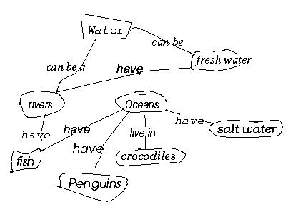
Three (3) basic building blocks of UML (cf. Harry)
Water
have
Fresh water
Rivers
Oceans
have
have
live in
Salt water
have
Fish
have
Crocodiles
Penguins
  Things - important modeling concepts
  Relationships - tying individual things
  Diagrams - grouping interrelated collections of things and relationships
Just glance thru
for now

Slide 6
3 basic building blocks of UML - Things
UML 1.x
  Structural — nouns/static of UML models (irrespective of time).
  Behavioral — verbs/dynamic parts of UML models.
  Grouping — organizational parts of UML models.
  Annotational — explanatory parts of UML models.
Main

Slide 7
Structural Things in UML- 7 Kinds (Classifiers)
Nouns.
Conceptual or physical elements.
Active Class
(processes/threads)
Component
Interface
Node
Class
(replaceable part,
realizes interfaces)
(collection of externally
Visible ops)
(computational
resource at run-time,
processing power
w. memory)
Student
std_id
grade
changeLevel( )
setGrade( )
getGrade( )
Event Mgr
thread
time
Start
suspend( )
stop( )
Course.cpp
IGrade
<<interface>>
IGrade
UnivWebServer
setGrade()
getGrade()
Manage Course
Registration
Register
for Courses
Use Case
Collaboration
(a system service
sequence of
Interactions w. actor)
(chain of responsibility
shared by a web of interacting objects,
structural and behavioral)

Slide 8
Behavioral Things in UML
Verbs.
Dynamic parts of UML models: “behavior over time”
Usually connected to structural things.
Two primary kinds of behavioral things:
Interaction
a set of objects exchanging messages, to accomplish a specific purpose.
harry: Student
ask-for-an-A
katie: Professor
name = “Harry Kid”
name = “Katie Holmes”
State Machine
specifies the sequence of states an object or an interaction goes through during its lifetime in response to events.
received-an-A/
buy-beer
inStudy
inParty
sober/turn-on-PC

Slide 9
Grouping Things in UML: Packages
- For organizing elements (structural/behavioral) into groups.
- Purely conceptual; only exists at development time.
- Can be nested.
- Variations of packages are: Frameworks, models, & subsystems.
University Administration
Course Manager
Course Manager
Student Admission
-Student
+Department
Annotational Things in UML: Note
- Explanatory/Comment parts of UML models - usually called adornments
- Expressed in informal or formal text.
flexible
drop-out dates
operation()
{for all g in children
g.operation()
}

Slide 10
3 basic building blocks of UML - Relationships
Student
University
attends
1. Associations
Structural relationship that describes a set of links, a link being a connection between objects. (UML2.0: The semantic relationship between two or more classifiers that involves connections among their instances.)
variants: aggregation & composition
Student
Person
2. Generalization
a specialized element (the child) is more specific the generalized element.
Student
3. Realization
one element guarantees to carry out what is expected by the other element.
(e.g, interfaces and classes/components; use cases and collaborations)
IGrade
harry: Student
Student
<<instanceOf>>
4. Dependency
a change to one thing (independent) may affect the semantics of the other thing (dependent).
(direction, label are optional)

Slide 11
3 basic building blocks of UML - Diagrams
A connected graph: Vertices are things; Arcs are relationships/behaviors.
UML 1.x: 9 diagram types.
UML 2.0: 12 diagram types
Structural Diagrams
Represent the static aspects of a system.
  Class;
  Object
  Component
  Deployment
Structural Diagrams
  Class;
  Object
  Component
  Deployment
  Composite Structure
  Package
Behavioral Diagrams
Represent the dynamic aspects.
  Use case
  Sequence;
  Collaboration
  Statechart
  Activity
Behavioral Diagrams
  Use case
  Statechart
  Activity
Interaction Diagrams
  Sequence;
  Communication
  Interaction Overview
  Timing

Slide 12
Diagrams in UML
The UTD wants to computerize its registration system
The Registrar sets up the curriculum for a semester
Students select 3 core courses and 2 electives
Once a student registers for a semester, the billing system is
notified so the student may be billed for the semester
Students may use the system to add/drop courses
for a period of time after registration
Professors use the system to set their preferred course offerings
and receive their course offering rosters after students register
Users of the registration system are assigned passwords
which are used at logon validation
What’s most important?

Slide 13
Diagrams in UML – Actors in Use Case Diagram
An actor is someone or some thing that must interact with the system under development
The UTD wants to computerize its registration system
The Registrar sets up the curriculum for a semester
Students select 3 core courses and 2 electives
Once a student registers for a semester, the billing system is
notified so the student may be billed for the semester
Students may use the system to add/drop courses
for a period of time after registration
Professors use the system to set their preferred course offerings
and receive their course offering rosters after students register
Users of the registration system are assigned passwords
which are used at logon validation
Registrar
Student
Billing System
Professor

Slide 14
Diagrams in UML – Use Cases in Use Case Diagram
A use case is a sequence of interactions between an actor and the system
Maintain
Curriculum
The UTD wants to computerize its registration system
The Registrar sets up the curriculum for a semester
Students select 3 core courses and 2 electives
Once a student registers for a semester, the billing system is
notified so the student may be billed for the semester
Students may use the system to add/drop courses
for a period of time after registration
Professors use the system to set their preferred course offerings
and receive their course offering rosters after students register
Users of the registration system are assigned passwords
which are used at logon validation
Register
for Courses
Registrar
Student
Billing System
Request
Course Roster
Set
Course Offerings
Professor

Slide 15
Diagrams in UML – Use Case Diagram
Use case diagrams depict the relationships between actors and use cases
UTD Registration System
system boundary
Maintain
Curriculum
Registrar
Register
for Courses
Billing System
Student
Manage
Seminar
Request
Course Roster
Set
Course Offerings
Anything wrong?
Professor

Slide 16
Diagrams in UML - Uses and Extends in Use Case Diagram
A uses relationship shows behavior common to one or more use cases
An extends relationship shows optional/exceptional behavior
<<extends>>
<<uses>>
Register for courses
Register for
Distance Learning courses
<<uses>>
Logon validation
<<uses>>
Maintain curriculum
Create course
<<uses>>
Maintain Schedule

Slide 17
Diagrams in UML – Flow of Events for each use case:
Typical contents:
How the use case starts and ends
Normal flow of events (focus on the normal first!) Alternate/Exceptional flow of events
Flow of Events for Creating a Course
Registrar
Create Course
This use case begins after the Registrar logs onto the Registration System with a valid password.
The registrar fills in the course form with the appropriate semester and course related info.
The Registrar requests the system to process the course form.
The system creates a new course, and this use case ends

Slide 18
Diagrams in UML – Interaction Diagrams
A use case diagram presents an outside view of the system.
Then, how about the inside view of the system?
Interaction diagrams describe how use cases are realized
in terms of interacting objects.
Two types of interaction diagrams
  Sequence diagrams
  Collaboration (Communication) diagrams
Notes:
Execution of these two concurrent substates continues in parallel.

Slide 19
Diagrams in UML - Sequence Diagram
A sequence diagram displays object interactions arranged in a time sequence
course form :
theManager :
Registrar
Create Course
: Registrar
CourseForm
CurriculumManager
This use case begins after the Registrar logs onto the Registration System with a valid password.
The registrar fills in the course form with the appropriate semester and course related info.
The Registrar requests the system to process the course form.
The system creates a new course, and this use case ends
1: set course info
2: request processing
3: add course
4: <<create>>
aCourse :
Course
Traceability!

Slide 20
Diagrams in UML – Collaboration (Communication)
Displays object interactions organized around objects and their direct links to one another.
Emphasizes the structural organization of objects that send and receive messages.
1: set course info
course form:
course form :
theManager :
2: request processing
CourseForm
: Registrar
CourseForm
CurriculumManager
1: set course info
2: request processing
: Registrar
3: add course
3: add course
4: <<create>>
aCourse:
Course
theManager :
aCourse:
CurriculumManager
Course
4: <<create>>
Traceability!

Slide 21
Diagrams in UML – Collaboration (Communication)
What would be the corresponding collaboration diagram?
: Student
registration
registration
math 101
math 101
form
manager
section 1
1: fill in info
2: submit
3: add course(Sue, math 01)
4: are you open?
5: are you open?
6: add (Sue)
7: add (Sue)
Which use case could this be for? How about <---- (see M3.2)

Slide 22
Skip the following for now: In M3.2

Slide 23
Sequence Diagrams & Some Programming
:Selection
:Purchase
purchase
buyMajor
buyMinor
create(cashTender)
:Payment
public Class Selection
{ private Purchase myPurchase = new Purchase();
private Payment myPayment;
public void purchase()
{ myPurchase.buyMajor();
myPurchase.buyMinor():
myPayment = new Payment( cashTender );
//. .
}
// . .
}

Slide 24
Interactions - Modeling Actions
Simple
Call
Return
Send
asynchronous in 2.0 (stick arrowhead) – no return value expected at end of callee activation
activation of caller may end before callee’s
half arrow in 1.x
c : Client
1
p : PlanningAgent
: TicketAgent
<<create>>
actual parameter
setItenerary( i )
calculateRoute()
loop
return
route
return value
call on self
for each conference
<<destroy>>
X
end of object life
notify()
send
destroy: e.g., in C++ manual garbage collection; in Java/C#, unnecessary
natural death/
self destruction

Slide 25
linking sequence diagrams
Sequence Diagrams – Generic vs. Instance
2 forms of sd:
  Instance sd: describes a specific scenario in detail; no conditions, branches or loops.
  Generic sd: a use case description with alternative courses.
ob3:C3
ob3:C3
ob3:C3
ob3:C3
op1
ob1:C1
[x>0] foo(x)
ob2:C2
conditional
concurrent lifelines
for conditionals
for concurrency
[x<0] bar(x)
do(z)
do(w)
[z=0] jar(z)
[z=0] jar(z)
recurse()
recursion
Here, conditional or concurrency?

Slide 26
Interaction Diagram: sequence vs communication
objects
p : StockQuotePublisher
s1 : StockQuoteSubscriber
s2 : StockQuoteSubscriber
object
role:ClassName
classifiers or their instances,
use cases or actors.
attach(s1)
attach(s2)
Procedure call, RMI, JDBC, …
Observer
design
pattern
Time
notify()
update()
{update < 1 minutes}
Activations
- Show duration of execution
- Shows call stack
- Return message
  Implicit at end of activation
  Explicit with a dashed arrow
getState()
update()
getState()
3 : notify()
4 : update()
s1 : StockQuoteSubscriber
1 : attach(s1)
6 : getState()
p : StockQuotePublisher
5 : update()
s2 : StockQuoteSubscriber
2 : attach(s2)
7 : getState()

Slide 27
Skip end: resume

Slide 28
Diagrams in UML - Class Diagrams
A class diagram shows the existence of classes and their relationships
Recall: A class is a collection of objects with common structure, common behavior, common relationships and common semantics
Some classes are shown through the objects in sequence/collaboration diagram
theManager :
CurriculumManager
Course
CurriculumManager
4: <<create>>
aCourse :
Course
Traceability!
registration
registration
RegistrationManager
form
manager
3: add course(Sue, math 01)
addCourse(Student,Course)

Slide 29
Diagrams in UML - Class Diagrams: static structure in the system
Naming & (often) 3 Sections;
Inheritance (as before);
Relationships - Multiplicity and Navigation
CurriculumManager
ScheduleAlgorithm
1
RegistrationForm
0..*
1
RegistrationManager
0..*
addStudent(student, course)
1
Course
0..*
name
User
numberCredits
name
Student
open()
major
addStudent(StudentInfo)
1
1..10
Professor
1..*
4
CourseOffering
tenureStatus
1
location
Reading?
0..4
open()
addStudent(StudentInfo)

Slide 30
Diagrams in UML – Object Diagrams
Shows a set of objects and their relationships.
As a static snapshot.
harry: Student
ooad06S: Course
name = “OOAD”
name = “Harry Kid”
katie: Professor
ooado: CourseOffering
name = “Katie Holmes”
location = “Fujitsu”
Anything wrong?
arch06F: Course
tom: Student
harry1: Professor
name = “Sw Architecture”
name = “Harry William”
name = “Tom Cruise”
alg06F: Course
surie: Professor
arch: CourseOffering
name = “Adv Algorithms”
name = “Surie Holmes”
location = “UTD”

Slide 31
Diagrams in UML – Object Diagrams
Prepare a UML class diagram with all the needed classes and relationships,
as precisely as possible, from the instance diagram below:
spouse
spouse
aGrandmother: Person
aGrandfather: Person
aGrandma: Person
aGrandpa: Person
owner
child
child
child
child
aFather: Person
spouse
aMother: Person
child
child
you: Person
Any issues?

Slide 32
Diagrams in UML – State Transition Diagram (Statechart Diagram)
The life history (often of a given class: from class to object behavior)
States, transitions, events that cause a transition from one state to another
Actions that result from a state change
initial
(internal)
condition
event/action
Add student [count < 10]
state
Add Student /
Initialization
Set count = 0
State name
Open
do: Initialize course
entry: Register student
activity
exit: Increment count
Cancel
Cancel
[ count = 10 ]
Canceled
do: Notify registered students
Closed
Cancel
do: Finalize course
final
What life history/class is this for?
What would be the value of “count”, after two(2) students have been added to the course?
Until what stage?

Slide 33
Diagrams in UML – Activity Diagrams
A special kind of statechart diagram that shows the flow from activity to activity.
initial
Initialize course
activity
Add student
fork/spawn
Notify Registrar
Notify Billing
What is this for?
Traceability???
Synchronization
[else]
[ count < 10 ]
guard
Close course
final

Slide 34
Diagrams in UML – Component Diagram
shows the organizations and dependencies among a set of
components (mostly <<uses>>).
In UML 1.1, a component represented implementation items, such as files and executables;
…
( In UML 2.0, a component is a replaceable/reusable, architecture/design-time construct w. interfaces)
Billing.exe
Register.exe
Billing
What is this lollipop?
User
Course
People.dll
Course.dll
Student
Professor
Course
Course
Offering
Student
Professor

Slide 35
Diagrams in UML – Deployment Diagram
shows the configuration of run-time processing elements and the software processes living on them.
visualizes the distribution of components across the enterprise.
Registrar Webserver
Course Oracle Server
Register.exe
Course
Course Offering
RMI, sockets
TCP/IP
wireless
Library Server
Main Building Solaris
People.dll
Billing.exe
Dorm PC
People Database
Student
Professor

Slide 36
3 basic building blocks of UML - Diagrams
Using UML Concepts in a Nutshell
Here, UML 1.x first
(UML 2.0 later)
    Use case
    Sequence;
    Collaboration
    (Communication)
    Class;
    Object
    Statechart
    Activity
    Component
    Deployment
  Display the boundary of a system & its major functions using use cases and actors
  Illustrate use case realizations with interaction diagrams
  Represent a static structure of a system using class diagrams
  Model the behavior of objects with state transition diagrams
  Reveal the physical implementation architecture with component & deployment diagrams
  Extend your functionality with stereotypes

Slide 37
Summary
Background
What is UML for (both 1.x and 2.0)?
for visualizing, specifying, constructing, and documenting models
Building blocks of UML
Things, Relationships (4 kinds) and Diagrams (9 different kinds)

Slide 38
Points to Ponder, for now
What kind of use case diagram is your program for?
List main actors
List main use cases
Associate the actors with the use cases
What kind of class diagram would you need?
List main classes
List main attributes
List main operations, …
Associate classes
Multiplicity
Visibility
Refine relationships
What kind of sequence diagrams would you need?
…

Slide 39
Module 2:
Introduction to UML - Appendix

Slide 40
Extensibility of UML
Stereotypes (<< >>) can be used to extend the UML notational elements
Stereotypes may be used to classify and extend associations, inheritance relationships, classes, and components
Examples:
  Class stereotypes: boundary, control, entity, utility, exception
  Inheritance stereotypes: uses and extends
  Component stereotypes: subsystem
  Stereotypes — extends vocabulary (metaclass in UML metamodel)
  Tagged values — extends properties of UML building blocks (i.e., metamodel)
  Constraints — extend the semantics of UML building blocks.
More on this later

Slide 41
Architectural Blueprints—The “4+1” View Model of Software Architecture
(http://www3.software.ibm.com/ibmdl/pub/software/rational/web/whitepapers/2003/Pbk4p1.pdf, 1995)
UML is for visualizing, specifying, constructing, and documenting with emphasis on system architectures (things in the system and relationships among the things) from five different views
Software architecture = {Elements, Forms, Rationale/Constraints}
Five views:
  the logical view, which is the object model of the design (when an object-oriented design method is used),
  the process view, which captures the concurrency and synchronization aspects of the design,
  the physical view, which describes the mapping(s) of the software onto the hardware and reflects its distributed aspect,
  the development view, which describes the static organization of the software in its development environment.
  The scenario view, which consists of a few selected use cases or scenarios, illustrates the description of an architecture, and also helps it evolve as well.
Logical View
Development View
End user
functionality
programmers
software management
Scenarios
Process View
Physical View
system engineers
topology
communications
integrators
performance
scalabilityty

Slide 42
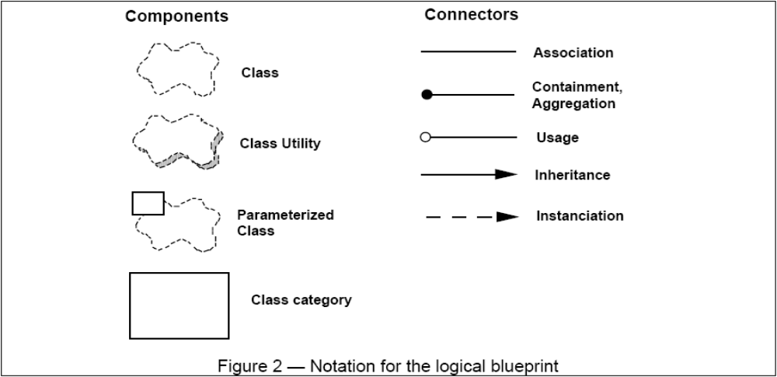
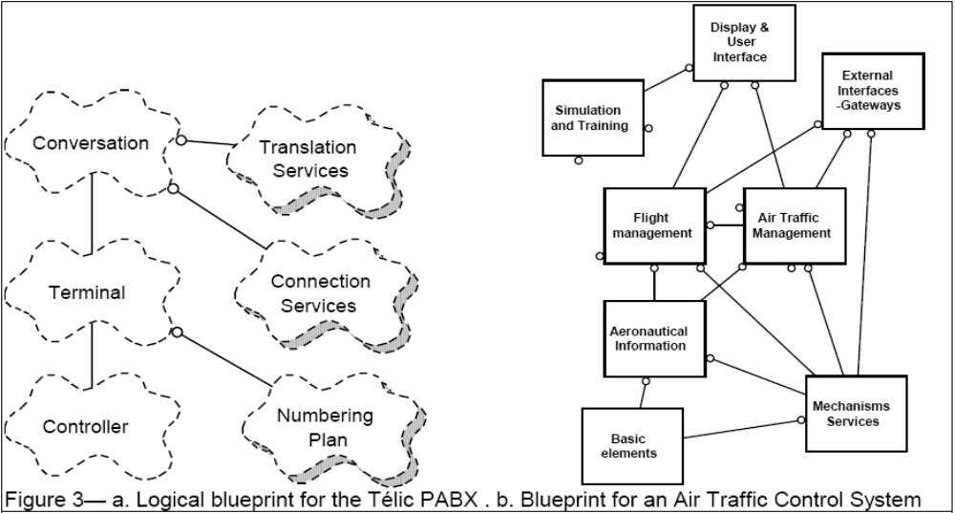
The “4+1” View Model of Software Architecture: Notation and Example

Slide 43
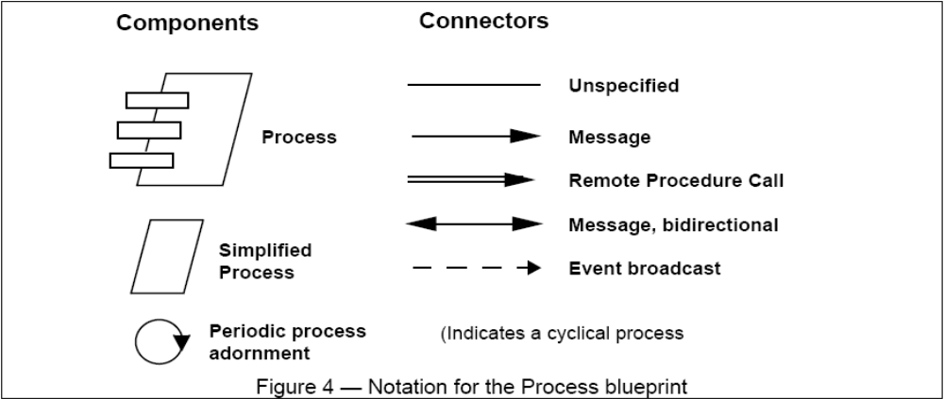
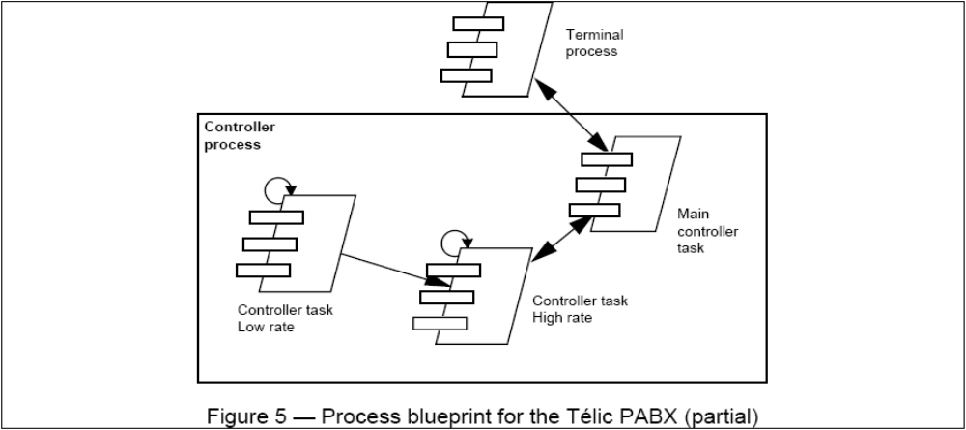
The “4+1” View Model of Software Architecture: Notation and Example

Slide 44
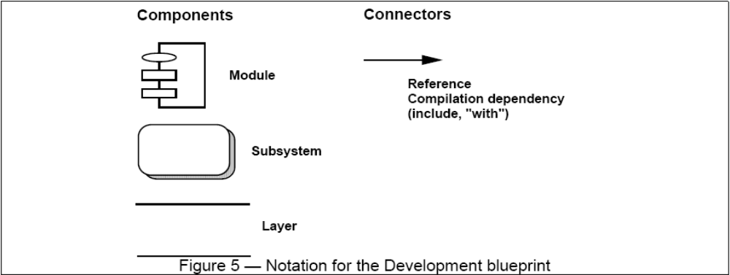
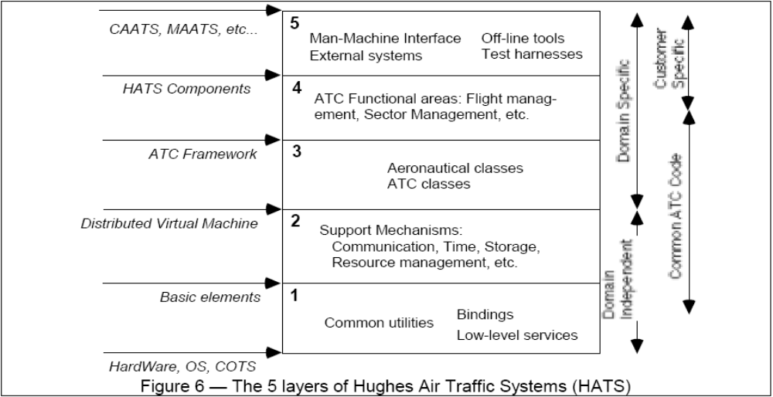
The “4+1” View Model of Software Architecture: Notation and Example

Slide 45
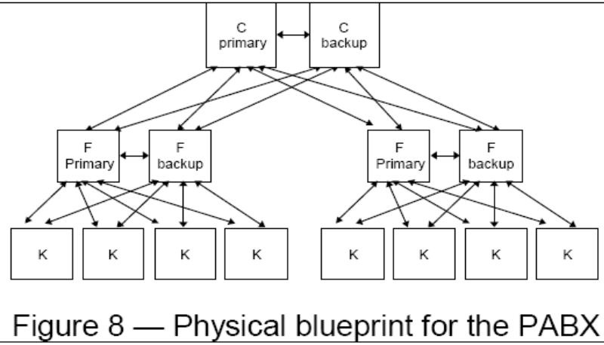
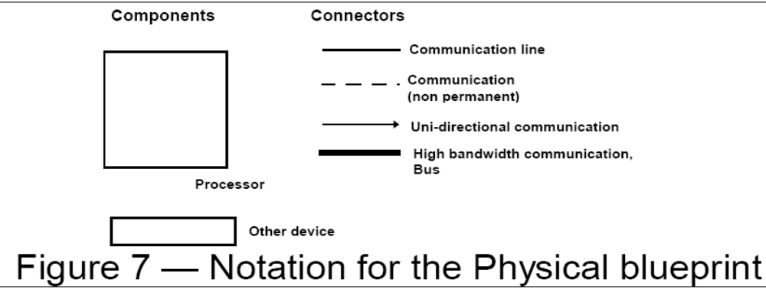
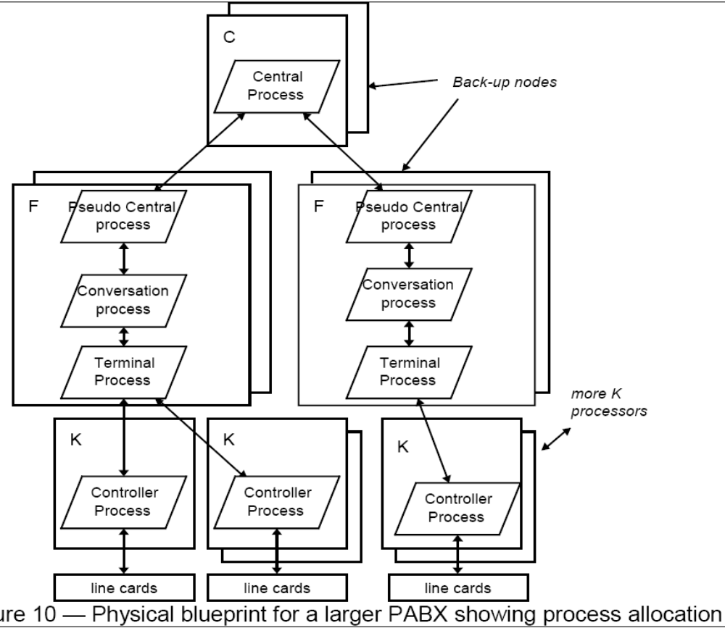
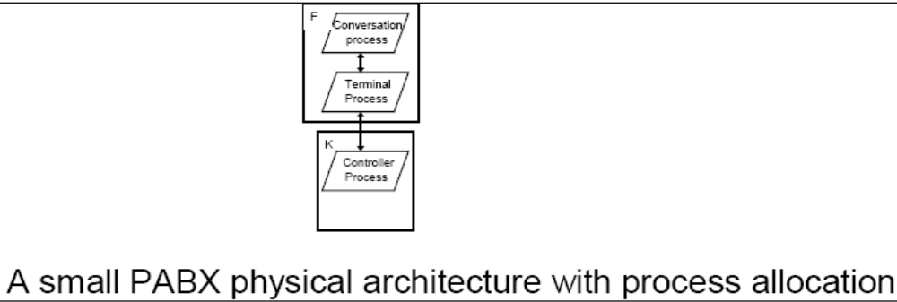
The “4+1” View Model of Software Architecture: Notation and Example

Slide 46
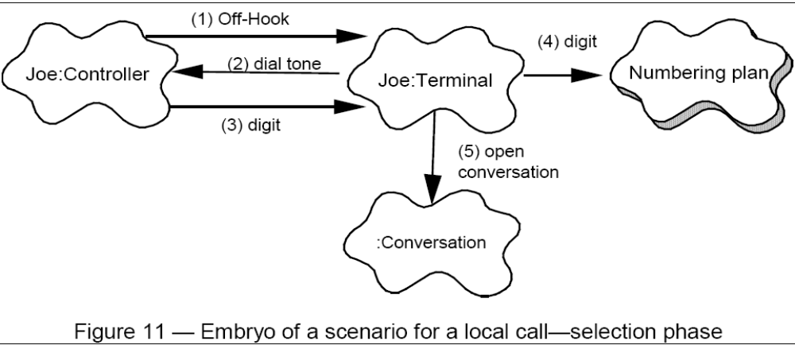
The “4+1” View Model of Software Architecture: Notation and Example

Slide 47
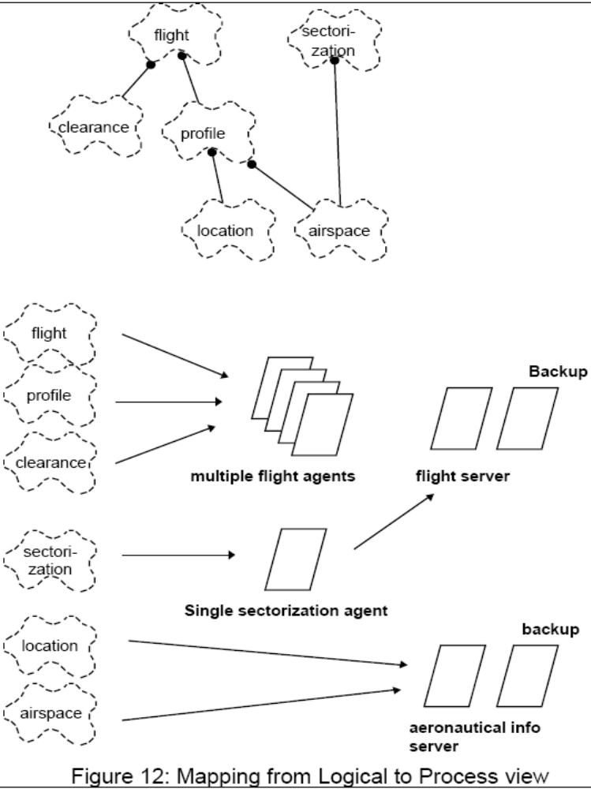
The “4+1” View Model of Software Architecture: Notation and Example

Slide 48
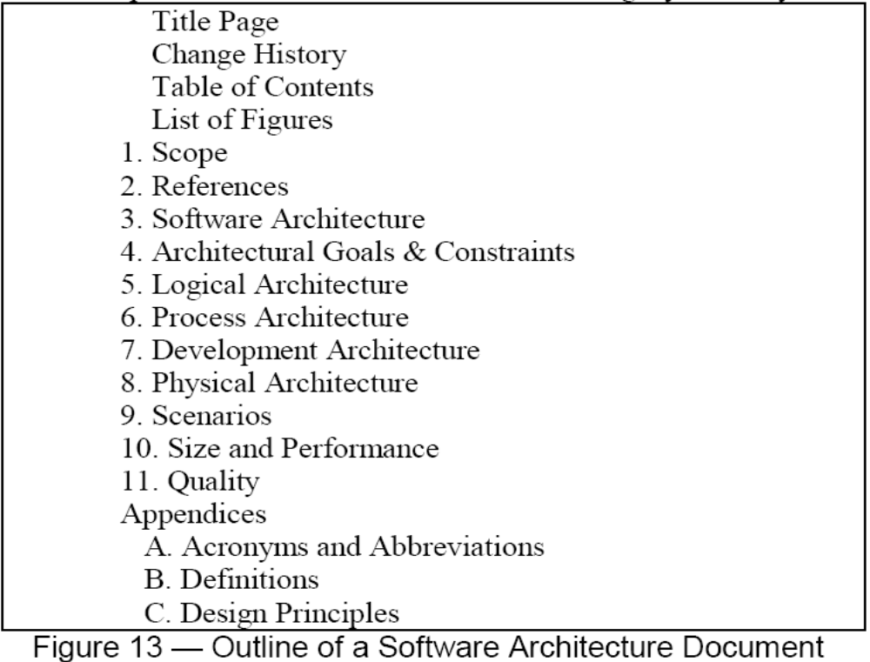
The “4+1” View Model of Software Architecture: Notation and Example

Slide 49
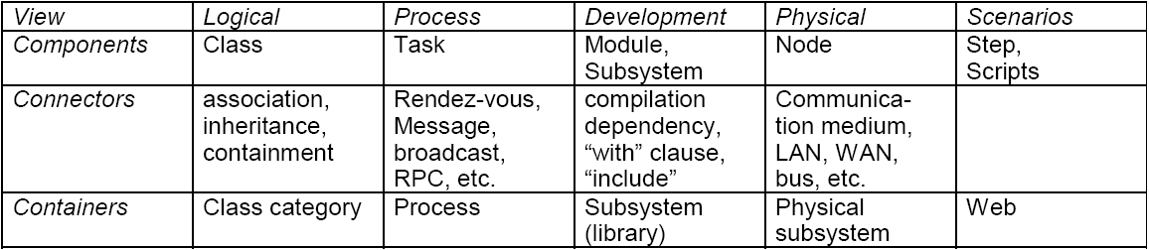
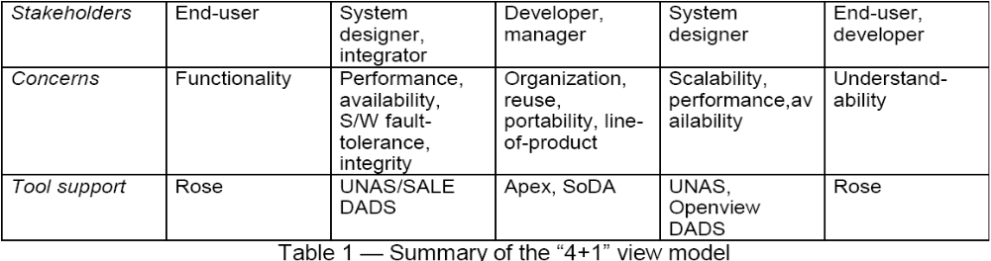
The “4+1” View Model of Software Architecture: Notation and Example

Slide 50
Architecture & Views (You can skip this part on the first reading)
UML is for visualizing, specifying, constructing, and documenting with emphasis on system architectures (things in the system and relationships among the things) from five different views
Architecture - set of significant decisions regarding:
  Organization of a software system.
  Selection of structural elements & interfaces from which a system is composed.
  Behavior or collaboration of elements.
  Composition of structural and behavioral elements.
  Architectural style guiding the system.
Design View
Implementation View
vocabulary
functionality
system assembly
configuration mgmt.
Use Case View
behavior
Process View
Deployment View
system topology
distribution
delivery
installation
performance
scalability
throughput

Slide 51
Views
Use Case View
Use Case Analysis is a technique to capture business process from user’s perspective.
Encompasses the behavior as seen by users, analysts and testers.
Specifies forces that shape the architecture.
Static aspects in use case diagrams; Dynamic aspects in interaction (statechart and activity) diagrams.
Design View
Encompasses classes, interfaces, and collaborations that define the vocabulary of a system.
Supports functional requirements of the system.
Static aspects in class and object diagrams; Dynamic aspects in interaction diagrams.
Process View
Encompasses the threads and processes defining concurrency and synchronization.
Addresses performance, scalability, and throughput.
Static and dynamic aspects captured as in design view; emphasis on active classes.
Implementation View
Encompasses components and files used to assemble and release a physical system.
Addresses configuration management.
Static aspects in component diagrams; Dynamic aspects in interaction diagrams.
Deployment View
Encompasses the nodes that form the system hardware topology.
Addresses distribution, delivery, and installation.
Static aspects in deployment diagrams; Dynamic aspects in interaction diagrams.

Slide 52
Rules of UML
Well formed models — semantically self-consistent and in harmony with all its related models.
Semantic rules for:
  Names — what you can call things.
  Scope — context that gives meaning to a name.
  Visibility — how names can be seen and used.
  Integrity — how things properly and consistently relate to one another.
  Execution — what it means to run or simulate a dynamic model.
Avoid models that are
Elided — certain elements are hidden for simplicity.
Incomplete — certain elements may be missing.
Inconsistent — no guarantee of integrity.

Slide 53
Process for Using UML
How do we use UML as a notation to construct a good model?
Use case driven — use cases are primary artifact for defining behavior of the system.
Architecture-centric — the system’s architecture is primary artifact for conceptualizing, constructing, managing, and evolving the system.
Iterative and incremental — managing streams of executable releases with increasing parts of the architecture included.
The Rational Unified Process (RUP)
Notes:
A well-defined process will guide you in deciding what artifacts to produce, what activities and what workers to use to create them and manage them, and how to use those artifacts to measure and control the project as a whole.

Slide 54
Process for Using UML - Iterative Life Cycle
It is planned, managed and predictable …almost
It accommodates changes to requirements with less disruption
It is based on evolving executable prototypes, not documentation
It involves the user/customer throughout the process
It is risk driven
Primary phases
  Inception — seed idea is brought up to point of being a viable project.
  Elaboration — product vision and architecture are defined.
  (http://www.utdallas.edu/~chung/OOAD_SUMMER04/HACS_vision_12.doc)
  Construction — brought from architectural baseline to point of deployment into user community.
  Transition — turned over to the user community.

Slide 55
Process for Using UML - Iterative Approach
Three Important Features
Continuous integration - Not done in one lump near the delivery date
Frequent, executable releases - Some internal; some delivered
Attack risks through demonstrable progress - Progress measured in products, not documentation or engineering estimates
Resulting Benefits
Releases are a forcing function that drives the development team to closure at regular intervals - Cannot have the “90% done with 90% remaining” phenomenon
Can incorporate problems/issues/changes into future iterations rather than disrupting ongoing production
The project’s supporting elements (testers, writers, toolsmiths, QA, etc.) can better schedule their work

Slide 56
Process for Using UML - Risk Reduction Drives Iterations
Define scenarios to address highest risks
Plan Iteration N
Cost
Schedule
Initial Project Risks
Initial Project Scope
Develop Iteration N
Collect cost and quality metrics
Iteration N
Assess Iteration N
Revise Overall
Project Plan
Cost
Schedule
Scope/Content
Revise Project Risks
Reprioritize
Risks Eliminated

Slide 57
Process for Using UML - Use Cases Drive the Iteration Process
Inception
Elaboration
Construction
Transition
Iteration 1
Iteration 2
Iteration 3
Each iteration is defined in terms of the scenarios it implements
“Mini-Waterfall” Process
Results of previous iterations
Up-to-date risk assessment
Controlled libraries of models, code, and tests
Selected scenarios
Iteration Planning
Reqs Capture
Analysis & Design
Implementation
Test
Release description
Updated risk assessment
Controlled libraries
Prepare Release

Slide 58
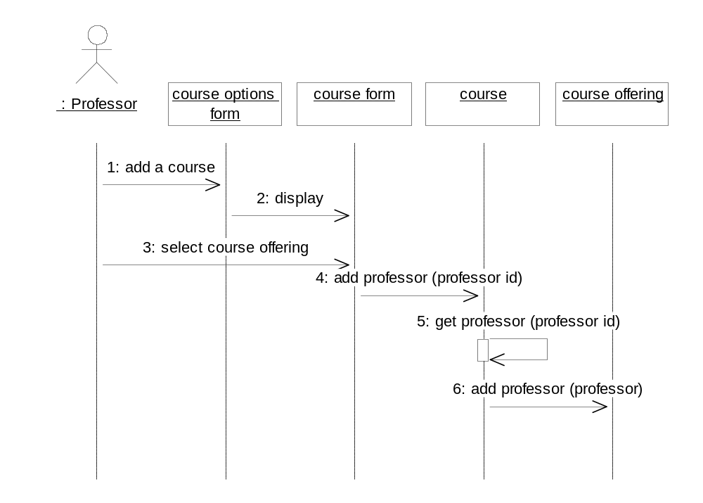
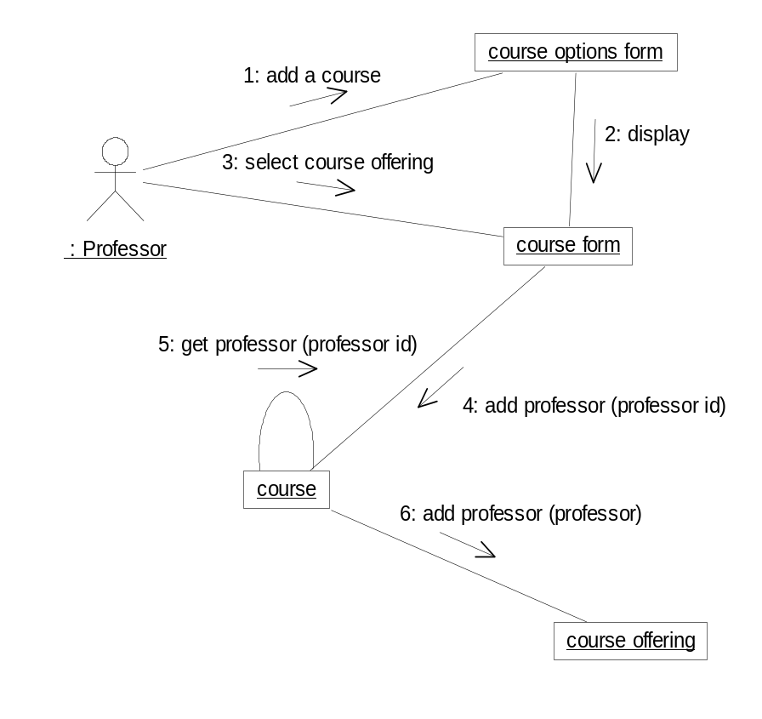
Points to Ponder
Are Sequence and Collaboration Diagrams Isomorphic?

Slide 59
Points to Ponder
How much unification does UML do?
Consider the Object Model Notation on the inside cover on the front and back of the textbook "Object Oriented Modeling and Design" by Rumbaugh, et.al.
List the OMT items that do not exist in UML
List the UML items that do not exist in OMT
For those items of OMT for which UML equivalents exist, map the notation to UML.
Where would you want to use stereotypes?
Model the “Business Process” on page 6 in UML.
Map the four (4) phases of the RUP to the traditional software lifecycle.
If an object refers to a concept, can an object refer to a concept of an concept? Consider some examples.
What would be the essential differences between a property and an attribute? Consider some examples.
What is the syntax and semantics of a class diagram?
In Component-Based Software Engineering (CBSE), components are the units, or building blocks, of a (distributed) software system.
What kind of building blocks of UML can be components for CBSE?

