Slide 1
Chapter 22 – Project Management

Slide 2
Software project management
Concerned with activities involved in ensuring that software is delivered on time and on schedule and in accordance with the requirements of the organisations developing and procuring the software.
Project management is needed because software development is always subject to budget and schedule constraints that are set by the organisation developing the software.

Slide 3
Success criteria
Deliver the software to the customer at the agreed time.
Keep overall costs within budget.
Deliver software that meets the customer’s expectations.
Maintain a coherent and well-functioning development team.

Slide 4
Factors influencing project management
Company size
Software customers
Software size
Software type
Organizational culture
Software development processes
These factors mean that project managers in different organizations may work in quite different ways.

Slide 5
WBS - Definition
A deliverable oriented grouping of project elements which organizes and defines the total scope of the project. Each descending level represents an increasingly detailed definition of a project component.

Slide 6
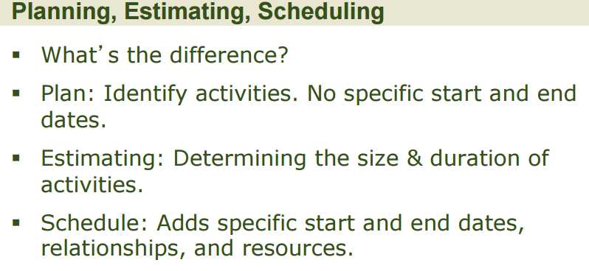

Slide 7
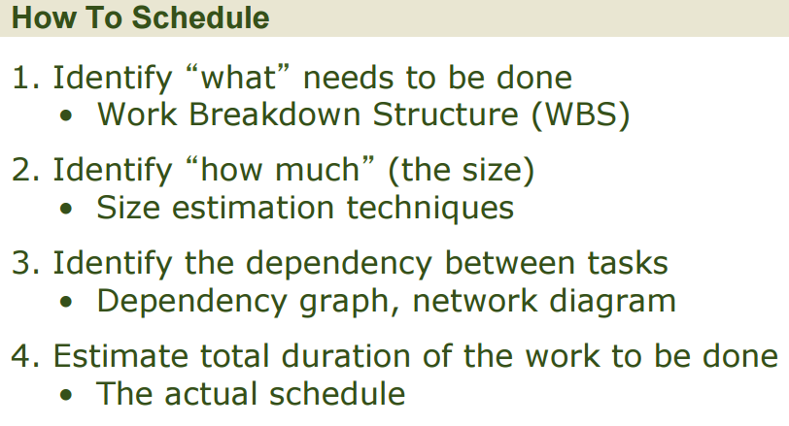
Why is it needed?

Slide 8
Agenda Work Breakdown Structure
Work Breakdown Structure—What is it?
Defining Activities (Summary Tasks)
Defining Tasks
More Examples

Slide 9
Work Breakdown Structure
It is a hierarchical description of the work that must be done to complete the project
It defines all of the activities that must be carried out in order for you to complete the project
Each activity has a number of tasks needed to be done in order to complete it

Slide 10
Work Breakdown Structure
Activity: an item of work needed to meet the requestor’s requirements
Task: a smaller item of work

Slide 11
Work Breakdown Structure
The tasks that you define in your Work Breakdown Structure are what you will put into MSProject
For each task, you will assign resources, an estimate of how long that task will take, and the dependencies (i.e. is a task dependent on another one to finish before it can start?)

Slide 12
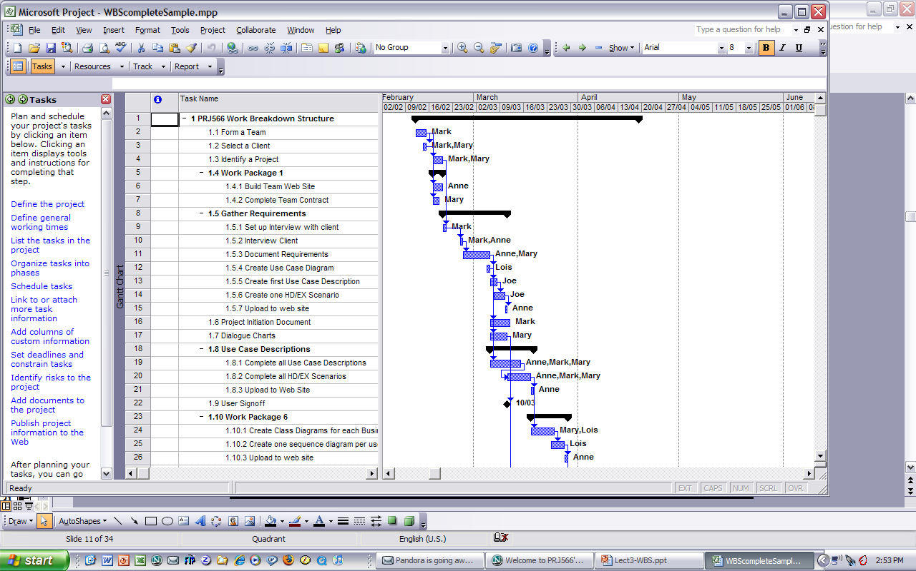
Work Breakdown Structure
Activity
Resource
Task
Duration
Milestone

Slide 13
Work Breakdown Structure
There are (at least) 4 uses for the WBS:
Thought Process Tool
Architectural Design Tool
Planning Tool
Project Tracking and Reporting Tool

Slide 14
Work Breakdown Structure
Thought Process Tool
A design and planning tool
Project Manager and team can visualize exactly how the work of the project is defined and managed effectively

Slide 15
Work Breakdown Structure
Architectural Design Tool
A picture of the work of the project and how the tasks relate to one another.

Slide 16
Work Breakdown Structure
Planning Tool
Take the tasks that need to be done to develop the project and estimate effort, elapsed time and resources
Build a schedule of when the work will be done – will show project completion

Slide 17
Work Breakdown Structure
Project Tracking and Reporting Tool
Shows visually what is happening and when – it is used for reporting status
Shows how much of a specific task is completed

Slide 18
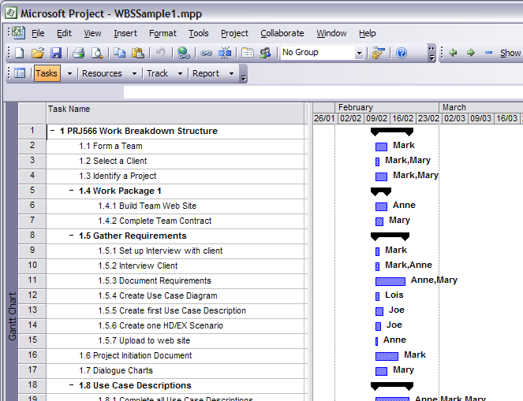
WBS Extract

Slide 19
Agenda
Work Breakdown Structure—What is it?
Defining Activities (Summary Tasks)
Defining Tasks
More Examples

Slide 20
Defining Activities
How to define Activities (Summary Tasks):
There are various methods used:
Top Down
Team
Bottom Up

Slide 21
Defining Activities
Top Down
Start at a goal (activity) level and break down the work to lower levels (tasks). An activity may involve many steps (tasks) and many people (resources) being assigned to that one activity. It is important to break down to the lowest level task so that only one resource is assigned to that task.

Slide 22
Defining Activities
Top Down
Once you are down to the lowest level task you can sequence the tasks so that some can be done in parallel. This will allow you to save time on the overall project.

Slide 23
Defining Activities
Team
Assign team members various part of the overall project to determine the work breakdown structure for that section of the project. It may involve using the top-down approach at this point in time to build the detailed schedule.

Slide 24
Defining Activities
Bottom Up
More like a brain-storming session. Not very organized.
Start with the goal and as a large group identify the tasks needed to be completed.
Tasks are written down. When no more task suggestions are made then the group tries to organize the tasks into like groupings.
Very inefficient.

Slide 25
Defining Activities
We will use: Top Down
We will start with activities or summary tasks such as use cases, database creation, and so on, and break these into tasks

Slide 26
Defining Activities
Different approaches to defining activities:
Noun approach
e.g. functional decomposition (activities around building each use case or database creation)
Verb approach
e.g. common activities, from a project methodology e.g. design, build, test, document

Slide 27
Defining Activities
We will define activities that will identify a significant deliverable
Use case
Database
Documentation
System testing
Acceptance testing

Slide 28
Agenda
Where are we?
Work Breakdown Structure—What is it?
Defining Activities (Summary Tasks)
Defining Tasks
More Examples

Slide 29
Defining Tasks
Once you have decided on your activities (summary tasks), you need to define the sub tasks needed for each activity.

Slide 30
Defining Tasks
Each task in your WBS must meet the following six criteria:
1. Status/Completion is measurable
For your plan, make tasks small enough so you can use a binary measure: done or not done
2. Start/End clearly defined
Just give MSProject the duration; it will compute the start and end dates. We will provide MSProject with a project start date only.

Slide 31
Defining Tasks
Task criteria continued:
3. Task has a deliverable
Makes it easier to track; gives it validity
4. Time/Cost easily estimated
Smaller tasks are easier to estimate

Slide 32
Defining Tasks
Task Criteria Continued
5. Duration is within acceptable limits
Shorter tasks are easier to manage (problems become apparent very quickly)
Tasks must be less than 10 hours
6. Tasks are independent
One person per task (except for meetings)

Slide 33
Defining Tasks
Keep refining your task hierarchies until you are satisfied that you have covered al of the work that needs to be done in order to get your project completed

Slide 34
Agenda
Where are we?
Work Breakdown Structure—What is it?
Defining Summary Tasks
Defining Tasks
More Examples

Slide 35
Build Dog House

Slide 36
Build Dog House

Slide 37
Paint Room

Slide 38
Paint Room

Slide 39
A Small System

Slide 40
A Small System

Slide 41
A Small System

Slide 42
Example
You have decided to relocate to a new apartment on November1st. Identify the activities and tasks that are necessary to complete this move.
Identify activities (summary tasks)
Identify tasks within activities

Slide 43
Example
Identify the tasks that need to be done to do requirements gathering. Do not consider doing Business Use Case Diagrams or Business Use Case Descriptions.

