Slide 1
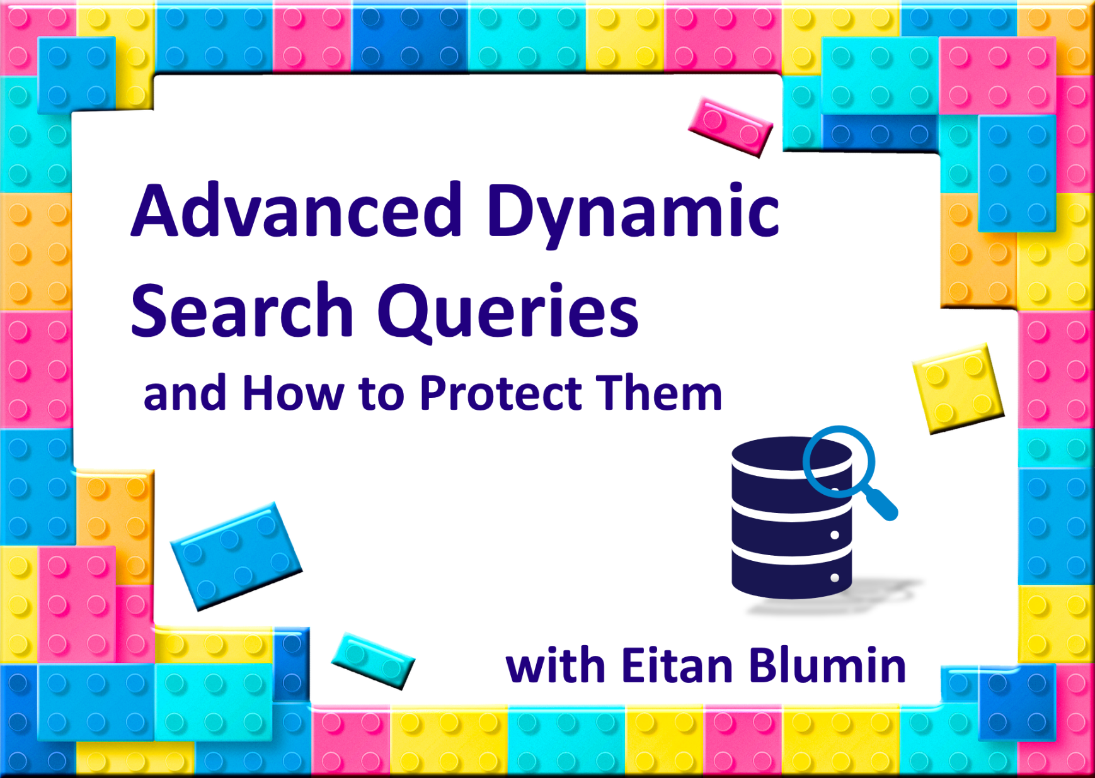

Image by Annalise Batista

Slide 2

Copyright © 2019 Madeira Ltd
All Rights Reserved
Full rights, including copyrights, belong exclusively to Madeira Ltd
No use of the materials, in any form, is allowed,
unless receiving a prior written permission from Madeira Ltd

Slide 3




About Me…
Name: Eitan Blumin
Email Address: eitan@madeiradata.com
Twitter: @EitanBlumin
LinkedIn: www.linkedin.com/in/eitanblumin
Blog: www.eitanblumin.com
SQL Server consultant in:
SQL Server DBA since 2005
Since 2010
Notes:
Hands-on experience with SQL Server since year 2005, and as a professional consultant in Madeira Data Solutions since 2010

Slide 4


Before we start…
All Source Code is available at:
github.com/EitanBlumin/DynamicFilters
Notes:
Let them know that everything they’re about to see is open source and available on GitHub.
Also, since I’ll be continuing on delivering this presentation in other channels, I’ll be continuously improving the project with time.

Slide 5


We’ll start with a story…
This Photo by Unknown Author is licensed under CC BY-SA
Notes:
Client had a GUI where they allowed users to search in a database table.

Slide 6
What they had:
Notes:
This is sort of what they had before: single parameter and single operator per column at most.
How did they implement it? See next slides.

Slide 7






Common Dynamic Search Queries
(we’ll start with simple, common methods)
SELECT * FROM Members WHERE IsActive=1
AND Name LIKE '%{0}%'
AND Country = {1}
AND RegistrationDate >= '{2}'
SELECT * FROM Members WHERE IsActive=1
AND Name LIKE '%John%'
AND Country = 1
AND RegistrationDate >= '2018-01-01'
LINQ to SQL
Implemented by the app
Notes:
Example construction of ad-hoc query using either ad-hoc parameterization or SQL injection.
In other words: The dynamic logic is implemented by the front-end or business-logic layer.

Slide 8
Common Dynamic Search Queries
(we’ll start with simple, common methods)
SELECT * FROM Members WHERE IsActive=1
AND Name LIKE '%' + {0} + '%'
AND Country = {1}
AND RegistrationDate >= {2}
SELECT * FROM Members WHERE IsActive=1
AND Name LIKE '%' + @p1 + '%'
AND Country = @p2
AND RegistrationDate >= @p3
LINQ to SQL
Implemented by the app
Notes:
More sophisticated example preventing SQL injection (e.g. LINQ or Entity Framework)

Slide 9

Common Dynamic Search Queries
CREATE PROCEDURE SearchMembers
@Name nvarchar(…) = NULL,
@Country int = NULL,
@RegistrationDateFrom datetime = NULL,
…
AS
SELECT * FROM Members WHERE IsActive=1
AND (@Name IS NULL OR Name LIKE '%' + @Name + '%')
AND (@Country IS NULL OR Country = @Country)
AND (@RegistrationDateFrom IS NULL OR RegistrationDate >= @RegistrationDateFrom)
…
Implemented by the DB
OPTION (RECOMPILE)
Notes:
Example stored procedure implementing dynamic search.
OPTION(RECOMPILE) is a good solution to parameter sniffing problem, but only if it’s not being called too frequently, otherwise would cause CPU stress

Slide 10
Common Dynamic Search Queries
SELECT * FROM Members WHERE IsActive=1
AND Name = @Name
CREATE PROCEDURE SearchMembers
@Name nvarchar(...) = NULL,
@Country int = NULL,
@RegistrationDateFrom datetime = NULL,
...
AS
DECLARE @CMD NVARCHAR(MAX)
SET @CMD = N'SELECT * FROM Members WHERE IsActive=1'
IF @Name IS NOT NULL SET @CMD = @CMD + N' AND Name LIKE @Name'
IF @Country IS NOT NULL SET @CMD = @CMD + N' AND Country = @Country'
IF @RegistrationDateFrom IS NOT NULL SET @CMD = @CMD + N' AND RegistrationDate >= @RegistrationDateFrom'
...
EXEC sp_executesql @CMD
, N'@Name nvarchar(...), @Country int, @RegistrationDateFrom datetime, ...'
, @Name, @Country, @RegistrationDateFrom, ...
SELECT * FROM Members WHERE IsActive=1
AND Country = @Country
AND RegistrationDate >= @RegistrationDateTimeFrom
Notes:
This method reduces recompiles.
See a couple examples of output query code.
We’ll assume this to be our common standard from now on.

Slide 11
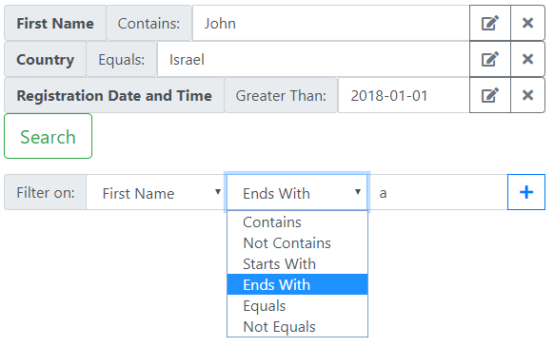
What they wanted:
Notes:
This is what they wanted it to look like.
They wanted to allow full customizability…
Not just any combination of columns to filter by
But also the type of operator to use per each column (equals, not equals, less than, in, not in,…)

Slide 12

Limitations to the common methods
@
@
Number of parameters is limited
Operator type per parameter is fixed or limited
Adding new column/parameter/operator requires change in:
Frontend GUI
BL
Database
@
=
<
IN

Slide 13



Why do these limitations exist? Let’s understand the problem
(first… a few definitions)
Parameter Collection
Parameter
Literal Value
Notes:
First let’s set a few definitions:
A parameter value (red) is a literal value of a parameter received from the end-user, let’s say “John” for the @Name parameter
A parameter (orange) is the parameter itself, let’s say @Name
A parameter collection (green) is the total set of parameters (@Name, @Country, …)

Slide 14
Understanding the problem…
SELECT * FROM Members WHERE IsActive=1
AND Name LIKE ‘%John%’
AND Country = 1
AND RegistrationDate >= ‘2018-01-01’
Notes:
Remember this query? The red parts are literal values sent from the end-user, the yellow parts are specific parameter/column definitions.
Where’s the green part? That’s the entire query actually.

Slide 15
Understanding the problem…
CREATE PROCEDURE SearchMembers
@Name nvarchar(…) = NULL,
@Country int = NULL,
@RegistrationDateFrom datetime = NULL,
…
AS
DECLARE @CMD NVARCHAR(MAX)
SET @CMD = N’SELECT * FROM Members WHERE 1=1’
IF @Name IS NOT NULL SET @CMD = @CMD + N’ AND Name = @Name’
IF @Country IS NOT NULL SET @CMD = @CMD + N’ AND Country = @Country’
IF @RegistrationDateFrom IS NOT NULL SET @CMD = @CMD + N’ AND RegistrationDate >= @RegistrationDateFrom’
…
EXEC sp_executesql @CMD
, N’@Name nvarchar(…), @Country int, @RegistrationDateFrom datetime, …’
, @Name, @Country, @RegistrationDateFrom, …
Notes:
The procedure itself serves as the parameter collection, explicitly defining each parameter.
That means that any change in a parameter would require changing each yellow section.
Since we know how to prevent SQL injection, there’s no “parameter value” part here.

Slide 16



Understanding the problem…
GUI
BL
DB
callMethod( frm.Name,
frm.Country,
…
)
cmd.parameters.add @Name, pName
cmd.parameters.add @Country, pCountry
cmd.parameters.add …
PROC SearchMembers
@Name nvarchar(…),
@Country int,
…
Notes:
Note how the parameter collection is explicitly defined in each layer: GUI, BL and DB.
The objects passed between each layer are each parameter individually.
What do we have to do when we want to add a column/parameter/operator?

Slide 17
Ok, so… How do we solve it?
@
@
Number of parameters is limited
Operator type per parameter is fixed or limited
Adding new column/parameter/operator requires change in:
Frontend GUI
BL
Database
@
=
<
IN
Notes:
Ask for suggestions from the crowd
If they followed you along so far in understanding the problem, they should be able to figure out the answer

Slide 18

Solution: We add another layer of abstraction
Parameter Parser
Parameter Collection
Parameter
Literal Value
Code
Code
Data
Code
Data
End-User
Notes:
We implement a “Parameter Parser”, which would be generic and agnostic to any specific parameter collection.
Parameters and parameter collections are no longer defined or maintained by code. They’re maintained by data instead.

Slide 19


Adding another layer of abstraction
filterColumns: [
{id:1, name: “Name”, operators: [1,2,3] },
{id:2, name: “Country”, operators: [1,2,4], list: [“Israel”, “USA”, “Italy”,…] }, … ],
filterOperators: [
{id:1, name: “Equals”, multi_value: false},
{id:2, name: “Not Equals”, multi_value: false}, {id:3, name: “Contains”, multi_value: false}
{id:4, name: “In”, multi_value: true}, … ]
GUI
BL
DB
callMethod(frm.parametersObj)
cmd.parameters.add @Params, params
PROC SearchContacts @Params (???)
Notes:
Each layer would implement a generic parameter parser.
The collection of parameters (and operators) would be defined in one place only: in the DB – single point of maintenance, as data and not as code.
Each layer would pass along the entire parameter collection for the next layer, thus they’d be completely agnostic to its contents.

Slide 20
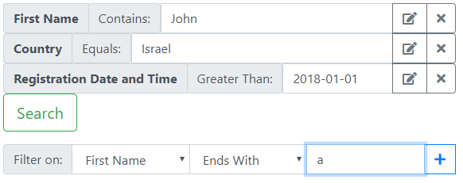
Adding another layer of abstraction
filters: [
{columnId:1, operatorId: 1, value: [“John”] },
{columnId:2, operatorId: 4, value: [“Israel”, “USA”] }, … ]
GUI
BL
DB
callMethod(frm.parametersObj)
cmd.parameters.add @Params, params
PROC SearchContacts @Params (???)
Notes:
Each layer would pass along the entire parameter collection for the next layer, thus they’d be completely agnostic to its contents.
Optionally, there would be no logic at all at the BL level:
The GUI would generate the parameter collection based on user interactions, and the DB would parse the collection based on strongly typed ruleset.
The BL would only be responsible for delivering the data as it is to the next layer.

Slide 21
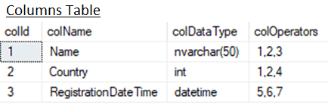
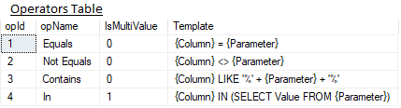
Adding another layer of abstraction
1
DECLARE @p1 nvarchar(50)
SET @p1 = @Params.value[id=1]
DECLARE @p2 TABLE (int)
INSERT INTO @p2 SELECT value FROM @Params.value[id=2]
SELECT * FROM Members WHERE 1=1
AND Name = @p1
AND Country IN (SELECT value FROM @p2)
XML </>
JSON { }
TVP @T
CLR ???
2
DECLARE @p1 nvarchar(50)
SET @p1 = @Params.value[id=1]
DECLARE @p2 TABLE (int)
INSERT INTO @p2 SELECT value FROM @Params.value[id=2]
EXEC sp_executesql @CMD, @CMDParams, @p1, @p2
filters: [
{columnId:1, operatorId: 1, value: [“John”] },
{columnId:2, operatorId: 4, value: [“Israel”, “USA”] }, … ]
GUI
BL
DB
callMethod(frm.parametersObj)
cmd.parameters.add @Params, params
PROC SearchContacts @Params (???)
1
EXEC sp_executesql @ParsedSQL, N'@Params ???', @Params
EXEC sp_executesql @ParsedSQL
, N'@Params ???, @CMD nvarchar(max), @CMDParams nvarchar(max)’
, @Params, @CMD, @CMDParams
2
Notes:
The generated parsed SQL consists of two main parts: 1) parameter initialization. 2) generated query.
These two parts could either be executed as a single command [1] or as “encapsulated” sp_executesql [2].
The parameter collection itself could be either of the following: XML, JSON, or Table-Valued Parameter. Anything that can serve as a collection of values but also have its individual values be accessible deterministically (using an “indexer” of sorts).

Slide 22
Let’s Review…
With Abstraction Layer | Without Abstraction Layer
GUI receives meta-data from DB and uses it to generate search form | GUI is hard-coded
BL receives single object from GUI and executes DB proc with single param | BL executes DB proc with multiple params (and again: hard-coded)
DB proc parses param collection and dynamically generates command | DB proc dynamically generates command based on hard-coded logic
Notes:
Also: In-between scenario where the “abstraction layer” is implemented by the app instead of the DB

Slide 23
Let’s see it in action!
1. Demo web GUI + SQL Profiler
Notes:
Demo steps:
Demonstrate the GUI + SQL Profiler to capture resulting DB commands

Slide 24
Let’s see it in action!
2. Database Tables
Notes:
Demo steps:
2. Show tables ERD and contents of meta-data

Slide 25

What have we achieved?
@
=
@
<
@
IN
Number of conditions is unlimited: As much as the user wants, in any combination (as per the limitations defined in the metadata)
Multiple operator types per parameter are possible
Single point of maintenance: Database tables (Data, not Code!)
Despite all of the above: SQL injection is impossible because we never concatenate literal values entered by an end-user
Photo by Unknown Author is licensed under CC BY-NC-ND
Notes:
Alternative methods:
Talk about recursive nested conditions with dynamic AND/OR setting.
Talk about various alternative methods:
Column -> Operators vs. Column -> Type -> Operators
LINQ for SQL and other BL-only logic for parameter generation/parsing

Slide 26
What’s next?
1 Go to my GitHub repository and download the project
2 Review and study the SP responsible for parsing filters (or build your own based on your understanding of this presentation)
3 Go to your developers and tell them you have a nice surprise for them
4 Start worrying about end users going wild and abusing your indexes

Slide 27

Source Code:
github.com/EitanBlumin/DynamicFilters
Image courtesy of David Castillo Dominici / FreeDigitalPhotos.net

Slide 28







Keep in Touch…
github.com/EitanBlumin/DynamicFilters
Name: Eitan Blumin
Email: eitan@madeiradata.com
Twitter: @EitanBlumin
LinkedIn: www.linkedin.com/in/eitanblumin
Blog: www.eitanblumin.com
Also in:
madeiradata.com

