Slide 1
נושאים מתקדמים בבסיסי נתונים- תרגול 1: הקדמה
מרצה הקורס: ד"ר גלעד כץ
מתרגלת: דנה בהנם
בודק תרגילים: בן לרר

Slide 2
מנהלות
דרישות הקורס:
20%- 2 תרגילי בית תכנותיים
30%- פרויקט סופי
50%- מבחן סופי
הגשת התרגילים בזוגות
שעות קבלה:
בתיאום מראש במייל: behnamd@post.bgu.ac.il

Slide 3
Topics:
PL/SQL
JDBC
Hibernate
Cassandra
Redis
Map-Reduce

Slide 4

Tools & Languages
Java (jre 1.6)
Oracle SQL Developer
Eclipse Java EE IDE for Web Developers (Juno Release)
Hibernate Tools
Cassandra 1.x
Redis 2.8

Slide 5
PL/SQL
Connection using Oracle SQL Developer
Main Features
Block Structure
Variables and Constants
Operations and Built In Functions
https://www.tutorialspoint.com/plsql/

Slide 6
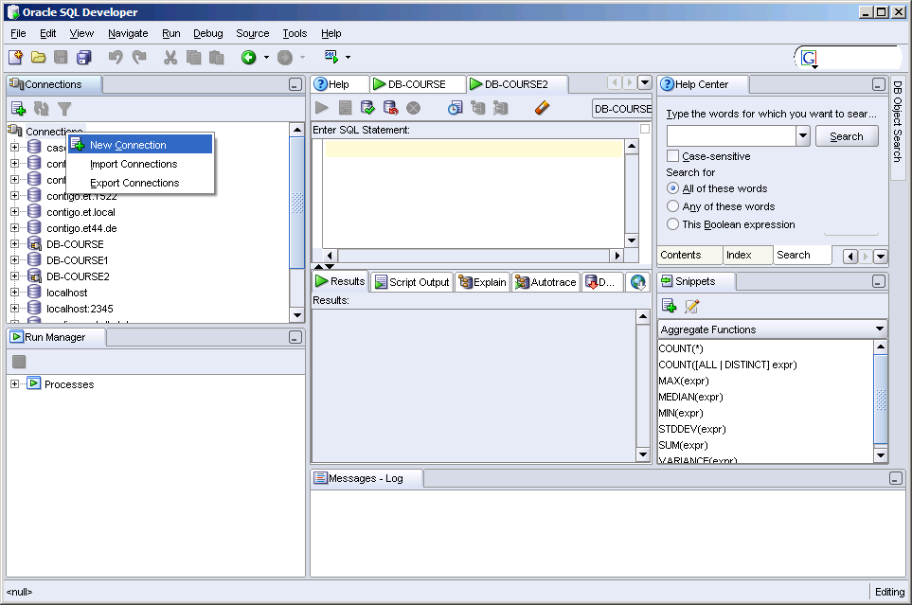
Connection using Oracle SQL Developer
Create a new connection

Slide 7
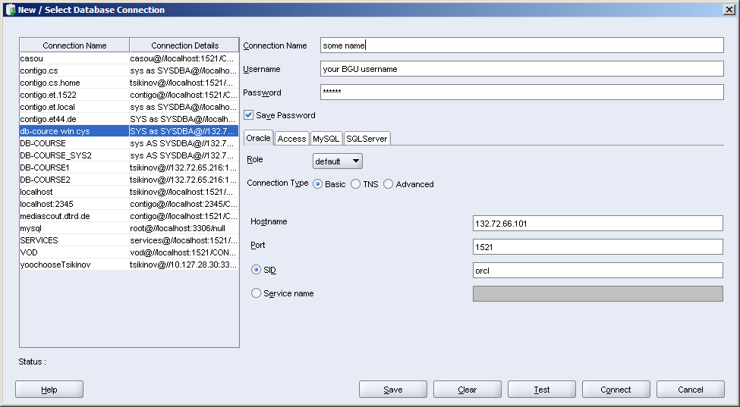
Connection using Oracle SQL Developer
Your university username
Fill the required fields
abcd
later you should change it.
Server IP
132.72.65.216
ora1.ise.bgu.ac.il
ora2.ise.bgu.ac.il
132.72.65.216
oracle
Oracle Port

Slide 8
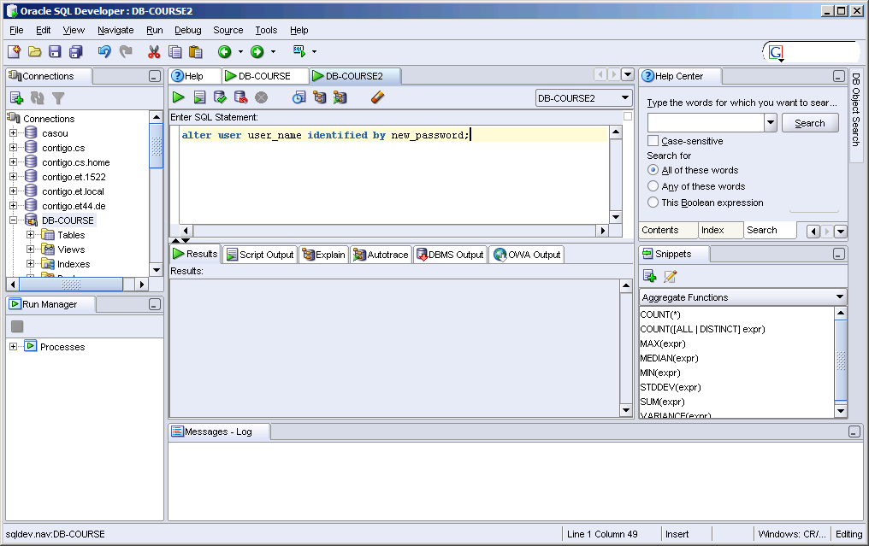
Connection using Oracle SQL Developer
For changing the password:
alter user user_name
identified by new_password

Slide 9
Main Features
בשפת PL\SQL משתמשים בפקודות SQL כדי לשלוט בנתונים שבבסיס הנתונים ובפקודות flow of control כדי לעבד את הנתונים.
ניתן להצהיר על קבועים ומשתנים, להגדיר פרוצדורות, פונקציות וטריגרים ולתפוס שגיאות. בכך PL\SQL משלבת את יכולות המניפולציה שלSQL עם יכולות העיבוד של שפה פרוצדוראלית.
דוגמה: תכנית בPL\SQL שמעדכנת את טבלת "רכישות" ואת טבלת "מלאי" בעת קניית מחבט טניס:
-- this is a comment: First Example
DECLARE
qty_on_hand NUMBER(5);
BEGIN
SELECT quantity INTO qty_on_hand FROM inventory WHERE product = 'TENNIS RACKET'
FOR UPDATE OF quantity;
IF qty_on_hand > 0 THEN -- check quantity
UPDATE inventory SET quantity = quantity - 1 WHERE product = 'TENNIS RACKET';
INSERT INTO purchase_record VALUES ('Tennis racket purchased', SYSDATE);
ELSE
INSERT INTO purchase_record VALUES ('Out of tennis rackets', SYSDATE);
END IF;
COMMIT;
END;

Slide 10
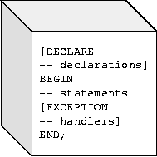
Block Structure
PL/SQL is a block-structured language.
The basic units (procedures, functions, and anonymous blocks) that make up a PL/SQL program are logical blocks, which can contain any number of nested sub-blocks.
A block (or sub-block) lets you group logically related declarations and statements. That way, you can place declarations close to where they are used. The declarations are local to the block and cease to exist when the block completes.
A PL/SQL block has three parts:
a declarative part,
an executable part,
and an exception-handling part.
Only the executable part is required.

Slide 11
Variables and Constants
PL/SQL allows you to declare constants and variables, then use them in SQL and procedural statements anywhere an expression can be used.
You must declare a constant or variable before referencing it in other statements, including other declarative statements.
Declaring Variables
Variables can have any SQL datatype, such as CHAR, DATE, or NUMBER, or any PL/SQL datatype, such as BOOLEAN or BINARY_INTEGER.
For example, assume that you want to declare:
a variable named part_no to hold 4-digit numbers,
a string emp_name to hold up to 20 characters
and a variable named in_stock to hold the Boolean value TRUE or FALSE.
Default setting: hours_worked INTEGER DEFAULT 40;
Not null setting: acct_id INTEGER(4) NOT NULL := 9999;
part_no NUMBER(4);
emp_name VARCHAR2(20);
in_stock BOOLEAN;

Slide 12
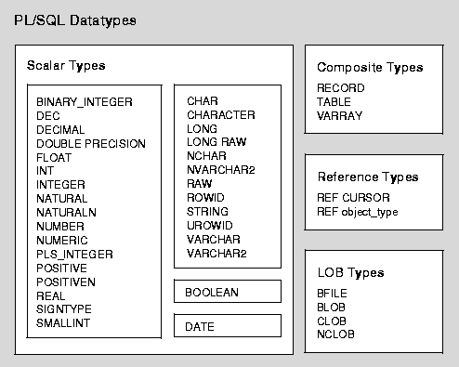
Datatypes
The LOB (large object) datatypes BFILE, BLOB, CLOB, and NCLOB let you store blocks of unstructured data (such as text, graphic images, video clips, and sound waveforms) up to four gigabytes in size. And, they allow efficient, random, piece-wise access to the data. LOBs support random access to data, while LONGs (and LONG RAW) support only sequential access. LOB types store values, called lob locators, that specify the location of large objects stored in an external file, in-line (inside the row) or out-of-line (outside the row). BFILE data is stored in operating system files outside the database.

Slide 13
Assigning Values to a Variable
You can assign values to a variable in two ways:
The first way uses the assignment operator. Place the variable to the left of the operator and an expression to the right:
The second way to assign values to a variable is to select or fetch database values into it.
Example: compute a 10% bonus when you select the salary of an employee:
tax := price * tax_rate;
bonus := current_salary * 0.10;
amount := TO_NUMBER(SUBSTR('750 dollars', 1, 3));
valid := FALSE;
SELECT sal * 0.10 INTO bonus FROM emp WHERE empno = emp_id;

Slide 14
Declaring Constants
Declaring a constant is like declaring a variable except that you must add the keyword CONSTANT and immediately assign a value to the constant.
Thereafter, no more assignments to the constant are allowed.
Example:
credit_limit CONSTANT REAL := 5000.00;

Slide 15
Order of Operations
Operator | Operation
**, NOT *, / +, -, || =, <, >, <=, >=, <>, !=, ~=, ^=, IS NULL, LIKE, BETWEEN, IN AND OR | exponentiation, logical negation multiplication, division addition, subtraction, concatenation comparison conjunction inclusion

Slide 16
Built in functions
Error | Number | Character | Conversion | Date | Misc
SQLCODE SQLERRM | ABS ACOS ASIN ATAN ATAN2 CEIL COS COSH EXP FLOOR LN LOG MOD POWER ROUND SIGN SIN SINH SQRT TAN TANH TRUNC | ASCII CHR CONCAT INITCAP INSTR INSTRB LENGTH LENGTHB LOWER LPAD LTRIM NLS_INITCAP NLS_LOWER NLSSORT NLS_UPPER REPLACE RPAD RTRIM SOUNDEX SUBSTR SUBSTRB TRANSLATE TRIM UPPER | CHARTOROWID CONVERT HEXTORAW RAWTOHEX ROWIDTOCHAR TO_CHAR TO_DATE TO_MULTI_BYTE TO_NUMBER TO_SINGLE_BYTE | ADD_MONTHS LAST_DAY MONTHS_BETWEEN NEW_TIME NEXT_DAY ROUND SYSDATE TRUNC | BFILENAME DECODE DUMP EMPTY_BLOB EMPTY_CLOB GREATEST LEAST NLS_CHARSET_DECL_LEN NLS_CHARSET_ID NLS_CHARSET_NAME NVL SYS_CONTEXT SYS_GUID UID USER USERENV VSIZE

Slide 17
Some Syntax and functions
Strings (type CHAR) represented by enclosing them with single quotes: ’bla bla’
We represent ‘ by two single quotes inside a string: ‘don’’t bla bla’
Null represents a missing value (IF variable IS NULL THEN ...)
Comments:
Single line: --this is a single line comment
Multi lines: /* this is a
multi lines comment*/
Like: ename LIKE 'J%SON'
An underscore (_) matches exactly one character; a percent sign (%) matches zero or more characters.
Between: 45 BETWEEN 38 AND 44

Slide 18
Some Syntax and functions
In: DELETE FROM emp WHERE ename IN (NULL, 'KING', 'FORD');
Double vertical bars (||) serve as the concatenation operator, which appends one string to another: 'suit' || 'case‘ ➔ 'suitcase‘
DECODE: SELECT DECODE(rating, NULL, 1000, 'C', 2000, 'B', 4000, 'A', 5000) INTO credit_limit FROM accts WHERE acctno = my_acctno;
→ acts like a case statement: for rating = null, c, b and a the value that follows the rating case is returned.
The function NVL returns the value of its second argument if its first argument is null: start_date := NVL(hire_date, SYSDATE);
Replace: REPLACE('Gold-i-locks', '-', NULL);➔ 'goldilocks'
Printing output on screen: DBMS_OUTPUT.PUT_LINE(num_changed);

Slide 19
Conditional Control
התוכנית הבאה מטפלת בטרנזקציות בנקאיות. לפני שהיא מאפשרת לך למשוך 500$ מחשבון מס' 3, היא מוודא שיש בחשבון זה יתרה מספקת. אם יש יתרה מספקת התכנית מחיבת את החשבון בסכום המבוקש, אחרת התכנית מוסיפה רשומה לטבלת ביקורת חשבונות.
DECLARE
acct_balance NUMBER(11,2);
acct CONSTANT NUMBER(4) := 3;
debit_amt CONSTANT NUMBER(5,2) := 500.00;
BEGIN
SELECT bal INTO acct_balance FROM accounts WHERE account_id = acct FOR UPDATE OF bal;
IF acct_balance > debit_amt THEN
UPDATE accounts SET bal = bal - debit_amt WHERE account_id = acct;
ELSIF acct_balance = debit_amt THEN
UPDATE accounts SET bal = bal - debit_amt WHERE account_id = acct;
INSERT INTO temp VALUES(acct, 0, 'Account is empty');
-- insert account, current balance, and message
ELSE
INSERT INTO temp VALUES(acct, acct_balance, 'Insufficient funds');
-- insert account, current balance, and message
END IF;
COMMIT;
END;

Slide 20
תרגילון- מס' 1:
צור בבסיס הנתונים טבלה בשם results המכילה שדה מספרי בשם difference ושני שדות טקסט באורך של עד 10 תווים, האחד מייצג זמן התחלה והשני זמן סיום.
כתוב בלוק בשפת pl/sql המודד את זמן התחלת התוכנית ומדפיסה אותו. לאחר מכן, מודד שוב את הזמן הנוכחי של המערכת. הכניסו לשני משתנים מסוג מחרוזת (לדוגמה: start_time ו finish_time ) את הערכים המייצגים את כמות השניות לאחר חצות של כל זמן שנמדד.
היעזרו בפקודה to_char(date, format) ובפונקציה sysdate.
היעזרו ב: set serveroutput on כדי להפעיל את הdbms_output
התוכנית מחשבת את ההפרש בין שני המשתנים ומכניסה את הערכים לטבלת results .

