Slide 1
session1: an R taster

Slide 2
Rationale
in this session we will give you a quick taste of R
to show you what you can do
we will get you to type commands in R and see what happens
we don’t expect you to understand completely at this stage
we will return to concepts later

Slide 3
Content
download a project from Github into RStudio
read in data from a file
look at the data
manipulate the data
plot the data

Slide 4
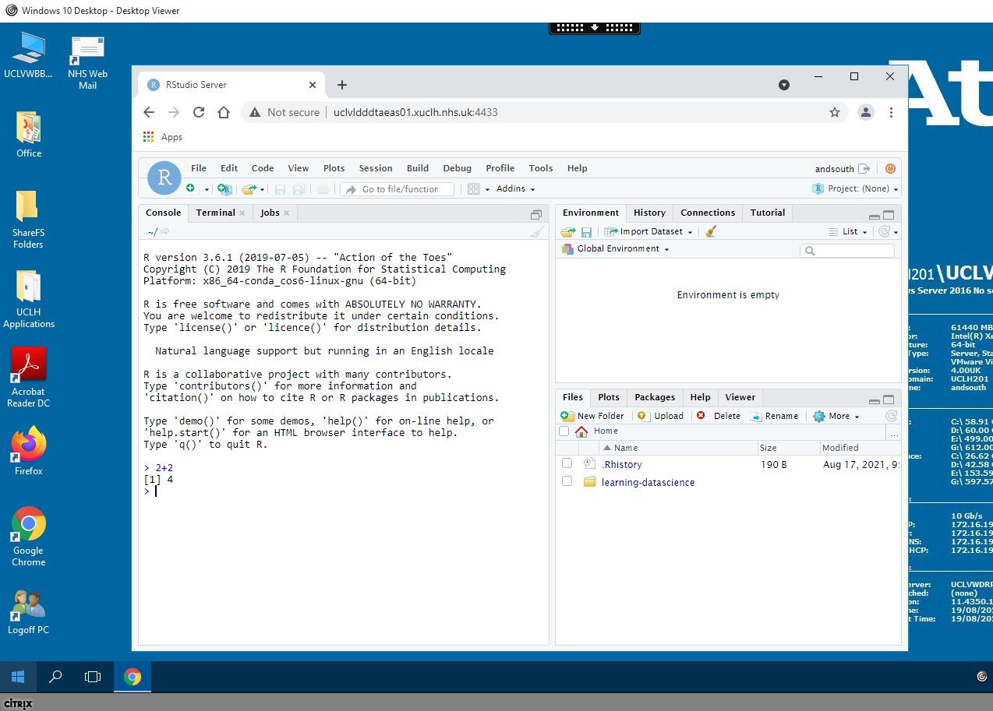
If you don’t see something like this, let us know and we’ll help

Slide 5
Working with RStudio
RStudio is an Integrated Development Environment (IDE). – (also the name of the company that develops it and a lot more)
Easier to work with than R on it’s own, since it it a bit more ‘point and clicky’
Allows
Code editing
Syntax highlighting
Plotting tools
Workspace management
Version control

Slide 6
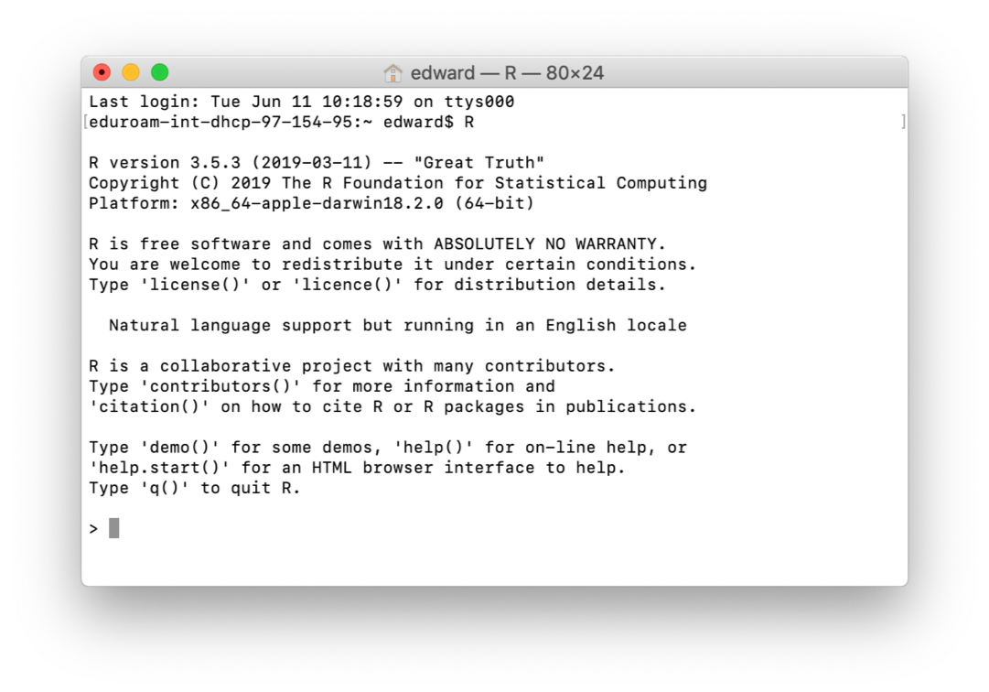
This is what R on it’s own looks like

Slide 7
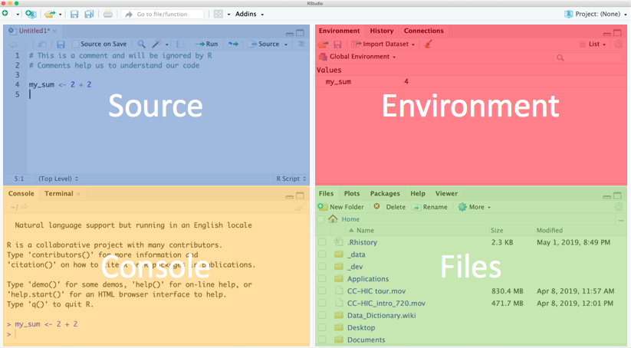
RStudio is much easier to work with & what we recommend
Notes:
Explain each window.
Console - this is where R is run. Commands executed but not saved.
Source - text files that contain commands.
Environment - tells you which R objects you are working with.
Files - actually a helper window. Gives you files, help, plots.

Slide 8
Using the Source/Text editor
Type 2 + 2 in top left, then Enter.
What happens?
To ask R to run code
Highlight the code and:
MacOS: Cmd + Enter
Windows: Ctrl + Enter
Notice the output in the console.

Slide 9
Saving your work
Click the save icon
Save the file under a meaningful name.
Save it somewhere you can find it again.
.R is the file extension for R scripts.
If you were to close RStudio
The file would remain & you could run again.

Slide 10
A warning about R warnings & errors
DON’T PANIC : they are common & expected
Warnings give you info that often you can ignore
Errors usually need to be fixed and are usually due to a typo
Errors check the first one - if it doesn’t make sense to you google it

Slide 11
Instructor to switch to live demo in RStudio (remaining slides for info)

Slide 12
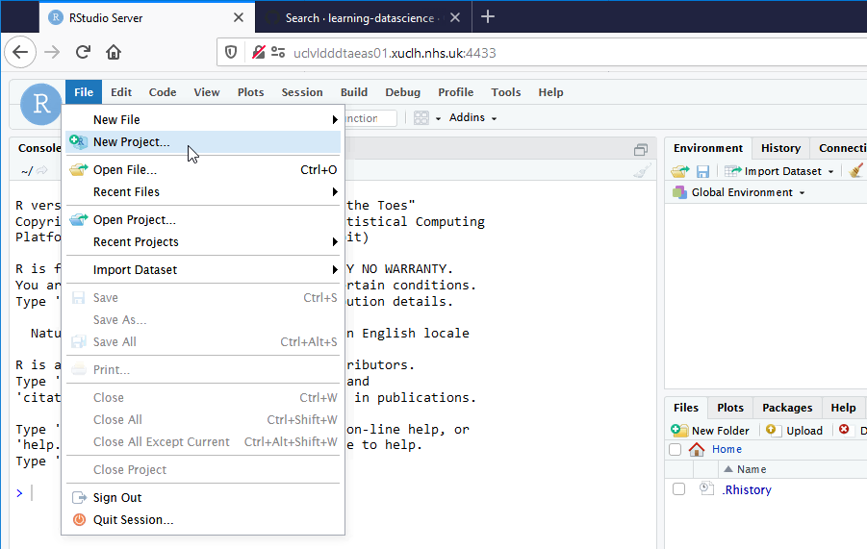
download a project from Github into RStudio

Slide 13
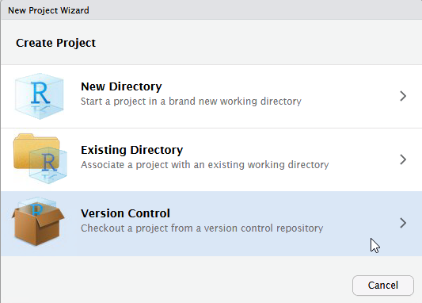

Slide 14
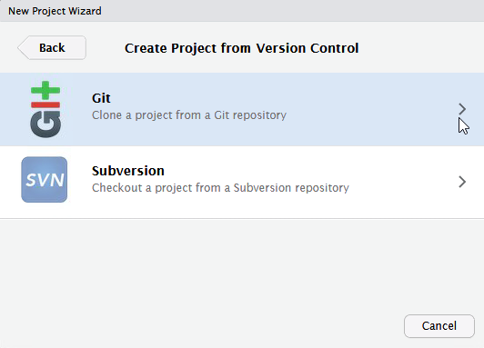

Slide 15
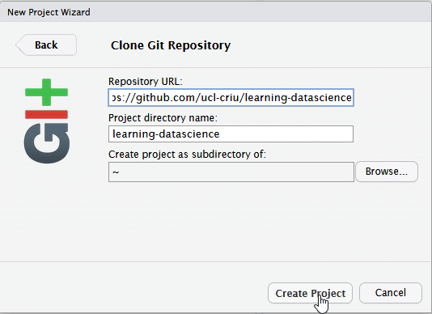
Copy into first box https://github.com/ucl-criu/learning-datascience

Slide 16
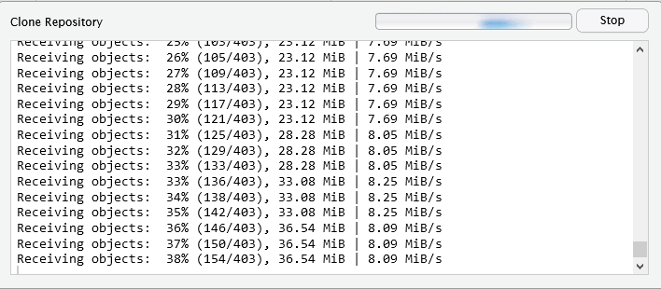
may take a while to copy files.

Slide 17
Intructor will step through sessions/1-R-taster-script.R

