Slide 1
session1: an R taster

Slide 2
Rationale
in this session we will give you a quick taste of R
to show you what you can do
we will get you to type commands in R and see what happens
we don’t expect you to understand completely at this stage
we will return to concepts later

Slide 3
Content
download a project from Github into RStudio
read in data from a file
look at the data
manipulate the data
plot the data

Slide 4
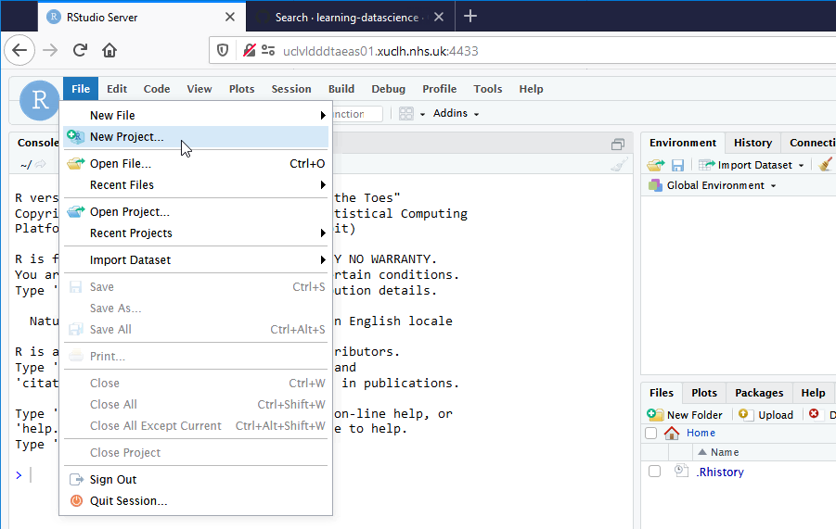
download a project from Github into RStudio

Slide 5
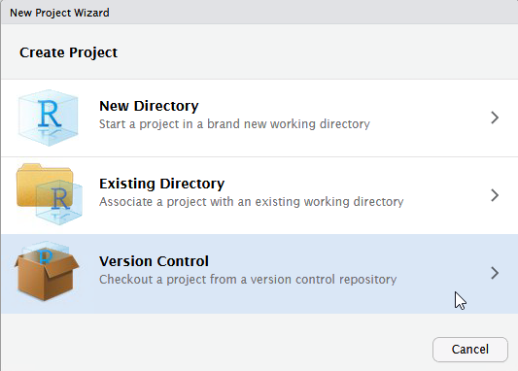

Slide 6
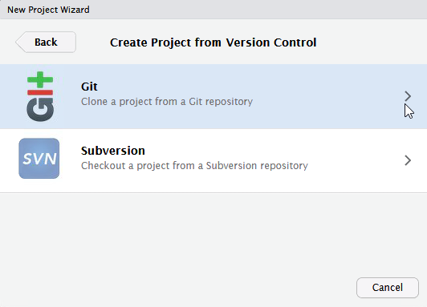

Slide 7
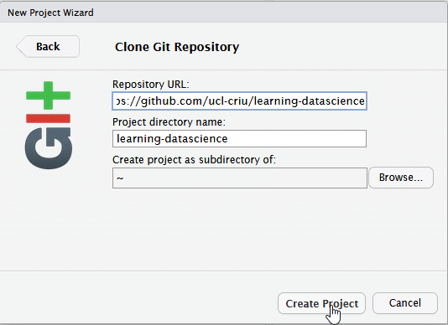
Copy into first box https://github.com/ucl-criu/learning-datascience

Slide 8
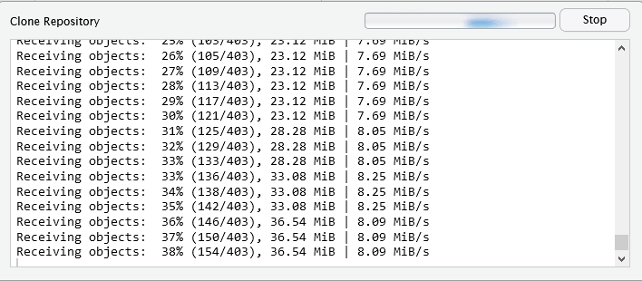
may take a while to copy files.

