Slide 1
session2: Intro to R

Slide 2
Content
Motivation for R: what and why?
R studio: a tour
R building blocks
Using/Writing functions

Slide 3
What is R?
Free software for statistical computing, plotting (and almost anything else you can think of )
Works on all platforms
Built around handling data.

Slide 4
Why use R?
Why not?
Need to learn a new language
Does not use ‘point and click’
Need to describe to the computer the steps you want it to take
Why?
You can do anything
Not limited to the pre-designed command process of an app.
You record everything you do, so you can do it again.

Slide 5
Really, why R?
Save time
Small upfront investment for long term gain
New data? - Easy
Repeat analysis? - Easy
Found an error? - Easy
Reproducible Science
Code makes your analysis explicit
Writing code = writing lab-book = good reproducible science

Slide 6
Working with RStudio
RStudio is an Integrated Development Environment (IDE). – (also the name of the company that develops it and a lot more)
Easier to work with than R on it’s own, since it it a bit more ‘point and clicky’
Allows
Code editing
Syntax highlighting
Plotting tools
Workspace management

Slide 7
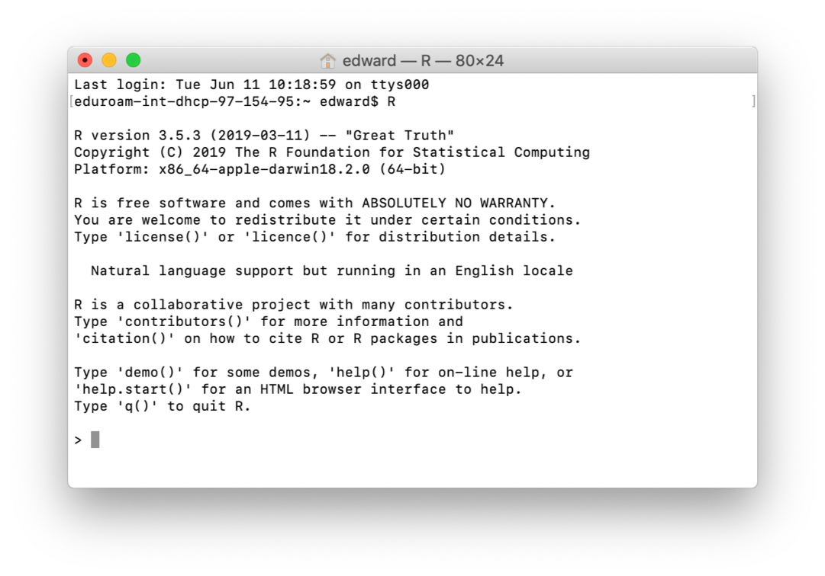
This is what R on it’s own looks like

Slide 8
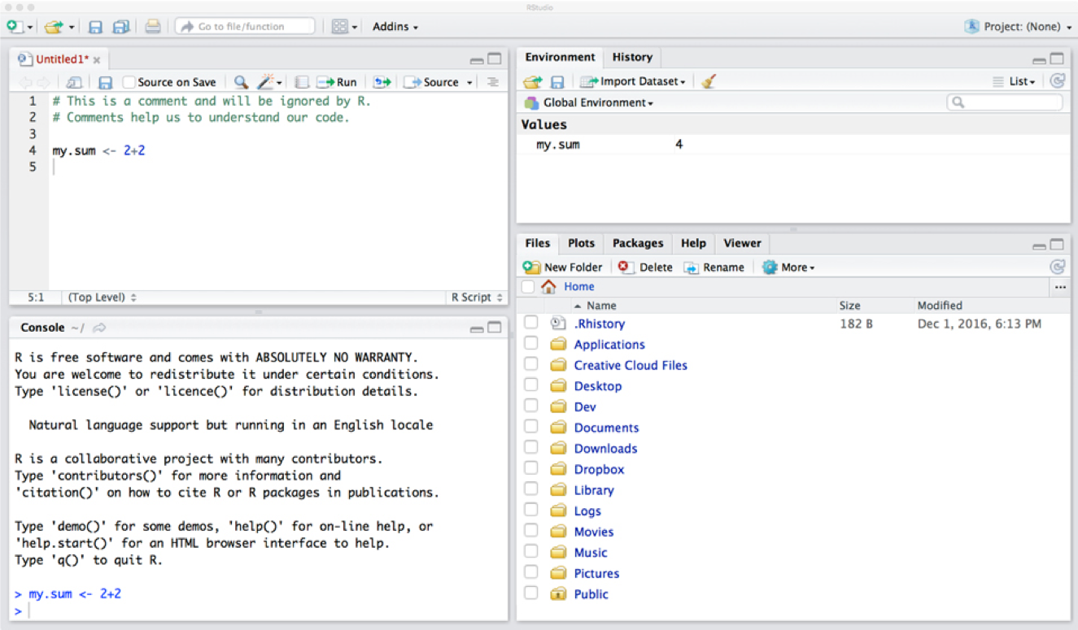
This is what RStudio looks like - much easier to work with
Notes:
Ask learners to open RStudio, but don’t get them to type anything in yet.

Slide 9
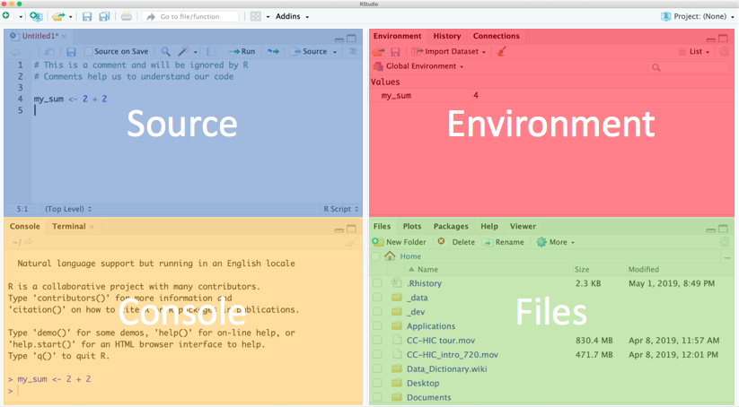
RStudio is made up of windows
Notes:
Explain each window.
Console - this is where R is run. Commands executed but not saved.
Source - text files that contain commands.
Environment - tells you which R objects you are working with.
Files - actually a helper window. Gives you files, help, plots.

Slide 10
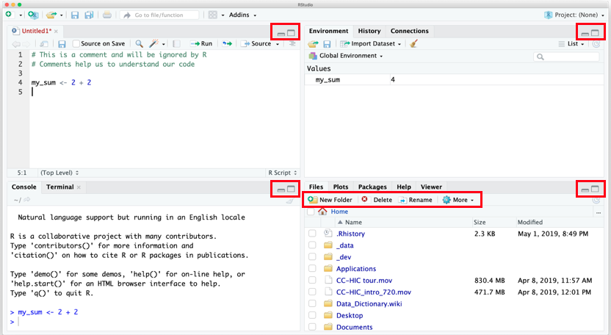
Adjusting your view of RStudio.
Notes:
Explain what each button does.

Slide 11
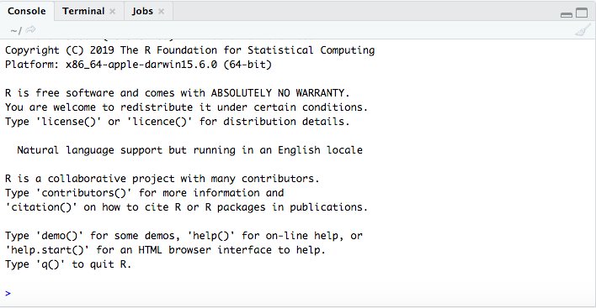
Using the Console window

Slide 12
Using the console
Bottom left window.
This is R!
This is your prompt to type >.
Type 2 + 2 then hit Enter.

Slide 13
Console output
You should see:
2 + 2
## [1] 4
> is the command prompt
2 + 2 is the command
4 is the output from R.
[1] is telling you that 4 is the first value in a sequence returned by R.
Notes:
Say that the ## sign is just printed on the slide as an indicator that we are seeing output rather than code entered. They shouldn’t see the symbol on their consoles.

Slide 14
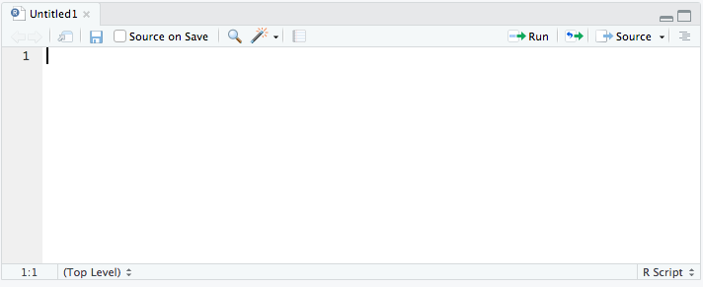
Using the Source or Text editor windows

Slide 15
Using the Source
Type 2 + 2, then Enter.
What happens?
To ask R to run code
Highlight the code and:
MacOS: Cmd + Enter
Windows: Ctrl + Enter
Notice the output in the console.

Slide 16
Saving your work
Click the save icon
Save the file under a meaningful name.
Save it somewhere you can find it again.
.R is the file extension for R scripts.
Close the Source window
Close R Studio
Restart R Studio and click the open icon
Find your file and open
Your code still there
You can run it again.
Notes:
Get them to do this. ?Use this to introduce the labbook idea? Every scientist is expected to maintain a labbook and this should be no different for a data scientist; so each time you sit down to work create a new file; I do this by creating a directory in each project called labbooks and then files named according as CCYY-MM-DD.R See - https://www.training.nih.gov/assets/Lab_Notebook_508_(new).pdf - http://www3.imperial.ac.uk/pls/portallive/docs/1/7289716.PDF - https://en.wikipedia.org/wiki/Lab_notebook

Slide 17
R building blocks
Names
Data
Vectors
Data Frames
Functions
Stored in packages

Slide 18
3 Main Building Blocks
Names
Everything needs a name in R: tables, plots, data files
Data
Data comes in different forms: Real Numbers/Counting Numbers/Characters etc.
Data is stored in vectors
Vectors are stored in data frames
Functions
Little factories
Take an input (raw material) use function (factory) get an output (product)
Functions are collated into packages

Slide 19
Names
You assign names to objects in R.
This is the assignment operator <-
Shortcut:
Mac OSX: Option + -
Windows: Alt + -
Return the stored value by typing the name.
practice <- 2 + 2 + 6 practice
## [1] 10
Notes:
Get them to do this.

Slide 20
Names
You can store any object under a name.
This example stores a string. You need to use quote marks to assign it.
say_hello <- "hello" say_hello
## [1] "hello"
Note that R does not like spaces in names.
say hello <- "hello"
## Error: <text>:1:5: unexpected symbol ## 1: say hello ## ^

Slide 21
Vectors
for R a vector is a container with elements of the same type.
A vector of integers - an example would be age
## [1] 50 25 32 67 46 19 48
A vector of real numbers - an example would be temperature.
## [1] 37.5 37.1 37.3 38.3 37.4 38.9
A vector of characters - an example would be name.
## [1] "Adam" "Sally" "Eve" "John" "James"
A vector of logicals - an example would be ‘are the blood results available?’
## [1] TRUE FALSE FALSE TRUE TRUE

Slide 22
Naming vectors.
The c() function combines individual values into a single vector.
# Storing several ages in one vector. age <- c(50, 25, 32, 67, 46, 19) age
## [1] 50 25 32 67 46 19
# Storing several names in one vector. name <- c("Adam", "Sally", "Eve", "John", "James", "Jennifer") name
## [1] "Adam" "Sally" "Eve" "John" "James" "Jennifer"

Slide 23
Recalling elements of a vector
R creates an index for each element of the vector.
It allocates a number to each element within the vector from left to right, starting with 1.
# The age of the second person. age[2]
## [1] 25
# The age of the fourth person. age[4]
## [1] 67
# The name of the fifth person. name[5]
## [1] "James"

Slide 24
Data Frames.
A data frame is a series of vectors aligned to form a table
Each vector becomes a column in the table
A properly formatted excel spreadsheet is essentially a data frame
Here we can create a new vector for gender
and combine the 3 vectors (name, age, gender) into a dataframe
## name age gender ## 1 Adam 50 male ## 2 Sally 25 female ## 3 Eve 32 female ## 4 John 67 male ## 5 James 46 male ## 6 Jennifer 19 female

Slide 25
Creating a data frame - excercise
Create and name vectors containing information about these 6 patients.
Name: "Adam", "Sally", "Eve", "John", "James", "Jennifer"
Age: 50, 25, 32, 67, 46, 19
Gender: "male", "female", "female", "male", "male", "female"
Quotation marks are not needed for names in R, but are when your data is a string e.g. “male”, “female”
As a rule:
Characters on the left side of the assignment operator. No quote marks.
Characters on the right side of the assignment operator. Use quote marks if storing letters.

Slide 26
Creating a data frame - exercise
Combine these vectors into a data frame using data.frame()
Hint, the vector names need to go inside the ()
Save the data frame under the name patients
Print the data frame called patients to your console

Slide 27
Creating a data frame - solution
# Creating individual vectors. name <- c("Adam", "Sally", "Eve", "John", "James", "Jennifer") age <- c(50, 25, 32, 67, 46, 19) gender <- c("male", "female", "female", "male", "male", "female") # Combining into a data frame. patients <- data.frame(name, age, gender)

Slide 28
This is the data frame.
patients
## name age gender ## 1 Adam 50 male ## 2 Sally 25 female ## 3 Eve 32 female ## 4 John 67 male ## 5 James 46 male ## 6 Jennifer 19 female
R arranges the vectors as columns in the data frame
R names the columns of the data frame after the names of the vectors
R numbers each row of the data frame

Slide 29
Recalling a vector in a data frame
Data frame colums are vectors.
$ can be used to extract a vector from a data frame.
We can get the age column from the data frame group
patients$age
## [1] 50 25 32 67 46 19

Slide 30
Vectors - other properties
Add a value of TRUE to a vector of integers
Give it a name
Recall the vector
Use str() to examine the structure of the vector.
What has happened?

Slide 31
Vectors - other properties
test <- c(1, 2, 3, 4, TRUE) test
## [1] 1 2 3 4 1
str(test)
## num [1:5] 1 2 3 4 1
The value of TRUE has been changed to 1.
The vector is still a numeric vector

Slide 32
Vectors - other properties
Add a string to a vector of integers
Recall the vector
What has happened?

Slide 33
Vectors - other properties
test2 <- c(1, 2, 3, 4, "hi") test2
## [1] "1" "2" "3" "4" "hi"
str(test2)
## chr [1:5] "1" "2" "3" "4" "hi"
The string has been added on to the end of the vector.
The vector is now a string vector.

Slide 34
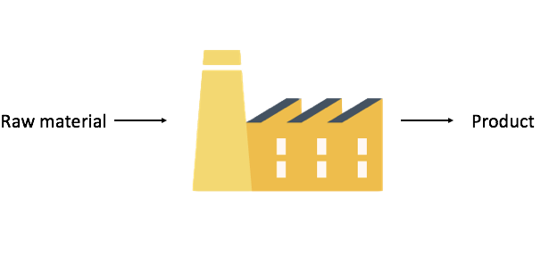
Functions as factories

Slide 35
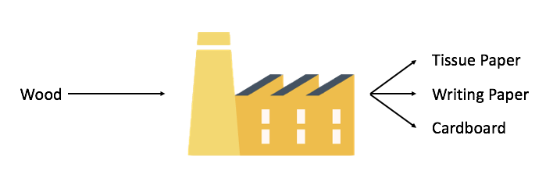
Functions as factories

Slide 36
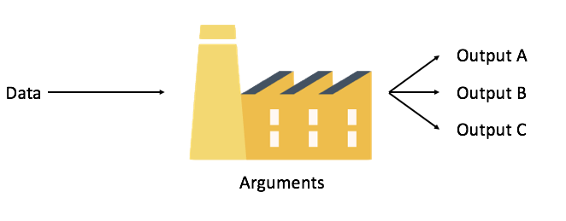
Functions as factories

Slide 37
Functions
Sometimes taught as a “black box”
You can think of them as a factory
Usually labelled as a verb (they are “doing” something)
Many come built into R
Sys.time()
mean(1:100)
You can also install ‘packages’ containing bundles of functions
View each function as a separate separate factory in a production line

Slide 38
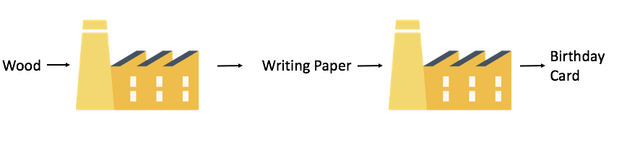
Functions in a line

Slide 39
Functions
You have been using functions already!
data.frame() is a function.
age, gender, weight are arguments.
data.frame(name, age, gender)
## name age gender ## 1 Adam 50 male ## 2 Sally 25 female ## 3 Eve 32 female ## 4 John 67 male ## 5 James 46 male ## 6 Jennifer 19 female
The data frame is the output

Slide 40
Try these functions yourself. What do they do?
Use the group data frame as the argument.
head()
tail()
summary()
mean()

Slide 41
Try these functions yourself.
head() Gives you the first 6 rows
tail() Gives you the last 6 rows
summary() Gives an overview of the object
mean() Gives the mean of a numeric vector

Slide 42
Warning note
Functions are carrying out pre-written instructions
They will fail if they are supplied with the wrong kind of data - they will return an error message instead
Try mean(group$gender)

Slide 43
Help with functions
How do you find out how to use a particular function?
Three ways:
Select the help tab in bottom right of RStudio, then type the function name into the search box, and read the help page.
Type ?function_name into the console.
If you can’t remember the exact function name try typing ??whatever_you_want_to_do into the console. It searches the whole database for matching terms.
Notes:
Get them to look up the help page for mean

Slide 44
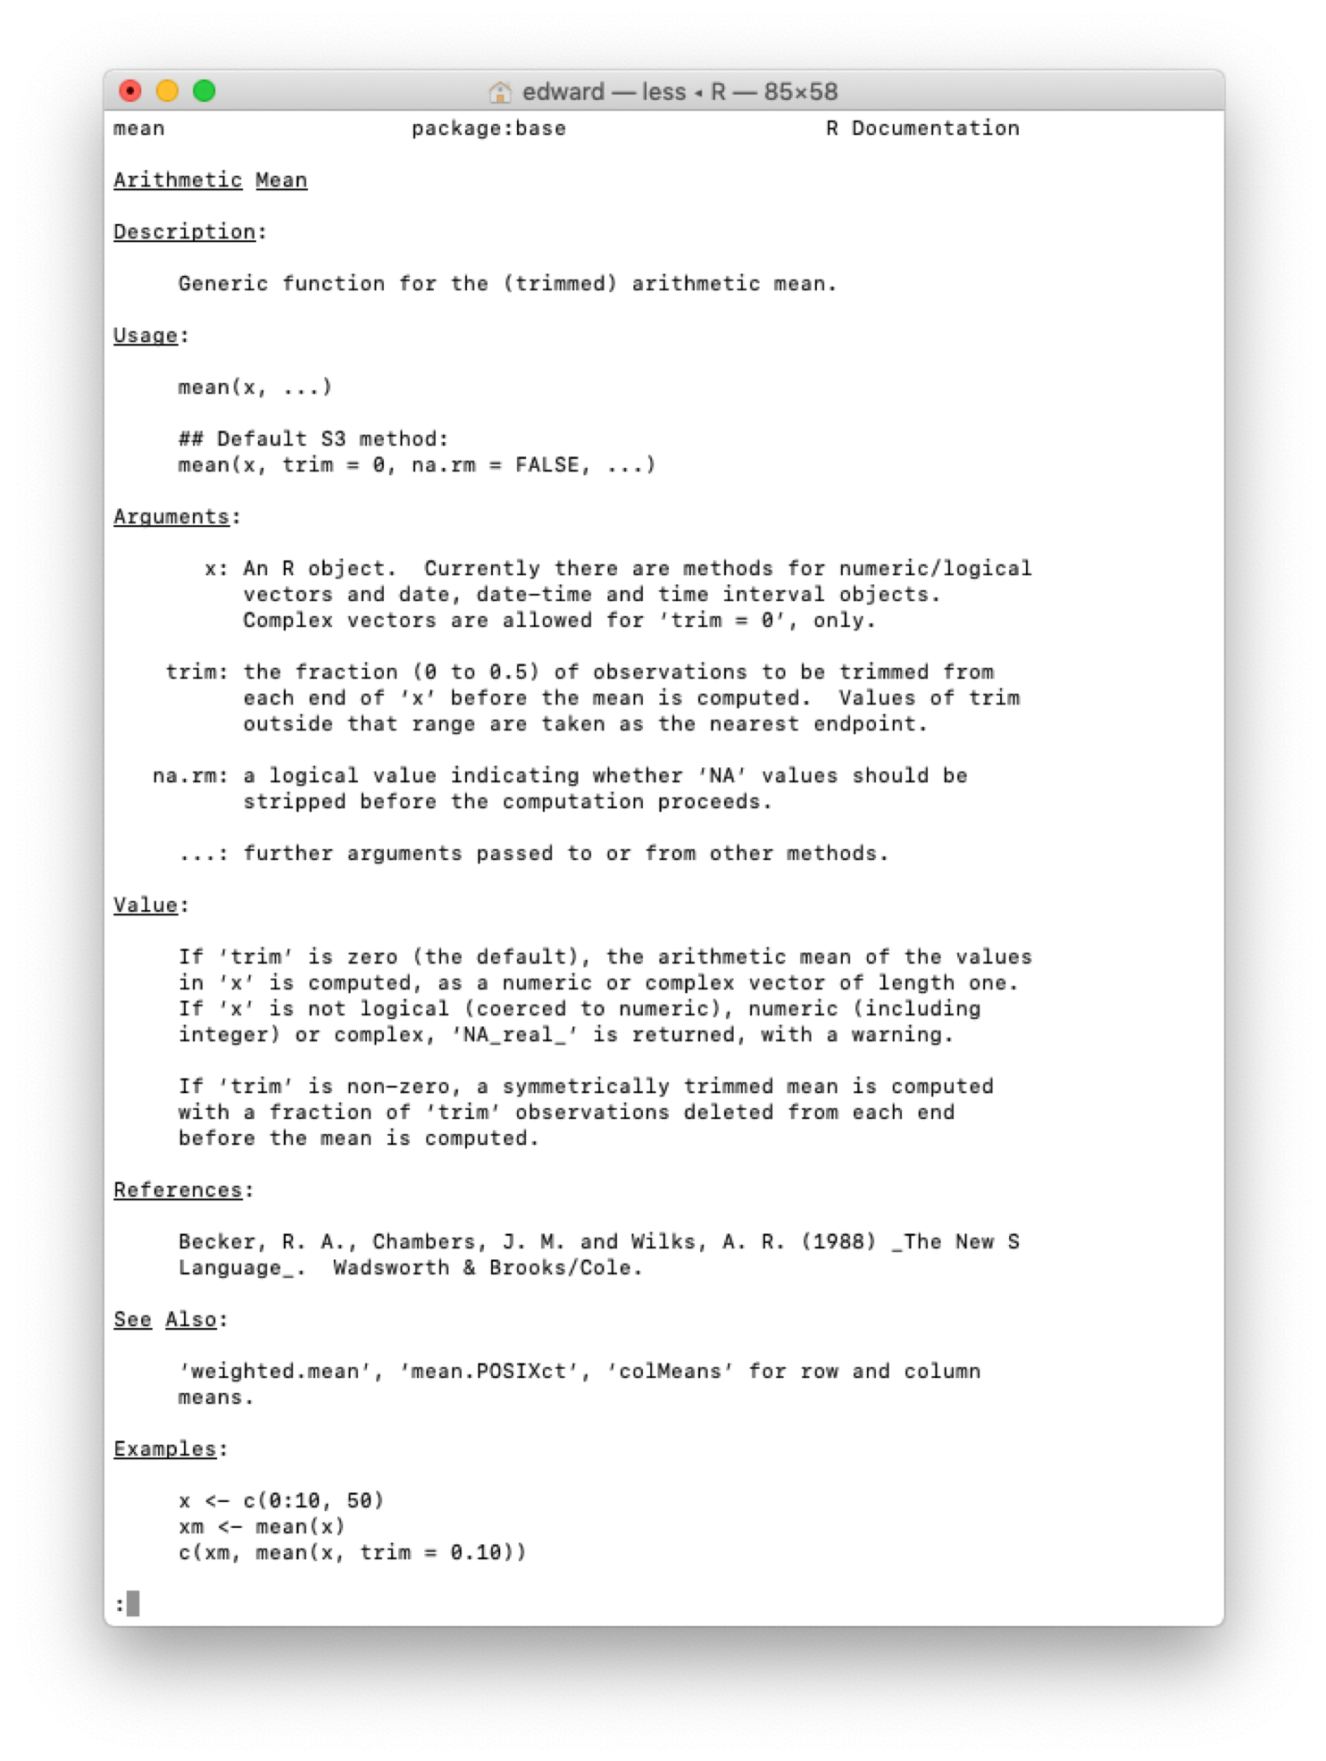
This is what a help page looks like.

Slide 45
Reading the help page
It’s quite complicated.
But the information is usually displayed in a standard format:
Brief description
An example of use
The argument(s) that can be passed to the function - along with any default value it takes if there is no value provided.
Breakdown of these arguments. Gives you more information about what you need to put in.
Tells you how the function works and what to expect to see in the output.
A reproducible example of use, that you can normally use verbatim.
Notes:
reference this back to the factory idea argument = names of the inputs function = machine/factory value = output

Slide 46
Explore functions yourself
Look up the function ls
What are the arguments you can give the function?
How do you specify the argument for ‘pattern’? Try it
When might this be useful?
How do you specify the argument for ‘sorted’? Try it
When might this be useful?
Notes:
Work through this with them.

Slide 47
Packages - collections of functions
There are bunch of functions that come with R. They are ‘base R’ functions.
Thousands of open access functions in other packages
To access these: install the packages, then load them.
Let’s install and load the ‘ggplot2’ package
install.packages("ggplot2") library(ggplot2)
You can now use all of the functions that come with ‘ggplot2’.
You need to load the package using library each time you open R. But you will not need to install it again.
Notes:
Get them to load ggplot2. Emphasise that this is a process we will keep repeating throughout the course.

Slide 48
Other useful packages
These are some packages we will be user later in the course.
ggplot2 - plots graphs in R
readr - imports data into R
stringr - helps you manipulate strings
lubridate - helps you manipulate dates
Notes:
Maybe mention tidyverse as a collection of packages including some of the above that can be loaded together.

