Slide 1
Data Visualization of Bird Strike Between 2000-2011
Prepared by: EJAJ AHAMAD

Slide 2
Introduction
Transport and communication is one of the crucial domain in field of analytics. Environmental impacts and safety are, nowadays, two major concerns of the scientific community with respect to transport scenarios and to the ever-growing urban areas. These issues gain more importance due to the increasing amount of vehicles and people. Seeking for new solutions is reaching a point where available technologies and artificial intelligence, especially MAS, are being recognized as ways to cope and tackle these kinds of problems in a distributed and more appropriate way.
A bird strike is strictly defined as a collision between a bird and an aircraft which is in flight or on a take-off or landing roll. The term is often expanded to cover other wildlife strikes - with bats or ground animals. Bird Strike is common and can be a significant threat to aircraft safety. For smaller aircraft, significant damage may be caused to the aircraft structure and all aircraft, especially jet-engine ones, are vulnerable to the loss of thrust which can follow the ingestion of birds into engine air intakes. This has resulted in several fatal accidents. Bird strikes may occur during any phase of flight, but are most likely during the take-off, initial climb, approach and landing phases due to the greater numbers of birds in flight at lower levels. To have a closer look the following document visually depicts the data collected on Bird Strikes by FAA between 2000-2011

Slide 3
Dataset Information
This a dataset related to the bird strikes occured by aeroplanes between 2000-2011 which contains information like Record ID, Aircraft Type, Altitude bin, Aircraft:Make/Model, Wildlife:Number struck, Flight Date, Effect:Impact to flight, Airline name, Effect:Indicated Damage, Origin State, Total Cost, Feet Above the Ground

Slide 4
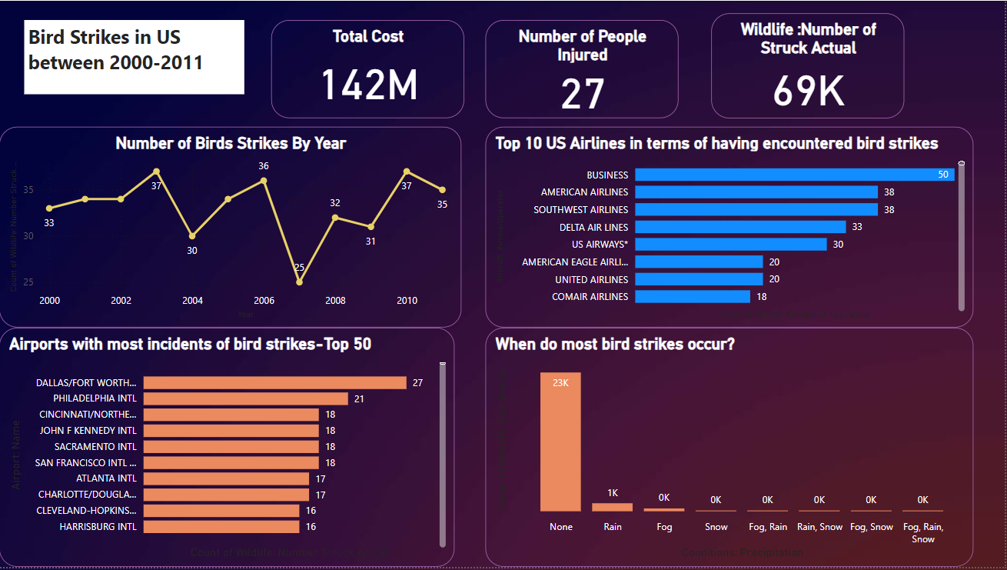
Total cost of 142M was introduced to repair aircrafts which damaged by bird strike.
27 people injured during these bird strikes.
Total 69k birds striked to aircraft between year 2000-2011.
Business Airline striked by birds most 50 times .
DALLAS/FORT worth INTL ARPT was the airport who faced most incidents of bird strike.

Slide 5
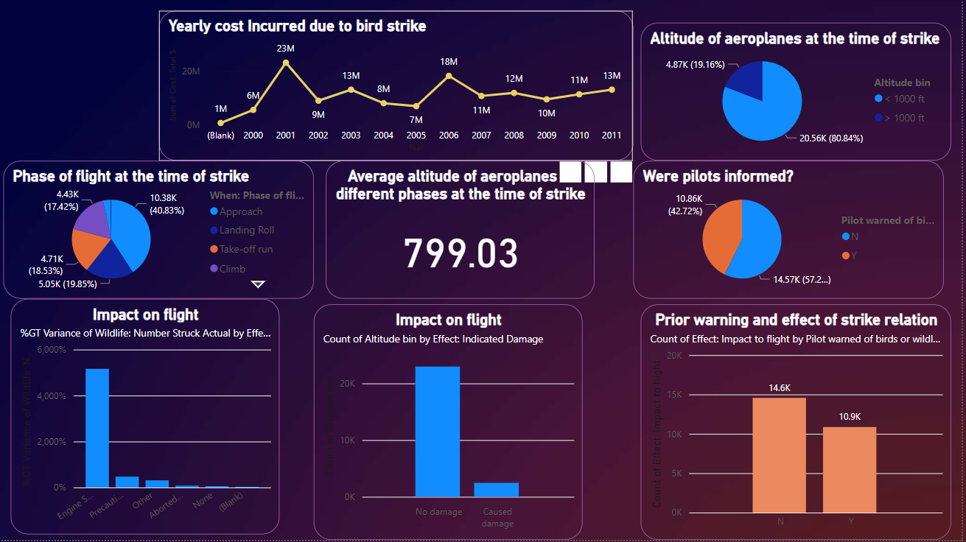
80.84% of flights aeroplanes were above 1000 ft altitude during bird strike while 19.16% of aeroplanes were below 1000ft.
Average Altitude of aeroplanes at different phases was 799.03 during bird strike.
57.28% pilots were unaware of possible bird strike whereas 42.72% of pilots were informed of bird strikes.

Slide 6
Thank you

