Slide 1
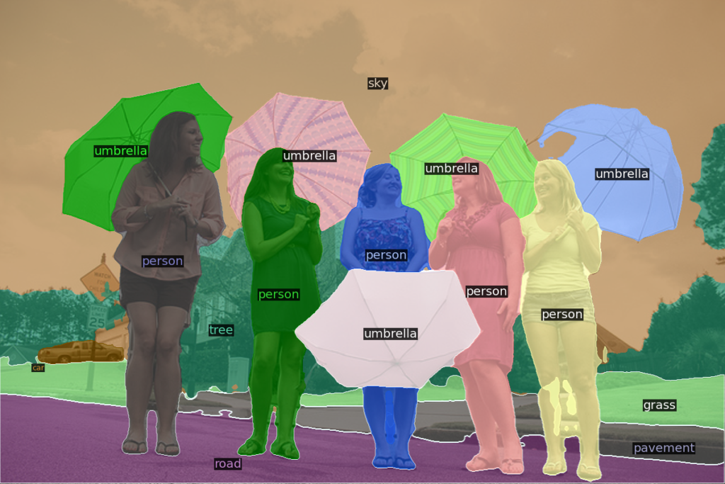
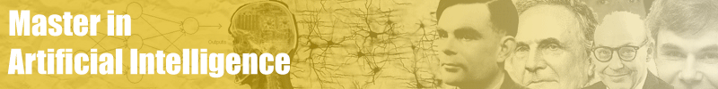

Computational vision:
Semantic Image segmentation
Petia Radeva
2021-2022

Slide 2
Index
Transfer learning
  Taxonomy
  Domain adaptation
  Multi-task learning
  Example: Food recognition
Image segmentation
  Semantic
  Instance
  Panoptic
  Evaluation
Conclusions

Slide 3
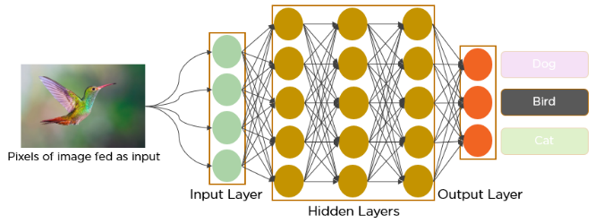
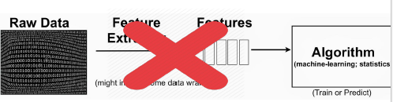
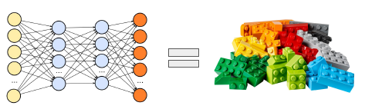
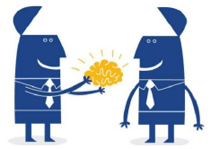
What makes DNN so popular?
It has the three advantages:
1. Self-learned high-level features representations
2. Modularity
3. Transfer Learning (a.k.a. fine-tunning)

Slide 4
Let’s imagine that…
Henry Roth is a man afraid of commitment up until he meets the beautiful Lucy.
They hit it off and Henry think he's finally found the girl of his dreams,
until he discovers:
she has short-term memory loss and forgets him the next day.

Slide 5
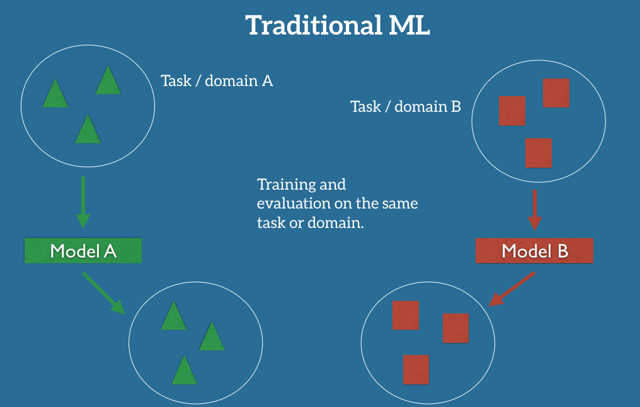
What is Transfer learning?
Transfer Learning (TL):
The ability of a system to recognize and apply knowledge and skills learned in previous tasks to novel tasks (in new domains).
https://ruder.io/transfer-learning/index.html#whatistransferlearning
Notes:
In the classic supervised learning scenario of machine learning, if we intend to train a model for some task and domain we assume that we are provided with labeled data for the same task and domain. We can see this clearly in Figure 1, where the task and domain of the training and test data of our model is the same. We will later define in more detail what exactly a task and a domain are). For the moment, let us assume that a task is the objective our model aims to perform, e.g. recognize objects in images, and a domain is where our data is coming from, e.g. images taken in San Francisco coffee shops.
In practice, however, we often experience a deterioration or collapse in performance as the model has inherited the bias of its training data and does not know how to generalize to the new domain.

Slide 6
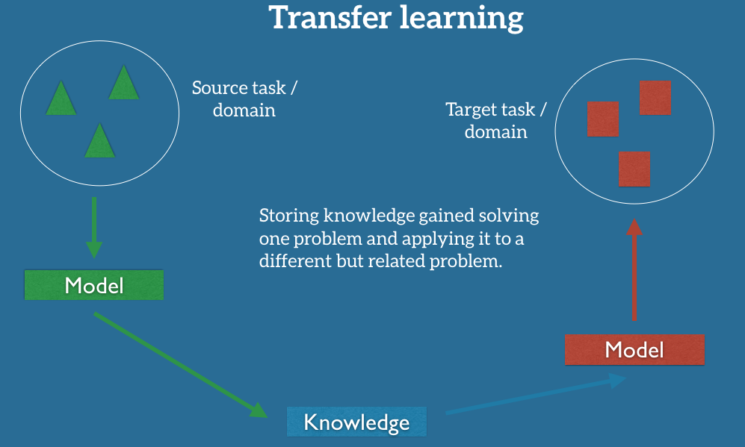
Transfer learning
https://ruder.io/transfer-learning/index.html#fn44
Notes:
Transfer learning allows us to deal with these scenarios by leveraging the already existing labeled data of some related task or domain. We try to store this knowledge gained in solving the source task in the source domain and apply it to our problem of interest as can be seen in Figure 2.

Slide 7
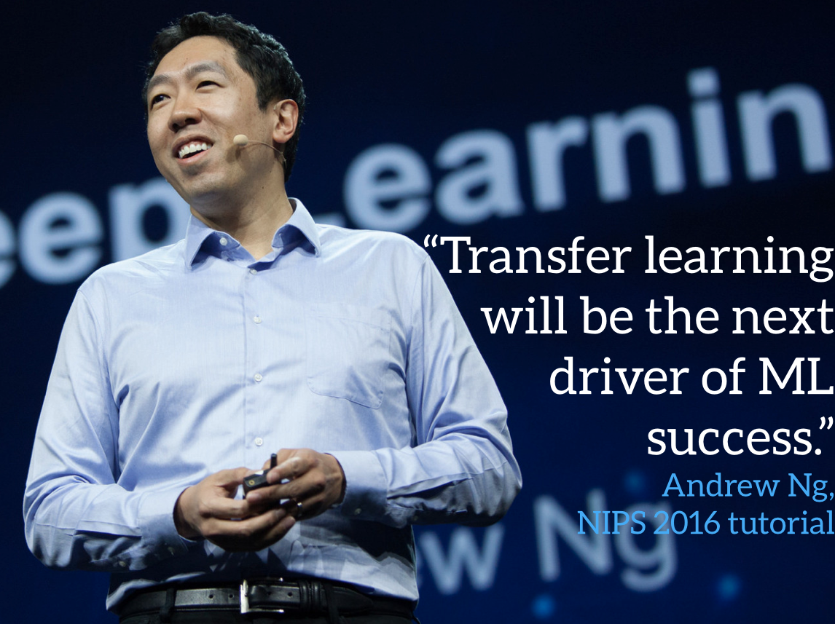
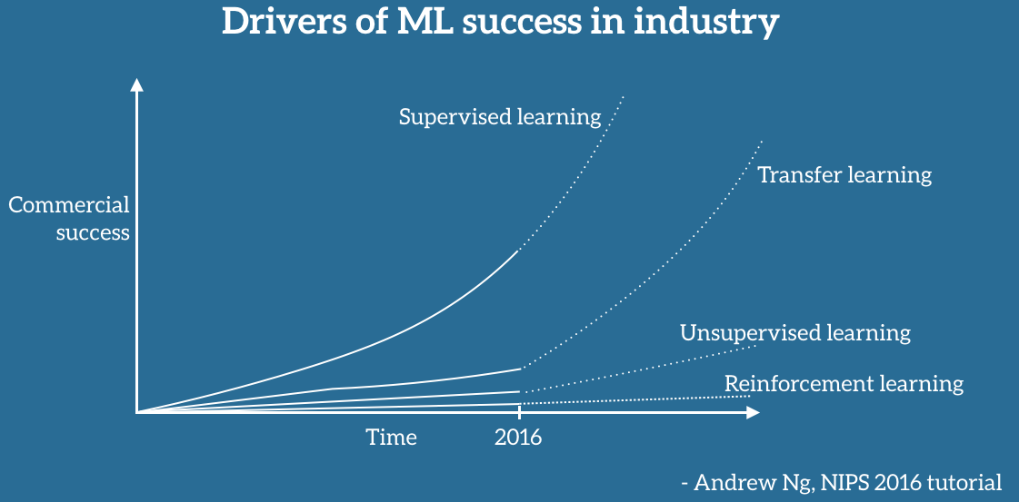
Why Transfer Learning Now?
Andrew Ng, chief scientist at Baidu and professor at Stanford
https://ruder.io/transfer-learning/index.html#fn44
Notes:
Andrew Ng, chief scientist at Baidu and professor at Stanford, said during his widely popular NIPS 2016 tutorial that transfer learning will be -- after supervised learning -- the next driver of ML commercial success.
According to Andrew Ng, transfer learning will become a key driver of Machine Learning success in industry.

Slide 8
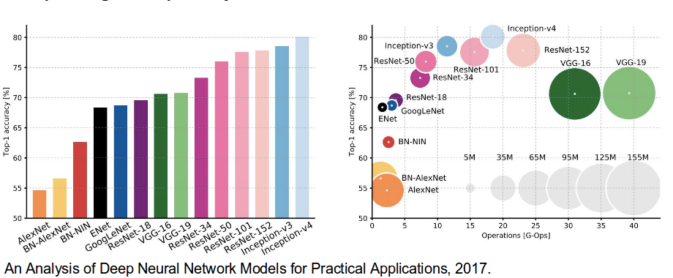
Why now is the time for Transfer Learning?
Availability of well working models
  ResNet achieveing superhuman performance
on recognizing objects
  Google's Smart Reply automatically handles 10% of all mobile responses;
  speech recognition error has consistently dropped and is more accurate than typing;
  we can automatically identify skin cancer as well as dermatologists;
  Google's NMT system is used in production for more than 10 language pairs, etc.
https://ruder.io/transfer-learning/index.html#fn44
Notes:
The current use of machine learning in industry is characterised by a dichotomy:
On the one hand, over the course of the last years, we have obtained the ability to train more and more accurate models. We are now at the stage that for many tasks, state-of-the-art models have reached a level where their performance is so good that it is no longer a hindrance for users. How good? The newest residual networks [1] on ImageNet achieve superhuman performance at recognising objects; Google's Smart Reply [2] automatically handles 10% of all mobile responses; speech recognition error has consistently dropped and is more accurate than typing [3]; we can automatically identify skin cancer as well as dermatologists; Google's NMT system [4] is used in production for more than 10 language pairs; Baidu can generate realistic sounding speech in real-time; the list goes on and on. This level of maturity has allowed the large-scale deployment of these models to millions of users and has enabled widespread adoption.
At the same time, when applying a machine learning model in the wild, it is faced with a myriad of conditions which the model has never seen before and does not know how to deal with; each client and every user has their own preferences, possesses or generates data that is different than the data used for training; a model is asked to perform many tasks that are related to but not the same as the task it was trained for. In all of these situations, our current state-of-the-art models, despite exhibiting human-level or even super-human performance on the task and domain they were trained on, suffer a significant loss in performance or even break down completely.

Slide 9
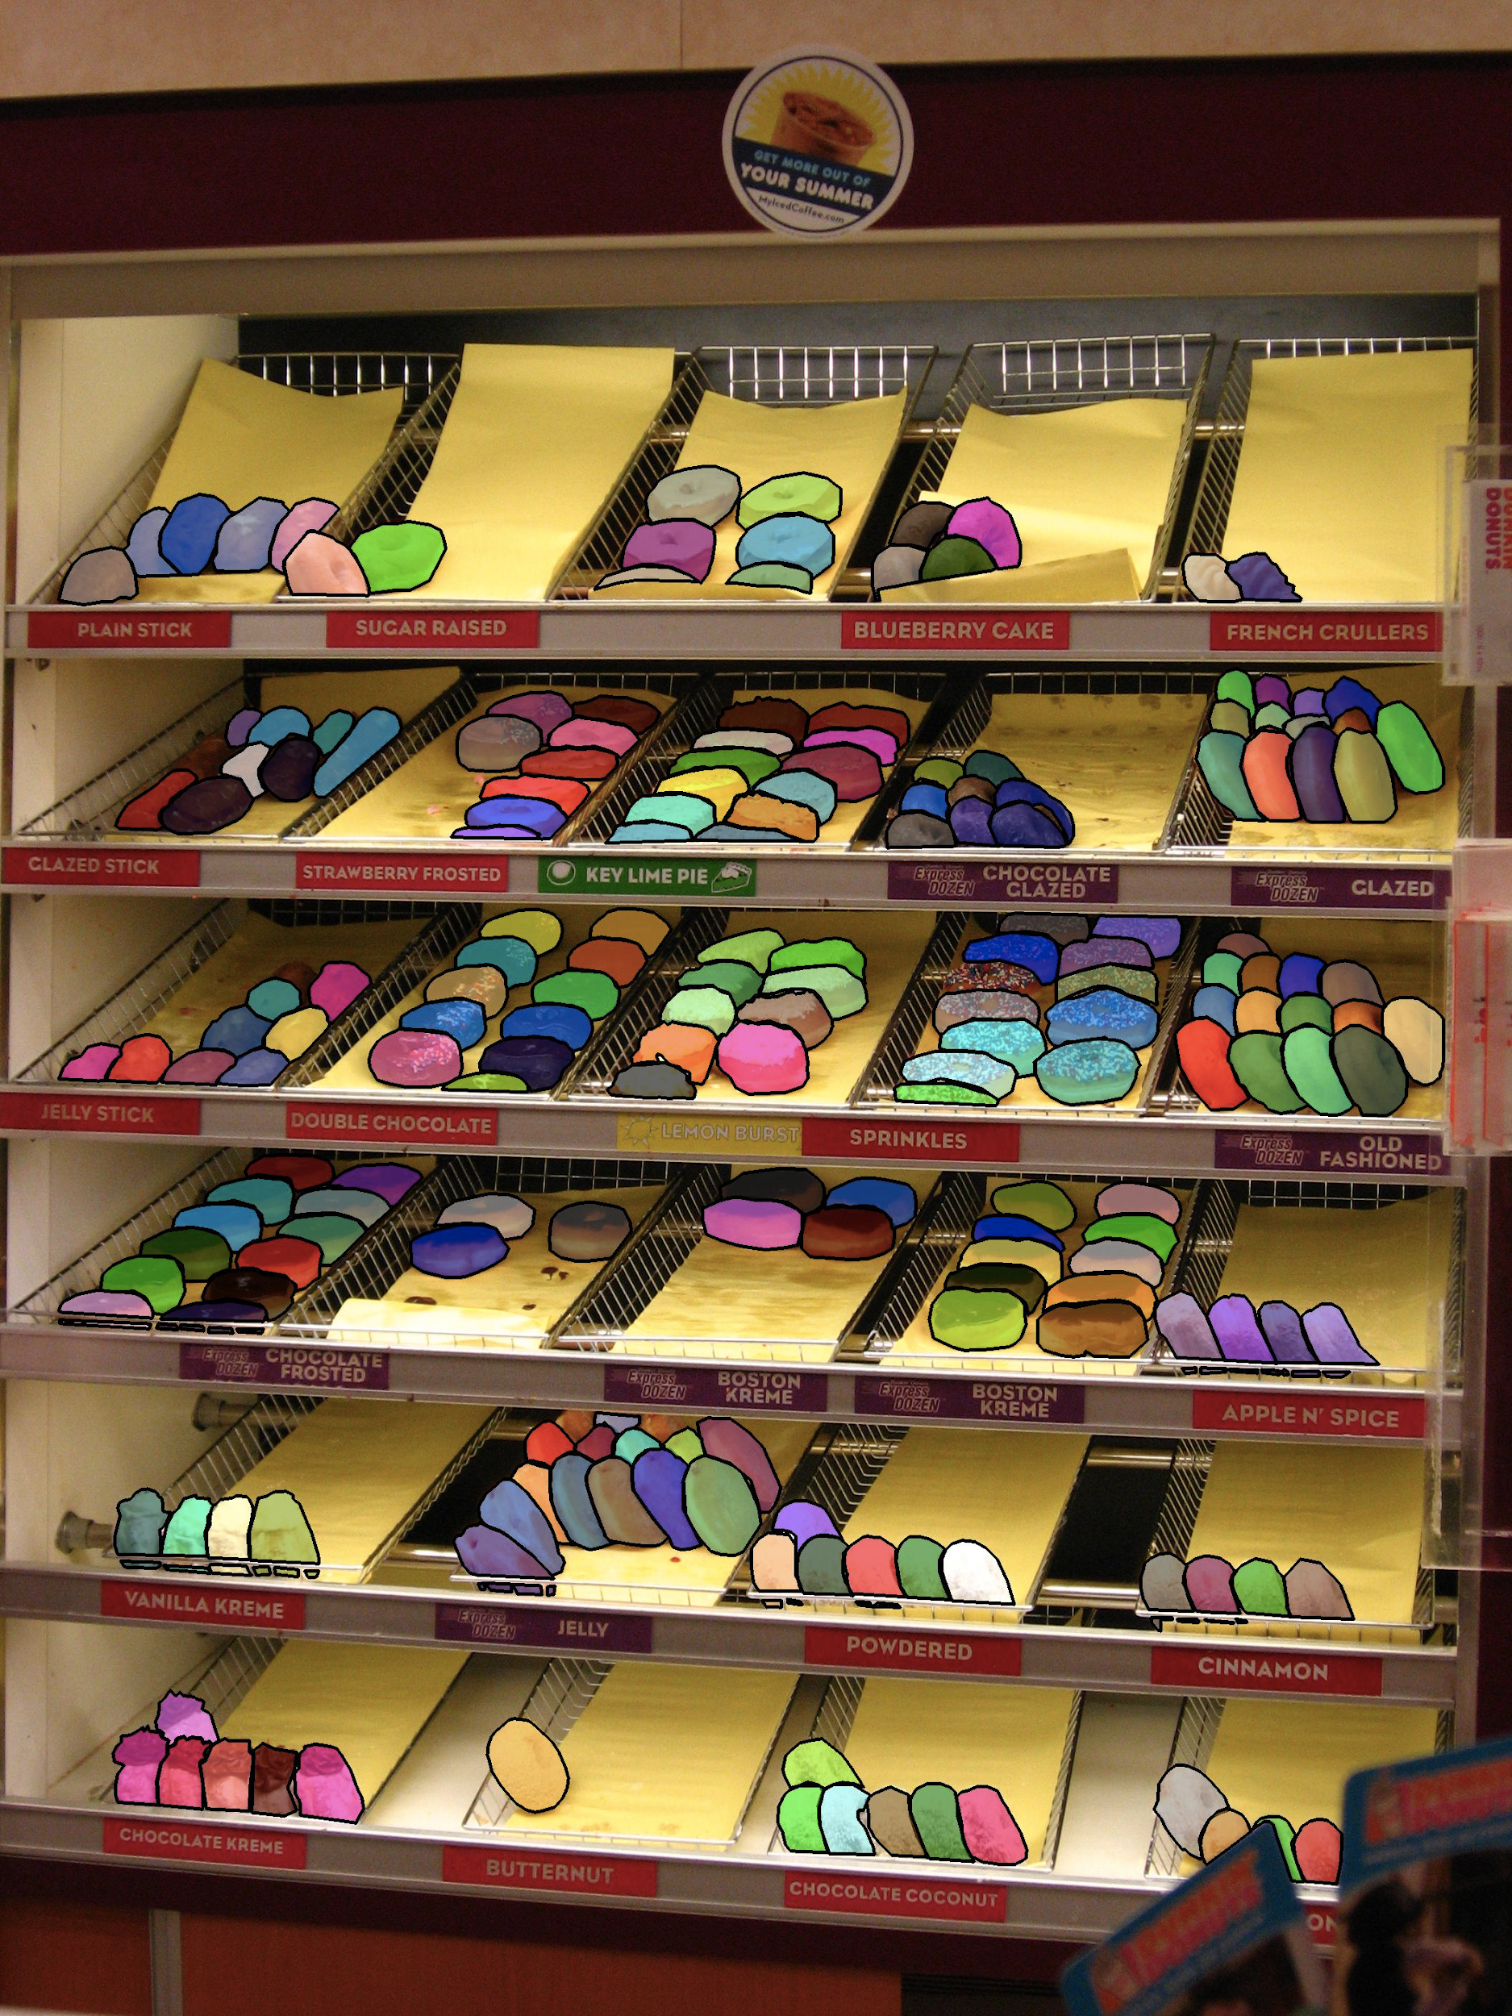
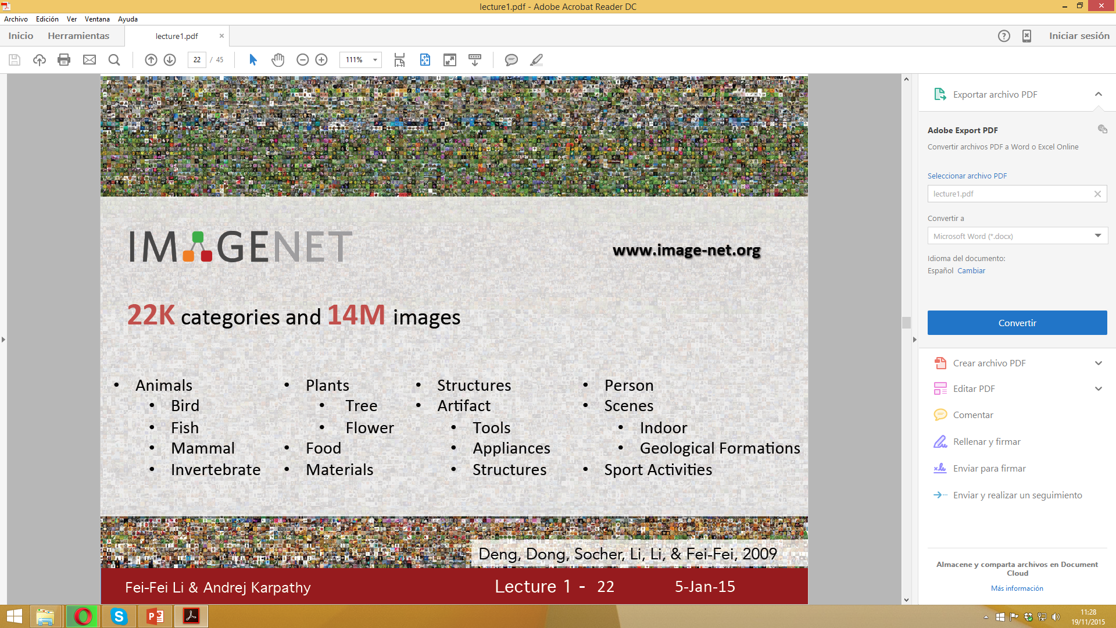
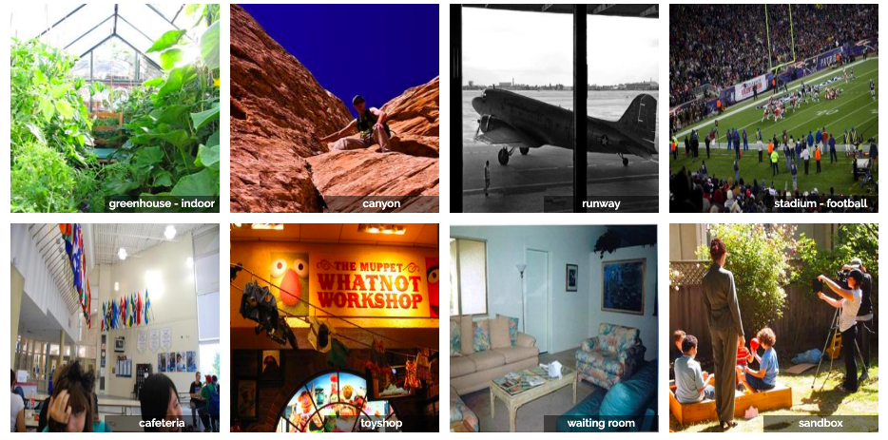
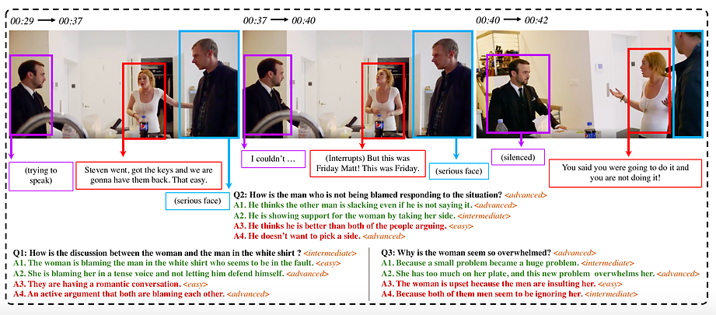
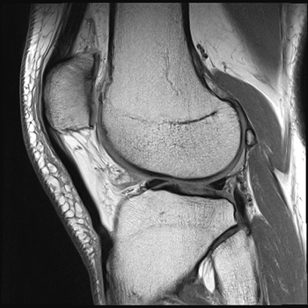
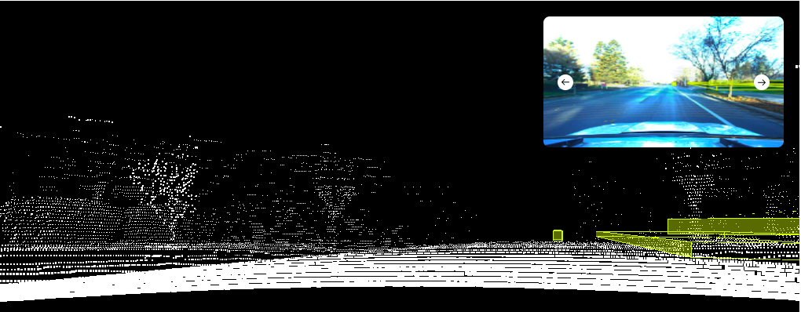
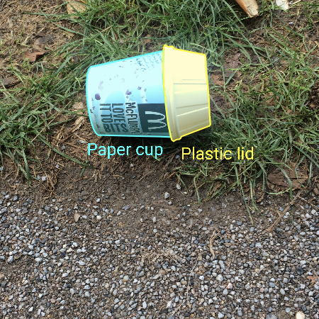
Why now is the time for Transfer Learning?
Successful models are immensely data-hungry and rely on huge amounts of labeled data to achieve their performance.
A model is asked to behave in a new situation on tasks that not exactly it was trained for.
LVIS Challenge: 2.2M masks, 16K images
Places2: 10M images
Lyft Level 5
SocialIQ
TACO: Waste in the wild
FastMRI
https://ruder.io/transfer-learning/index.html#fn44
Notes:
The current use of machine learning in industry is characterised by a dichotomy:
On the one hand, over the course of the last years, we have obtained the ability to train more and more accurate models. We are now at the stage that for many tasks, state-of-the-art models have reached a level where their performance is so good that it is no longer a hindrance for users. How good? The newest residual networks [1] on ImageNet achieve superhuman performance at recognising objects; Google's Smart Reply [2] automatically handles 10% of all mobile responses; speech recognition error has consistently dropped and is more accurate than typing [3]; we can automatically identify skin cancer as well as dermatologists; Google's NMT system [4] is used in production for more than 10 language pairs; Baidu can generate realistic sounding speech in real-time; the list goes on and on. This level of maturity has allowed the large-scale deployment of these models to millions of users and has enabled widespread adoption.
At the same time, when applying a machine learning model in the wild, it is faced with a myriad of conditions which the model has never seen before and does not know how to deal with; each client and every user has their own preferences, possesses or generates data that is different than the data used for training; a model is asked to perform many tasks that are related to but not the same as the task it was trained for. In all of these situations, our current state-of-the-art models, despite exhibiting human-level or even super-human performance on the task and domain they were trained on, suffer a significant loss in performance or even break down completely.

Slide 10
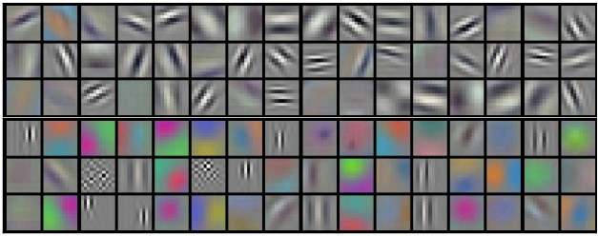

Transfer Learning Methods: Using pre-trained CNN features
Understanding CNNs:
Lower convolutional layers capture low-level image features, e.g. edges, while higher convolutional layers capture more and more complex details, such as body parts, faces, and other compositional features.
Classification is done by FC layers that explain how edges and shapes are combined.
For a new task, use the off-the-shelf features of a state-of-the-art CNN pre-trained on ImageNet and train a new model on these extracted features
Notes:
The final fully-connected layers are generally assumed to capture information that is relevant for solving the respective task, e.g. AlexNet's fully-connected layers would indicate which features are relevant to classify an image into one of 1000 object categories.
However, while knowing that a cat has whiskers, paws, fur, etc. is necessary for identifying an animal as a cat (for an example, see Figure 15), it does not help us with identifying new objects or to solve other common vision tasks such as scene recognition, fine grained recognition, attribute detection and image retrieval.

Slide 11
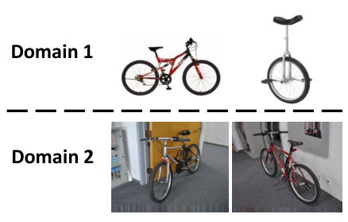
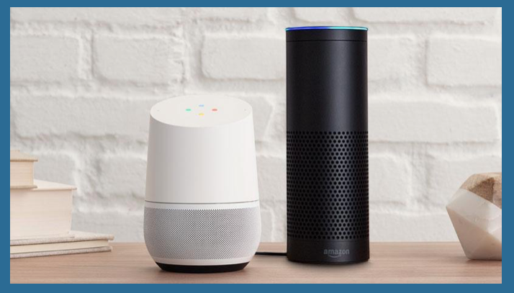
Fine-tuning: Adapting to new domains
Often the data where labeled information is easily accessible
  However, the training data could contain a bias imperceptible to humans
    even if the training and the test data look the same,
The goal: to easy the training in a new domain.
Source
Target
Notes:
Finally, while the above challenges deal with general text or image types, problems are amplified if we look at domains that pertain to individual or groups of users: Consider the case of automatic speech recognition (ASR). Speech is poised to become the next big platform, with 50% of all our searches predicted to be performed by voice by 2020. Most ASR systems are evaluated traditionally on the Switchboard dataset, which comprises 500 speakers. Most people with a standard accent are thus fortunate, while immigrants, people with non-standard accents, people with a speech impediment, or children have trouble being understood. Now more than ever do we need systems that are able to adapt to individual users and minorities to ensure that everyone's voice is heard.

Slide 12
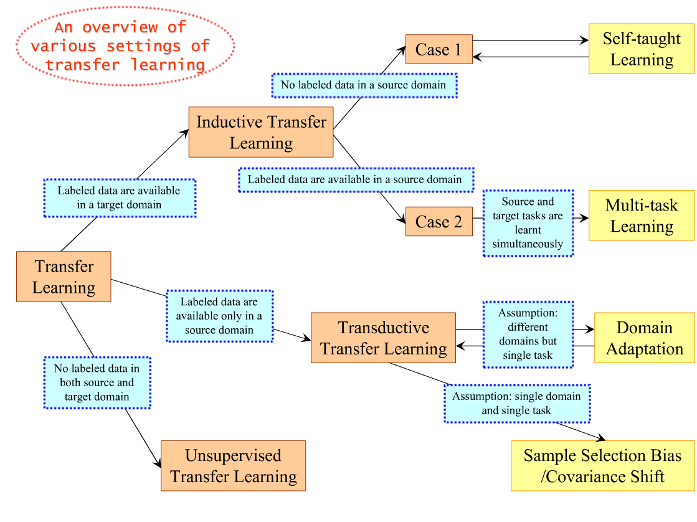
Taxonomy of Transfer Learning
Pan, S. J., & Yang, Q. (2009). A survey on transfer learning. IEEE Trans. KDE, 22(10), 1345-1359

Slide 13
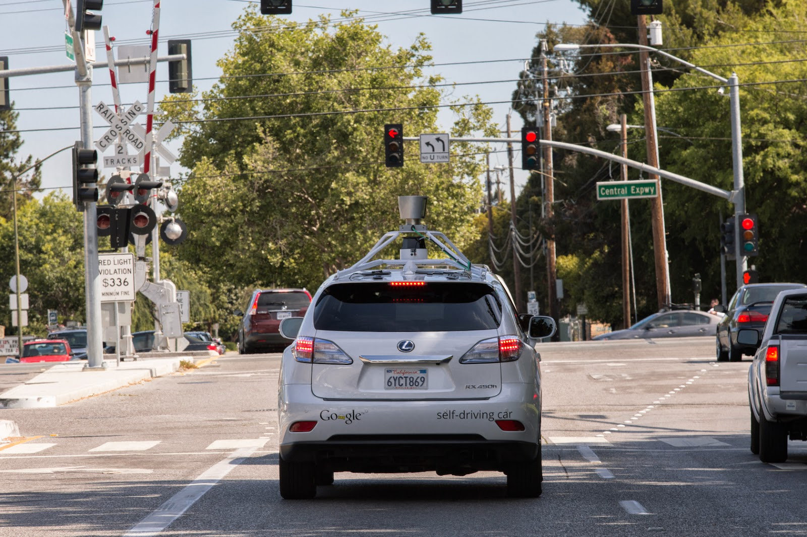
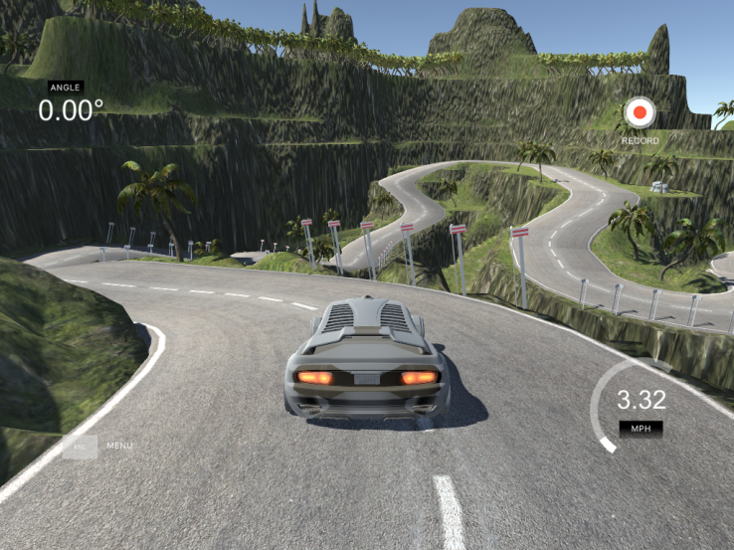
Domain adaptation: Learning from simulations
Gathering data and training a model in the real world is either expensive, time-consuming, or simply too dangerous.
Learning from a simulation and applying the acquired knowledge to the real world is an instance of transfer learning,
  as the feature spaces between source and target domain are the same,
  but the marginal probability distributions between simulation and reality are different,
  this difference diminishes as simulations get more realistic.
Notes:
Simulation is the preferred tool for this and is used towards enabling many advanced ML systems in the real world. Learning from a simulation and applying the acquired knowledge to the real world is an instance of transfer learning scenario 2, as the feature spaces between source and target domain are the same (both generally rely on pixels), but the marginal probability distributions between simulation and reality are different, i.e. objects in the simulation and the source look different, although this difference diminishes as simulations get more realistic. At the same time, the conditional probability distributions between simulation and real wold might be different as the simulation is not able to fully replicate all reactions in the real world, e.g. a physics engine can not completely mimic the complex interactions of real-world objects.
Learning from simulations has the benefit of making data gathering easy as objects can be easily bounded and analyzed, while simultaneously enabling fast training, as learning can be parallelized across multiple instances. Consequently, it is a prerequisite for large-scale machine learning projects that need to interact with the real world, such as self-driving cars (Figure 6). According to Zhaoyin Jia, Google's self-driving car tech lead, "Simulation is essential if you really want to do a self-driving car". Udacity has open-sourced the simulator it uses for teaching its self-driving car engineer nanodegree, which can be seen in Figure 7 and OpenAI's Universe will potentially allows to train a self-driving car using GTA 5 or other video games.

Slide 14
Multi-Task Learning
Input: A lot of labeled data in a source domain and the target domain that coincide.
Goal: Classifying the target and source domain data simultaneously .
Assumption: The source domain and target domain data share some common features, which can help classifying sharing knowledge.
Main Idea: To train simultaneously both tasks.

Slide 15
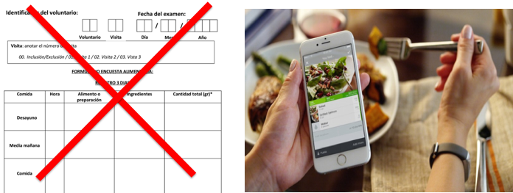
Let us consider the problem of food recognition
Did you know that:
180 million photos with the hashtag #food on Instagram
90 new photos hash-tagged #foodporn are uploaded to Instagram every minute.
54% of 18–24 year olds take a food photo while eating out,
    39% have posted it somewhere online.
5% of over-50s share food snaps on forums as Facebook & Twitter
"Camera eats first"

Slide 16
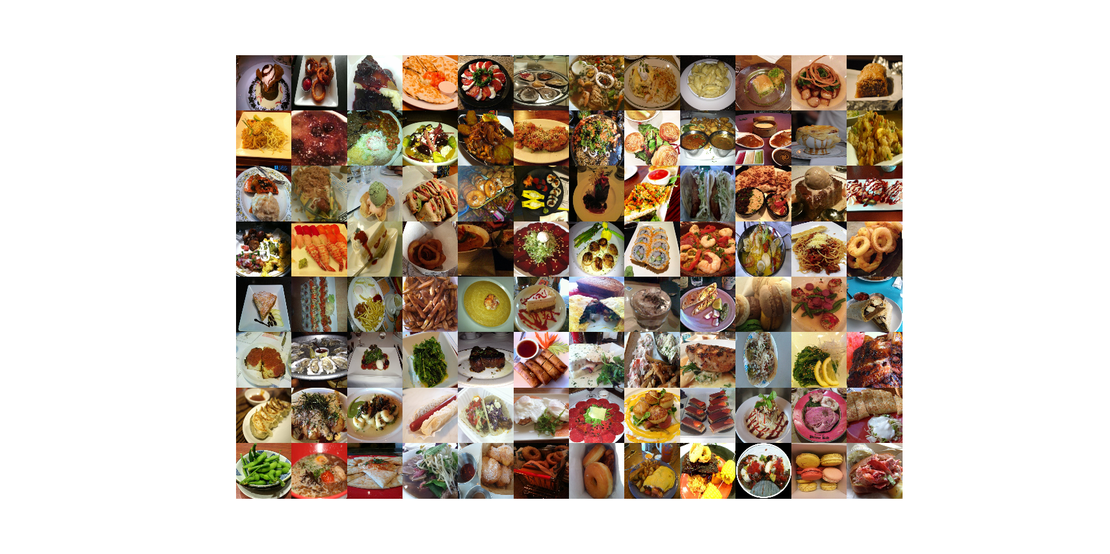
Why is the food recognition a challenge?

Slide 17
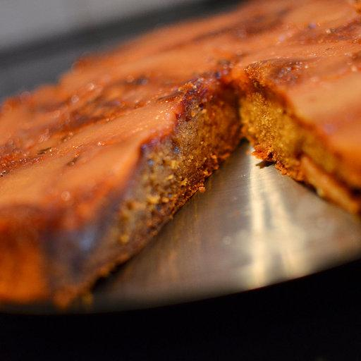
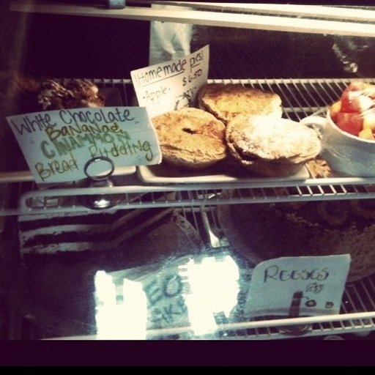
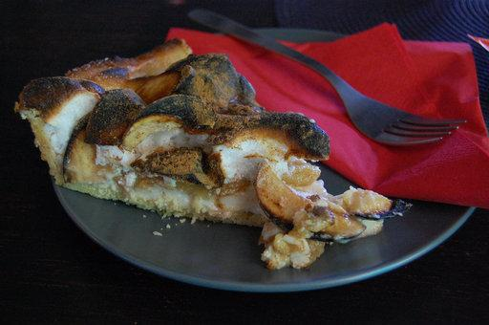
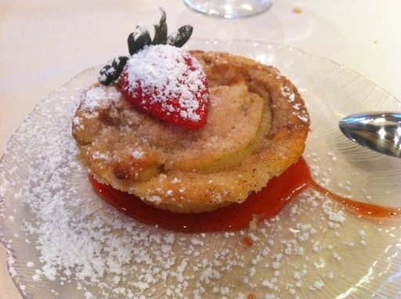
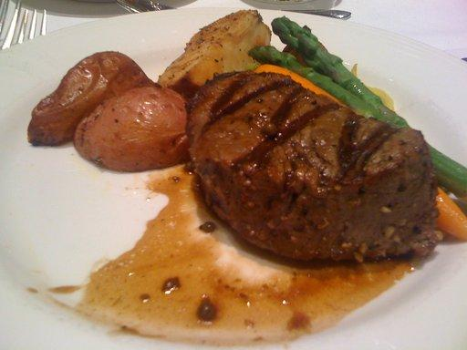
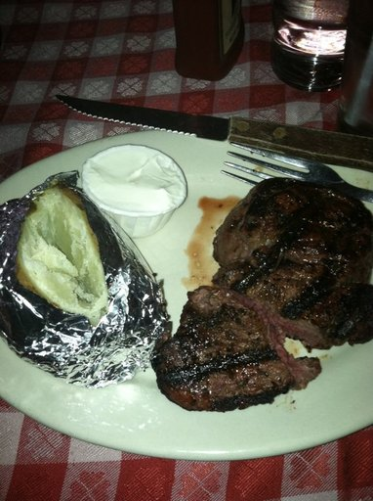
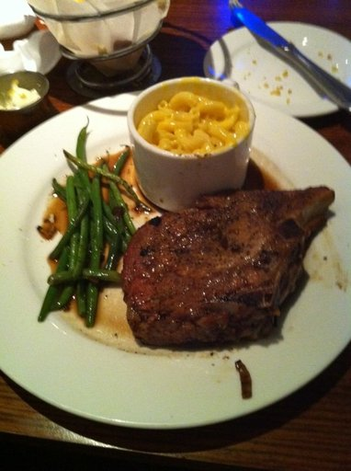
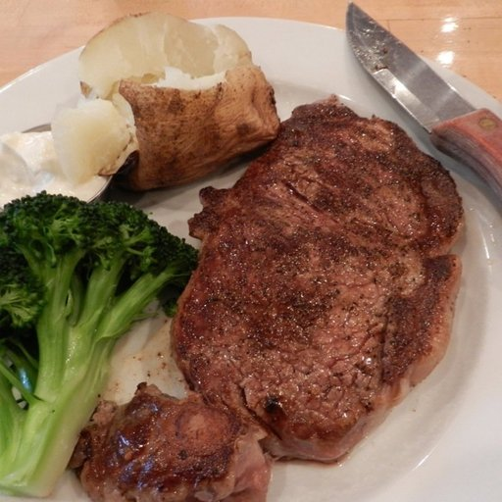
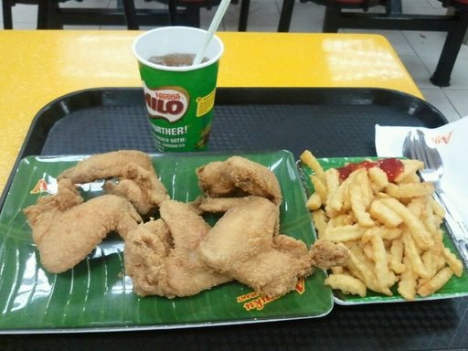
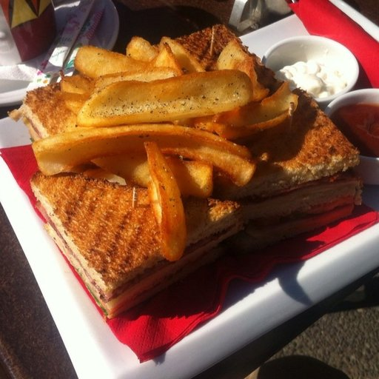
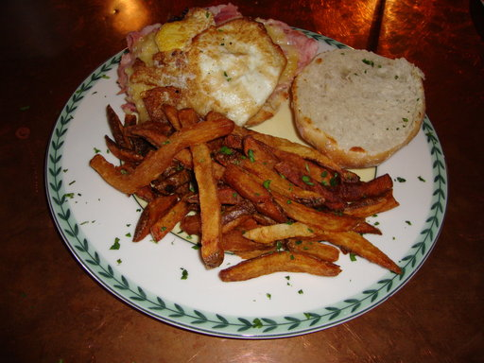
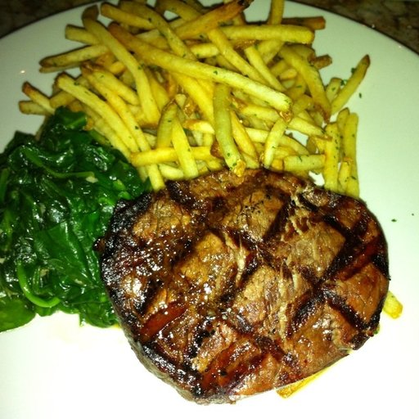
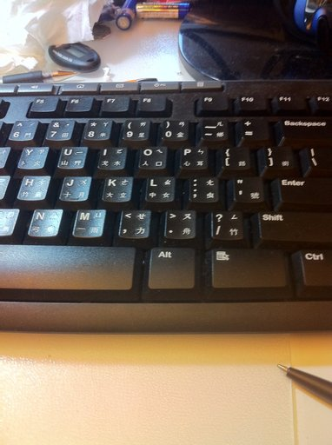
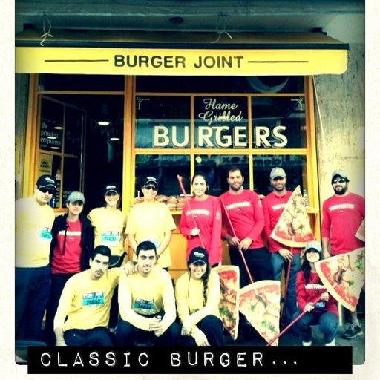
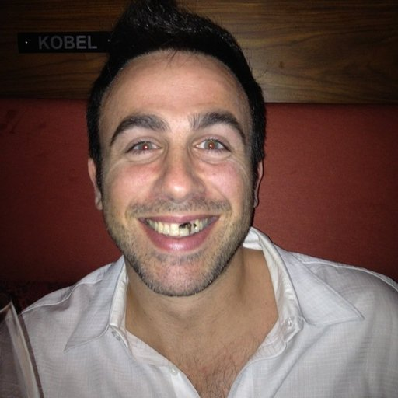
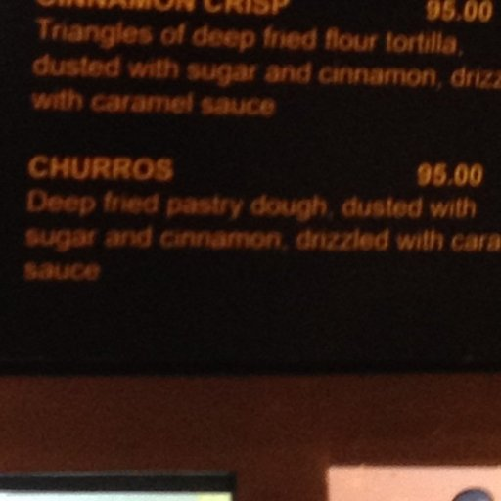
Difficulties
Huge intra-class variations
Ambiguous definition
Inter-class similarities
Mixed items
Need of huge datasets
Bad Labeled
What to do when you have a really complicate problem?

Slide 18
Are we able to recognize thousands of dishes?
79.46% - best performance on the food dataset UECFOOD-100
  72% in the extended version UECFOOD-256 [1]
44.1% - baseline performance in the largest dataset ChinFood1000 - [2]
It is well-known that the class number is inversely proportional to the model performance [3]
How to achieve scalability?
[1] Martinel, Niki and Foresti, Gian Luca and Micheloni, Christian, Wide-slice residual networks for food recognition, IEEE WACV, 2018.
[2] Fu, Zhihui and Chen, Dan and Li, Hongyu, ChinFood1000: a large benchmark dataset for Chinese food recognition, ICIC 2017.
[3] Luo, C., Li, X., Yin, J., He, J., Gao, D., Zhou, J.: How does the data set and the number of categories affect cnn-based image classification performance? Journal of Software, 2019.

Slide 19
Transfer Learning

Slide 20
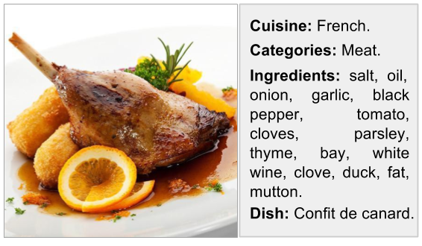
Multi-Task Learning (MTL)
Learning multiple objectives from a shared representation
- Efficiency and prediction accuracy.
Crucial importance in systems where long computation run-time is prohibitive
- Combining all tasks reduces computation.
Inductive knowledge transfer
-
Generalization by sharing the domain information between complimentary tasks.
Notes:
Multi-task learning aims to improve learning efficiency and prediction accuracy for for each task,
when compared to training the models separately [18, 19]. It can be considered an approach to
inductive knowledge transfer which improves generalisation by sharing the domain information
between complimentary tasks. It does this by using a shared representation to learn multiple tasks –
what is learned from one task can help other tasks be learned better [1].

Slide 21
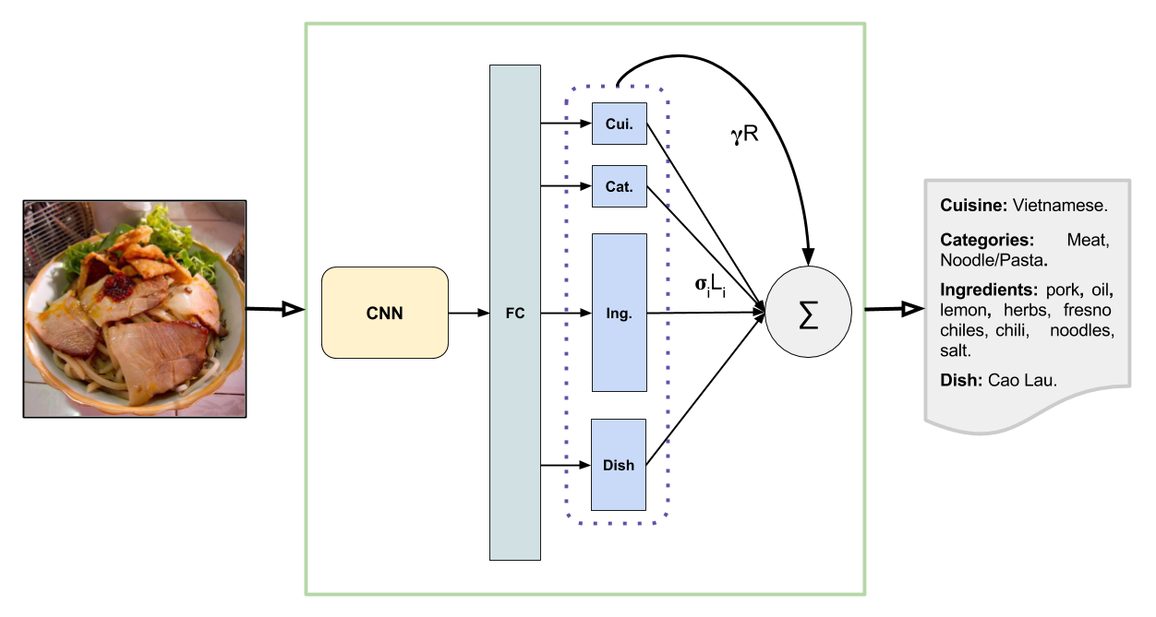
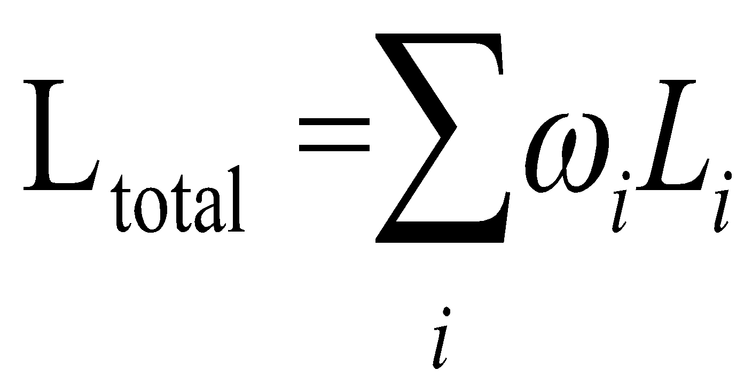
Food Recognition as a MTL

Slide 22
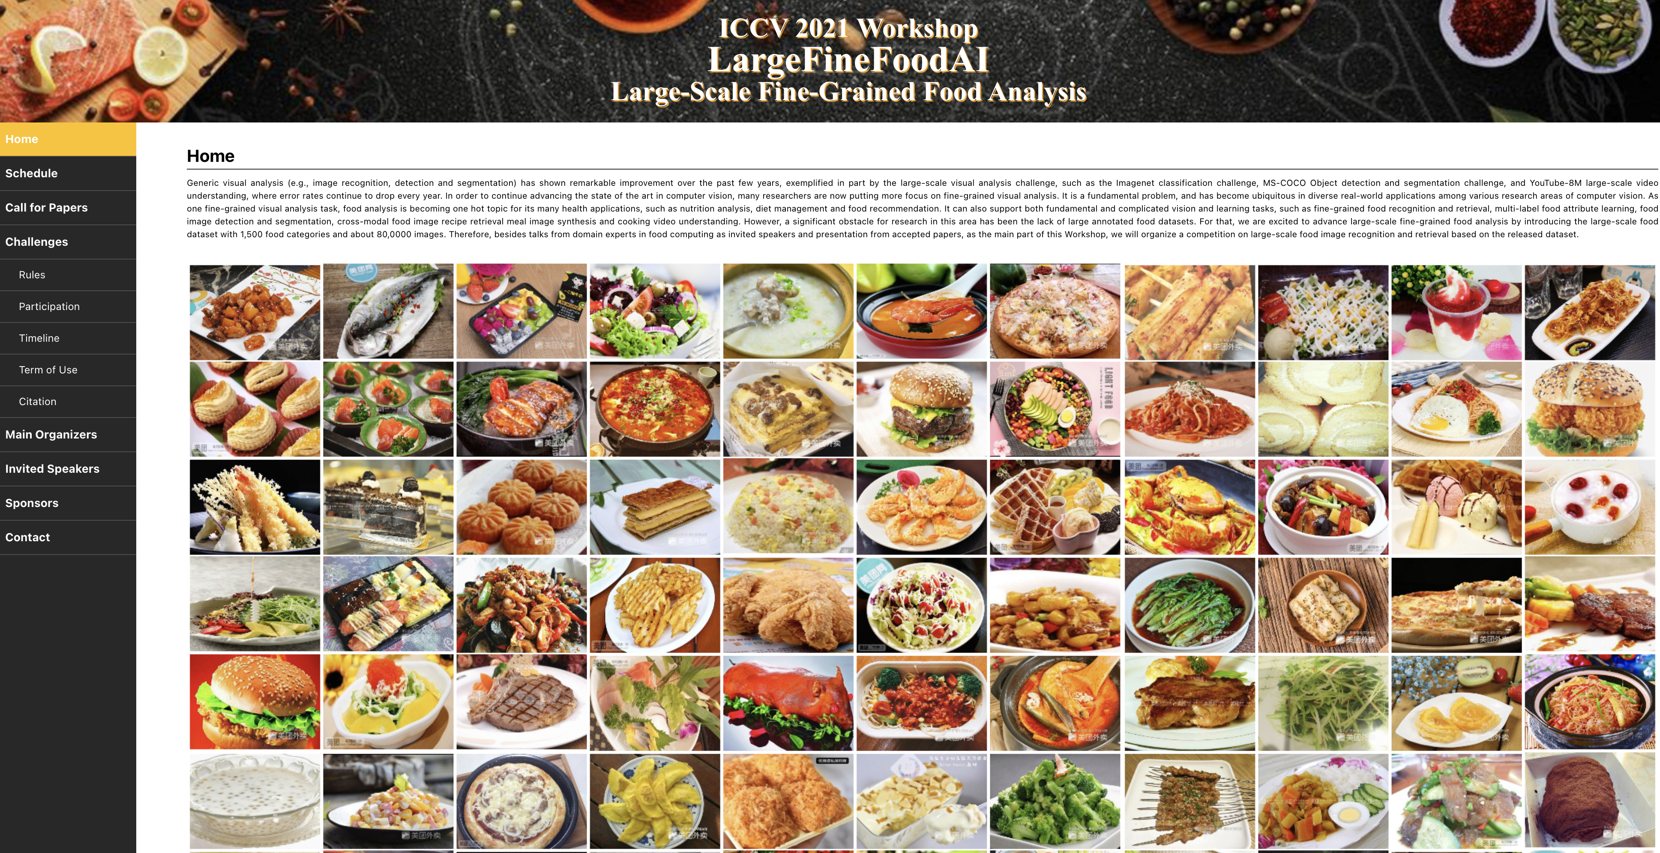
Food datasets
LargeFineFoodAI dataset 1,000 fine-grained food categories and over 50,000 images.
Notes:
We are proving that completing our proposals with transformers we can come up with 90% of top1 food recognition and 48% of food segmentation precision,

Slide 23
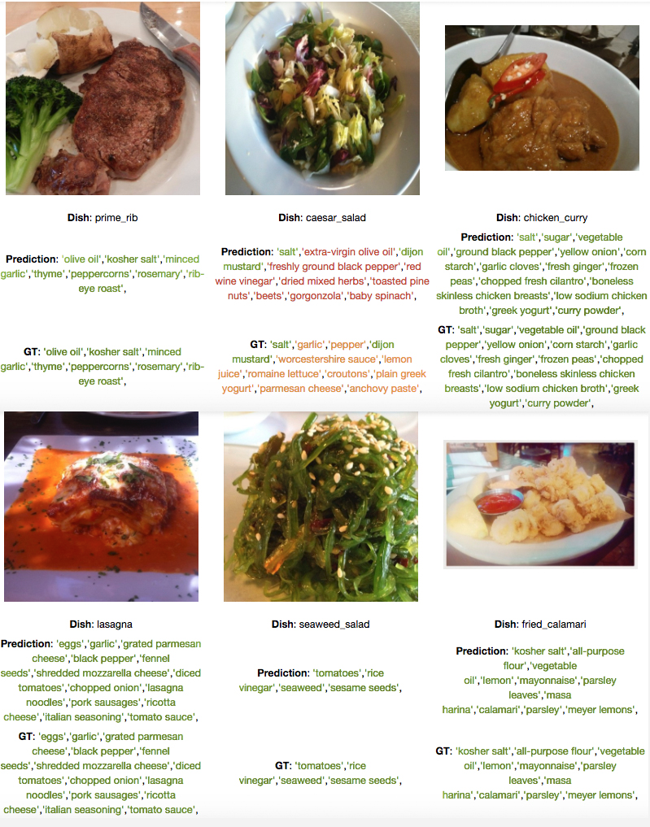
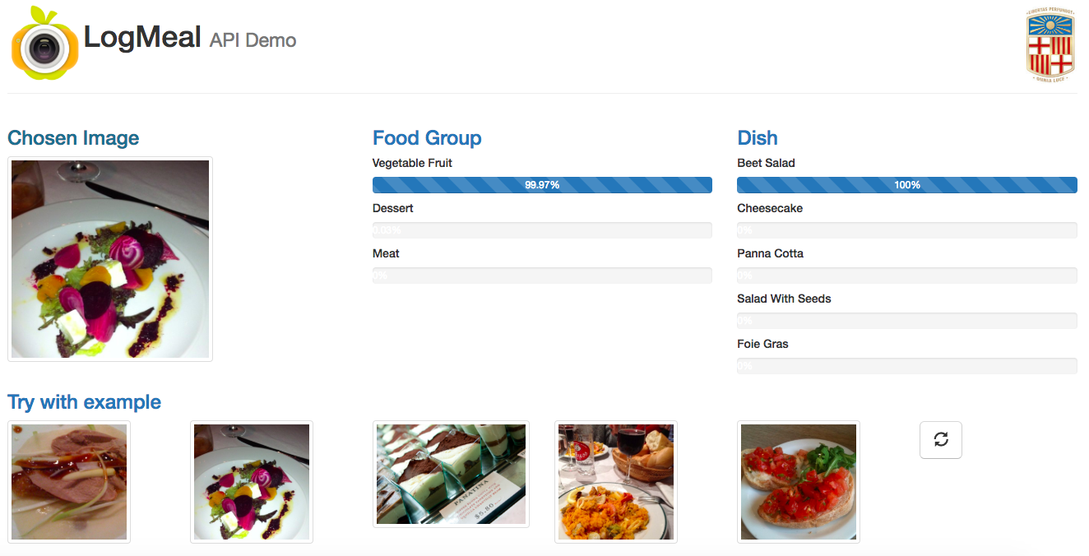
Food ingredients recognition
Food category and class recognition

Slide 24
Can you give an example of MTL from our previous lectures?
Shell all tasks be of same type (e.g. classification)?

Slide 25
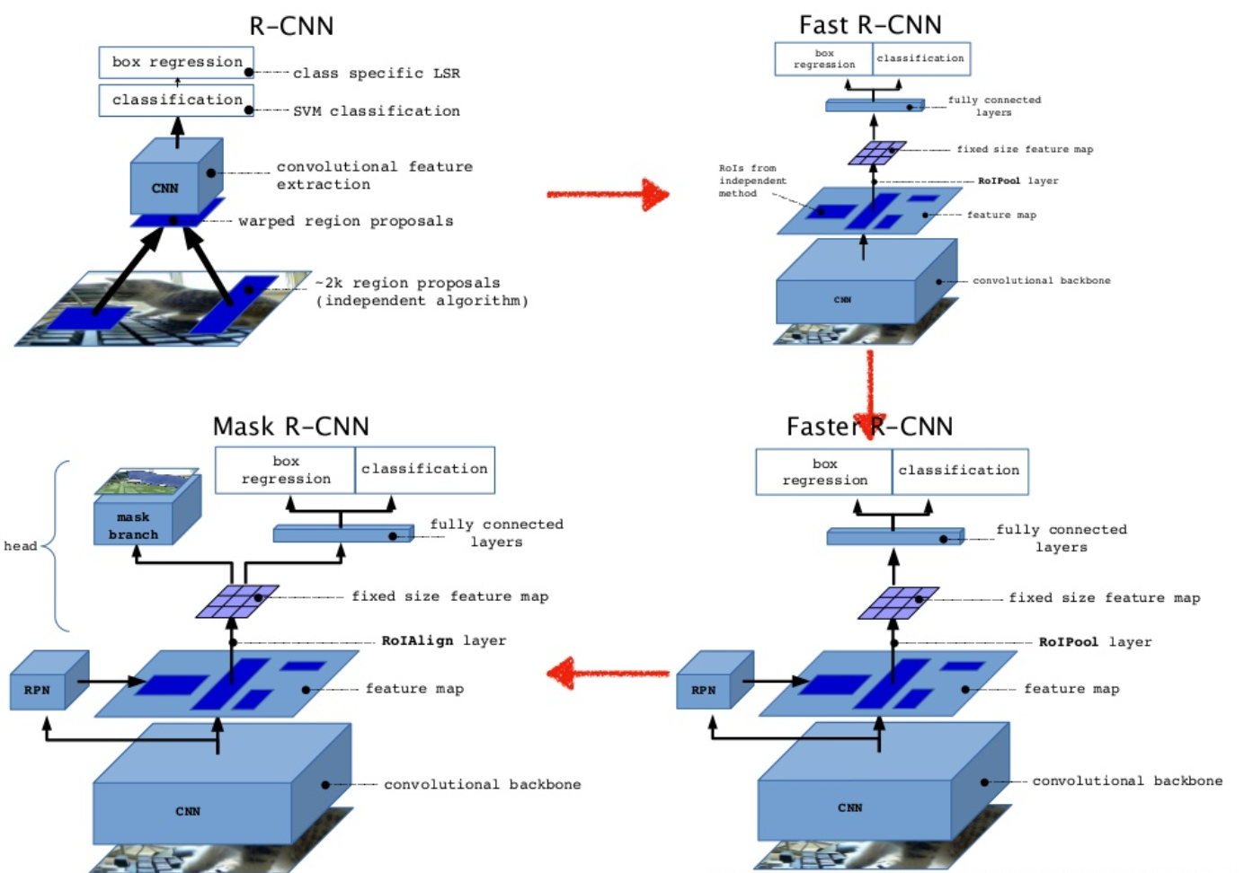
Object detection

Slide 26
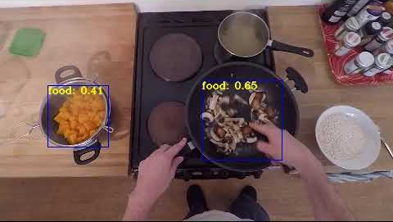
Understanding the cooking process

Slide 27
Object detection & segmentation
Object detection
Mask-RCNN does: detection, classification and segmentation

Slide 28

MTL for Scene Geometry and Semantics

Slide 29
Index
Transfer learning
  Taxonomy
  Domain adaptation
  Multi-task learning
  Example: Food recognition
  Image segmentation
  Semantic
  Instance
  Panoptic
  Evaluation
Conclusions

Slide 30

CVPR’2019

Slide 31


Semantic Segmentation

Slide 32
Semantic Segmentation
Classifying each pixel in the image
Recognizing and delineating objects in an image

Slide 33

Pixel-wise Semantic Segmentation
Label every pixel!
Don’t differentiate instances
Classic computer vision problem
http://cs231n.stanford.edu/slides/2016/winter1516_lecture13.pdf

Slide 34




Pixels in, pixels out
monocular depth estimation (Liu et al. 2015)
semantic
segmentation
boundary prediction (Xie & Tu 2015)
Image segmentation can be defined in different ways
Slide credit: Jonathan Long

Slide 35
Why Semantic Segmentation?
Road scenes understanding
Useful for autonomous navigation of cars and drones
Image taken from the cityscapes dataset.

Slide 36
Why Semantic Segmentation?
To help partially sighted people by highlighting important objects in their glasses

Slide 37
Why Semantic Segmentation?
To let robots segment objects so that they can grasp them

Slide 38
Why Semantic Segmentation?
Useful tool for editing images

Slide 39
Why Semantic Segmentation?
Medical purposes: e.g. segmenting
tumours, dental cavities, ...
Image taken from Mauricio Reyes
ISBI Challenge 2015, dental x-ray images

Slide 40
Biomedical Image Segmentation
Thousands of labeled training images for image segmentation are usually beyond reach
  1 million training images
For example AlexNet:
  8 layers and millions of parameters on the ImageNet dataset
The desired output should include localization
https://lmb.informatik.uni-freiburg.de/people/ronneber/u-net/

Slide 41

ISBI 2012 Task
Predict the class label of each pixel
Stacks of Electron microscopy (EM) images
EM segmentation challenge at ISBI 2012
30 training images
Black - neuron membranes
White - cells
Training stack
Ground truth
Ciresan, D.C., Gambardella, L.M., Giusti, A., Schmidhuber, J.: Deep neural net- works segment neuronal membranes in electron microscopy images. In: NIPS. pp. 2852{2860 (2012)
Notes:
Left: the training stack (one slice shown). Right: corresponding ground truth; black lines denote neuron membranes. Note complexity of image appearance.

Slide 42




CNNs
Padding = 0
Strides = 1
W - Input volume size
F – Receptive field size (Filter Size)
P - Zero padding used on the border
S - Stride
Output Size
Output Size
kernel
http://deeplearning.net/software/theano/tutorial/conv_arithmetic.html
https://sites.google.com/site/nttrungmtwiki/home/it/data-science---python/tensorflow/tensorflow-and-deep-learning-part-3?tmpl=%2Fsystem%2Fapp%2Ftemplates%2Fprint%2F&showPrintDialog=1

Slide 43


Challenge:
Segmentation of Neuronal Structures in EM
Remember the sliding window approach?

Slide 44


The DNN winner (ISBI 2012)
Trained a network in a sliding-window (local region (patch) around that pixel)
This network can localize
The training data in terms of patches is much larger than the number of training images
Slow because the network must be run separately for each patch
There is a lot of redundancy
Deep
Neural Netwok
Ciresan, D.C., Gambardella, L.M., Giusti, A., Schmidhuber, J.: Deep neural net- works segment neuronal membranes in electron microscopy images.
Notes:
IEEE International Symposium on Biomedical Imaging (ISBI)
Even without problem-specific postprocessing,
our approach outperforms competing techniques by a large margin in
all three considered metrics, i.e. rand error , warping error and pixel error . For
pixel error, our approach is the only one outperforming a second human observer.

Slide 45
The winner (ISBI 2012)
Trade-off between localization accuracy and the use of context.
Larger patches: Require more max-pooling layers → reduce the localization accuracy
Small patches: Allow the network to see only little context
We want a good localization and the use of context at the same time
Ciresan, D.C., Gambardella, L.M., Giusti, A., Schmidhuber, J.: Deep neural net- works segment neuronal membranes in electron microscopy images. In: NIPS. pp. 2852{2860 (2012)
Notes:
IEEE International Symposium on Biomedical Imaging (ISBI)

Slide 46
The winner (ISBI 2012)
Calibration.
The network outputs cannot be directly interpreted as probability values; instead, they tend to severely overestimate the membrane probability.
  Compare all outputs obtained on T_{test} (a total of 2.6 million instances) to ground truth, to compute the transformation relating the network output value and the actual probability of being a membrane;
The resulting function is well approximated by a monotone cubic polynomial, whose coefficients are computed by least-squares fitting.
Ciresan, D.C., Gambardella, L.M., Giusti, A., Schmidhuber, J.: Deep neural net- works segment neuronal membranes in electron microscopy images. In: NIPS. pp. 2852{2860 (2012)
Notes:
IEEE International Symposium on Biomedical Imaging (ISBI)
Because each class is equally represented in the training set but not in the testing data, the network
outputs cannot be directly interpreted as probability values; instead, they tend to severely overestimate
the membrane probability. To fix this issue, a polynomial function post-processor is applied to
the network outputs.
To compute its coefficients, a network N is trained on 20 slices of the training volume Ttrain and
tested on the remaining 10 slices of the same volume (Ttest, for which ground truth is available). We
compare all outputs obtained on Ttest (a total of 2.6 million instances) to ground truth, to compute
the transformation relating the network output value and the actual probability of being a membrane;
for example, we measure that, among all pixels of Ttest which were classified by N as having a 50%
probability of being membrane, only about 18% have in fact such a ground truth label; the reason
being the different prevalence of membrane instances in Ttrain (i.e. 50%) and in Ttest (roughly 20%).
The resulting function is well approximated by a monotone cubic polynomial, whose coefficients
are computed by least-squares fitting. The same function is then used to calibrate the outputs of all
trained networks.
After calibration (a grayscale transformation in image processing terms), network outputs are spatially
smoothed by a 2-pixel-radius median filter. This results in regularized of membrane boundaries
after thresholding.

Slide 47


ISBI 2015 Task
ISBI 2015- separation of touching objects of the same class
Light microscopic images (recorded by phase contrast microscopy)
Part of the ISBI cell tracking challenge 2014 and 2015
Raw image (HeLa cells)
Generated segmentation mask
(white: foreground, black: background)
Groundtruth segmentation.
Notes:
Fig. 3. HeLa cells on glass recorded with DIC (differential interference contrast) mi-
croscopy. (a) raw image. (b) overlay with ground truth segmentation. Different colors
indicate different instances of the HeLa cells. (c) generated segmentation mask (white:
foreground, black: background). (d) map with a pixel-wise loss weight to force the
network to learn the border pixels.

Slide 48


Challenge:
Segmentation of Neuronal Structures in EM
Notes:
Fig. 3. HeLa cells on glass recorded with DIC (differential interference contrast) microscopy. (a) raw image. (b) overlay with ground truth segmentation. Different colors
indicate different instances of the HeLa cells. (c) generated segmentation mask (white: foreground, black: background). (d) map with a pixel-wise loss weight to force the
network to learn the border pixels.

Slide 49
Challenge:
Segmentation of Neuronal Structures in EM
How to avoid the redundancy in the sliding window approach?

Slide 50
Convolutional Neural Networks (CNN)
The use of convolutional networks is on classification tasks where the output to typical image is a single class label.
The desired output should include localization
A class label is supposed to be assigned to each pixel.
https://www.saagie.com/blog/object-detection-part1

Slide 51


Biomedical Image Segmentation with U-net
U-Net
Input image
Output segmentation map
U-net learns segmentation in an end-to-end setting
Touching objects of the same class
Very few annotated images (approx. 30 per application)
IEEE International Symposium on Biomedical Imaging (ISBI 2015)
https://lmb.informatik.uni-freiburg.de/people/ronneber/u-net/
Notes:
In the last layer there are 2 channels (1 for background and one for foreground)

Slide 52

Fully convolutional neural network
Localization and the use of context at the same time
Input image with any size
Added Simple Decoder (Upsampling + Conv)
Removed Dense Layers
Localization and the use of context at the same time
https://www.azavea.com/blog/2017/05/30/deep-learning-on-aerial-imagery/

Slide 53
Convolutional Neural Network (CNN)
A standard CNN for image classification is composed of:
  Convolutional layers
  Down-sampling layers
    Stride convolution
    Max pooling
    Avg. Pooling
  Batch normalization
  Activation functions (e.g. ReLU)

Slide 54
Discrete convolution
A discrete convolution is a linear transformation
  Sparse – only few inputs contribute to a given output unit
  Reuses parameters – same kernel is applied over multiple input elements
 | x0 | x1 | x2
 | x3 | x4 | x5
 | x6 | x7 | x8
k0 | k1 | k2
k3 | k4 | k5
k6 | k7 | k8
 | y4
*
=
Input
Kernel
Output
Figure: In this example, each output element is computed using 9 pixels
Convolution layer takes an input feature map of dimension and produces an output feature map of dimension
Each layer is defined using following parameters:
# Input channels (N)
# Output channels (M)
Kernel size, Padding, Stride

Slide 55


Convolutional Layer
Figure: In this example, 5x5 input is convolved with 3x3 kernel with stride=padding=1 to produce an output of size 5x5.
Figure: In this example, 5x5 input is convolved with 3x3 kernel with stride=2 and padding=1 to produce an output of size 3x3.
Notes:
Strided convolution can be used for down-sampling

Slide 56

Convolutional Layer
Convolution layer takes dimensional input feature map and produces a dimensional output feature
Each layer is defined using the following parameters:
  # Input channels ()
  # Output channels ()
  Kernel size (
  Padding
  Stride
# of parameters learned by convolution layer is

Slide 57

Group Convolutional Layer
Input and kernel are split into groups across channel dimension
Each group then performs the convolutions independently
Each layer is defined using following parameters:
  # Input channels ()
  # Output channels ()
  Kernel size (
  Padding
  Stride
  Dilation rate ()
  # of groups ()
Figure: Standard convolution
Figure: Grouped convolution

Slide 58
Down-sampling
Learning representations at multiple scales is a fundamental step in computer vision
  Laplacian Pyramids
  SIFT, etc.
Down-sampling in CNNs
  Strided convolution
  Max pooling
  Avg. Pooling
  How to recover the original size of the image?
a0 | b1
c1 | d3
a0 | a1 | b0 | b1
a2 | a3 | b2 | b3
c0 | c1 | d0 | d1
c2 | c3 | d2 | d3
Max-Pooling
Avg. Pooling
y
Convolution

Slide 59

Solution: Dilation
Need subsampling to allow convolutional layers to capture large regions with small filters
  Can we do this without subsampling?

Slide 60
Solution: Dilation
Need subsampling to allow convolutional layers to capture large regions with small filters
  Can we do this without subsampling?

Slide 61
Solution: Dilation
Need subsampling to allow convolutional layers to capture large regions with small filters
  Can we do this without subsampling?

Slide 62

Addressing the resolution problem
Up-Sampling
‘deconvolutional’ layers (backwards convolution).
  Additional memory and computational time.
  Learning additional parameters.

Slide 63

Dilated Convolution Layer
Inserts spaces between the kernel element to increase the effective size of kernel
Same as the convolutional layer except it has additional parameter, dilation rate, that controls the spacing
Each layer is defined using following parameters:
  # Input channels ()
  # Output channels ()
  Kernel size (
  Padding
  Stride
  Dilation rate ()

Slide 64









U-NET Architecture
Output
segmentation map
(here 2 classes)
background and
foreground
Input
image
tile
Concatenation with
high-resolution features
from contracting path
Output Size (second conv)
= (570 – 3 +2*0)/1 + 1 = 568
→ 568 x 568
Create high-resolution
segmentation map
Contraction
Expansion
Increase the “What”
Reduce the “Where”
W - Input volume size
F – Receptive field size (Filter Size)
P - Zero padding used on the border
S - Stride
Output Size
Output Size (first conv)
= (572 – 3 +2*0)/1 + 1 = 570
→ 570 x 570
http://deeplearning.net/software/theano/tutorial/conv_arithmetic.html
Notes:
In the last layer there are 2 channels (1 for background and one for foreground)

Slide 65



The resolution issue
Problem: early layers not semantic
Late layers lose fine details information.
Horse
Visualizations from : M. Zeiler and R. Fergus. Visualizing and Understanding Convolutional Networks. In ECCV 2014.
Notes:
If you look at what one of these higher layers is detecting, here I am showing the input image patches that are highly scored by one of the units. This particular layer really likes bicycle wheels, so if this unit fires, you know that there is a bicycle wheel in the image. Unfortunately, you don’t know where the bicycle wheel is, because this unit doesn’t care where the bicycle wheel appears, or at what orientation or what scale.

Slide 66
Solution: Skip connections
Coarse prediction
upsampling
convolution
Finer prediction
Finest prediction

Slide 67



Skip connections
Fully convolutional networks for semantic segmentation. Evan Shelhamer, Jon Long, Trevor Darrell. In CVPR 2015

Slide 68
U-Net Training
Soft-max:
- Feature channel
- The activation in feature channel k at pixel position x
Cross-Entropy loss function:
- True label per a pixel

Slide 69

Data augmentation
Augment Training Data using Deformation
Random elastic deformation of the training samples.
Shift and rotation invariance of the training samples.
They use random displacement vectors on 3 by 3 grid.
The displacement are sampled from Gaussian distribution with standard deviation of 10 pixels
https://lmb.informatik.uni-freiburg.de/people/ronneber/u-net/
Notes:
In the last layer there are 2 channels (1 for background and one for foreground)

Slide 70
How to evaluate the result of the segmentation?

Slide 71

Precision, Recall and F₁-score
Precision
  TP/(TP+FP)
Recall /Sensitivity
  TP/(TP+FN)
Specificity
  TN/(TN+FP)
F₁ score
  2PR/(P+R)

Slide 72





Dice coefficient, Jaccard index and Overlap
Overlap represents the percentage of overlap as it relates only to the smallest volume:
Dice coefficient is closely related to F₁ score. In the F₁ score we need to assess a trade-off between the Recall (Sensitivity) and Precision.
Jaccard index or Intersection over Union (IoU)
It can be shown that:
Notes:
From the wikipedia page:
𝐽=𝐷2−𝐷and𝐷=2𝐽𝐽+1J=D2−DandD=2JJ+1
where 𝐷D is the Dice Coefficient and 𝐽J is the Jacard Index. In my opinion, the Dice Coefficient is more intuitive because it can be seen as the percentage of overlap between the two sets, that is a number between 0 and 1.As for the Overlap it represents the percentage of overlap as it relates only to the smallest volume:
𝑜𝑣𝑒𝑟𝑙𝑎𝑝=|𝑋∩𝑌|𝑚𝑖𝑛(|𝑋|,|𝑌|)overlap=|X∩Y|min(|X|,|Y|)
The relation between it and the other two measures is not direct, but one can be get from one the others and vice-versa with information of the area/volume of 𝑋X and 𝑌

Slide 73
Segmentation Evaluation
Pixel error: defined as 1 - F_{pixel}, where F_{pixel} represents the F₁ score of pixel similarity.
Rand error: defined as 1-F_{rand}, where F_{rand} represents the F₁ score of the Rand index, which measures the accuracy with which pixels are associated to their respective class neurons.
Warping error: a segmentation metric designed to account for topological disagreements; it accounts for the number of neuron splits and mergers required to obtain the candidate segmentation from ground truth.

Slide 74


Experiments: First task
EM segmentation challenge (since ISBI 2012)
Raw image
Ground truth
  The results of U-net was better than the sliding window convolutional network which was the best one in 2012 until 2015.

Slide 75
What about Instance and Panoptic Segmentation?

Slide 76
Instance segmentation
Mask-RCNN does: detection, classification and segmentation

Slide 77

Object segmentation today is based on Deep learning

Slide 78



Pedestrian segmentation
Notes:
Bicycle image
So we couldnDetection didn’t cover the persons leg
’t get it as an instance
A limitation of our method

Slide 79

City segmentation

Slide 80

Mobile Mask-RCNN

Slide 81

Other applications – Satellite image segmentation (Raster Vision)
Aerial and satellite imagery gives us the unique ability to look down and see the earth from above.
  Used to measure deforestation,
  map damaged areas after natural disasters,
  spot looted archaeological sites, and many more current and untapped use cases.
Enormous and ever-growing amount of imagery presents a significant challenge: how can we derive value and insights from all of this data?
- There are not enough people to look at all of the images all of the time.

Slide 82








Food segmentation
AI crowd dataset 26000 annotated segmented images with 273 classes

Slide 83
Summary and Conclusion
U-net advantages
Flexible and can be used for any rational image masking task
High accuracy (given proper training, dataset, and training time)
Doesn’t contain any fully connected layers
Faster than the sliding-window (1-sec per image)
Proven to be very powerful segmentation tool in scenarios with limited data
Succeeds to achieve very good performances on different biomedical segmentation applications.
U-net disadvantages
Larger images need high GPU memory.
Takes significant amount of time to train (relatively many layers)
Pre-trained models not widely available (it's too task specific)
Notes:
https://spark-in.me/post/unet-adventures-part-one-getting-acquainted-with-unet

