Slide 1
Farofa team
DT130
Edison Bejarano
Jeniffer Viegas
Zero deforestation mission

Slide 2

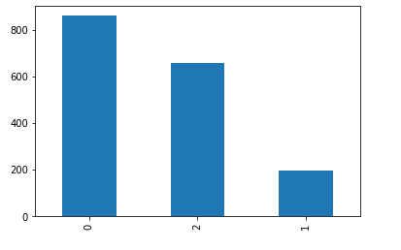

Goal: Classify green aereas from satellite images
Training DataSet : 1714 png images 332 x 332 x 3
Test DataSet : 614 png images 332 x 332 x 3
Problem: Unbalanced data
Nº of images
Labels

Slide 3
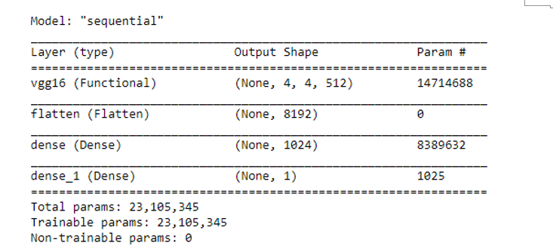
Approach
Data augmentation with ImageDataGenerator from keras.preprocessing.image
Transfer Learning with VG16 and Xception network
Put Real Image from our model! With the code my_model.summary()
Fig. 2- Network structure of the final model

Slide 4
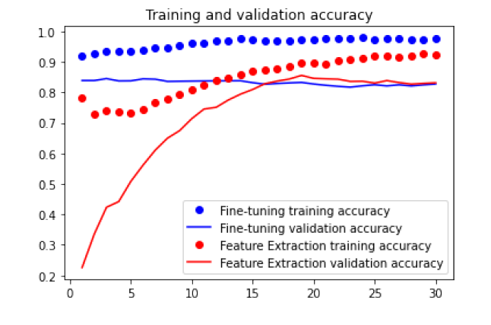
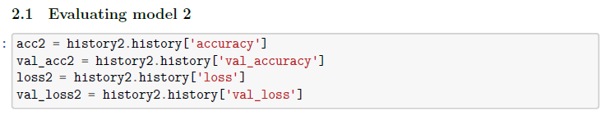
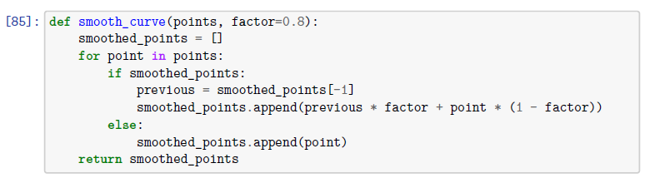
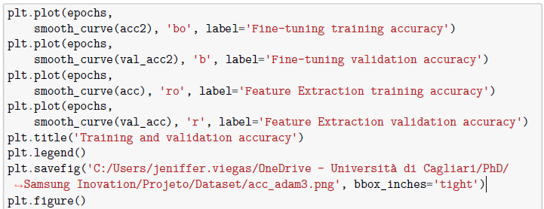
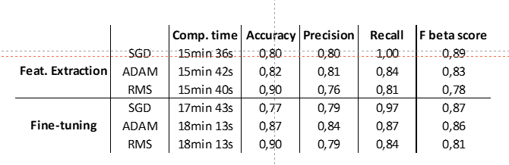
Results
Delete this code, is just if you need for plotting
Fig. 3- Accuracy of the final model
Tab. 1- Score resume

Slide 5
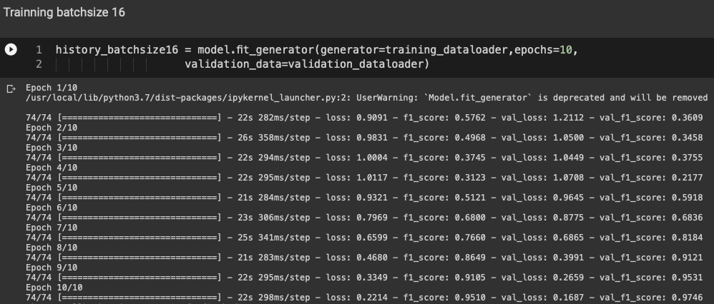
Future tests
Fine-tuning by freezing the VG16, before compiling and training the model.
Introduce the spatial relationship inherent in the latitude and longitude data.

