Slide 1
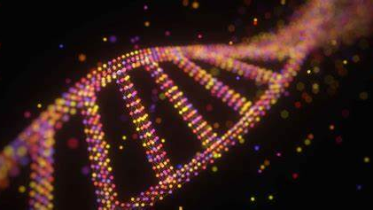
Genetic-based disease identification with deep learning on neural networks
TEAM MEMBERS:
EJJUROTHU DIVYA TEJASWI (700745894)
AKANKSHA PANCHANENI (700740529)
AJAY REDDY VELURU (700740836)
JOHN DAVID CONLEY (700645761)

Slide 2
Role/Responsibilities and Contribution to the Project:
NAME | RESPONSIBILITIES AND CONTRIBUTION
DIVYA TEJASWI EJJUROTHU | Project initial study (50%), project flow design(50%), Implementation of Algorithm(50%),code(25%)
AKANSHA PANCHANENI | Project initial study (50%), project flow design(50%), Implementation of Algorithm(50%),Code(25%)
AJAY REDDY VELURU | Data Collection(50%), Task Analysis(50%),Analyze Results(50%),Code(25%)
JOHN DAVID CONLEY | Data Collection(50%), Task Analysis(50%),Analyze Results(50%),Code(25%)

Slide 3
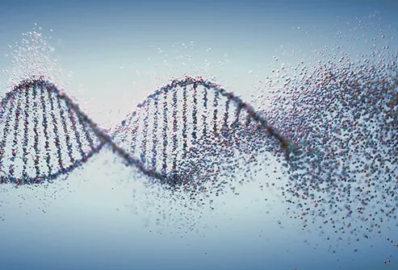
Motivation :
Identifying disease genes from the human genome is an important and fundamental problem in biomedical research. The motivation behind this research is to improve the identification of genetic-based diseases. Genetic diseases are often complex and difficult to diagnose, requiring expensive and time-consuming laboratory tests. The goal is to create a reliable and scalable tool that can assist healthcare professionals in making accurate diagnoses and providing personalized treatment plans to patients with genetic-based diseases.

Slide 4

Objectives:
The objective Genetic based disease identification with deep learning on neural networks is to detect the genetic disease in the patient records. In this work, the dataset containing the genetic disease dataset will be taken into consideration. The pre-processing will be applied to the dataset, and the noisy and null value data will be removed. After the data will be analyzed and visualized for further processing. The deep learning algorithm will be chosen to make the prediction.

Slide 5

Related Work:
A comprehensive review of existing literature and research on the topic
Analysis of relevant algorithms, models, and techniques used in previous studies
Collection and analysis of relevant datasets to inform the current study
Study and implementation of code or software used in previous studies to inform the current study
Comparison and evaluation of previous studies' findings with the current study's results

Slide 6

Problem Statement:
The problem statement addressed by this research is the difficulty in identifying genetic-based diseases using traditional diagnostic methods. While genetic testing has advanced significantly in recent years, accurately diagnosing genetic diseases remains a challenge. Conventional methods are often expensive, time-consuming, and can be inconclusive. The traditional approach typically involves performing laboratory tests to examine genetic variants, and it can take a long time to identify the specific genetic mutations that contribute to the disease. This delay in diagnosis can lead to delayed or incorrect treatment, which can have severe consequences for patients.

Slide 7
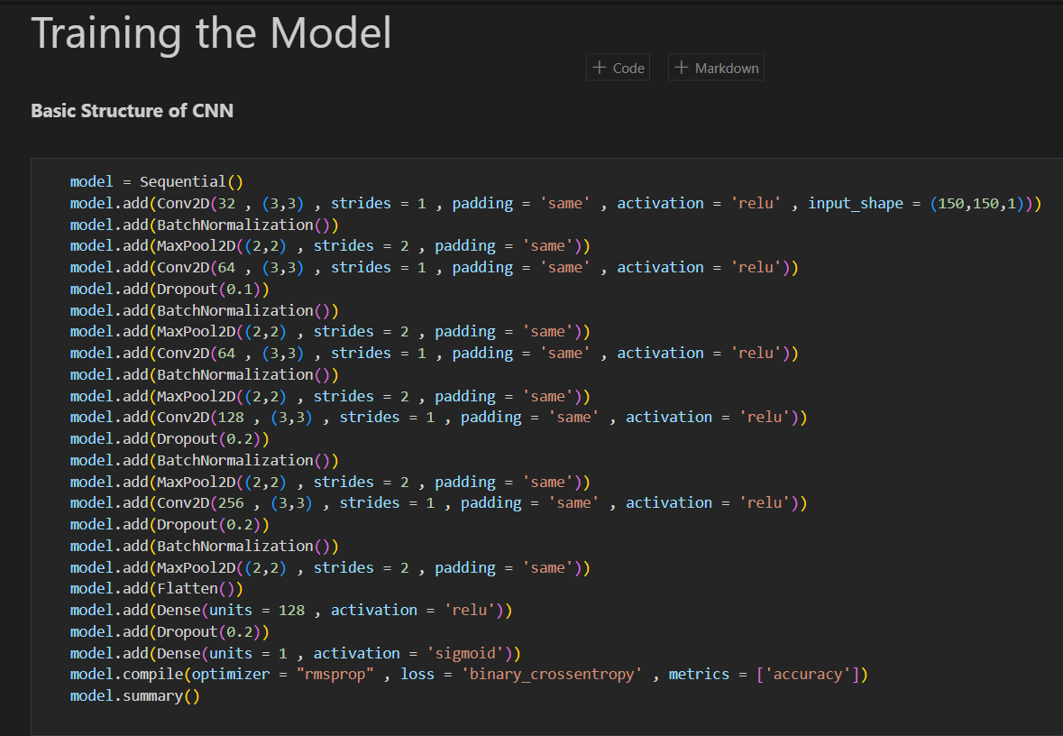
Proposed Solution :
The proposed system aims to predict genetic diseases using deep learning algorithms, specifically, Convolutional Neural Networks (CNN) implemented through Keras. The dataset is split into training and testing variables and passed through the CNN model for evaluation. The accuracy and confusion matrix of the neural network are analyzed, and the results are compared with other algorithms. The heat map matches genetic diseases with yes or no values, and the prediction results are shown. The final accuracy levels are depicted graphically, and future enhancements could involve using larger datasets to improve efficiency.

Slide 8
SYSTEM ARCHITECTURE DIAGRAM :
Data preprocess
Genetic disease Dataset
Data Cleaning
Training, test data
Genetic Disease prediction
Deep Learning Algorithm implementation

Slide 9
Convolutional Neural Networks model:
a convolutional neural network (CNN) is a class of artificial neural networks most commonly applied to analyze visual imagery. CNNs use a mathematical operation called convolution in place of general matrix multiplication in at least one of their layers. They are specifically designed to process pixel data and are used in image recognition and processing
Keras model of Deep Learning:
Keras is a high-level, user-friendly API used for building and training neural networks. It is an open-source library built in Python that runs on top of TensorFlow.

Slide 10
Libraries used in the application:
keras.models -Sequential: A Sequential model is appropriate for a plain stack of layers where each layer has exactly one input tensor and one output tensor
Keras. layers - Dense: The Dense layer connects every neuron in the current layer to every neuron in the next layer.
Numpy:NumPy is a Python library for numerical computation that provides powerful data structures for working with multi-dimensional arrays and matrices.
pandas :Pandas is a Python library for data manipulation and analysis. It provides data structures and functions for working with tabular data, including data import/export, data cleaning, merging, reshaping, and aggregation
matplotlib:Matplotlib is a Python library for creating static, animated, and interactive visualizations in Python. It provides a wide range of tools for creating charts, plots, histograms, and other types of visualizations.
seaborn:Seaborn is a Python data visualization library built on top of Matplotlib. It provides a high-level interface for creating informative and attractive statistical graphics
Os:The os module in Python provides a way to interact with the underlying operating system, including functions for manipulating files and directories, working with environment variables, and launching external processes.
Sklearn :Scikit-learn, also known as sklearn, is a popular Python library for machine learning. It provides a wide range of tools for data preprocessing, feature engineering, model selection, and model evaluation.

Slide 11
SYSTEM SPECIFICATIONS
HARDWARE REQUIREMENTS
Processor Intel(R) Pentium(R) CPU G2010 @
Clock Speed 2.80GHz
RAM 2.00 GB
Hard Disk 1 TB HDD
SOFTWARE REQUIREMENTS
Operating System: Windows 10
Front-End Tool: Python in Google Colab

Slide 12
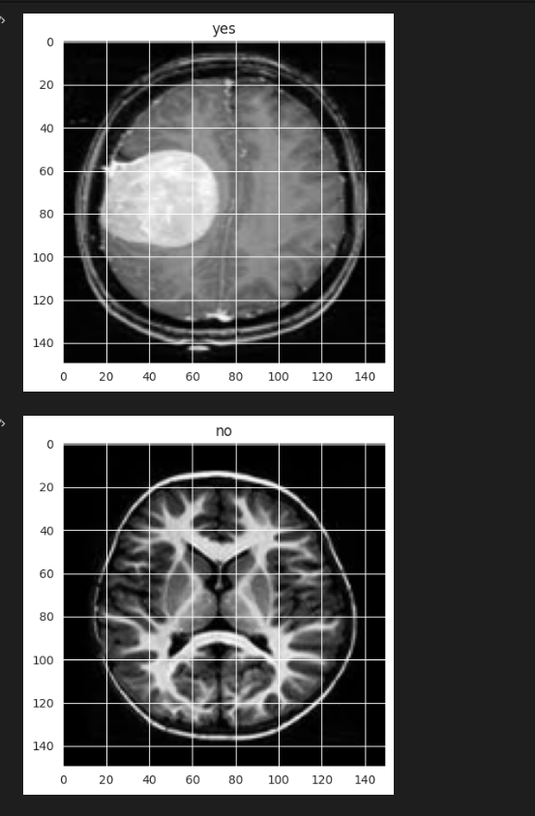
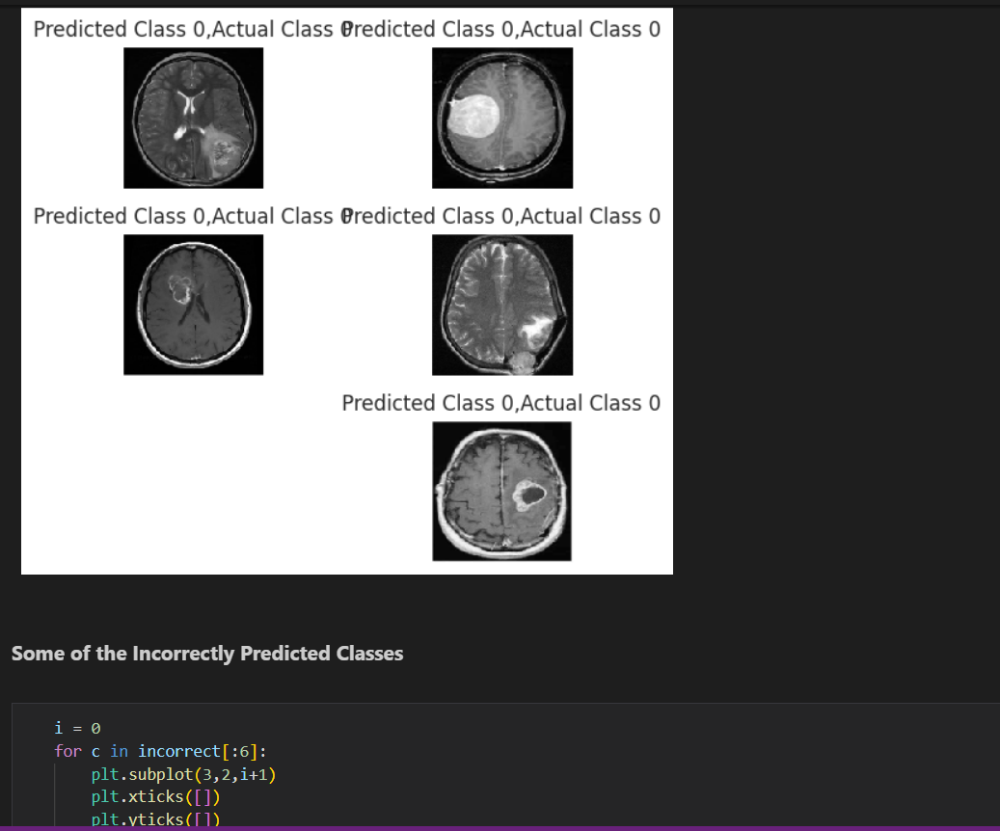
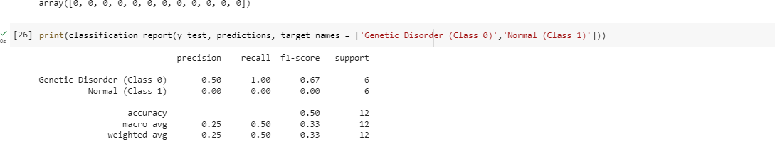
Results/Simulations:
Genetic-based disease identification with deep learning on neural networks will be the Python-based application which contributes to finding out the genetic disease. It will be helpful in finding the genetic disease based on the attributes of the patient records. The results of these studies demonstrate the potential of deep learning on neural networks for genetic-based disease identification. These models offer high accuracy rates and improved efficiency compared to traditional diagnostic methods, with the potential to improve patient outcomes.

Slide 13

References:
[1]. Chunyu Wang1 , Junling Guo1 , Ning Zhao1 , Yang Liu1 , Xiaoyan Liu1 , Guojun Liu1 , Maozu Guo2,3,” A Cancer Survival Prediction Method Based on Graph Convolutional Network”- DOI 10.1109/TNB.2019.2936398, IEEE.
[2]. NOUR ELDEEN M. KHALIFA 1 , MOHAMED HAMED N. TAHA 1 , DALIA EZZAT ALI 1 , ADAM SLOWIK 2 , (Senior Member, IEEE), AND ABOUL ELLA HASSANIEN 1-“ Artificial Intelligence Technique for Gene Expression by Tumor RNA-Seq Data: A Novel Optimized Deep Learning Approach”- date of publication January 29, 2020, date of current version February 6, 2020 , IEEE.
[3]. Haibing Guo1,* , Yongjin Zhang2-“ RESTING STATE fMRI AND IMPROVED DEEP LEARNING ALGORITHM FOR EARLIER DETECTION OF ALZHEIMER’S DISEASE”- DOI 10.1109/ACCESS.2020.3003424, IEEE Access.
[4]. Xiangxiang Zeng, Senior Member, IEEE, Yinglai Lin, Yuying He, Linyuan Lu, Xiaoping Min ¨ ∗ , and Alfonso Rodr´ıguez-Paton-“ Deep collaborative filtering for prediction of disease genes”- DOI 10.1109/TCBB.2019.2907536, IEEE/ACM Transactions on Computational Biology and Bioinformatics.

Slide 14


