Slide 1
Time Series Prediction
Project: Forecasting electricity consumption in Germany

Slide 2
Table of Content
Introduction
Literature Review
Dataset Characteristics
Baseline Model
Models
Results
Challenges & Errors
Discussion
Q&A

Slide 3
Introduction
Description of the problem:
Forecast of the hourly German electricity consumption
Dataset used:
15-min interval data of electricity load from 2017 until 2019 in Germany
From the webpage “Energy-Charts” provided by ENTSO-E
For temperature: also from “Energy Chart” provided by DWD
Our approach is to perform regression on the data by using several (ML) methods which proved to be efficient for similar problems
Notes:
Why this time frame: Because we want to exclude covid impact
ENTSO-E: European Network of Transmission System Operators

Slide 4
Literature Review
Author | Objective | Methods | Outcomes
Bláquez-García et al. (2020) | Forecast of electricity conumption of a green elevator | 3 SARIMA models (daily, hourly and 15min) | 1h SARIMA outperformed the other models
Arslan (2022) | Proposition of an efficient forecasting framework for energy consumption | Combining LSTM and Prophet | For some countries, outperformance of other methods. For other countries, it has competitive performance
Amalou et al. (2022) | Comparative analysis of some deepl learning models | LSTM, GRU, RNN | GRU > LSTM > RNN in terms of accuracy
Mahjoub et al. (2022) | Predicting Energy Consumption Using Neural Networks | LSTM, Multi-Layer GRU and Drop-GRU | LSTM model produces a better result than the GRU and the Drop-GRU forecasting methods

Slide 5
Dataset Characteristics
Electricity data:
The dataset contains raw data that records the load in MW at fifteen-minute intervals from 2017 to 2019
We processed the data to obtain hourly data entries
The time frame for this data adheres is in Coordinated Universal Time (UTC)
Temperature data:
The temperature data contains hourly arithmetic means of all stations in Germany, measured in degrees Celsius.
The time frame for this data is in Coordinated Universal Time (UTC)

Slide 6
Baseline Model
We chose a Seasonal ARIMAX model
After conducting several iterations, we determined the SARIMAX(1,1,1)(1,0,1,24) to be the best performing
Motivation
Our data exhibits strong „multi-layer“ seasonal patterns
Electricity consumption is also driven by outside temperature
Notes:
Motivation
Our data exhibits strong „multi-layer“ seasonal patterns
Electricity consumption is driven by outside temperature
We did not want to have a ”too simple benchmark”

Slide 7
Models
Model | Short description | Motivation
Prophet | Additive model including seasonality, trend factor and holidays | Time-efficiency Easy to interpret Good result for data with strong seasonality
LightGBM | Decision tree-based algorithm using gradient-boosting | Good performance and stability, especially with large data Leaf-wise tree growth
LSTM | A type recurrent neural network which can account for long-term dependencies | Long-term dependencies It has shown very good results in the literature
GRU | A „lighter“ form of LSTM as it has less input parameter | Simplicity More efficient (both in terms of time and computing)
Notes:
Advantages Prophet:
It has proven good results for data with strong seasonality
Good performance in a reasonable amount of time
The model is easy to interpret thanks to its breakdown into the time components
Motivation Light GBM:
Focus on performance and stability
Capable of handling large-scale data
Leaf-wise tree growth -> increased accuracy, efficiency and ability to capture complex patterns

Slide 8
Models
Model | Feature Engineering + hyper parameter tuning | How did we evaluate the models
Prophet | We add time-related dummy variables Determination of Trend and Seasonality parameters | Root Mean Square Error (RMSE) Mean Absolut Error (MAE) Mean Absolut Percentage Error (MAPE) Mean Squared Error (MSE) R Squared
LightGBM | We add time-related variables Determination of Learning rates, Max Dept and number of leaves
LSTM | We add several variables (load, temperature, HDL, holiday etc.) Determination of N_steps and learning rate
GRU | We add several variables (load, temperature, HDL, holiday etc.) Determination of N_steps and learning rate
Notes:
Group 1: Feature (Load)
Group 2: Feature (Load, Temperature)
Group 3: Feature (Load, Temperature, HDL)
Group 4: Feature (Load, Temperature, HDL, holiday)
Group 5: Feature (Load, Temperature, HDL, holiday, month, week

Slide 9
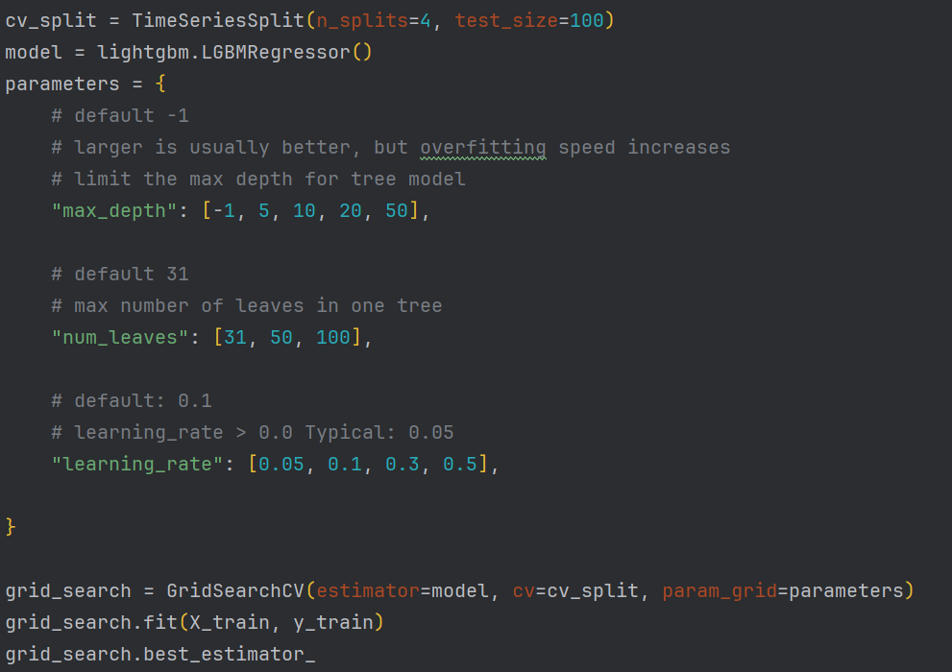
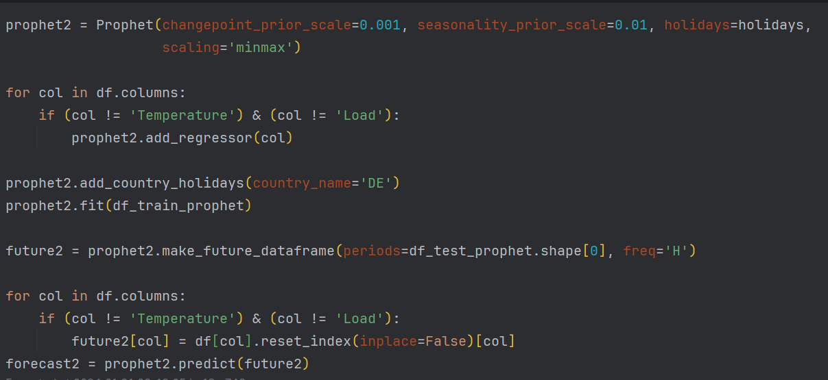
Models
Link to the github-Repo with the code:
https://github.com/EjoelM/Opencampus_SH_TimeSeries_Energy/tree/main

Slide 10
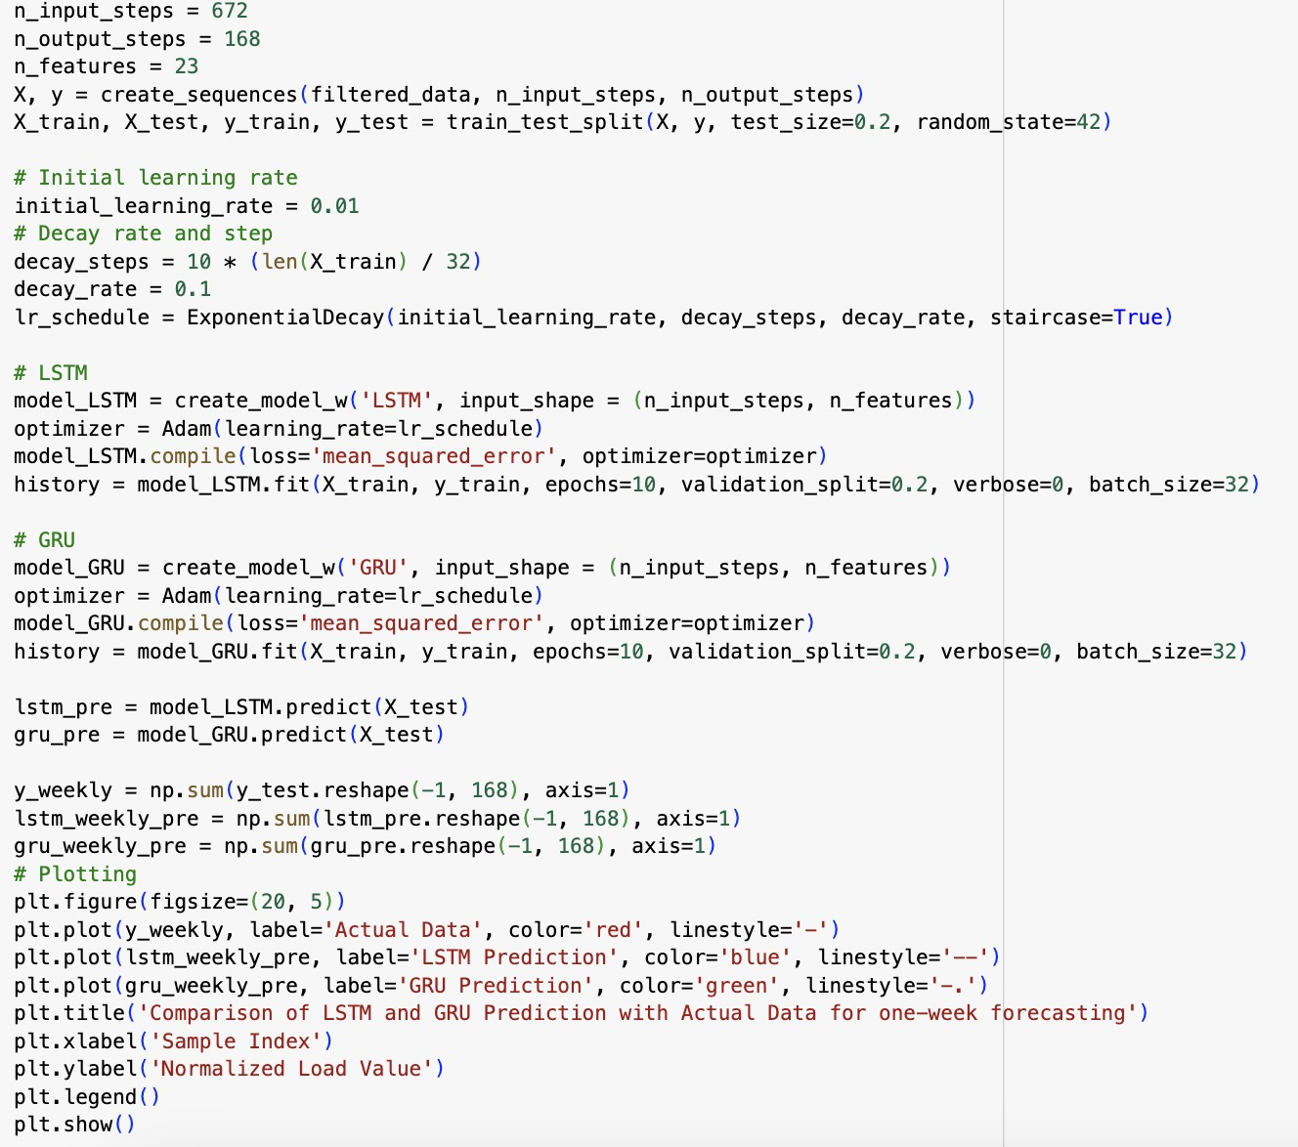
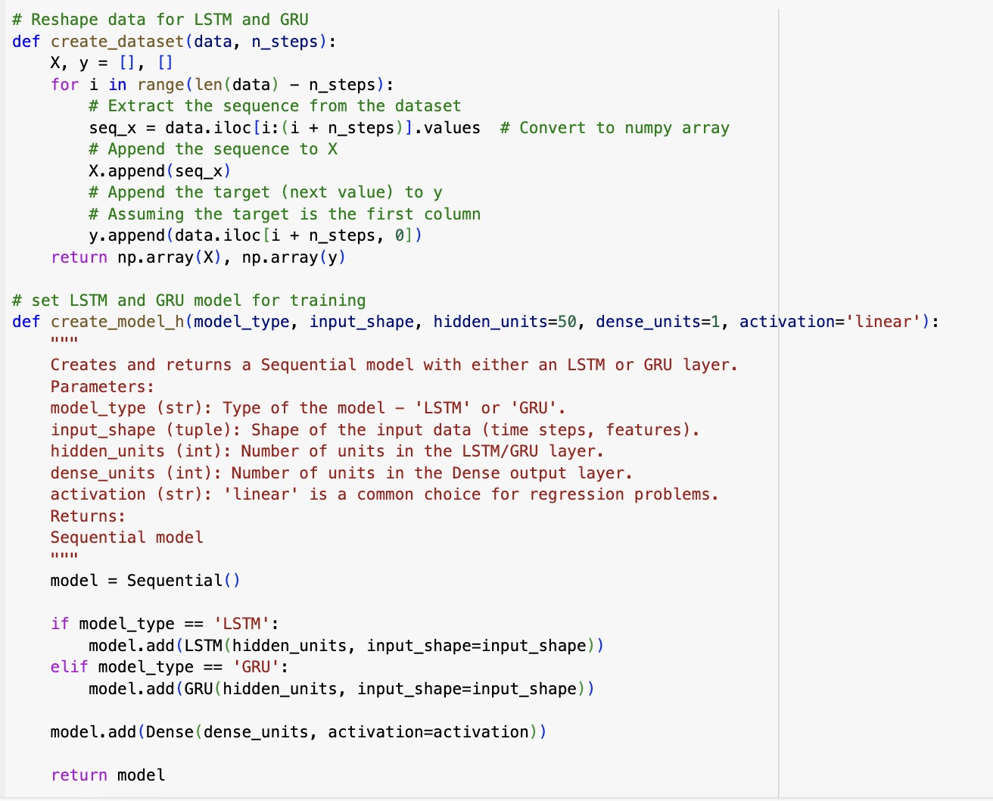
Models
Link to the github-Repo with the code:
https://github.com/EjoelM/Opencampus_SH_TimeSeries_Energy/tree/main

Slide 11
Results for one week forecast
Model | MAE | MSE | RMSE | MAPE % | R²
Baseline SARIMAX | 22,818.45 | 8.840221e+08 | 29,732.51 | 11.23 | 37.65
Prophet | 12,891.63 | 2.572657+08 | 16,039.5 | 6.59 | 78.34
LightGBM | 3,513.16 | 2.908014e+07 | 5,392.6 | 1.6 | 98.18
LSTM | 0.05431 | 0.00599 | 0.07739 |  | 88.98
GRU | 0.04045 | 0.00285 | 0.05339 |  | 94.76
Notes:
Normalization is a common preprocessing step for time series data when using LSTM and GRU models. If choose to input non-normalized data directly for predictions, the scale and distribution of the input data would be different from what the model was trained on and can lead to inaccurate or meaningless predictions. Then I tried Inverse Transformation for Post-Processing Predictions, but R squared be negative this time. Maybe the model is overfitted to the training data, it might perform poorly on unseen test data, resulting in negative R-squared values. However, given that your normalized results seem reasonable, this is less likely unless the normalization process itself is contributing to overfitting.

Slide 12
Challenges and Errors
Models | Challenges and/or Errors | How we overcame
SARIMAX | Other explanatory variables | Including different exogenous variables (is_weekend, ...)
Prophet | Trend parameter and additional features like holidays | Search for optimal trend parameter
LightGBM | Using too many hyperparameters | Only using a small amount of broadly used parameters
LSTM & GRU | Complexity and Computation Time Hyperparameter Tuning Results not really useful | Implementing learning rate schedules (like learning rate decay) and using adaptive learning rate algorithms (like Adam) can help in converging faster and more stably.
Notes:
For SARIMAX: Data limitation regarding the conumer (household vs. Industry)

Slide 13
Discussion
Some thoughts:
All models outperformed the baseline model
Apply models to other time frames in order to look at overfitting (e.g. COVID)
SARIMAX: Look for additional improvements, e.g. include additional features like holidays, events
LSTM/GRU: While neural networks like LSTM and GRU are prone to overfitting, the structured nature of SARIMAX can help to regularise the model.
Notes:
Parameter tuning = SARIMAX and Prophet are more statistically oriented; LightGBM is more ML oriented

Slide 14
Question & Answers

