Slide 1

SARVA SHIKSHA ABHIYAN
EXPLORATORY DATA ANALYSIS
Course Code: IT495
Semester 2
Course Instructor: Gopinath Panda
Group Number – 01

Slide 2
GROUP MEMBERS:
Muskan Khare Riya Kumari Dhruv Solanki
202218037 202218049 202218053
Chinmaya Pandey Jatan Sahu
202218054 202218061

Slide 3
Problem Statement
Sarva Shiksha Abhiyan (SSA) is a flagship program of the Indian government who aims at providing free and compulsory education to all children in the age group of 6 to 14 years.
Project involves analyzing historical budget allocation and expenditure data to identify patterns and trends.
Using this analysis, a predictive model is developed to estimate the budget allocation for the next year

Slide 4
5 Steps of EDA
Data Cleaning
3
Data Prediction
Data Collection
1
5
2
4
Data Understanding
Data Visualization and Analysis

Slide 5
Dataset Collection
1
Extracted from openbudgetsindia.org

Slide 6
Dataset Description
Dataset contains 999 rows and 26 columns.
The dataset comprises following features:
State
Financial Year
Funds Released by the Government of India
Funds Released by the States/UTs
Total Funds Released (Government of India and States' Share)
Expenditure Incurred by the States/UTs.
Unspent Balance.
Extent of Funds Released against Budget Approved (%).
Extent of Funds Utilised against Budget Approved (%).

Slide 7
Dataset Understanding
2
Understand the attributes of the data.
Summarize the data by identifying key characteristics
Understand the problems with the data

Slide 8
Libraries Used
Pandas
Numpy
Matplotlib.pyplot
Missingno
Sklearn

Slide 9
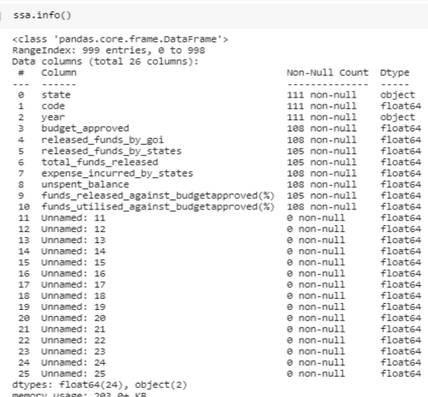
Data Information
‘data.info()’
gives information about whole Dataset

Slide 10
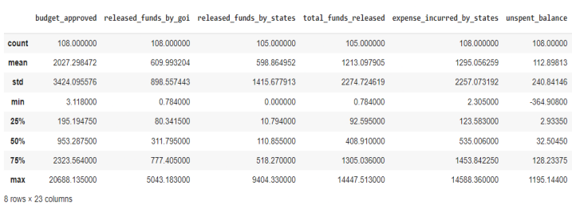
Descriptive Analysis
Summary Of the Data (including 5 number summary)

Slide 11
Dataset Cleaning
3
Handling missing values.

Slide 12
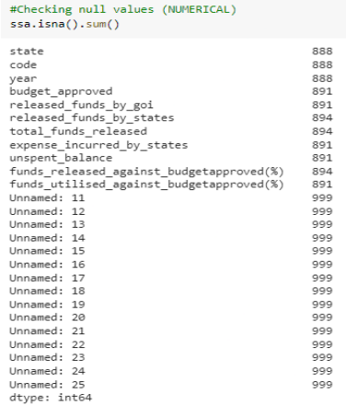
Checking Missing Value
Checking for missing values in data is a crucial step in data analysis and preprocessing.
Missing values refer to the absence of data entries or values in specific variables or observations within a dataset.
Checking for missing values is important because it can affect the accuracy and reliability of any data analysis.

Slide 13
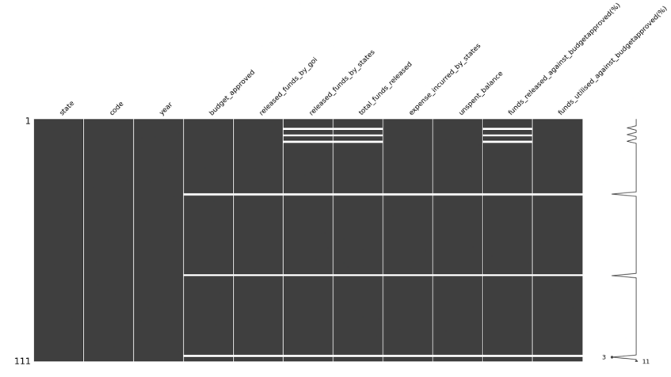
Visualizing Missing Values
Matrix plot visualization of missing values using msno.matrix(ssa)

Slide 14
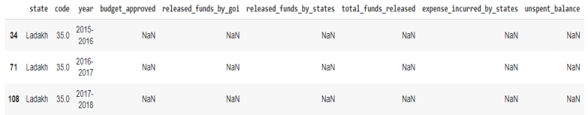
Drop/Delete Missing Values
We can see that the ‘budget_approved’ column is null for ‘state’ Ladakh. Furthermore, all columns of Ladakh are null. Since this data won't be beneficial for our analysis it's better to delete this from our dataset.

Slide 15
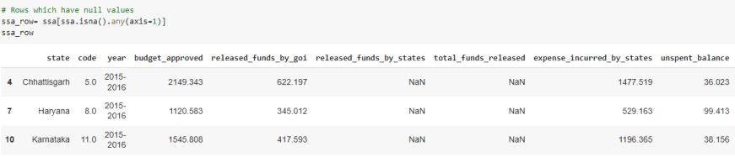
Other Null Values
For Chhattisgarh, Haryana and Karnataka we have null values in some cells. We need to handle these missing values in order to further work on our data.

Slide 16
Types of Missing Values
Missing Completely At Random (MCAR)
Missing At Random (MAR)
Missing Not At Random (MNAR)
Here the missingness depends on other observed variables in the dataset, but not on the missing variable itself. Hence our data is Missing at Random(MAR), so we impute it by using their respective mean and pattern.

Slide 17
Imputation
For column “released_funds_by_states” we have filled the null values by taking the mean of other years’ data.
For column “total_funds_released” we have filled null values using the formula below -
total_funds_released = released_funds_by_goi + released_funds_by_states
For column “funds_released_against_budget_approved” we have filled null values using the formula below -
funds_released_against_budget_approved = (total_funds_released/budget_approved)×100

Slide 18
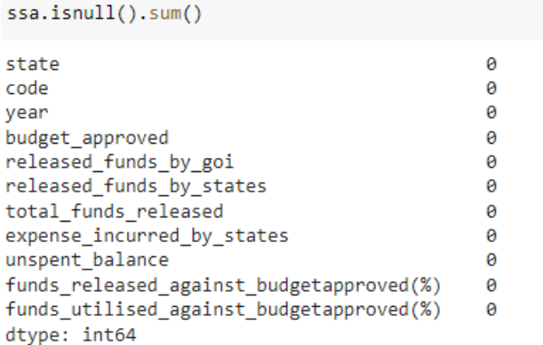
Verifying Null Values
After completing the imputation process, it is essential to conduct a thorough verification of null values to ensure that no additional missing values have been overlooked.

Slide 19
Dataset Visualization and Analysis
4
Representation of Data through use of common Graphics.
Easy way to convey concepts in a universal manner.

Slide 20
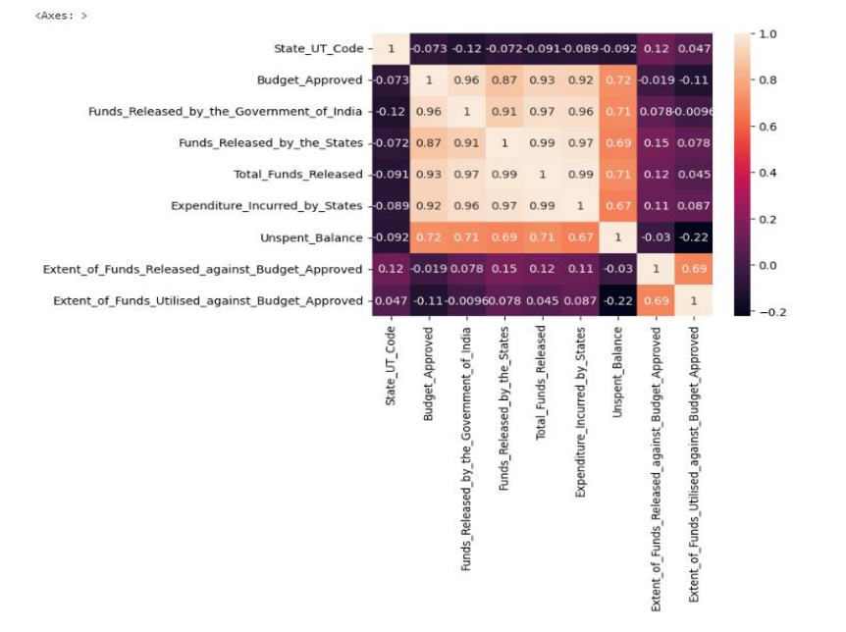
Heatmap
Correlation Map using Seaborn Library

Slide 21
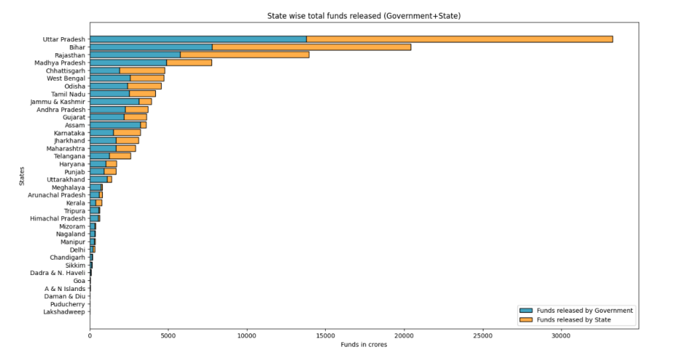
Stacked Bar Chart
Distribution of the funds among each state. (Using Matplotlib)

Slide 22
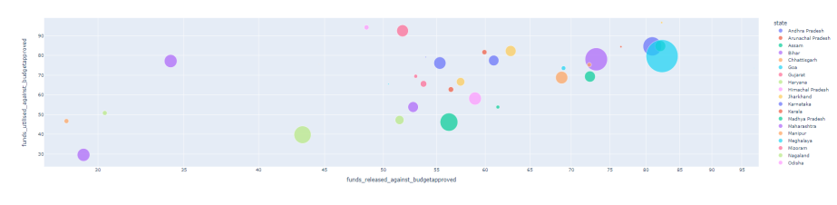
Weighted Scatter Plot
Scatter plot is of funds released vs utilised against the budget. Weights in the scatter is of the budget approved. We can see that as funds released increases the utilization of that funds also increases.

Slide 23
Visualization Dashboard
A visualization dashboard is a collection of visualizations and interactive components that provide a high-level overview of key performance indicators (KPIs).
Visualization dashboards can be created using various tools and software, including Excel, Tableau, Power BI, and other data visualization software.
Here, we have used Power BI to make the dashboard. We have made static visuals and dynamic dashboard for the project.

Slide 24
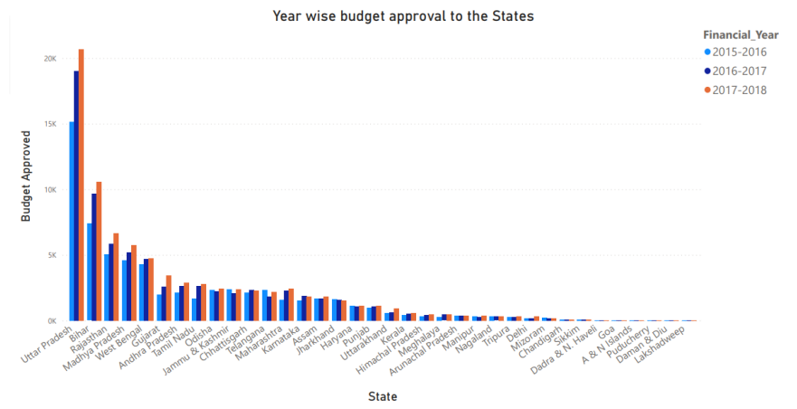
Static Visual

Slide 25
Dynamic Dashboard
A dynamic dashboard is an interactive and customizable data visualization tool that provides real-time updates and allows users to explore and analyze data dynamically. It typically consists of multiple visual components, such as charts, graphs, tables, and filters, that are interconnected and update automatically as the underlying data changes.
Power Bi Dashboard - Link

Slide 26
Dataset Prediction
5
Feature Selection
Machine Learning Modeling

Slide 27
Feature Selection
Finding Correlation
Taking state_code and year as independent variable.
Taking approved budget as dependent variable.
Preprocessing Data For Modelling
Encoding year.
Creating dataframes for specific year.

Slide 28
Machine Learning Modelling
Objectives
OBJECTIVE 1- We will train data of 2 years(2015-16 to 2016-17) and will take 'approved_budget' as test data for year 2017-18 and decide which ML model will work efficiently.
OBJECTIVE 2 - We will take ML model from objective 1 for better result and train data of 3 years(2015-16 to 2017-18) and hence will predict 'budget_approved' for 2018-19 financial year.

Slide 29
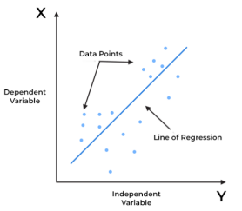
Objective 1
Using Linear Regression
Linear regression is a statistical method used to analyze the relationship between a dependent variable and one or more independent variables.
The goal of linear regression is to find the linear relationship between the variables, which can be used to make predictions.

Slide 30
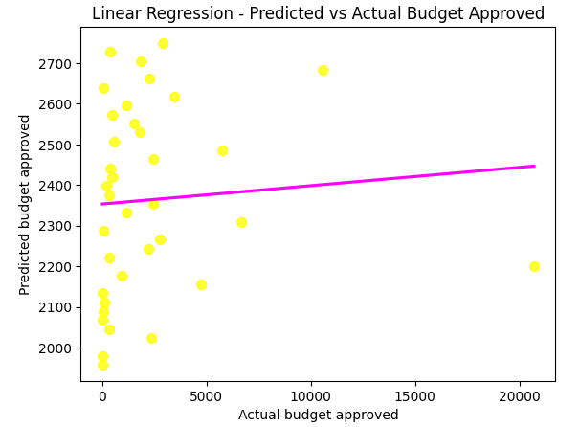
Objective 1
USING LINEAR REGRESSION
Data is non linear so it will not be a good model to use linear data.

Slide 31
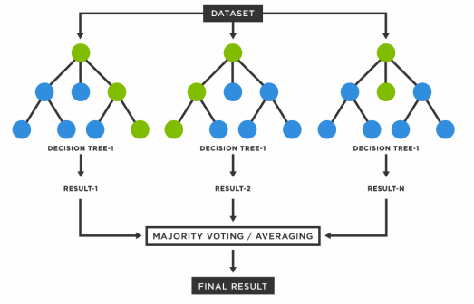
Objective 1
USING RANDOM FOREST
Random forest is a machine learning algorithm that is used for classification, regression, and other tasks that involve supervised learning
It is an ensemble method that combines multiple decision trees to improve accuracy and reduce overfitting.

Slide 32
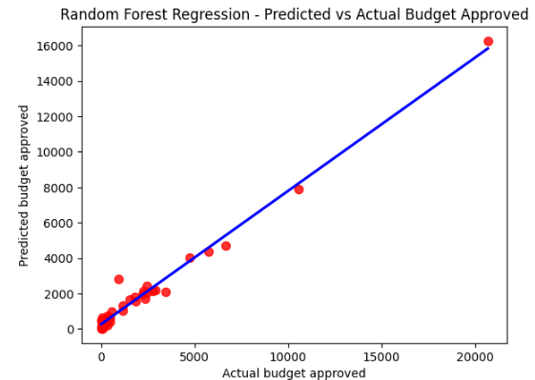
Objective 2
USING RANDOM FOREST
After applying we find that our accuracy is increased and error is decreased.

Slide 33

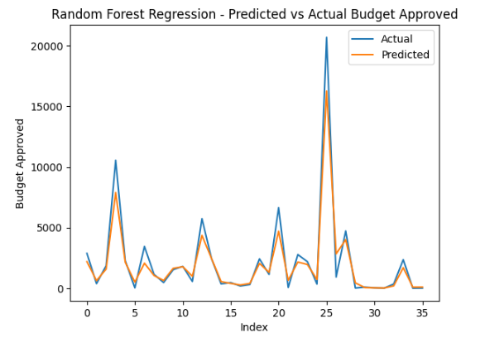

Slide 34
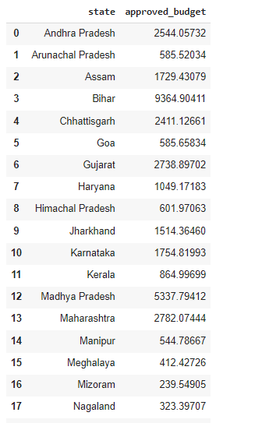

Objective 2
RESULT :-
Prediction for approved_budget for 2018-19
Due to availability of limited data to predict budget for next year our mean absolute error is high.

Slide 35
Thank You!

