Slide 1
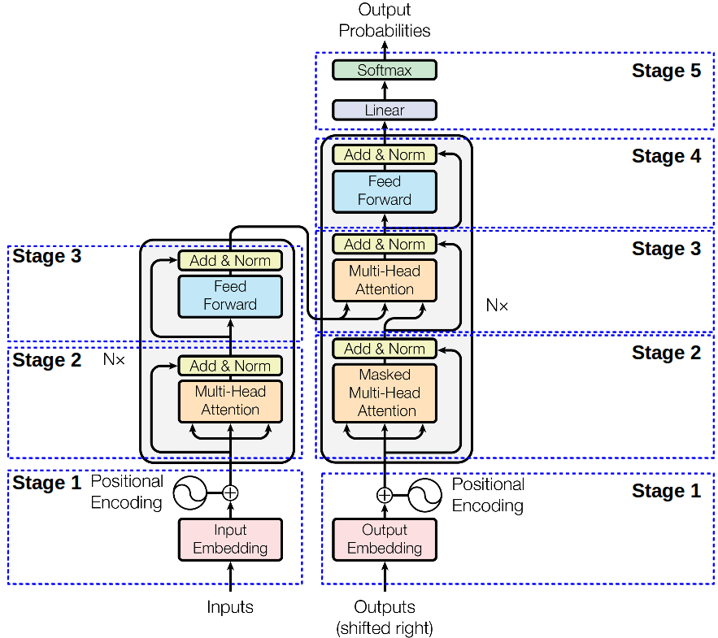
The Transformer

Slide 2
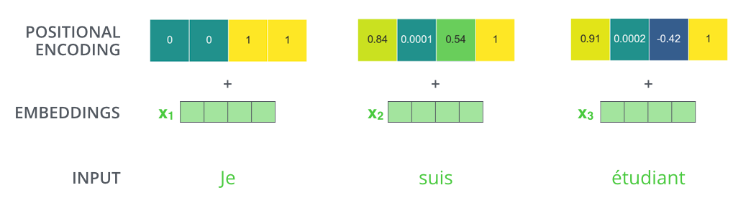
Positional Encoding
The closer the words are the higher is the dot product is
Help determine which word is associated to the current word

Slide 3
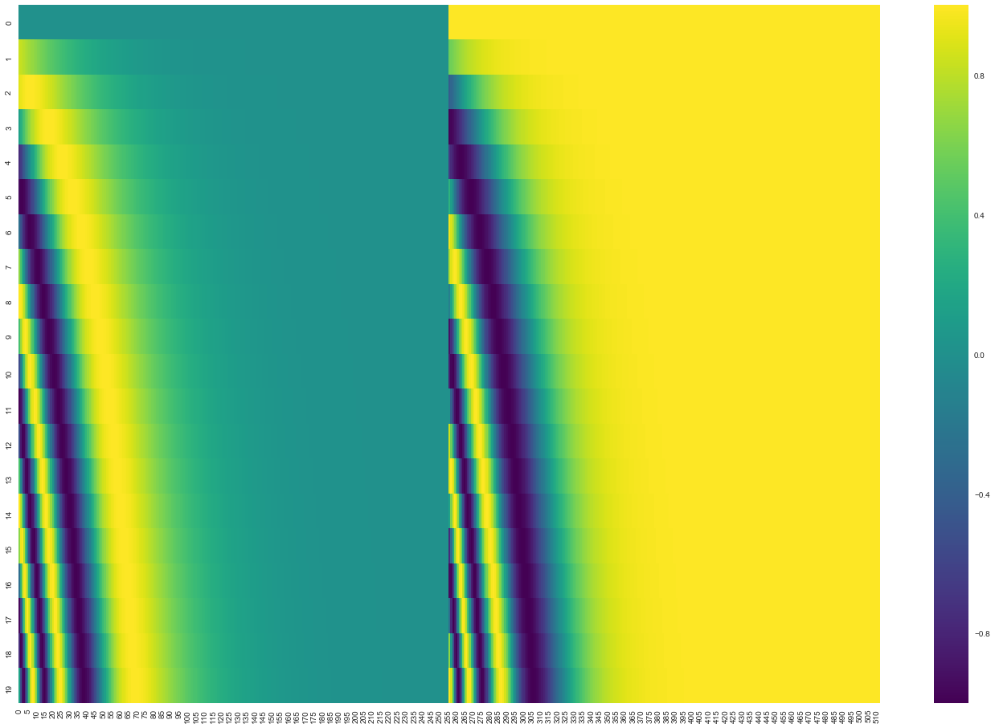
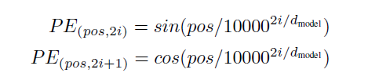
Positional Encoding

Slide 4
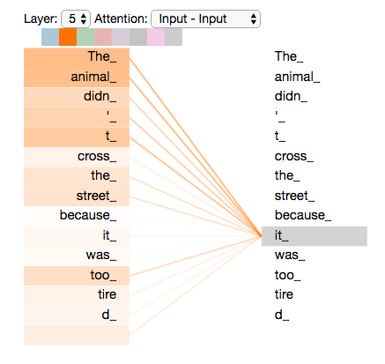
Self-Attention

Slide 5
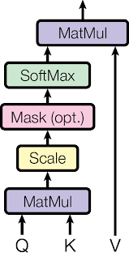

Self-Attention
$\operatorname{Attention}{(Q, K, V)}$ = $\operatorname{Softmax}\left(\frac{QK^{T}}{\sqrt{d_{k}}}\right)V$
Q, K and V are trainable matrices

Slide 6
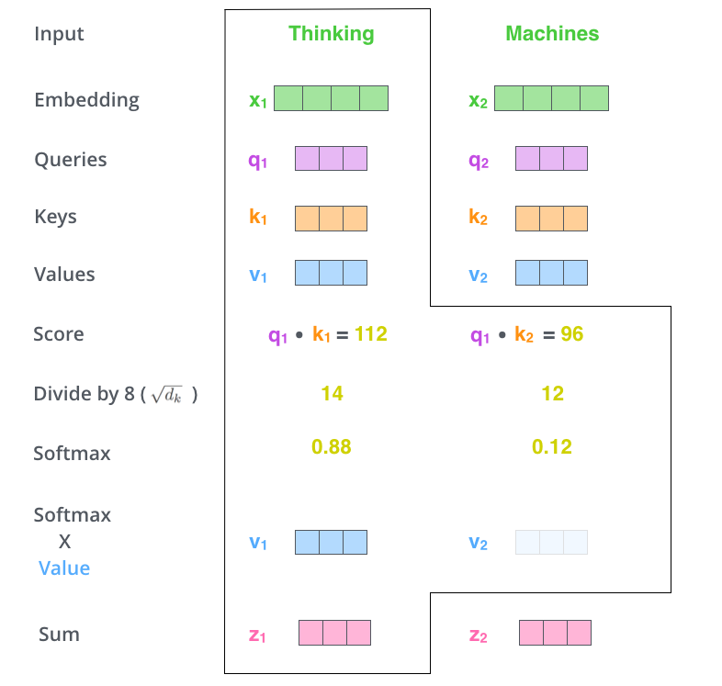
Self Attention

Slide 7
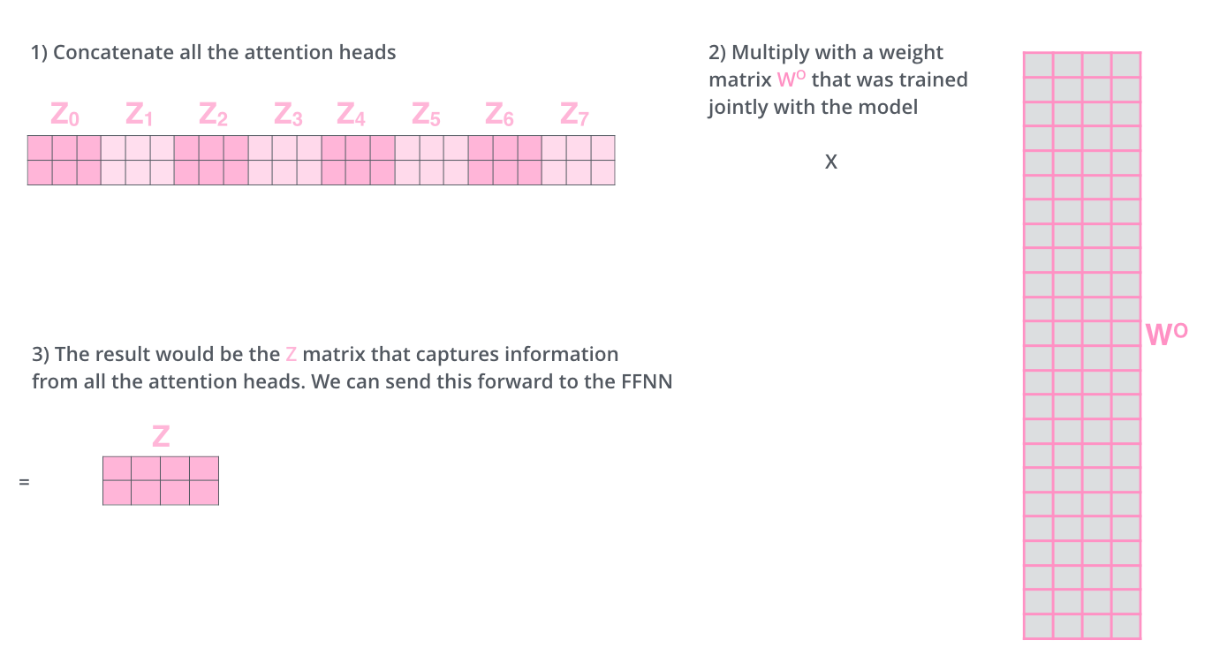
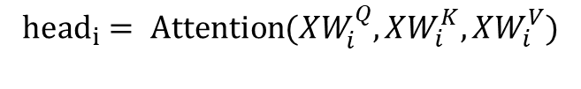
Multi-Head Self-Attention
$$MultiHeadAttention={Concat\left(head_{0},…, head_{n}\right)W^{O}}$$
$${head}_{i}= Attention{({XW}_{i}^{Q},{XW}_{i}^{K},{XW}_{i}^{V})}$$
The result can be used for the next layer

Slide 8
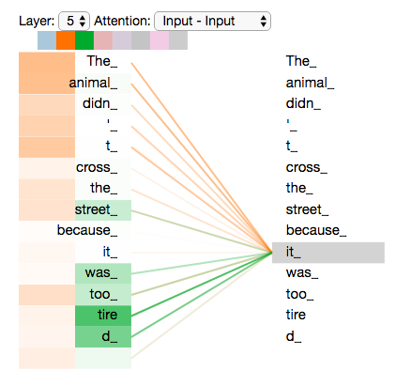
Multi-Head Self-Attention

Slide 9
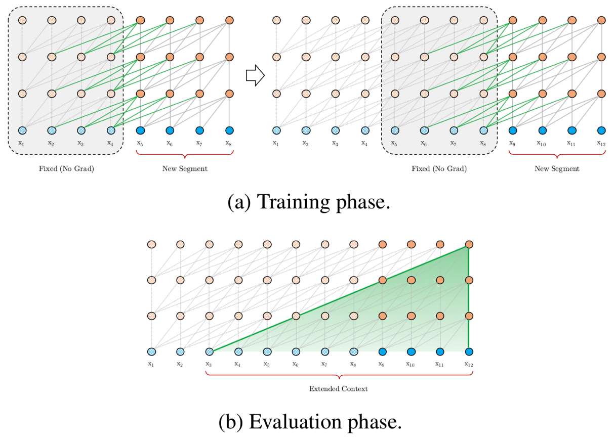
Transformer XL : Transformer with memory

Slide 10
