Slide 1
HR ANALYTICS · POWER BI
HR Dashboard: Understanding &
Reducing Employee Attrition
A data-driven look at why employees leave — and where to focus retention efforts
1,470 employees | 16.12% attrition | $21.04M total salary

Slide 2
01 — INTRODUCTION
Project Overview
This project analyzes workforce data for a 1,470-employee organization using Power BI. The goal is to move beyond a single attrition number and understand why employees are leaving — by examining satisfaction, overtime, commute distance, promotion status, department, and compensation together.
1,470
Total employees analyzed
7.01 yrs
The result is an interactive HR dashboard that lets stakeholders filter by age and job role, and drill into the drivers of attrition at a glance.
Average employee tenure
60% / 40%
Male / Female workforce split
2

Slide 3
02 — THE PROBLEM
Business Challenge
The company is losing employees at a rate of 16.12%, against an 84% retention rate. Leadership lacks a clear, data-backed view of which segments are most at risk, and what's actually driving people out the door.
16.12%
84%
3 questions
Attrition rate
Retention rate
unanswered: WHO leaves, WHY, and WHERE to focus HR effort
Without this visibility, retention efforts risk being reactive and unfocused — and the cost of continued turnover (recruitment, onboarding, lost productivity) keeps compounding.
3

Slide 4
03 — WHAT WE SET OUT TO ANSWER
Business Questions
1
What is the overall headcount, gender split, and average tenure?
2
How is total salary distributed across departments and performance levels?
3
How satisfied are employees, and how does that relate to attrition?
4
Does commute distance affect attrition?
5
Does overtime combined with low satisfaction increase attrition risk?
6
Does promotion status influence attrition?
4

Slide 5
04 — APPROACH
Action: Data & Processing
1
2
3
4
Data Preparation
Modeling
Measures
Visualization
Raw HR records cleaned and shaped in Power Query — data types fixed, duplicates/blank fields removed, categories structured (satisfaction, overtime, promotion, location).
Relationships built between employee attributes (department, job role, performance, satisfaction, tenure) to enable cross-filtering.
DAX measures created for Attrition Rate, Retention Rate, Total Salary, Average Tenure, and Headcount.
Final model visualized in Power BI Desktop with interactive slicers for Age and Job Role.
5

Slide 6
05 — FINDINGS
Key Insights — Workforce & Pay
1,470
$21.04M
882 / 588
65.37%
Total headcount
Total salary paid
Male / Female (60% / 40%)
Of headcount is in R&D
$17.84M vs $3.2M
R&D leads spend
722 of 1,470
Salary paid to 'Good' vs 'Satisfactory' performers
$13.7M (R&D) > $6.46M (Sales) > $850K (HR)
employees report LOW satisfaction with their job
Research & Development carries the largest share of both people and payroll — making it the highest-leverage department for retention investment.
6

Slide 7
05 — FINDINGS
Key Insights — What Drives Attrition
Commute distance
Far / very-far employees attrite noticeably more than close / very-close employees.
Overtime + dissatisfaction
Employees who are dissatisfied AND work overtime show the highest attrition of any group.
Promotion status
Not-due-for-promotion employees attrite MORE (33.91%) than those due for promotion (28.46%) — promotion timing isn't the main driver.
Bottom line: Job dissatisfaction — not promotion — is the primary driver of attrition, amplified by long commutes and overtime.
7

Slide 8
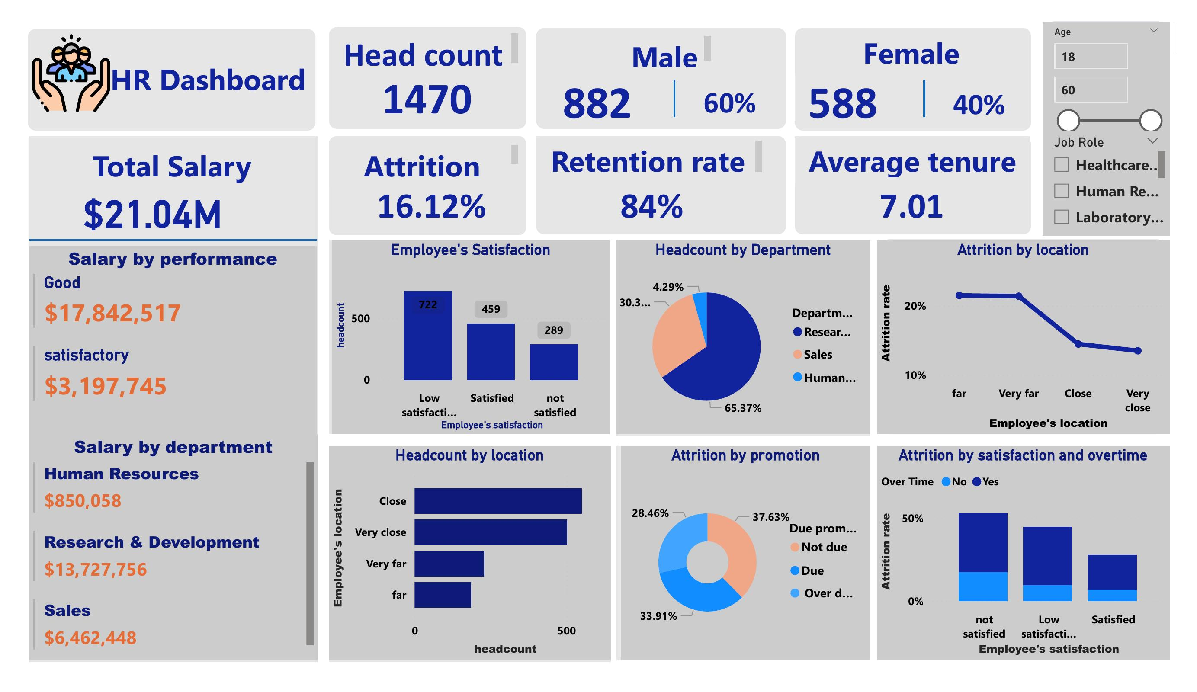
THE DASHBOARD
Power BI HR Dashboard
8

Slide 9
06 — NEXT STEPS
Recommendations
Prioritize satisfaction
Fix the overtime trap
Investigate root causes of low satisfaction (workload, management, growth) — the leading attrition signal.
Reduce or better compensate overtime for already-dissatisfied employees — this combo has the highest attrition.
Support long commutes
Focus on R&D retention
Offer hybrid/remote options or transport support for staff living far / very far from work.
R&D holds the largest headcount and payroll — small retention gains here yield outsized savings.
Re-evaluate promotion cadence
Build continuous listening
Not the top driver, but keep timelines transparent and fair — perceived stagnation still matters.
Run regular pulse surveys to catch dissatisfaction before it becomes attrition.
9

Slide 10
CONCLUSION
Attrition is driven by dissatisfaction — not promotion timing.
With 1,470 employees, a 16.12% attrition rate, and $21.04M in annual salary exposure, targeted retention efforts — starting with satisfaction and workload — offer the clearest path to protecting both people and payroll investment. The Power BI dashboard gives HR and leadership a reusable, interactive tool to monitor these drivers going forward.
TOOLS USED
• Power Query — data transformation
• DAX Measures — Attrition, Retention, Salary, Tenure
• Power BI Desktop — modeling & dashboard design
10

