Slide 1
Kaldu Reviews Analytics
Mining customer reviews for sentiment, topics, and actions

Slide 2
Project Overview
Tujuan: Menggali insight dari ulasan publik/non-rahasia.
Pendekatan: EDA, Sentiment (VADER/lexicon), N-gram, KMeans (unsupervised).
Dataset: kaldu-cleaning.xlsx

Slide 3
Raw Dataset
Local: sandbox:/mnt/data/kaldu-cleaning.xlsx
Sheets: Recovered_Sheet1, Recovered_Sheet1 (2)

Slide 4
Analysis Process
Load & clean
Text prep
Sentiment
N-grams
KMeans topics
KPIs & charts

Slide 5
Insight & Findings
Total reviews: 255
Owner reply rate: 26%
Sentiment counts: {'positive': 8, 'neutral': 245, 'negative': 2}
Top terms: enak, makanan, pelayanan, ga, yg, tempatnya, makanannya, makan

Slide 6
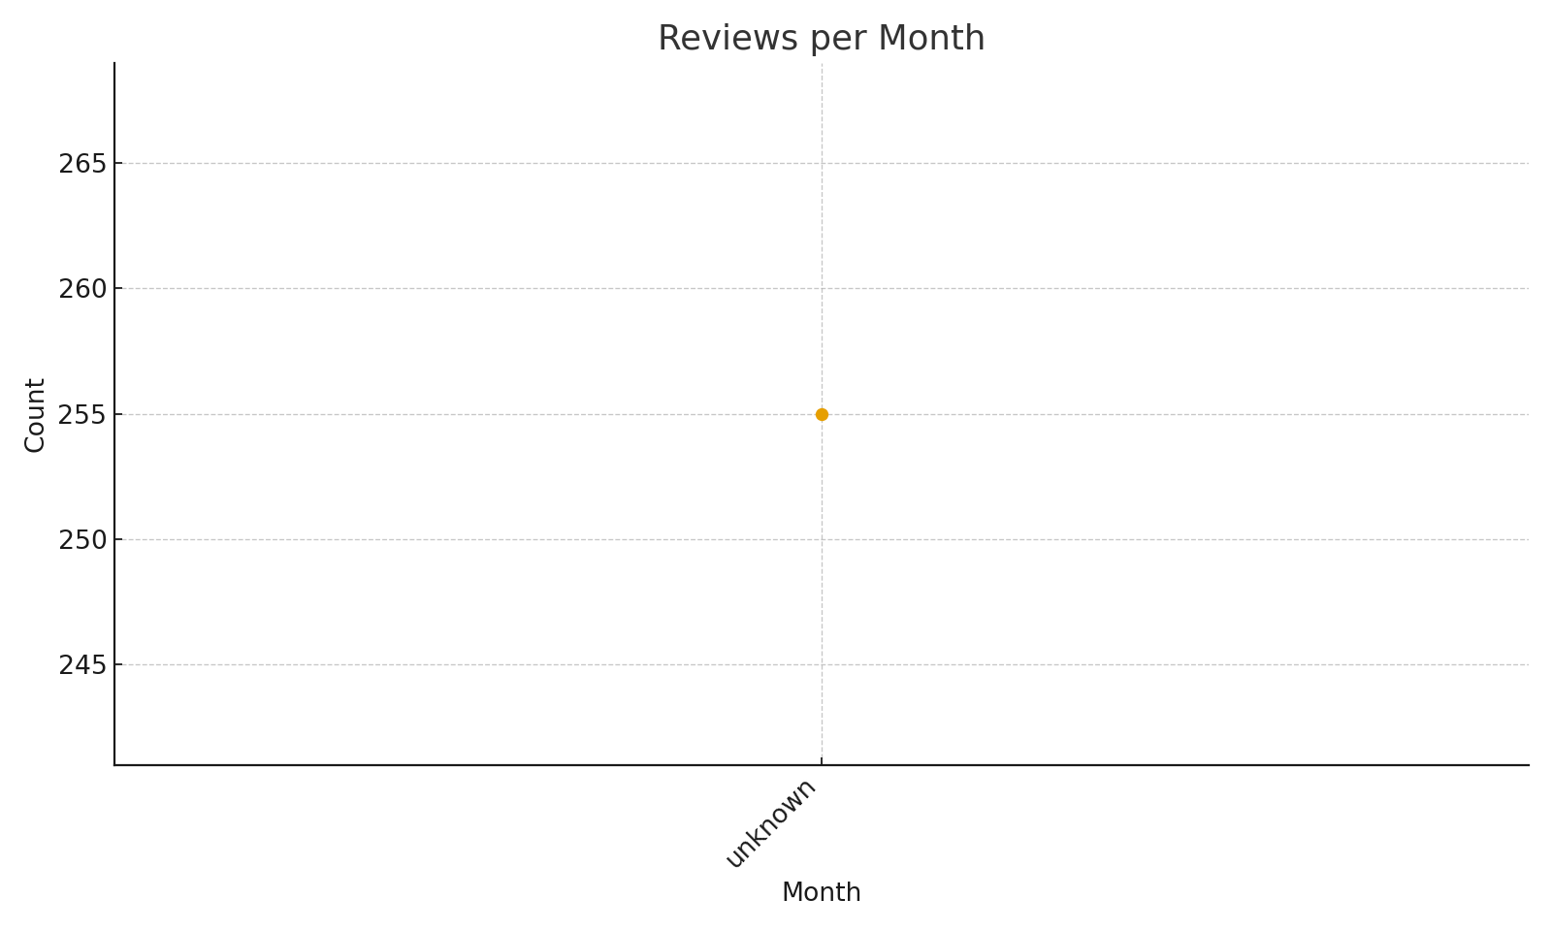
Reviews per Month

Slide 7
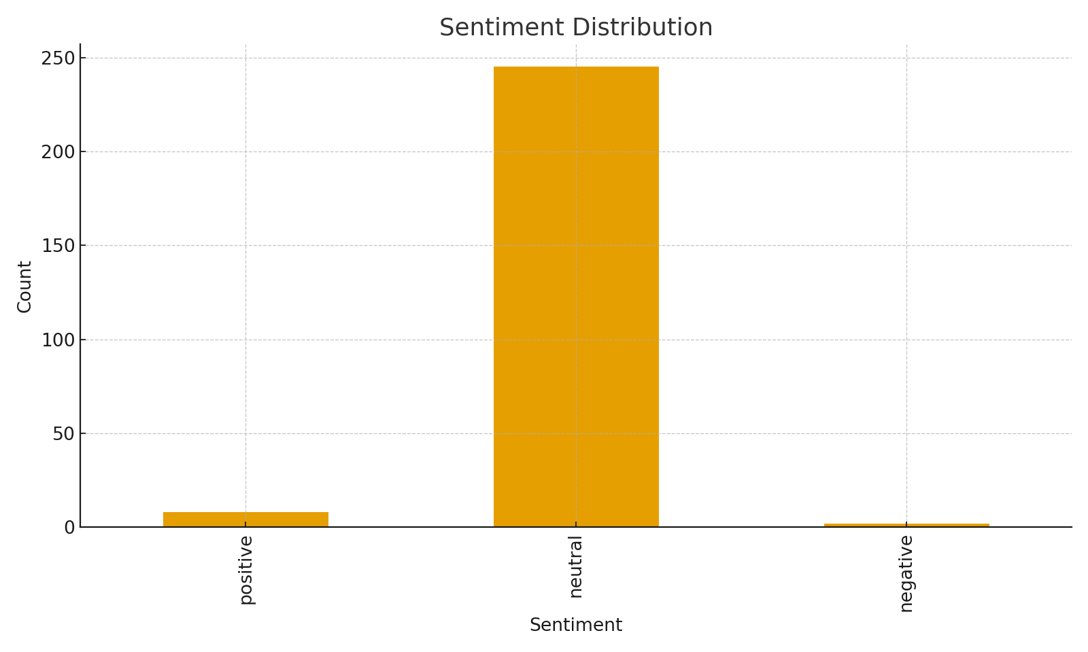
Sentiment Distribution

Slide 8
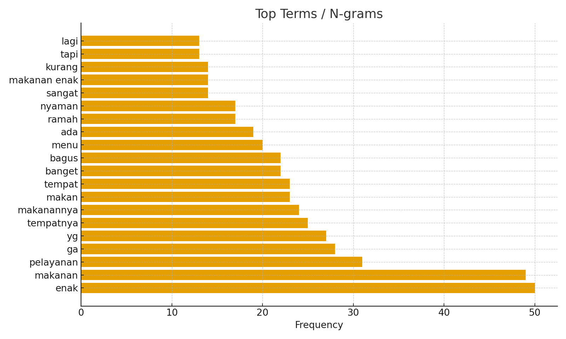
Top Terms

Slide 9
Conclusion & Recommendations
Standardize owner replies to ≥80% with helpful templates.
Use negative terms & topics as punch list for ops fixes.
Encourage detailed UGC; prompt reviews post-purchase.
Track monthly to see impact of interventions.

Slide 10
AI Support Explanation
Sentiment via VADER (or lexicon fallback).
KMeans for unsupervised topic cues.
LLM used to refine narrative & recommendations.

