Slide 1
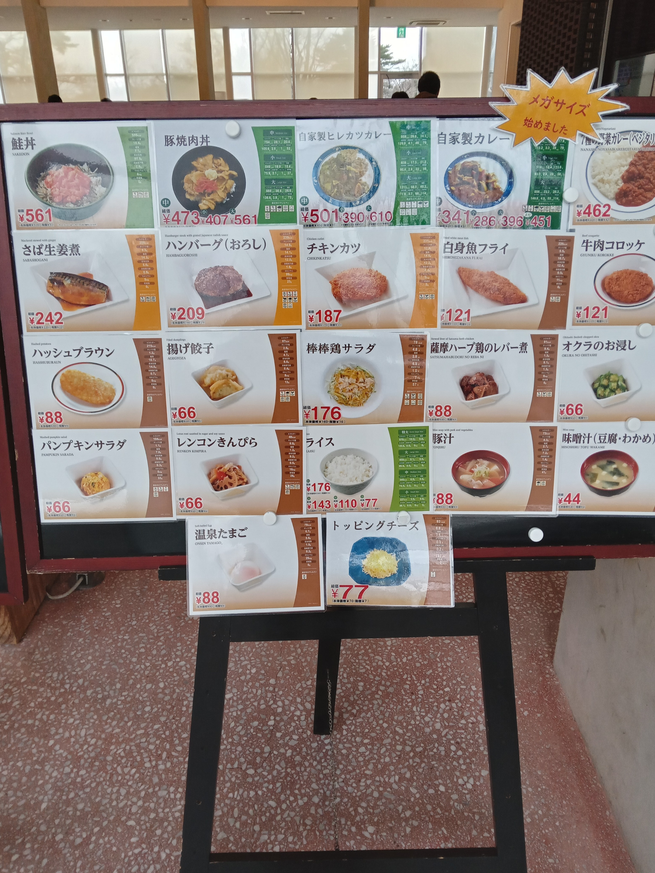
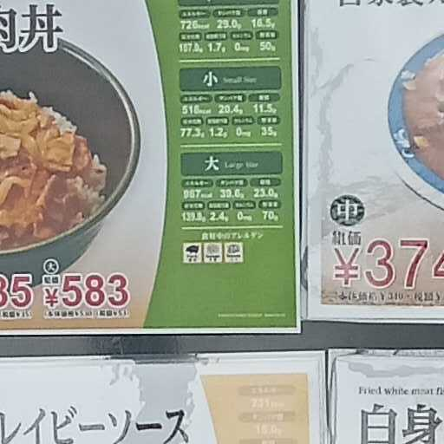
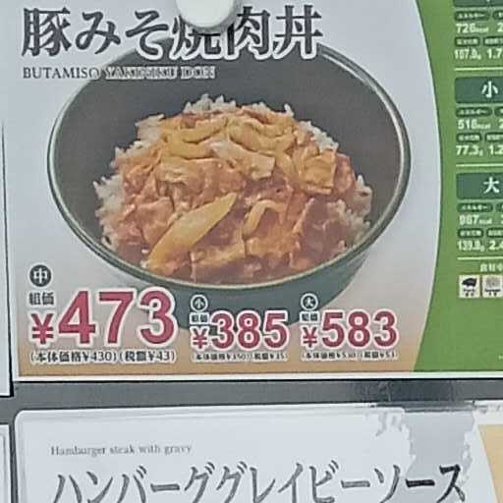
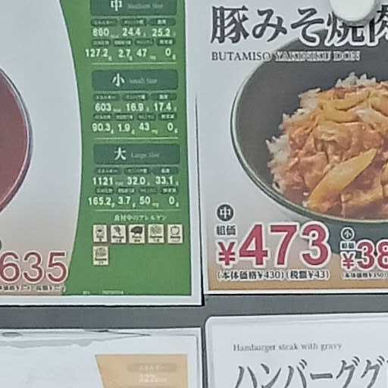
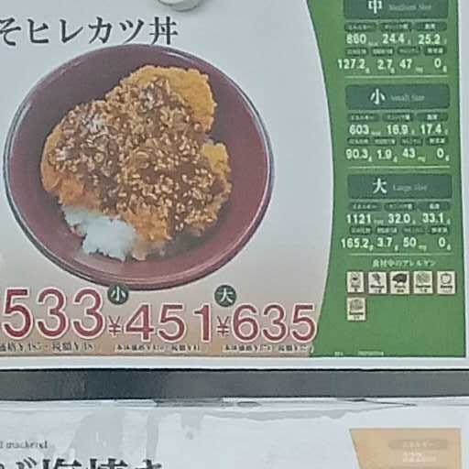
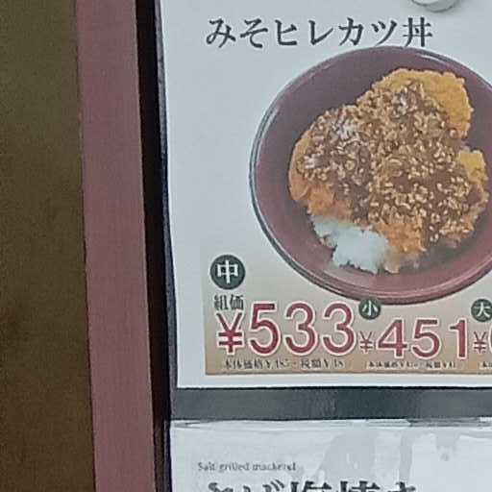
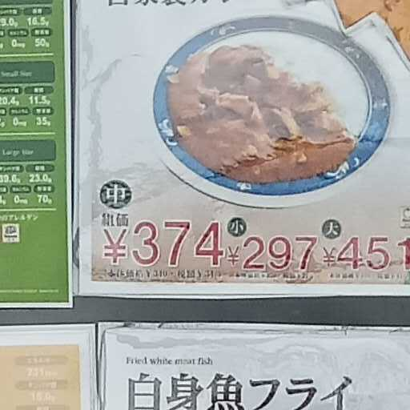
Cropped image
Image size 512 by default
The odd of each class/menu for a particular cropped image
EfficientNet-B2
[0 , 7, 1, …]
[10, 0, 1, …]
[0 , 0, 1, …]
….
Output only when the odd > threshold
By default, threshold is 5
Strided with spacing half of the image size

