Slide 1
FINAL CAPSTONE PRESENTATION
ASSESSING THE IMPACT OF (NIGERIAN, GHANAIAN, ZIMBABWEAN, RWANDAN AND KENYAN) ACCENTS ON ENGLISH SPEAKING SPEECH RECOGNITION SYSTEMS.
EKAB-OSOWO TAWO
MIS [THESIS]

Slide 2
CONTENT
Background/Motivation
Research Question/Objective
Literature Review
Methodology
Results
Key Findings
Future Work
PRESENTATION OUTLINE

Slide 3
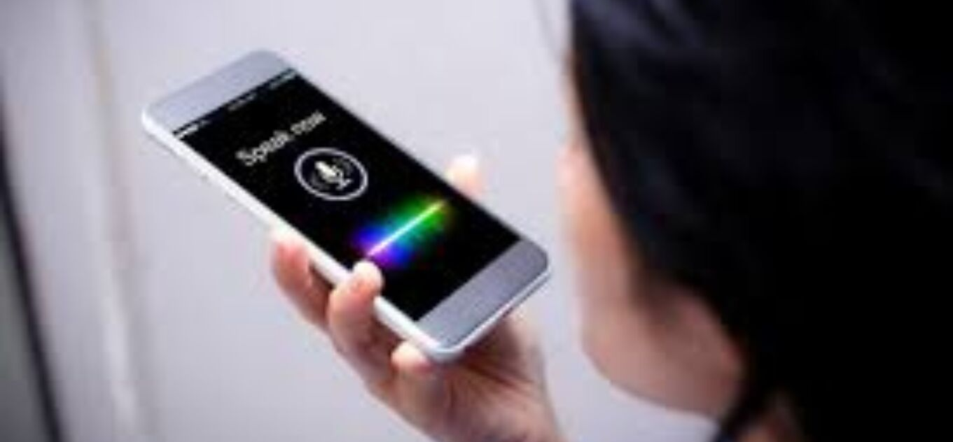
BACKGROUND/MOTIVATION

Slide 4
RESEARCH QUESTION
OBJECTIVE
How does Nigerian, Ghanaian, Zimbabwean, Rwandan and Kenyan Accents affect English speaking speech recognition systems?.
The objective of this research is to understand and assess to a considerable extent the impact of some African accents: Nigerian, Ghanaian, Zimbabwean, Rwandan and Kenyan, on English speaking Speech Recognition systems.

Slide 5
LITERATURE REVIEW
Automatic Speech recognition and speaker variability – Benzeghiba, De Mori et al..
Word Error Rate Estimation for Speech Recognition – Ali and Renals.
Accents of English – J.C Wells.

Slide 6
METHODOLOGY
STRATIFIED SELECTION
EXPERIMENTATION
COMPUTATION(WER)

Slide 7
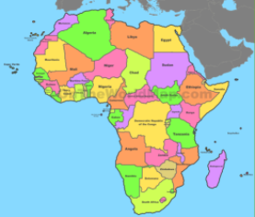
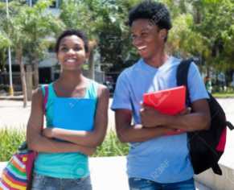

STRATIFIED SELECTION
SELECTION OF COUNTRIES
SELECTION OF PARTICIPANTS
SELECTION OF SPEECH RECOGNISERS

Slide 8
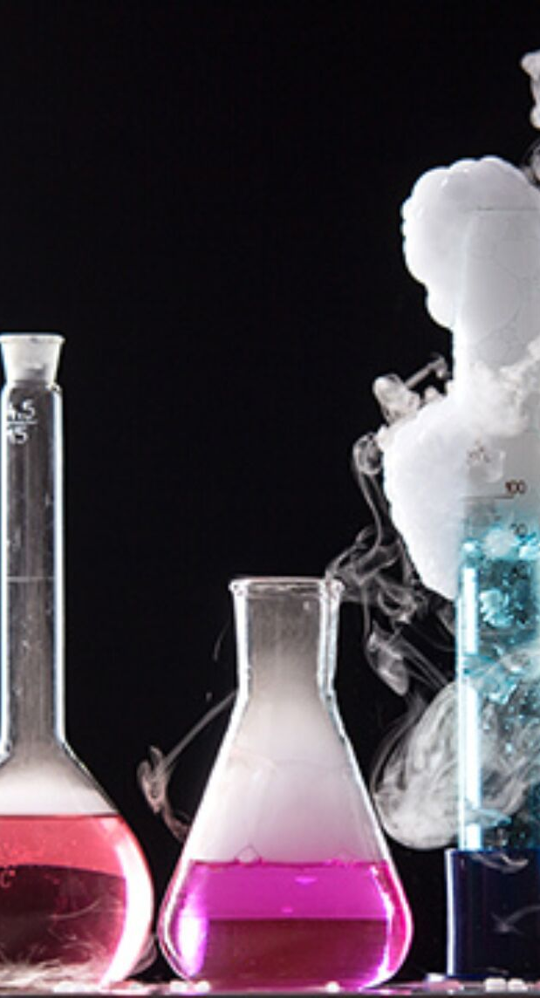
EXPERIMENTATION
SENTENCE CREATION
RECORDING OF PARTICIPANTS
TRANSCRIPTION OF RECORDED DATA

Slide 9
SENTENCES USED
What route is better if I want to go to the mall?
In my country buses are red and cars are green.
The greatest gift is a passion for reading.
Look at that lady over there, she has a purple eye.
I like my bread with butter or jam and not mayonnaise.
What play are we going to see in the theaters?
What do you call it when rain falls while the sun shines?
Donuts covered in Caramel are just the best.
I need a white envelope its urgent.
What is the largest telecommunication network in West Africa?

Slide 10
EXAMPLE OF TRNSCRIPTIONS

Slide 11
A Ghana Google
What route is better if I want to go to the mall? | What’s which is better if I want to go to the mall?
In my country buses are red and cars are green. | In my country buses are red and causing a green.
The greatest gift is a passion for reading. | The greatest gift is a passion for reading.
Look at that lady over there, she has a purple eye. | Look at that lady over there she has a purple eye.
I like my bread with butter or jam and not mayonnaise. | I like my bread with butter and jam and what’s my name
What play are we going to see in the theaters? | What’s play are we going to spend a few houses?
What do you call it when rain falls while the sun shines? | What do you call it when the rain falls while the sun shines?
Donuts covered in Caramel are just the best. | Donuts covered in Caramel, I just a bit
I need a white envelope its urgent. | I need a white envelope the edges.
What is the largest telecommunication network in West Africa? | What is the largest telecommunication network in West Africa?
A Ghana IBM
What route is better if I want to go to the mall? | What's new is is this a if I want to go to the mall.
In my country buses are red and cars are green. | In my country buses are read in because it of green.
The greatest gift is a passion for reading. | The greatest gift is a passion for reading.
Look at that lady over there, she has a purple eye. | Look at the leading over the shows the papal I'd.
I like my bread with butter or jam and not mayonnaise. | Like my bread the bustle John and that's mine.
What play are we going to see in the theaters? | Was the only good thing that the essence.
What do you call it when rain falls while the sun shines? | What do you call it when they're in full as well the sunshine?
Donuts covered in Caramel are just the best. | Donuts covered in Carmel adjusted this.
I need a white envelope its urgent. | I need a life on you agents.
What is the largest telecommunication network in West Africa? | What is the largest telecommunication network in West Africa?

Slide 12
B Ghana Google
What route is better if I want to go to the mall? | What route is better if I want to go to the mall?
In my country buses are red and cars are green. | In my country roses are red in casa green
The greatest gift is a passion for reading. | The greatest gift is a passion for reading.
Look at that lady over there, she has a purple eye. | Lucas valley urology
I like my bread with butter or jam and not mayonnaise. | I like our bridge with bats our jam. I’m not my enemies.
What play are we going to see in the theaters? | What’s play are we going to see in the theaters?
What do you call it when rain falls while the sun shines? | When do you call it when it rains while the sun shines?
Donuts covered in Caramel are just the best. | Do not cover in caramel. I just did this.
I need a white envelope its urgent. | I need a White Sands Loop it surgeons
What is the largest telecommunication network in West Africa? | What is the largest telecommunication as WIC in West Africa?
B Ghana IBM
What route is better if I want to go to the mall? | With roots is but if I want to go to the mall.
In my country buses are red and cars are green. | In my country buses are rude and because of.
The greatest gift is a passion for reading. | The greeters give this a question for you.
Look at that lady over there, she has a purple eye. | Because of the need you on the she hasn't.
I like my bread with butter or jam and not mayonnaise. | I like my bread with but so John notes monies.
What play are we going to see in the theaters? | What's plea only going to see in the defense's.
What do you call it when rain falls while the sun shines? | What do you call it it's when it's means what the sunshine.
Donuts covered in Caramel are just the best. | Do not score than in Carmel and just that this.
I need a white envelope its urgent. | I need a way to end the decisions.
What is the largest telecommunication network in West Africa? | What is the largest city communication as we can stuff.

Slide 13
WORD ERROR RATE (WER)
A METHOD USED IN CALCULATING THE PERFORMANCE OF ASR.
FORMULA IS;
WER = (I+D+S)/N
Where I = Insertions
. D = Deletion
S = Substitution
N = No. of words.
COMPUTATION

Slide 14
RESULTS
Google Ghana Average: 29.03% Nigeria Average: 27.66% Zimbabwe Average: 24.07% Rwanda Average: 36.92% Kenya Average: 28.76% *America Average: 13.82% Google Average: 29.29% Google Male Average: 30.60% Google Female Average: 23.07% | IBM Ghana Average: 64.25% Nigeria Average: 64.96% Zimbabwe Average: 69.78% Rwanda Average: 76.03% Kenya Average: 65.32% *America Average: 22.22% IBM Average: 68.06% IBM Male Average: 61.20% IBM Female Average: 59.65%
Male Average: 45.90% Female Average: 41.36%

Slide 15
KEY FINDINGS
There exist major differences between Google and IBM transcriptions.
Female Gender have better WER than the Male Gender
There exist major differences between Google’s stated WER(4.9%) and the WER calculated in this study
There exist major differences between IBM’s stated WER (5.5%)and the WER calculated in this study.

Slide 16
KEY FINDINGS
Cause of differences in WER’s is due to bias in training data used.
Accents causes differences in WER among African countries.

Slide 17
Using a larger data set for research
Developing African trained speech recognition system
FUTURE WORKS

Slide 18
Thank You.

