Slide 1

USING RECURRENT NEURAL NETWORKS TO SOLVE OPTIMIZATION PROBLEMS :HOPFIELD NEURAL NETWOKS(HNN)
COURSE CODE – 7CS041/UM1 : MSC PROJECT DATA SCIENCE
STUDENT NUMBER - 2050717

Slide 2
TABLE OF CONTENT
INTRODUCTION
Neural Networks
Problem Statement
Project Objective
HOPFIELD NETWORK
Hopfield Nets
TESTING/ARTEFACT DEMONSTRATION
DISCUSSION & CONCLUSION
Recurrent Neural Networks
Hebbian Learning

Slide 3
WHAT Are neural NETWORKs?
Neural Networks are algorithms that deal with cognitive tasks; including learning and optimization processes that are vaguely based on ideologies relating to the nature of the brain. Neural Network is a network where there’s an interconnection between all its elements.
Neural Networks also involves building machines with the idea that these machines work similarly to how the human brain functions and there ate four major types. Perceptron, Multilayer perceptron, Convolutional and Recurrent Neural Networks, respectively.
Perceptrons are oldest Neural Networks with one neuron. Multilayer Perceptrons have both input, hidden and output layers and are the foundation of NLPs.
Convolutional Neural Networks are used for image recognition and computer vision while Recurrent Neural Networks are useful in predicting future outcomes and are known for their feedback loop.

Slide 4
RECURRENT NEURAL NETWORKS
Recurrent Neural Networks(RNNs) are designed to understand and learn sequences as well as time varying patterns. Using recursive connections, RNNs are quite good in storing past information as well as being good predictors. With the emergence of Optimization problems, RNNs have been applied and has proven to be effective when solving such problems. These problems include; Language modeling, speech and handwriting recognition, and image recognition.
Examples of Recurrent Neural Networks - Recurrent Backpropagation nets, Hopfield Network, BAM etc.
Recurrent Neural Networks Architectures basically describe the set up of how various networks are set.
TYPES OF RNN ARCHITECTURE
Standard RNNs an architecture that has an input vector I, a hidden vector H, and an output vector O.
Long short-term memory (LSTM) tackles gradient-based learning issues by its memory cells using soft multiplicative gates to control information flows.
Stacked RNNs are deep hybrid that are used to increase an RNN's architectural expressiveness by “stacking” RNNs sequentially.
Multiplicative RNNs use a matrix factorization that allows weights in the hidden transition to change largely depending on the input.

Slide 5

PROBLEM DEFINITION
Optimization problems involve finding the best solution among the possible ones available. Optimization problems need optimized methods that allow the maximization and minimization of various objective functions.
There are generic linear and polynomial examples of optimization problems, however some problems that need optimization may not be solved and as such, some form of approximation is necessary.
Optimization problems can be nonlinear as well and these are extremely complex due to numerous constraints and finding the best possible solutions requiring the shortest computation time is the. main objective when solving optimization problems. There is a need to find real-time solutions for optimization problems as these problems exist specifically in scientific and engineering fields.
Optimization problems come in numerous forms and if not tackled can lead to some consequences. The primary or basic consequence of not tackling the optimization problem is not using the best possible solution when solving machine learning and technical issues at hand.

Slide 6

Project objective
Neural networks have over decades been used in investigating optimization problems such as system identification, filter design, function approximation, regression analysis and image/pattern recognition and identification. Using Hopfield Network, a type of RNN(which are good in predictive analysis), this research investigates Optimization problems (pattern/image recognition specifically).
The main objective of this research is to develop a predictive Hopfield Neural Network model that can be used for predictive analysis in pattern recognition and identification, where an output pattern is returned based on an input pattern(s).
Hebbian Learning rule is applied to the Hopfield Neural Network for the model to be developed.

Slide 7
HOPFIELD NETS
The Hopfield net is a recurrent neural network type that has a synaptic connection pattern where a fundamental Lyapunov (energy) function exists for the activity dynamics. They can also be seen as sets of neurons that are bidirectionally linked to one another with symmetric weights and are not self connected.
Characteristics of a Hopfield Network
They are unsupervised
Patterns are memorized easily from just one sample. This is done without the aid of training sets.
They work as error correctors and auto associators.
They are recurrent because the inputs of each neurons are the outputs of the others.
They learn using simple Hebbian Learning rules.

Slide 8
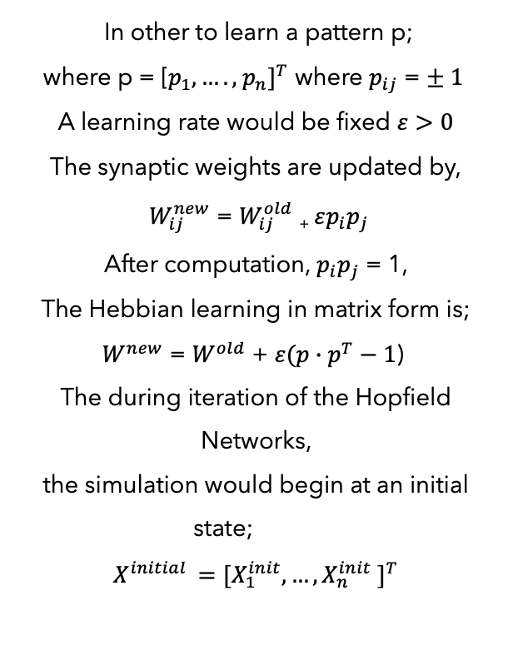
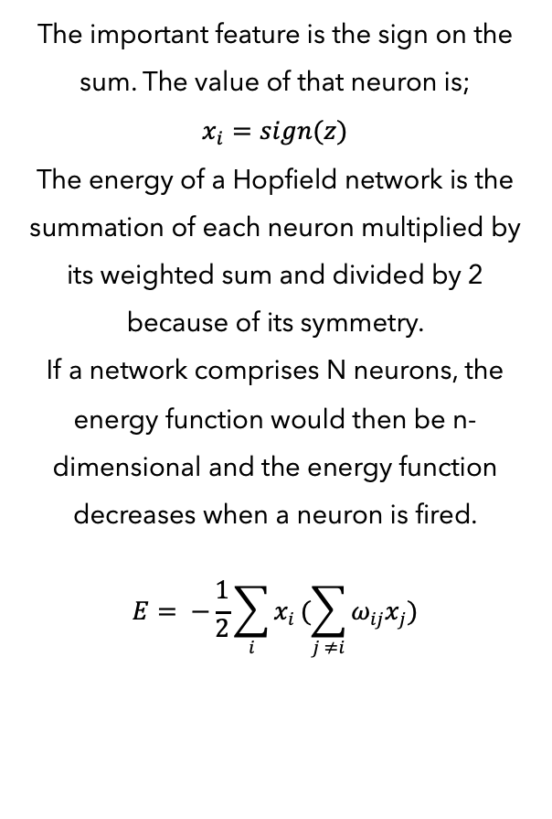
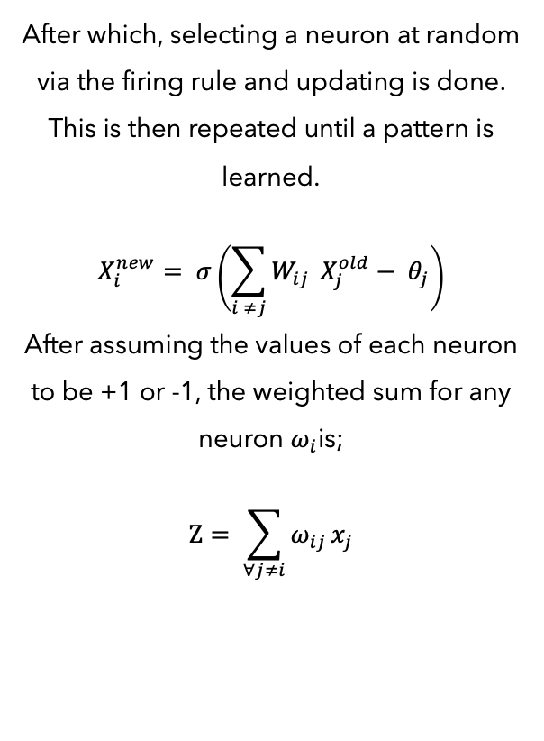
HOPFIELD NETWORK
HEBBIAN LEARNING RULE - indicates that the value of a weight ($ω_{ij}$) between 2 neurons ($x_{i}$ & $x_{j}$) are the products of the value of that neuron ($ω_{ij}= x_{i} ∗ x_{j})$
In other to learn a pattern p;
where p = [$p_{1},….,{ p_{n}]}^{T}$ where $p_{ij}$ = $± 1$
A learning rate would be fixed $ε>0$
The synaptic weights are updated by,
$W_{ij}^{new}$ = $W_{ij}^{old}$ ₊ $εp_{i}p_{j}$
After computation, $p_{i}p_{j}$ = 1,
The Hebbian learning in matrix form is;
$W^{new}$ = $W^{old}$ + $ε(p∙p^{T}−1$)
The during iteration of the Hopfield Networks,
the simulation would begin at an initial state;
$$X^{initial }=[X_{1}^{init},…{,X}_{n}^{init}{ ]}^{T}$$
The important feature is the sign on the sum. The value of that neuron is;
$$x_{i}=sign(z)$$
The energy of a Hopfield network is the summation of each neuron multiplied by its weighted sum and divided by 2 because of its symmetry.
If a network comprises N neurons, the energy function would then be n-dimensional and the energy function decreases when a neuron is fired.
$$Ε= −\frac{1}{2}\sum_{i}{x_{i}}(\sum_{j ≠i}{ω_{ij}x_{j}})$$
After which, selecting a neuron at random via the firing rule and updating is done. This is then repeated until a pattern is learned.
$$X_{i}^{new}= σ\left(\sum_{i ≠j}{W_{ij}} X_{j}^{old}− θ_{j}\right)$$
After assuming the values of each neuron to be +1 or -1, the weighted sum for any neuron $ω_{i}$is;
$$Ζ= \sum_{∀j≠i}{ω_{ij}}x_{j}$$

Slide 9
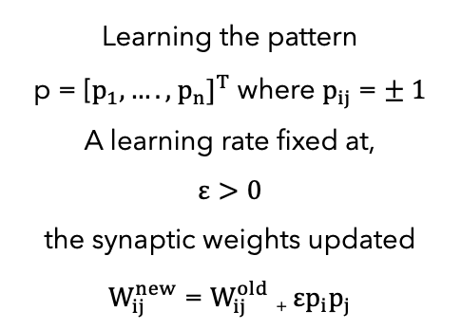
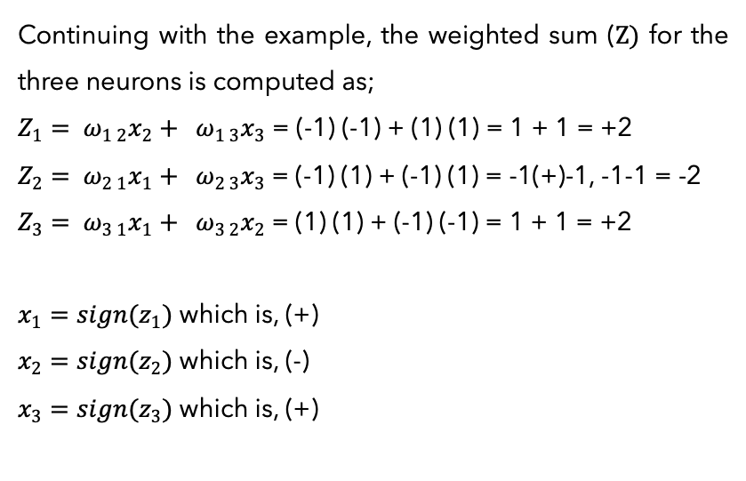
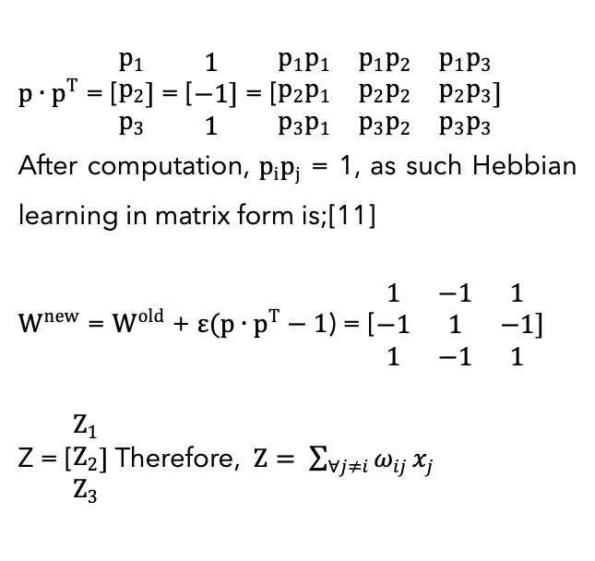
HOPFIELD NETWORK CONT’D
Let’s take an example to adequately highlight the Hebbian learning as well as the Hopfield network. In Hopfield Network, (+1) depicts a fired neuron and (-1) an unfired neuron. We assume N = 3 neurons with values of $x_{1}$, $x_{2}$, $x_{3}$, to be [1,-1,1] respectively, then;
$p∙p^{T}$ = [$\begin{matrix}p_{1} \\ p_{2} \\ p_{3}\end{matrix}]$= [$\begin{matrix}1 \\ −1 \\ 1\end{matrix}]$ = [$\begin{matrix}p_{1}p_{1} & p_{1}p_{2} & p_{1}p_{3} \\ p_{2}p_{1} & p_{2}p_{2} & p_{2}p_{3} \\ p_{3}p_{1} & p_{3}p_{2} & p_{3}p_{3}\end{matrix}]$
After computation, $p_{i}p_{j}$ = 1, as such Hebbian learning in matrix form is;[11]
$W^{new}$ = $W^{old}$ + $ε(p∙p^{T}−1$) = [$\begin{matrix}1 & −1 & 1 \\ −1 & 1 & −1 \\ 1 & −1 & 1\end{matrix}]$
Z = [$\begin{matrix}Z_{1} \\ Z_{2} \\ Z_{3}\end{matrix}]$ Therefore, $Ζ= \sum_{∀j≠i}{ω_{ij}}x_{j}$
Continuing with the example, the weighted sum ($Ζ)$ for the three neurons is computed as;
$Z_{1}= ω_{1 2}x_{2}+ ω_{1 3}x_{3}$ = (-1) (-1) + (1) (1) = 1 + 1 = +2
$Z_{2}= ω_{2 1}x_{1}+ ω_{2 3}x_{3}$= (-1) (1) + (-1) (1) = -1(+)-1, -1-1 = -2
$Z_{3}= ω_{3 1}x_{1}+ ω_{3 2}x_{2}$= (1) (1) + (-1) (-1) = 1 + 1 = +2
$x_{1}=sign(z_{1})$ which is, (+)
$x_{2}=sign(z_{2})$ which is, (-)
$x_{3}=sign(z_{3})$ which is, (+)
Learning the pattern
p = [$p_{1},….,{ p_{n}]}^{T}$ where $p_{ij}$ = $± 1$
A learning rate fixed at,
$$ε>0$$
the synaptic weights updated $W_{ij}^{new}$ = $W_{ij}^{old}$ ₊ $εp_{i}p_{j}$
When programmed, after the learning, the iterations are done until the pattern is learned.

Slide 10


Slide 11
DISCUSSION & CONCLUSION
The model accurately stores images/patterns given to it, predicts and returns the expected output pattern once the guessed pattern has been applied to it. This was noted during testing.
However also during testing some major deductions were observed;
Hopfield networks work closely and similarly to how the human brain works (Hippocampus).
Presence of Spurious Minima was also observed during the experiments.
There is limit to the storage capacity of the Hopfield Network. (Retreival errrors exists when the number of stored patterns surpasses 14% of the size of the network.
The model developed to a large extent adequately recognized patterns based on inputs received, returning the expected outputs. However, the performance of the model wasn’t perfect due to the presence of some constraints (capacity of model, spurious minima). More research can be done involving using novel network types that have larger capacity as well as trying facial image recognition.

Slide 12
REFERENCES
B. Müller, J. Reinhardt, and M. T. Strickland, Neural Networks: An Introduction. Springer Science & Business Media, 1995.
P. Picton, ‘What is a Neural Network?’, in Introduction to Neural Networks, P. Picton, Ed. London: Macmillan Education UK, 1994, pp. 1–12. doi: 10.1007/978-1-349-13530-1_1.
‘What are Neural Networks?’, Aug. 03, 2021. https://www.ibm.com/cloud/learn/neural-networks (accessed Oct. 11, 2022).
L. Medsker and L. C. Jain, Recurrent Neural Networks: Design and Applications. CRC Press, 1999.
S. Liviu, ‘Hopfield nets and the brain’, Medium, Sep. 10, 2019. https://medium.com/@serbanliviu/hopfield-nets-and-the-brain-e5880070cdba (accessed Oct. 26, 2022).
G. Villarrubia, J. F. De Paz, P. Chamoso, and F. D. la Prieta, ‘Artificial neural networks used in optimization problems’, Neurocomputing, vol. 272, pp. 10–16, Jan. 2018, doi: 10.1016/j.neucom.2017.04.075.
V. Folli, M. Leonetti, and G. Ruocco, ‘On the Maximum Storage Capacity of the Hopfield Model’, Frontiers in Computational Neuroscience, vol. 10, 2017, Accessed: Dec. 17, 2022. [Online]. Available: https://www.frontiersin.org/articles/10.3389/fncom.2016.001

