Slide 1
LearnSphere AI
Active Workspace and Deployment System
MindForgeAI Internship 2026 | Chatake Innoworks Pvt. Ltd.
LearnSphere AI Team: Vaishnavi Mali (2026IT012, Team Lead), Nagweni Kumbhar (2026IT011), Aishwarya Ekanath (2026IT010)

Slide 2
Why an Active Workspace?
A separate clone protects the baseline project while the team develops, tests, documents, and releases improvements.

Slide 3
Independent Localhost
The active workspace runs on http://localhost:5051. It uses its own virtual environment and database, separate from the original project server.

Slide 4
Readable Page Structure
Overview, planner, library, practice, and team pages each have their own HTML file. Shared behavior and styling remain in dedicated asset files.

Slide 5
Integration Architecture
Browser -> frontend -> Flask API -> SQLite
GitHub Pages -> runtime config -> Render API
Git push -> Actions -> GitHub Pages

Slide 6
Safe Change Workflow
Pull approved work. Create a feature branch. Run localhost. Edit mapped files. Test. Review diff. Commit. Push. Review and deploy.

Slide 7
Team and Internship Identity
LearnSphere AI Team
Vaishnavi Mali | Nagweni Kumbhar | Aishwarya Ekanath
Chatake Innoworks Pvt. Ltd. | MindForgeAI Internship 2026

Slide 8
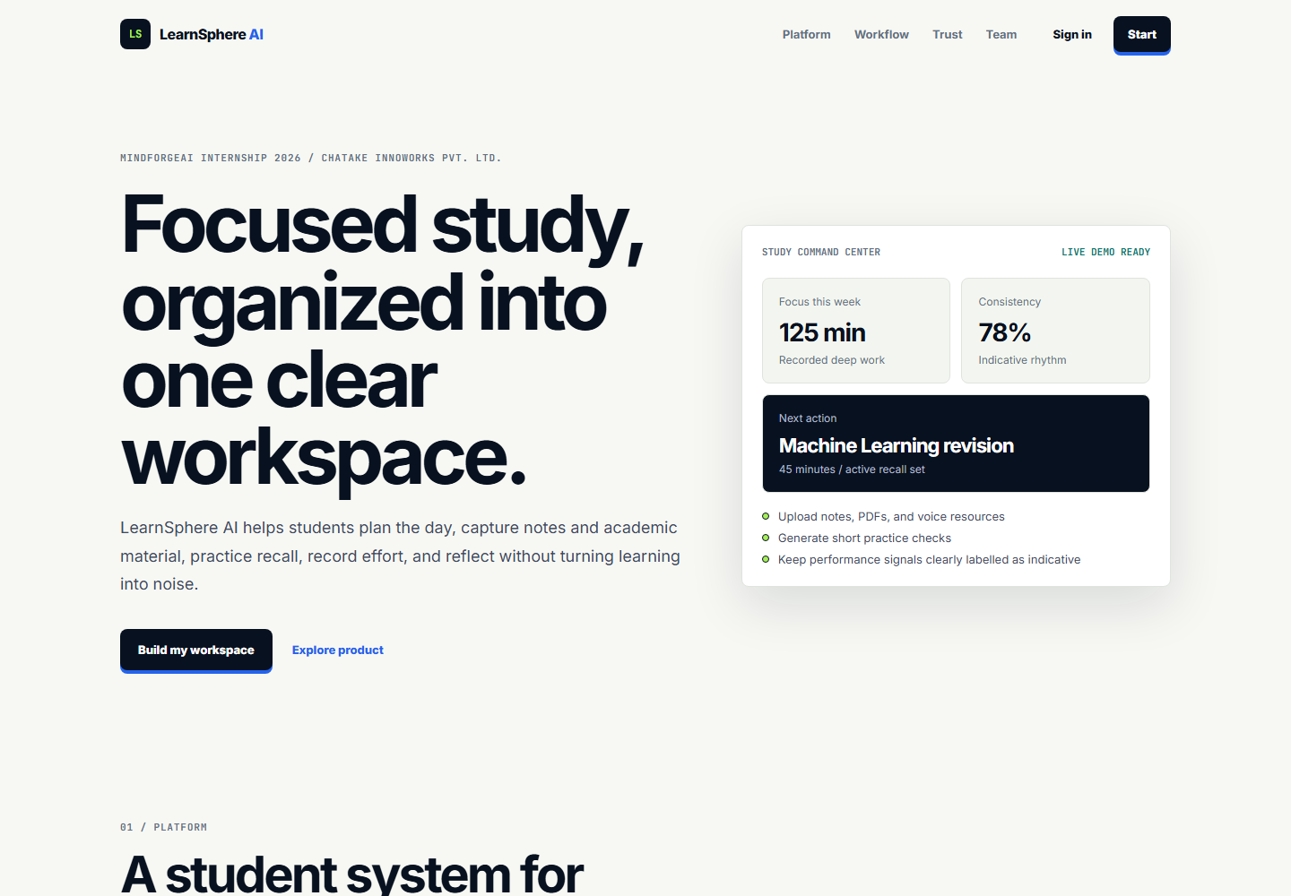
Live Active Workspace Portal

Slide 9
Conclusion
The active workspace provides a clear path for future development: understandable source files, documented commands, repeatable testing, controlled Git updates, and deployment readiness.

