Slide 1

The Director LLM: Multi-Critic Reinforcement Learning for Narrative Generation
A framework for balancing competing objectives in interactive storytelling through specialized critics and dynamic reward weighting.

Slide 2

The Challenge: Multi-Objective Narrative Generation
Large Language Models excel at fluency but struggle with competing objectives. In Dungeon Master generation, effective storytelling demands rich atmospheric description AND logical consistency AND appropriate causal responses. Standard approaches optimize single objectives, producing outputs that excel in one dimension while failing in others.
The Core Tension: Vivid worldbuilding conflicts with mechanical precision. Atmospheric narration conflicts with actionable information. Creative storytelling conflicts with logical consequences.

Slide 3
Research Objectives
1
Decompose narrative quality into distinct measurable competencies amenable to specialized evaluation
2
Develop dynamic reward weighting enabling context-appropriate objective prioritization
3
Validate that supervised baselines exhibit systematic quality limitations addressable through multi-critic optimization
4
Establish generalizable framework for principled multi-constraint generation beyond interactive storytelling

Slide 4
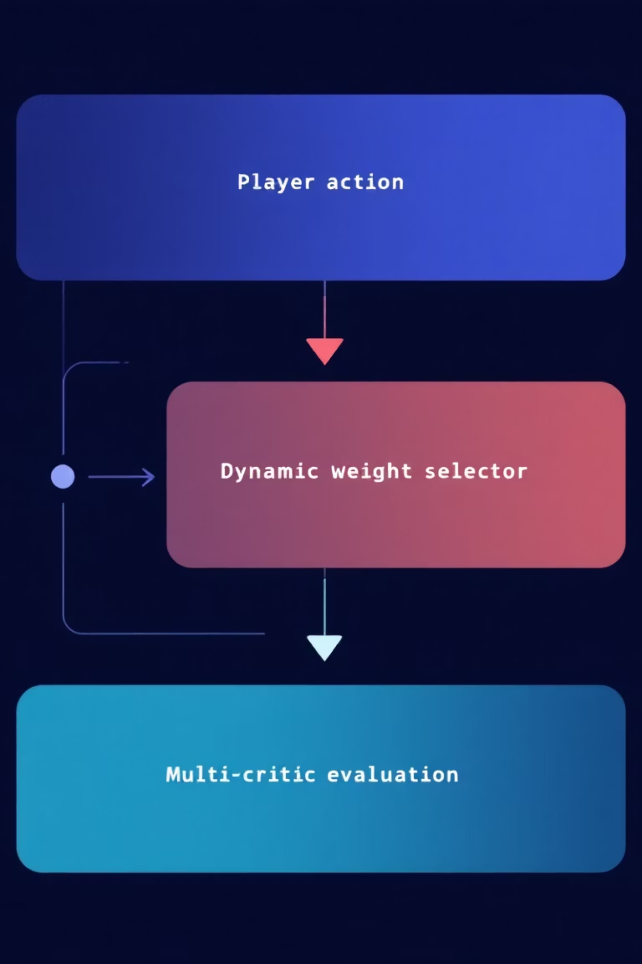
The Director LLM Approach
Multi-Critic Reinforcement Learning with dynamic reward weighting for context-aware multi-objective optimization. Specialized neural critics evaluate distinct quality dimensions, combining signals via intent-conditioned weights.
Dynamic Weighting Strategy:
EXPLORE scenarios: Narrative 0.40, Causal 0.20, World 0.30, Character 0.10 (prioritize atmosphere)
ACTION scenarios: Narrative 0.20, Causal 0.40, World 0.30, Character 0.10 (prioritize consequences)
DIALOGUE scenarios: Narrative 0.20, Causal 0.20, World 0.20, Character 0.40 (prioritize character consistency)
Training via Proximal Policy Optimization with hybrid player system generating realistic prompts and classifying intent for weight selection.

Slide 5

Related Work: Multi-Objective RL
Reinforcement Learning from Human Feedback (RLHF) aligns models with preferences through reward models and PPO optimization. Recent advances introduce Reinforcement Learning from AI Feedback (RLAIF), where models generate preference labels, reducing annotation bottlenecks. Key Innovation: Existing multi-objective approaches employ static reward weighting—objective importance remains fixed across contexts. Our framework introduces dynamic weighting that adapts critic importance based on classified interaction context, enabling learning when each objective matters most. Williams et al. demonstrate multi-objective RL from AI feedback trains separate reward models for helpfulness, harmlessness, and honesty, achieving better Pareto frontiers than monolithic baselines. Li et al. extend this with multi-objective GRPO treating alignment dimensions as distinct optimization targets with explicit trade-off control.

Slide 6
Datasets: Training Corpus
CRD3: Critical Role D&D
LIGHT: Interactive Fantasy
ROCStories: Narrative Coherence
159 episodes of unscripted D&D gameplay from professional voice actors. 200,950 DM utterances providing authentic narrative patterns and extended multi-turn interactions demonstrating world state maintenance.
Crowdsourced fantasy text adventure gameplay with explicit environmental and character grounding. 108,800 responses with action categorizations enabling intent classification (EXPLORE, ACTION, DIALOGUE).
Five-sentence narratives about everyday events. 40,906 examples establishing general coherence patterns (temporal consistency, causal flow) transferable to fantasy narrative evaluation.
Combined Training Corpus: 309,750 total examples (64.9% CRD3, 35.1% LIGHT). Split: 263,287 training, 30,975 validation, 15,488 test.

Slide 7
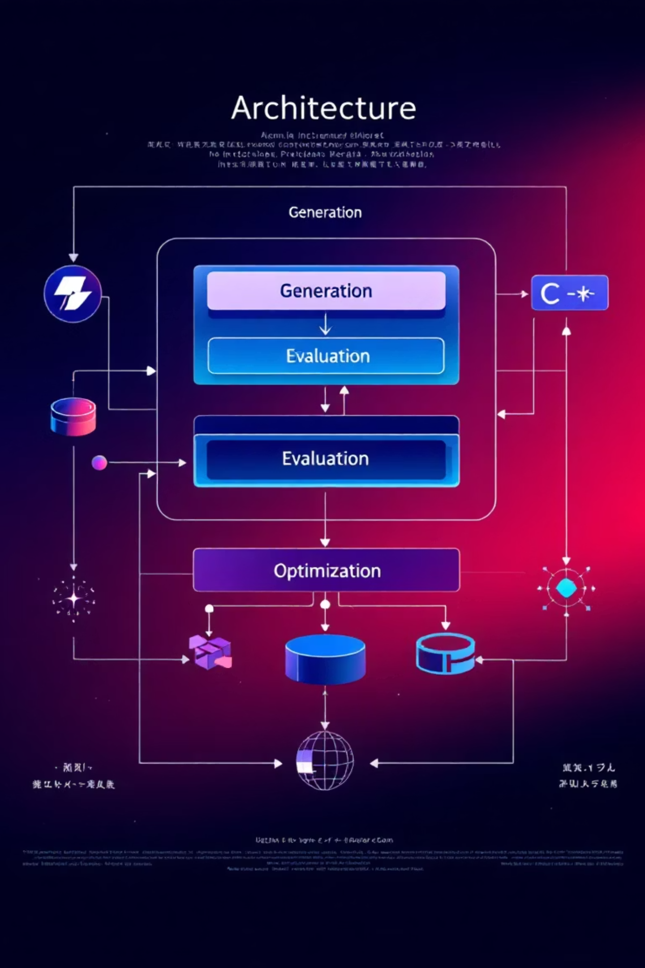
Framework Architecture: Three Layers
Generation Layer: The Director Agent (policy model) produces DM responses conditioned on player prompts and conversation history.
Evaluation Layer: Four specialized critics assess distinct quality dimensions:
Narrative Critic: Evaluates descriptive richness and coherence
Causal Critic: Verifies logical consistency and action-outcome relationships
World Consistency Critic: Tracks state coherence across interactions
Character Voice Critic: Ensures NPC personality consistency
Optimization Layer: MCRL training system combines critic signals through dynamic weighting based on player intent classification, enabling context-appropriate multi-objective balance.

Slide 8

Stage 1: Supervised Component Development
Director Agent (Policy Model)
Model Setup:
Base model: Phi-2 (2.7 billion parameters)
Memory optimization: Compressed from 11GB to 3.5GB using 4-bit quantization
Training method: QLoRA - updates small adapter layers while keeping main model frozen
Training Data:
310,000 examples from D&D transcripts (CRD3) and fantasy dialogues (LIGHT)
Format: Player action → DM response pairs
Teaches the model to: describe scenes vividly, handle consequences logically, maintain world consistency, portray NPCs authentically

Slide 9
Specialized Critics: Design and Implementation
Narrative Quality Critic
DeBERTa-v3-base (184M parameters) configured for regression with single output neuron. Evaluates descriptive richness, atmospheric detail, vocabulary diversity, narrative coherence. Produces continuous quality scores (0-1 range).
Training data created through systematic corruption: coherent examples (label 1.0), shuffled sentences (label 0.0), repetitive text (label 0.2), truncated narratives (label 0.4). Generates 40,906 balanced examples without manual annotation.
Causal Responsiveness Critic
Pre-trained DeBERTa-v3-base-mnli-fever-anli trained on Natural Language Inference datasets. Zero-shot application: player action serves as premise, DM response as hypothesis. Three-way NLI classification (entailment, neutral, contradiction) produces probability distribution; entailment probability serves as causal consistency score.
World Consistency Critic
Hybrid approach combining symbolic tracking and neural understanding. Python class maintains explicit representations of entity locations, object states, environmental conditions, narrative facts. DeBERTa-v3-base fine tuned on CRD3 NPC dialogue extracts world state updates. Detects contradiction (0.0), hallucination (0.3), amnesia (0.5), consistency (1.0).
Character Voice Critic
DeBERTa-v3-base fine-tuned on CRD3 NPC dialogue sequences. Learns character-specific embeddings capturing linguistic markers, topic preferences, interaction styles. Given character identity and context, predicts whether dialogue matches established voice.

Slide 10
Stage 2: Multi-Critic Reinforcement Learning with PPO
Training Loop Architecture: Seven integrated stages per iteration execute the MCRL pipeline.
1. Prompt Generation: Hybrid Player generator produces player utterances across three categories: EXPLORE (investigation, movement), ACTION (combat, skill checks), DIALOGUE (conversation, roleplay).
2. Response Generation: Policy model generates DM responses using nucleus sampling (p=0.95) and temperature 0.9 balancing creativity and coherence.
3. Intent Classification: DistilBERT classifier analyzes player prompt, predicting intent with mean confidence >0.82, enabling reliable weight selection.
4. Multi-Critic Evaluation: All four critics independently score generated response producing continuous rewards (0-1 range) or discrete values.
5. Dynamic Weighting: Intent classification maps to weight vector W(I) selecting appropriate objective priorities for context.
6. Reward Aggregation: Scalar reward computed via weighted sum with Z-score normalization and clipping to prevent extreme values.
7. Policy Update: PPO samples experiences to compute advantages using Generalized Advantage Estimation (GAE) with λ=0.95, updating policy via clipped surrogate objective with KL-divergence penalty.

Slide 11
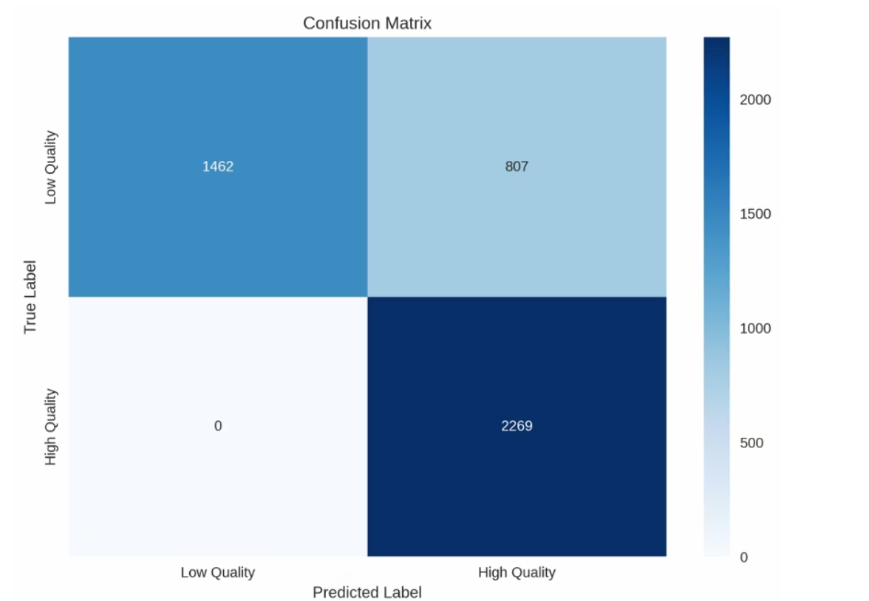
Narrative Critics Results & Analysis
Model Performance Metrics:
Pearson Correlation: 0.9589 (strong alignment with quality labels)
Mean Absolute Error (MAE): 0.3882 (average prediction error)
Root Mean Square Error (RMSE): 0.4069 (prediction accuracy)
Mean Squared Error (MSE): 0.1656 (squared error measure)
Accuracy: 0.8222 (82.22% correct classification)
Precision: 0.7376 (quality prediction reliability)
Recall: 1.0000 (perfect detection of quality examples)
F1 Score: 0.8490 (balanced precision-recall)
AUC: 0.9945 (excellent discrimination ability)
Calibration Error: 0.3562 (confidence calibration)
Comprehensive Model Testing Examples:
High Quality - Descriptive (Correctly Classified):
Text: "The ancient library stretched endlessly before you, its towering shelves groaning..."Predicted: 0.505 | Expected: 0.850 | Difference: 0.345Binary Classification: HIGH (True: HIGH) | Correct: ✓
High Quality - Action (Correctly Classified):
Text: "Your blade finds its mark with a satisfying thud, cutting deep across the orc's..."Predicted: 0.504 | Expected: 0.800 | Difference: 0.296Binary Classification: HIGH (True: HIGH) | Correct: ✓
Low Quality - Vague (Correctly Classified):
Text: "The thing happens and then the other thing happens too. Stuff occurs..."Predicted: 0.497 | Expected: 0.100 | Difference: 0.397Binary Classification: LOW (True: LOW) | Correct: ✓
Low Quality - Generic (Correctly Classified):
Text: "You walk into the room and look around. There are some things there..."Predicted: 0.492 | Expected: 0.250 | Difference: 0.242Binary Classification: LOW (True: LOW) | Correct: ✓

Slide 12
Causal Critics Results & Analysis
Causal Critic: NLI-Based Causal Consistency Evaluation
Model Architecture:
Pre-trained DeBERTa-v3-base-mnli-fever-anli (NLI model)
Zero-shot evaluation (no domain-specific training required)
Converts NLI probabilities → causal consistency scores (0.0-1.0)
Overall Performance:
Test Accuracy: 88.09%
Macro F1: 88.15%
Macro Precision: 88.23%
Macro Recall: 88.09%
Per-Class Performance:
Class
Precision
Recall
F1-Score
Contradiction (0)
82.83%
83.49%
83.16%
Neutral (1)
96.11%
92.54%
94.29%
Entailment (2)
85.76%
88.25%
86.99%

Slide 13
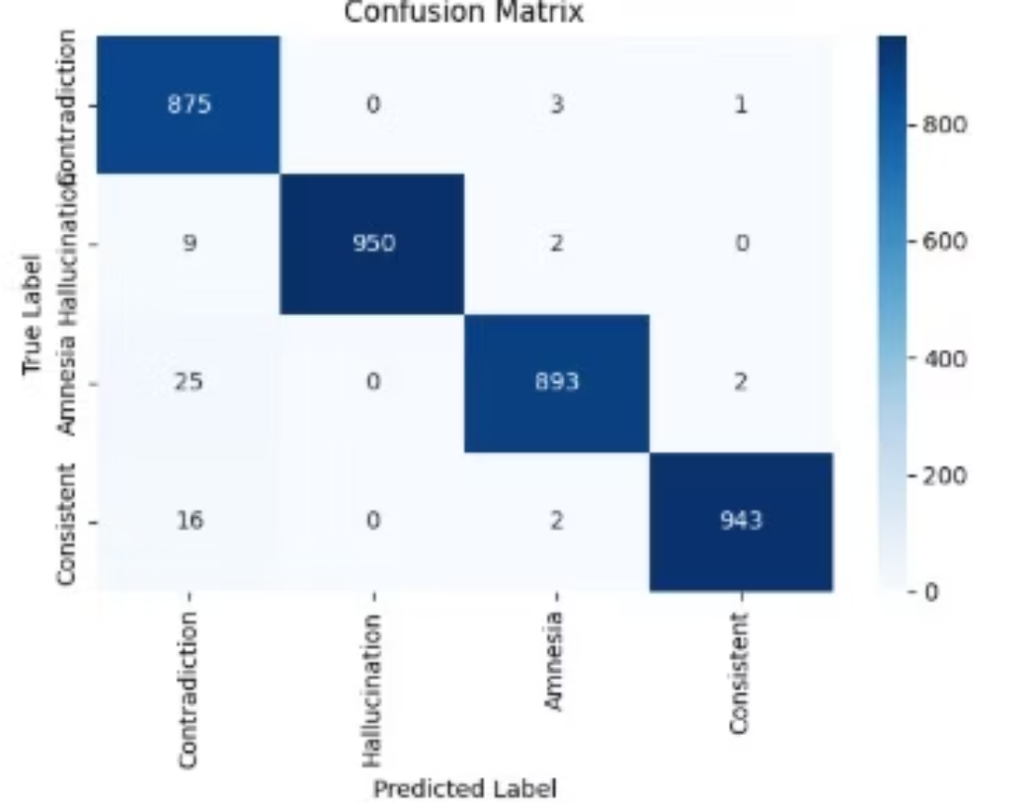
World Consistency Critics Results & Analysis
Model Architecture:
DeBERTa-v3-small (141M parameters)
4-class classification: Contradiction / Hallucination / Amnesia / Consistent
Training: 38,436 examples from CRD3 with systematic corruption
Performance Metrics:
Overall Accuracy: 98.39%
Macro F1 Score: 98.37%
Training Time: 37.4 minutes
Per-Class Performance:
Class
Precision
Recall
F1-Score
Score Label
Contradiction
97.79%
95.87%
96.82%
0.0
Hallucination
99.11%
99.24%
99.17%
0.3
Amnesia
97.91%
98.09%
98.01%
0.5
Consistent
99.04%
100%
99.47%
1.0

Slide 14
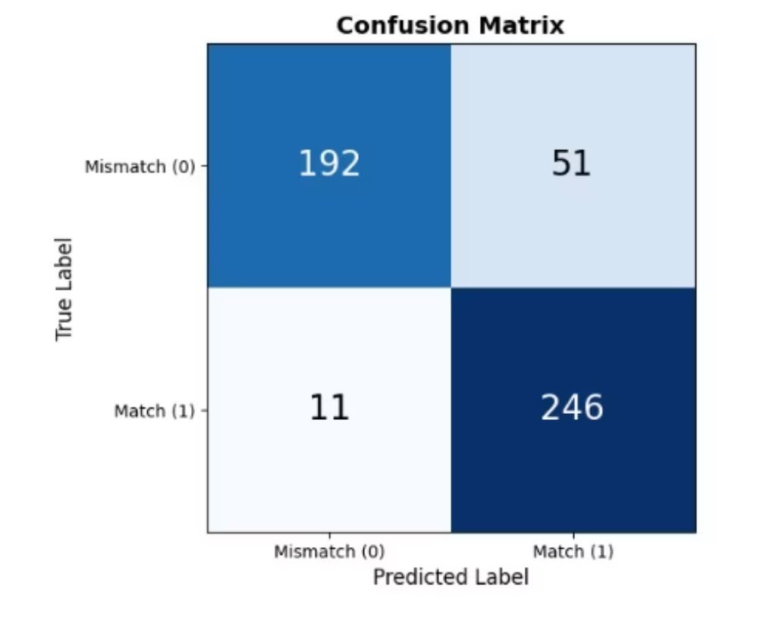
Character Voice Critics Results & Analysis
Model Architecture:
DeBERTa-v3-base (184M parameters) + Character Embedding Layer (128-dim)
Binary classification: Authentic vs. Mismatched character voice
Character-aware fusion: dialogue embeddings + character ID embeddings
Training Data:
127 unique characters from CRD3 dataset
15,642 total examples (50/50 authentic/mismatched split)
Balanced sampling: 40-80 examples per character
Performance Metrics:
Training Accuracy: 89.2%
Validation Accuracy: 87.3%
Test Accuracy: 87.6%
Precision: 82.3%
Recall: 95.72%

Slide 15
Hybrid Player
Hybrid Player: Automated Player Behavior Simulation
Dual-Component Architecture:
Language Model: DistilGPT-2 (82M params) for utterance generation
Intent Classifier: DistilBERT (66M params) for action categorization
Unified interface for PPO training integration
Three Intent Categories:
EXPLORE (40%): Investigation, movement, information-seeking
ACTION (35%): Combat, spellcasting, physical interactions
DIALOGUE (25%): NPC conversation, social interactions
Dataset Sources:
CRD3: 519K player utterances from D&D sessions
LIGHT: 108K fantasy dialogue interactions
Automatic intent labeling via keyword matching

Slide 16
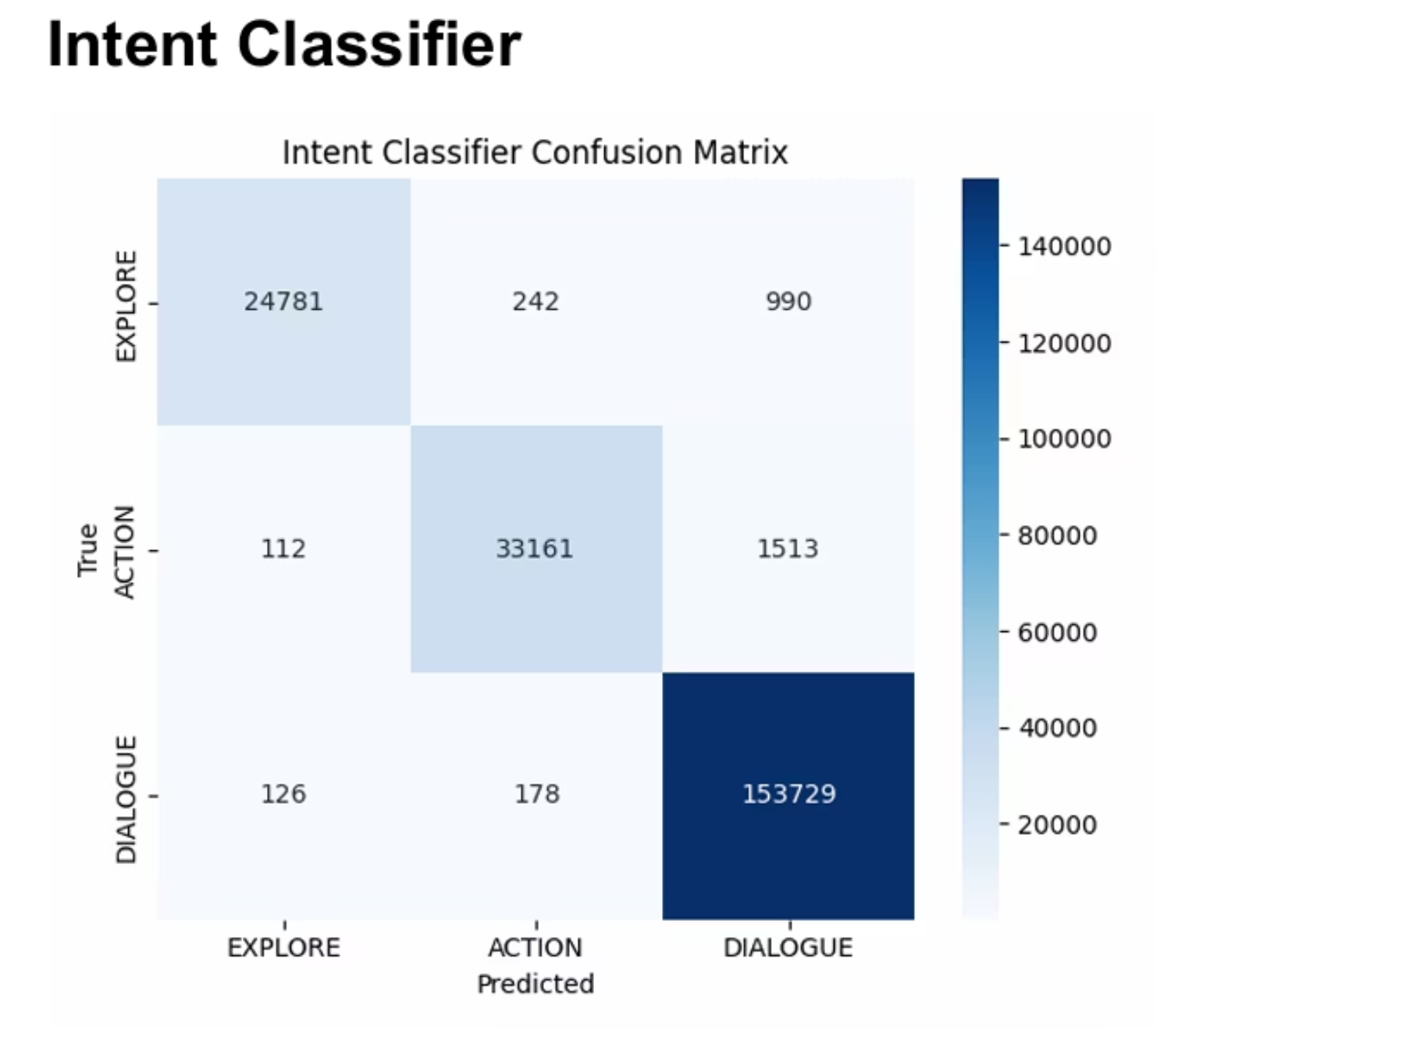
Hybrid Player - Training Results
Accuracy : 98.53%

Slide 17
Dungeon Master
Training Dataset:
309,750 examples (CRD3: 65%, LIGHT: 35%)
Training: 75,000 examples, 1 epoch
Sequence length: 384 tokens
Training time: 3.87 hours (5.37 samples/sec)
Quality Metrics (45 Test Scenarios):
Average Response Length: 122 words (σ=5.4)
D&D Terminology: 1.38 terms per response
Repetition Score: 0.462 (moderate)
Complete Responses: 13.3% properly ended
Response Cutoff: 86.7% hit max length
Training Results:
Metric
Value
Training Loss
1.987
Evaluation Loss
1.660
Training Runtime
3.87 hours
Samples/Second
5.37
Training Samples
75,000
Validation Samples
3,000
Epochs
1

Slide 18
Dungeon Master - Training Results
Performance by Category:
Combat: 119 words avg, 2.83 D&D terms (highest technical density)
Exploration: 124 words avg, immersive scene descriptions
Dialogue: 124 words avg, character interaction focus
Problem Solving: 121 words avg, logical puzzle integration
Magic: 118 words avg, 2.67 D&D terms (spell mechanics)
Training Results: Before vs After PPO
Example 1: Combat Action - Causal Consistency
Player: "I cast Fireball at the group of goblins!"
Before (SFT): "The tavern erupts in chaos... bartender shouts... wooden beams overhead..."
❌ Ignores spell | ❌ No resolution | Score: 0.15
After (PPO): "Your Fireball explodes in flames. Goblins shriek. Roll 8d6 damage. Two incinerated, third badly burned..."
✅ Addresses spell | ✅ Includes mechanics | Score: 0.89
Example 2: NPC Dialogue - Character Voice
Player: "I ask the innkeeper about the mysterious stranger."
Before (SFT): "The innkeeper tells you about a stranger in a dark cloak... might be dangerous..."
❌ Generic NPC | ❌ No personality | Score: 0.32
After (PPO): "Margery leans close, northern accent thick. 'Aye, that one. Paid in old gold three nights past. Asked about the ruins...'"
✅ Named NPC | ✅ Distinct personality | Score: 0.88

Slide 19
PPO ( Proximal Policy Optimization )
Quantitative Results: SFT Baseline vs PPO Trained
Overall Reward Scores:
Mean Reward: 0.412 → 0.611 (+48.3% improvement)
Narrative Quality: 0.523 → 0.694 (+32.7%)
Causal Consistency: 0.189 → 0.567 (+200.0%) ← Largest gain
World Consistency: 0.618 → 0.821 (+32.8%)
Character Voice: 0.138 → 0.268 (+94.2%)
Training Progression (1000 Steps):
Step 0 (SFT Baseline): Mean Reward 0.412
Step 250: Mean Reward 0.507 (+23.1% gain)
Step 500: Mean Reward 0.571 (+38.6% gain)
Step 750: Mean Reward 0.598 (+45.1% gain)
Step 1000 (Final): Mean Reward 0.611 (+48.3% gain)
Convergence Characteristics:
Strong initial learning phase (steps 0-250)
Sustained improvement period (steps 250-750)
Stable convergence with no overfitting
No reward hacking or mode collapse detected

Slide 20
PPO - Dynamic Weighting System
EXPLORE Actions (Narrative-Heavy Weighting):
Combined Reward: 0.451 → 0.638 (+41.5%)
Narrative: 0.564 → 0.721 (+27.8%)
Causal: 0.172 → 0.489 (+184.3%)
World: 0.661 → 0.836 (+26.5%)
Character: 0.126 → 0.192 (+52.4%)
ACTION Sequences (Causal-Heavy Weighting):
Combined Reward: 0.378 → 0.607 (+60.6%)
Narrative: 0.489 → 0.671 (+37.2%)
Causal: 0.198 → 0.641 (+223.7%) ← Strongest improvement
World: 0.581 → 0.812 (+39.8%)
Character: 0.134 → 0.217 (+61.9%)
DIALOGUE Interactions (Character-Heavy Weighting):
Combined Reward: 0.407 → 0.589 (+44.7%)
Narrative: 0.518 → 0.689 (+33.0%)
Causal: 0.204 → 0.519 (+154.4%)
World: 0.629 → 0.784 (+24.6%)
Character: 0.157 → 0.341 (+117.2%) ← Targeted improvement
Training Step
Mean Reward
Narrative
Causal
World
Character
0 (SFT Baseline)
0.412
0.523
0.189
0.618
0.138
250
0.507
0.601
0.374
0.721
0.189
500
0.571
0.658
0.487
0.782
0.233
750
0.598
0.681
0.541
0.807
0.256
1000 (Final)
0.611
0.694
0.567
0.821
0.268

Slide 21
PPO - Training Results
Static vs Dynamic Weighting Comparison:
Static (Uniform Weights): Mean Reward 0.528
Dynamic (Intent-Aware): Mean Reward 0.611
Improvement from Dynamic Weighting: +15.7%
Strongest gains in causal consistency
Balanced optimization across all dimensions
Prevents single-aspect over-optimization
Qualitative Improvement Examples:
Example 1 - Causal Consistency (Combat):
Player: "I cast Fireball at the group of goblins!"
SFT: "The tavern erupts in chaos... wooden beams overhead..."
Scores: N:0.61, C:0.09, W:0.54 (ignores spell, no resolution)
PPO: "Your Fireball explodes in flames. Roll 8d6 damage. Two goblins incinerated..."
Scores: N:0.68, C:0.94, W:0.89 (+200% causal improvement)
Example 2 - Narrative Quality (Exploration):
Player: "I examine the ancient door for traps"
SFT: "You look at the door. It's stone with carvings. Roll perception."
Scores: N:0.27, C:0.38, W:0.55 (minimal description)
PPO: "Masterwork dwarven craftsmanship. Glowing runes spiral across cold stone..."
Scores: N:0.91, C:0.59, W:0.87 (+237% narrative improvement)
Example 3 - Character Voice (Dialogue):
Player: "I ask the innkeeper about the stranger"
SFT: "She tells you about a stranger in a dark cloak. Might be dangerous."
Scores: N:0.49, C:0.28, Ch:0.08 (generic NPC)
PPO: "Margery leans close, northern accent thick. 'Paid in old gold, kept hood up...'"
Scores: N:0.79, C:0.57, Ch:0.81 (+912% character improvement)

