Slide 1
REACT FRONT END

Slide 2
Hi! Welcome to REACT workshop
Follow these steps:
Clone repo: https://github.com/FullstackAcademy/Study-Saturday-Week3
createDB study-saturdays
npm install
npm run seed
git checkout cycle-1

Slide 3
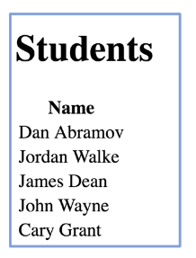
Cycle-1 : Show list of all Students
Starting point: git checkout cycle-1
In browser/ index.js
import `React` and `ReactDOM` and use the latter to render a
heading that says “Hello React!”
Hint: you’ll need to use a DOM node from index.html
Create a components folder in the browser folder.
In that new components folder, create a <Main> component that fetches a list of all students from the server. It should render a table of those students with one column: the student’s full name
Review at 12:45pm

Slide 4
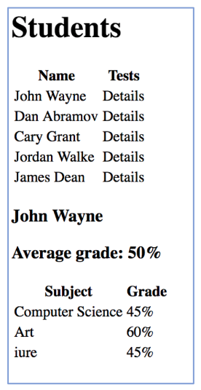
Cycle-2 : Shows Student Tests
Add a second column to the table
Refactor your list of students from cycle-1 into a StudentList
component which will map and render each student
In the second column, add a word like “Details”, that, when clicked, renders a SingleStudent component
Create a SingleStudent component to render the selected student’s test scores
Review at 3:15pm

