Slide 1
Document quality check before OCR
Goal: accept suitable photos before OCR
My dataset
1,800 synthetic images
900 good and 900 bad
INN, passport and SNILS
GOOD
Continue to document type recognition,
perspective correction, OCR and JSON extraction.
Split | Good | Bad
Train | 654 | 654
Validation | 108 | 108
Test | 138 | 138
BAD
Ask the user to take another photograph.
300 source documents. Related variants stay in the same split.
Ekaterina Shigarova, IIKb-24
Practice 6, Task 4. Seed: 24500007
1 / 4
Notes:
Hello. My project checks the quality of document photographs. A user uploads a photograph, and the quality model makes the first decision. If the photograph is good, the pipeline can continue. Later stages recognise the document type, correct perspective, read the text with OCR and extract JSON data. If the photograph is bad, the user should take another photo. A bad photo can cause problems later, so both accuracy and speed matter.
I used 1,800 synthetic images of INN documents, passports and SNILS documents. There are 900 good and 900 bad images. They come from 300 source documents with several versions of each source. I kept related versions in the same split. All models use the same seed and the same 276 test images.
Sources: reports/model_selection_memo.md; metadata.jsonl; results/*/results.json. Pipeline context: course Task 1 and Requirements for Task 2, 3 and 4.

Slide 2
Four experiments on the same test images
Model | Acc. % | F1 macro | Latency (ms) | MB
M MobileNetV2 | 99.64 | 0.9964 | 135.49 | 10.28
N YOLOv8n-cls | 99.28 | 0.9928 | 31.85 | 2.96
S YOLOv8s-cls | 99.64 | 0.9964 | 89.41 | 10.26
E EfficientNet-B0 | 99.28 | 0.9928 | 25.22 | 16.31
CPU benchmark: batch 1, 20 warm-ups, 100 timed predictions
Accuracy axis is zoomed. Dashed line: 100 ms budget.
One test error changes accuracy by 0.36 percentage points.
224 × 224, frozen: MobileNetV2, EfficientNet
640 × 640, fine-tuned: both YOLO variants
2 / 4
Notes:
I compared three model families in four experiments. MobileNetV2 is the required baseline. I also trained the nano and small YOLOv8 classifiers. EfficientNet-B0 is my third family.
The table comes from the four saved results.json files. MobileNetV2 and YOLOv8s have the highest test accuracy, about 99.64 percent. YOLOv8n and EfficientNet reach about 99.28 percent. The difference is only one photograph. I also report macro F1, because accuracy alone is not enough.
EfficientNet has the lowest measured CPU latency, about 25 milliseconds. YOLO nano takes about 32 milliseconds. MobileNetV2 takes about 135 milliseconds and misses my 100 millisecond budget. I used twenty warm-up predictions and one hundred timed predictions.
The configurations differ: the frozen models use 224 pixel inputs, while YOLO uses 640 pixel inputs and full fine-tuning. The results compare these complete configurations, not architecture alone. The full report also includes precision, recall, parameter counts, training time and epochs.
Sources: results/mobilenetv2_frozen/results.json; results/week7_yolov8n_cls/results.json; results/week7_yolov8s_cls/results.json; results/efficientnetb0_frozen/results.json. Timings exclude image decoding, loading and network communication. Saved checkpoint formats and precision differ.

Slide 3
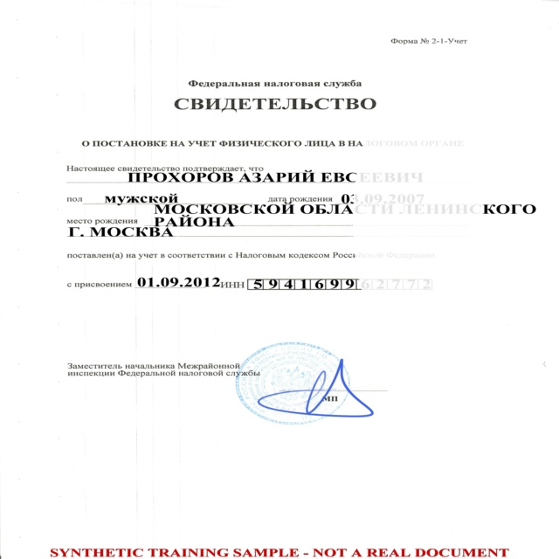
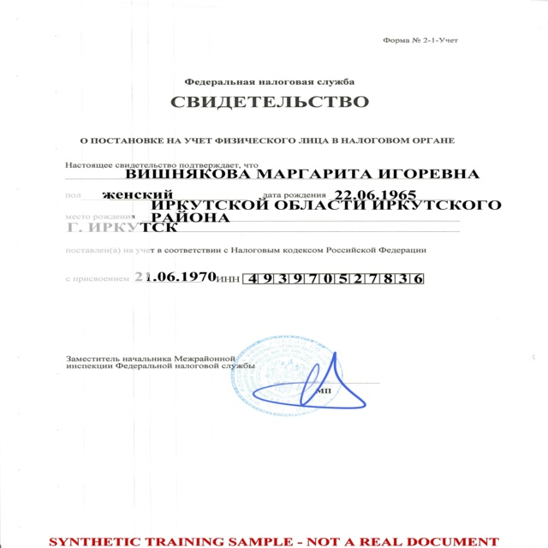
Glare is the hardest defect in my test results
EfficientNet-B0: two bad photos predicted good
Total test errors
MobileNetV2: 1
YOLOv8n-cls: 2
YOLOv8s-cls: 1
EfficientNet-B0: 2
Every false accept
involves glare.
glare_242_v2
True: bad. Predicted: good.
glare_182_v2
True: bad. Predicted: good.
All actual errors are in the report. Each model has fewer than the five requested examples.
3 / 4
Notes:
This slide shows both EfficientNet mistakes. Both images are synthetic INN documents with glare. The true label is bad, but the model predicts good. Bright areas make parts of the text difficult to see. Much of the page still looks clear, which makes these examples difficult. I have not run OCR, so I cannot report an OCR error rate.
EfficientNet correctly rejects 136 of 138 bad images and correctly accepts all 138 good images. Its bad recall is about 98.55 percent. Across the four models, every false accept is an image with glare. YOLO nano also rejects one good image.
The task asks for five mistakes per model. My models made fewer mistakes, so I show every real error and explain this shortfall in the report. I need the instructor to confirm how to handle this requirement.
To improve glare detection, I would add more varied glare to the training images, especially over text fields. I would check borderline quality labels and collect real reflection examples. These changes are proposals, not experiments I have already completed.
Sources: reports/error_analysis.md; all four confusion matrices and test_predictions.csv files. Photos: results/efficientnetb0_frozen/errors/true_bad_pred_good_bad_inn_glare_242_v2.jpg and true_bad_pred_good_bad_inn_glare_182_v2.jpg. These are synthetic samples, as marked in the originals.

Slide 4
My choice: EfficientNet-B0 for the CPU prototype
99.28% accuracy
0.9928 macro F1
25.22 ms per image
16.31 MB checkpoint
Risks and next steps
EfficientNet missed 2 bad photos.
Each YOLO variant missed 1.
Real-photo performance is still unknown.
Test real photos and improve glare data.
My rule before training
Pass all limits first.
When F1 differs by at most 0.01,
prefer lower latency, then smaller size.
CPU server first.
Investigate ONNX for mobile later.
Recheck accuracy and speed after export.
Course reference: synthetic-to-real gap of 2.8–5.8 percentage points. This is not my measured gap.
4 / 4
Notes:
My choice is EfficientNet-B0 for a CPU prototype. This follows the rule I wrote before training. A model must first pass my accuracy, F1, bad recall, latency and size limits. If macro F1 differs by at most zero point zero one, I prefer lower latency, then smaller size. EfficientNet passes all limits and wins that tie-break in this benchmark.
However, this choice has a cost. EfficientNet accepts two bad images, while each YOLO variant accepts one. YOLO nano is also much smaller. I would reconsider the choice if storage or the cost of accepting bad photos became the main priority. One timing measurement cannot prove a stable ranking on every machine.
All my results use synthetic data. The course describes a synthetic-to-real gap of 2.8 to 5.8 percentage points. I have not measured this gap for my models. Before real use, I would test real photographs, improve glare examples and include operator review. Any threshold tuning must use validation data.
For the server, I would load the model once and use the same preprocessing as training. For mobile later, I would investigate ONNX export and measure accuracy and speed again. I have not completed export or bot integration. Thank you.
Sources: reports/model_selection_memo.md; reports/decision_memo.md; reports/comparison.md. Course gap: Requirements for Task 2, 3 and 4, Task 4 R5, referring to thesis Table 7. This is course background evidence, not a measurement from these experiments.

