Slide 1
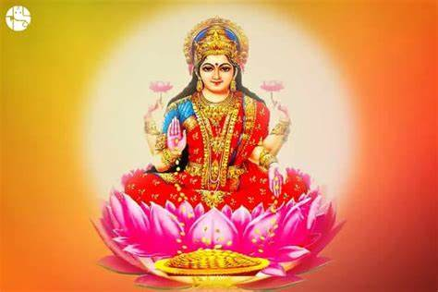
Varalaxmi Vratham
We are giving 5% of this money to the poor people
List of items :
Pasupu Vathulu
Kunkuma Harathi
Gandham Pooja oil
Aaku Vakka Dhoop Sticks
Kaluva Puvvu Fruits
Mamidi Kommalu Milk
Flowers Kommu Senagalu
Sweetcorn Pacchi Senagalu
Bangles Palli
Red Jacket Bellam
Coconut Sugar
Agar Bathi Vratham books

