Slide 1
TEXT TO IMAGE GENERATOR
API Provided by stability.ai
Team Members,
Alan B
Arun Pandi S
Ekhesh Ram P K
Fariz F

Slide 2
Objective
AI image generators can produce high-quality art and realistic images much faster than humans.
Everyone can create images and artwork without having to know technical drawing skills.
A designer or artist will focus more on the concept and imagination of an image than on its technical aspects.

Slide 3
Search vs generation
Search :
Typical search will provide the images that is already available on the internet.
There is no processing involved in the search operation.
Generation :
In generation the a image will be newly created based on the text given by the user to the system and the images available in the database.

Slide 4
Justification
They can help artists develop ideas for new works they need to do. For example, a concept artist can create many ideas for a video game in less than an hour.
Everyone can create images and artwork without having to know technical drawing skills.
AI image generators can quickly and easily generate large numbers of images, making them ideal for marketing applications.

Slide 5
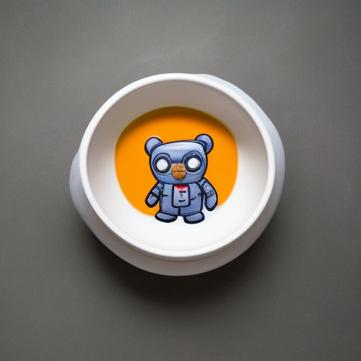
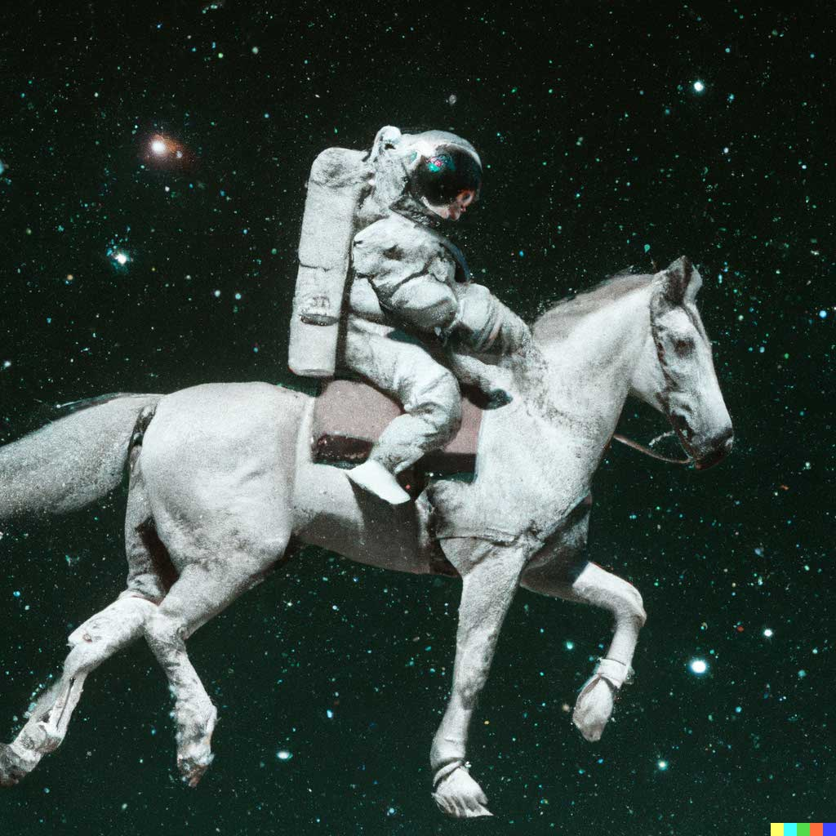
Examples
AI Generated Images
A teddy astronaut in a soup bowl
An astronaut riding a horse in space

Slide 6
Abstract
Text to image synthesis refers to the method of generating images from the input text automatically.
Deciphering data between picture and text is a major issue in artificial intelligence.
Automatic image synthesis is highly beneficial in many ways. Generation of the image is one of the applications of conditional generative models.
For generating images, GAN(Generative Adversarial Models) are used.
Recent progress has been made using Generative Adversarial Networks (GAN).

Slide 7
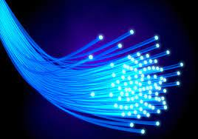
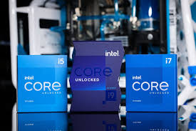
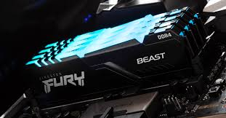
Hardware Requirements
Computer/ Laptop
With access to internet
Intel Pentium Processor (or above Generations)
/ Ryzen Processors
Ram 2gb (or more)

Slide 8


Software Requirements
Browsers
Any Operating System
(Linux, Windows, MacOS)

Slide 9
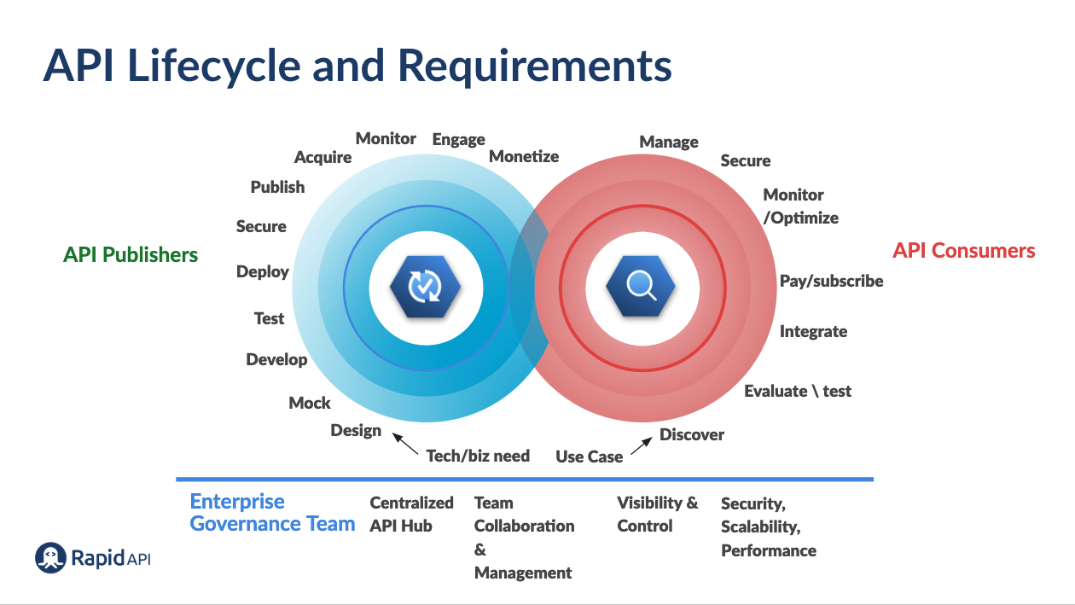
Design Module

Slide 10
Existing System
GANs were first introduced by Goodfellow in 2014, Reed, S.; Akata, Z.; Yan, X.; Logeswaran, L.; Schiele, B.; Lee, H. but Reed et al. was the first to use them for text-to-image generation in 2016.
Proposed training stabilizing techniques for previously untrainable models and achieved better results on the MNIST, CIFAR-10, and SVHN datasets.
Ref -- https://www.mdpi.com/2673-4591/20/1/16#B7-engproc-20-00016

Slide 11
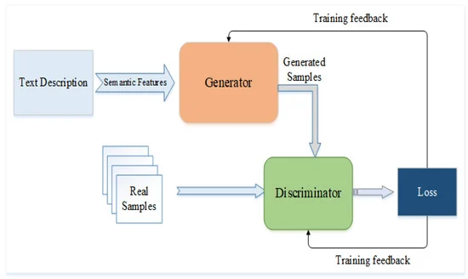
Proposed System

