Slide 1
STARPOST SIGNALS · LEVEL 5 BLUE BELT
Every grant should
earn its payout.
✦
Community preference becomes transparent, milestone-controlled funding on Stellar Testnet.
Signal → Fund → Prove → Approve → Payout
Notes:
Open on the product promise: communities can prioritize work, fund it, and release escrow only after public milestone evidence passes the contract rules.
[Sources]
- https://github.com/EkinOnat/starpost-signals
- https://starpost-signals.vercel.app
[/Sources]

Slide 2
THE COORDINATION GAP
02
Community funding loses trust between promise and payout.
01
02
03
Priority is noisy
Progress is opaque
Payout is binary
Votes, chats, and donor intent live in different tools, so the strongest signal is hard to preserve.
Updates arrive as links and screenshots without a durable chain from milestone to decision.
Funds often move upfront or remain stuck while contributors debate whether the work is complete.
The product opportunity is not another donation page—it is a shared, inspectable decision trail.
Problem statement · community groups, NGOs, diaspora initiatives, and university clubs
Notes:
Frame the problem around coordination and trust. Starpost does not claim to solve the global development finance gap; it targets the narrower workflow between community intent, milestone evidence, and controlled payout.
[Sources]
- https://desapublications.un.org/publications/financing-sustainable-development-report-2026
- https://github.com/EkinOnat/starpost-signals
[/Sources]

Slide 3
THE PRODUCT
THE PRODUCT
03
One public workflow connects the crowd’s signal to the payout rule.
01
Choose
What the user sees
One wallet records one category preference on-chain.
A guided action,
a confirmed receipt,
and a public proof link.
02
Fund
Contributors deposit Testnet XLM into project escrow.
03
Verify
Evidence, reviewers, contributor votes, and contract thresholds control release.
The frontend guides. The wallet authorizes. The contracts decide.
Solution · additive Level 5 onboarding preserves every existing contract and transaction interface
Notes:
Explain the separation of concerns. The Level 5 release adds onboarding and evidence collection; it does not replace the deployed Registry and Escrow contracts.
[Sources]
- https://github.com/EkinOnat/starpost-signals
[/Sources]

Slide 4
SIGNAL TO PAYOUT
04
Five on-chain stages make the decision trail inspectable.
1
2
3
4
5
SIGNAL
FUND
PROVE
APPROVE
PAYOUT
One-wallet vote
Escrowed XLM
Hashed evidence
Role + quorum rules
Exact milestone release
Every successful action ends with an RPC-confirmed transaction hash and Stellar Expert route.
Workflow · contract state is authoritative; telemetry and indexer data are never payout authority
Notes:
Walk the audience from vote to payout. Emphasize that user-visible success appears only after RPC confirmation and that Explorer links make each action independently inspectable.
[Sources]
- https://github.com/EkinOnat/starpost-signals
- https://developers.stellar.org/docs/build/smart-contracts/overview
[/Sources]

Slide 5
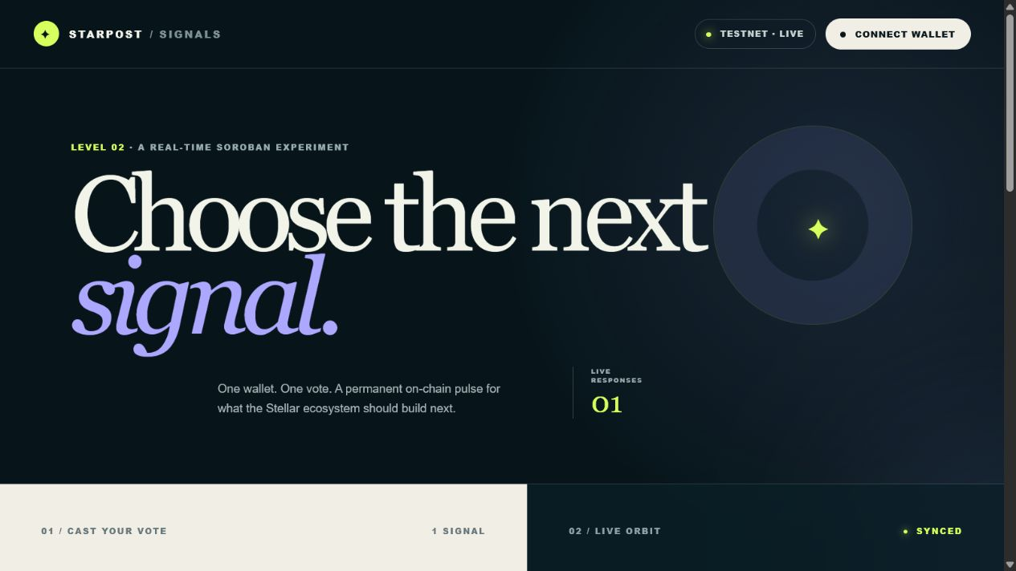
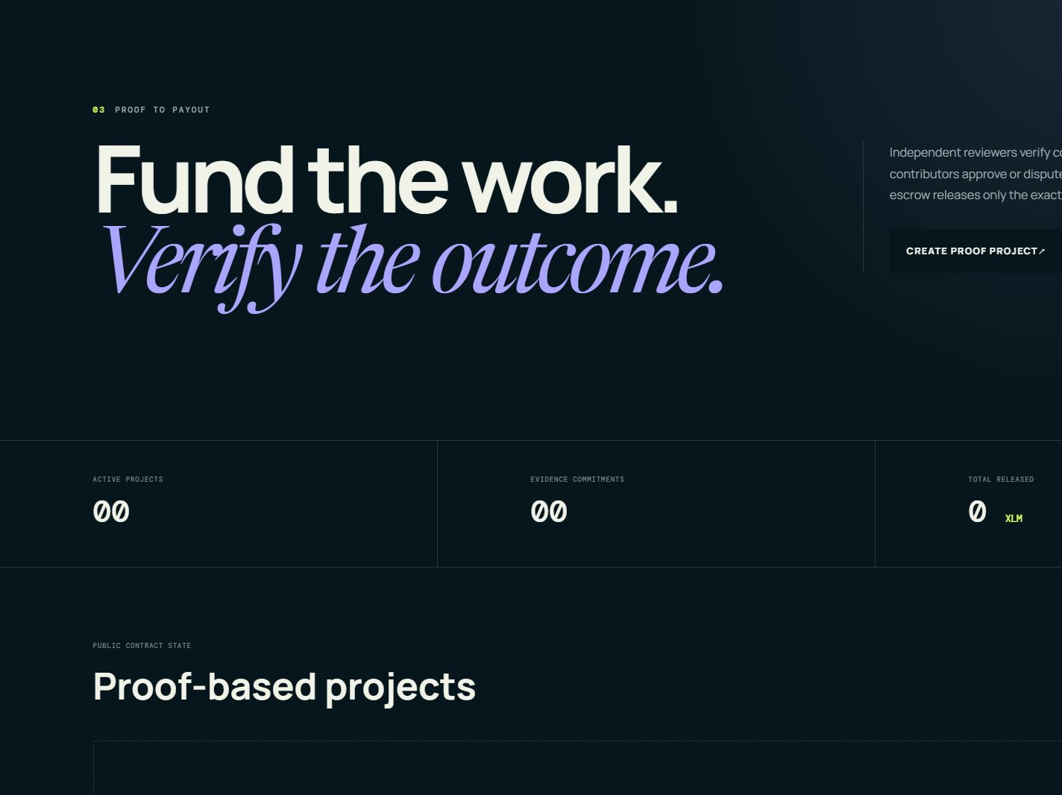
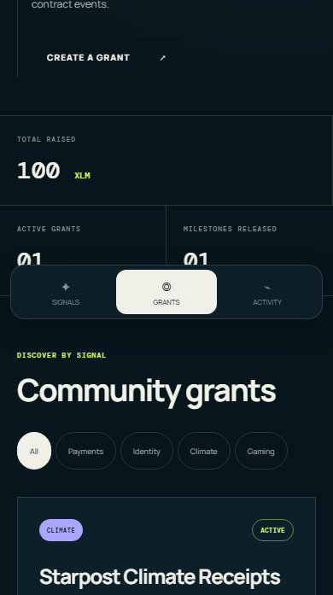
LIVE PRODUCT
05
The product already spans signal, grant, and proof-to-payout flows.
Signals
Proof
390px
Public Testnet interface with real contract addresses, wallet signatures, responsive layouts, and Explorer evidence.
Live application · starpost-signals.vercel.app
Notes:
Use these screenshots to show the preserved Level 2 Signals poll, the Level 4 proof surface, and the responsive grant workflow. If presenting live, switch to the current deployment after this slide.
[Sources]
- https://starpost-signals.vercel.app
- https://github.com/EkinOnat/starpost-signals
[/Sources]

Slide 6
TRACTION AND LEVEL 5 GATE
06
Proof exists today; Level 5 adds scale—not fabricated traction.
10
10
0
independent Level 4 users
unique successful votes
verification failures
LEVEL 5 COHORT
0 / 50 qualified new participants
Pending authentic recruitment, consented Forms, and verified transactions.
Evidence standard · unique person, email, wallet, Form, consent, approved contract, and successful transaction
Notes:
State the evidence honestly. Ten Level 4 participants are preserved as baseline proof and do not count toward the new 50-person campaign. The Level 5 counter remains zero until authentic responses pass the verifier.
[Sources]
- https://github.com/EkinOnat/starpost-signals
[/Sources]

Slide 7
FEEDBACK AND ITERATION
07
Feedback is now a release gate, not a collection of anecdotes.
1
2
3
4
5
ONBOARD
COLLECT
VERIFY
PRIORITIZE
RELEASE
role + readiness
19-field Form
identity + chain
frequency + score
commit + before/after
Already shipped
Unlocks after Wave 1 and Wave 2
Guided roles · wallet readiness · Friendbot funding · confirmed proof handoff · aggregate funnel events
Two Level 5 feedback-derived releases with direct Git commit links and measured before/after results.
Deterministic priority · blockers first, then ≥3 mentions or mean score <4.0, then frequency / rating / effort
Notes:
Separate implemented campaign infrastructure from future feedback-driven releases. The final submission will count only changes that originate in authentic Level 5 feedback and include a direct commit plus before/after evidence.
[Sources]
- https://github.com/EkinOnat/starpost-signals
[/Sources]

Slide 8
MARKET OPPORTUNITY
08
The wedge sits where development funding, diaspora flows, and transparent rails meet.
$4T
$685B
$55.6B
annual SDG financing gap
remittances to LMICs
Stellar payment volume
developing countries · UN 2026
2024 estimate · World Bank
2025 · Stellar Development Foundation
These figures establish context—not Starpost revenue or a claimed TAM. The initial market remains community-scale Testnet coordination.
Beachhead · community groups, NGOs, diaspora initiatives, and university clubs
Notes:
Treat these as adjacent market signals. The opportunity thesis is that large, cross-border pools of capital need clearer coordination and proof, but Starpost has not yet validated a commercial market size.
[Sources]
- https://desapublications.un.org/publications/financing-sustainable-development-report-2026
- https://blogs.worldbank.org/en/peoplemove/in-2024--remittance-flows-to-low--and-middle-income-countries-ar
- https://stellar.org/blog/foundation-news/2025-year-in-review
[/Sources]

Slide 9
ARCHITECTURE
09
Financial authority stays on Stellar; growth services observe and guide.
IMPACT REGISTRY V1
milestones · evidence · decisions
USER + WALLET
keys never enter app
REACT APP
guide · simulate · confirm
STELLAR RPC
source of truth
IMPACT ESCROW V1
custody · exact release · refunds
INDEXER + EVIDENCE + AGGREGATE TELEMETRY
read-only services · degraded state never blocks transactions
Stellar / Soroban · Rust → Wasm contracts; React wallet client; HTTPS indexer and evidence service
Notes:
Explain the trust boundary from left to right. Wallets authorize. RPC and contracts are authoritative. The indexer, evidence store, and telemetry support discovery and growth but cannot move funds.
[Sources]
- https://github.com/EkinOnat/starpost-signals
- https://developers.stellar.org/docs/build/smart-contracts/overview
[/Sources]

Slide 10
SECURITY AND PAYOUT CONTROLS
10
Payout authority stays on-chain; the growth layer cannot move funds.
Wallet authorization
Confirmed state
Users review and sign; no recovery phrase or secret key enters the frontend.
Simulation and submission are not shown as success until RPC returns SUCCESS.
Role separation
Exact accounting
Reviewer, arbitrator, creator, and contributor rules prevent one UI path from bypassing policy.
Escrow releases only the approved milestone amount and preserves terminal refund paths.
RESIDUAL RISK · Testnet only · no independent audit · TTL and public-wallet privacy require active operations
Security posture · transparent controls plus explicit limitations
Notes:
Do not overstate security. Contract tests and layered controls reduce risk, but the system is Testnet software without an independent audit. Public wallet activity and contract TTL are operational realities.
[Sources]
- https://github.com/EkinOnat/starpost-signals
- https://developers.stellar.org/docs/learn/fundamentals/fees-resource-limits-metering
[/Sources]

Slide 11
GROWTH AND RETENTION
11
Three waves turn onboarding data into two measurable product releases.
WAVE 1
WAVE 2
WAVE 3
10 users
20 users
20 users
Fix every transaction blocker + most repeated usability problem
Compare funnel and ratings + ship the second priority request
Validate the final release + close evidence collection
RETENTION CHECK
Measure distinct repeat activity after seven days; report the real result even when it is zero.
Campaign target · exactly 50 qualified new users and at least 10 deeper lifecycle actions
Notes:
The campaign is gated. Invalid records are replaced rather than counted. At least ten participants complete deeper actions, collectively including contribution and one creator/reviewer/approval/payout lifecycle.
[Sources]
- https://github.com/EkinOnat/starpost-signals
[/Sources]

Slide 12
ROADMAP AND CLOSING ASK
12
Help Starpost prove 50 real people can coordinate one transparent grant.
01
02
03
Recruit
Validate
Expose
Community and NGO testers across four roles
Two authentic feedback releases and seven-day repeat activity
Ecosystem demos, pilot partners, and an independent security review
LIVE
CODE + EVIDENCE
starpost-signals.vercel.app
github.com/EkinOnat/starpost-signals
Next phase · authentic cohort → feedback releases → recorded walkthrough → Blue Belt submission
Notes:
Close with a specific ask: introductions to real testers and community partners, plus ecosystem feedback on the proof-to-payout model. The deck and code are ready; the 50-person campaign and final video remain authentic human work.
[Sources]
- https://starpost-signals.vercel.app
- https://github.com/EkinOnat/starpost-signals
[/Sources]

