Slide 1
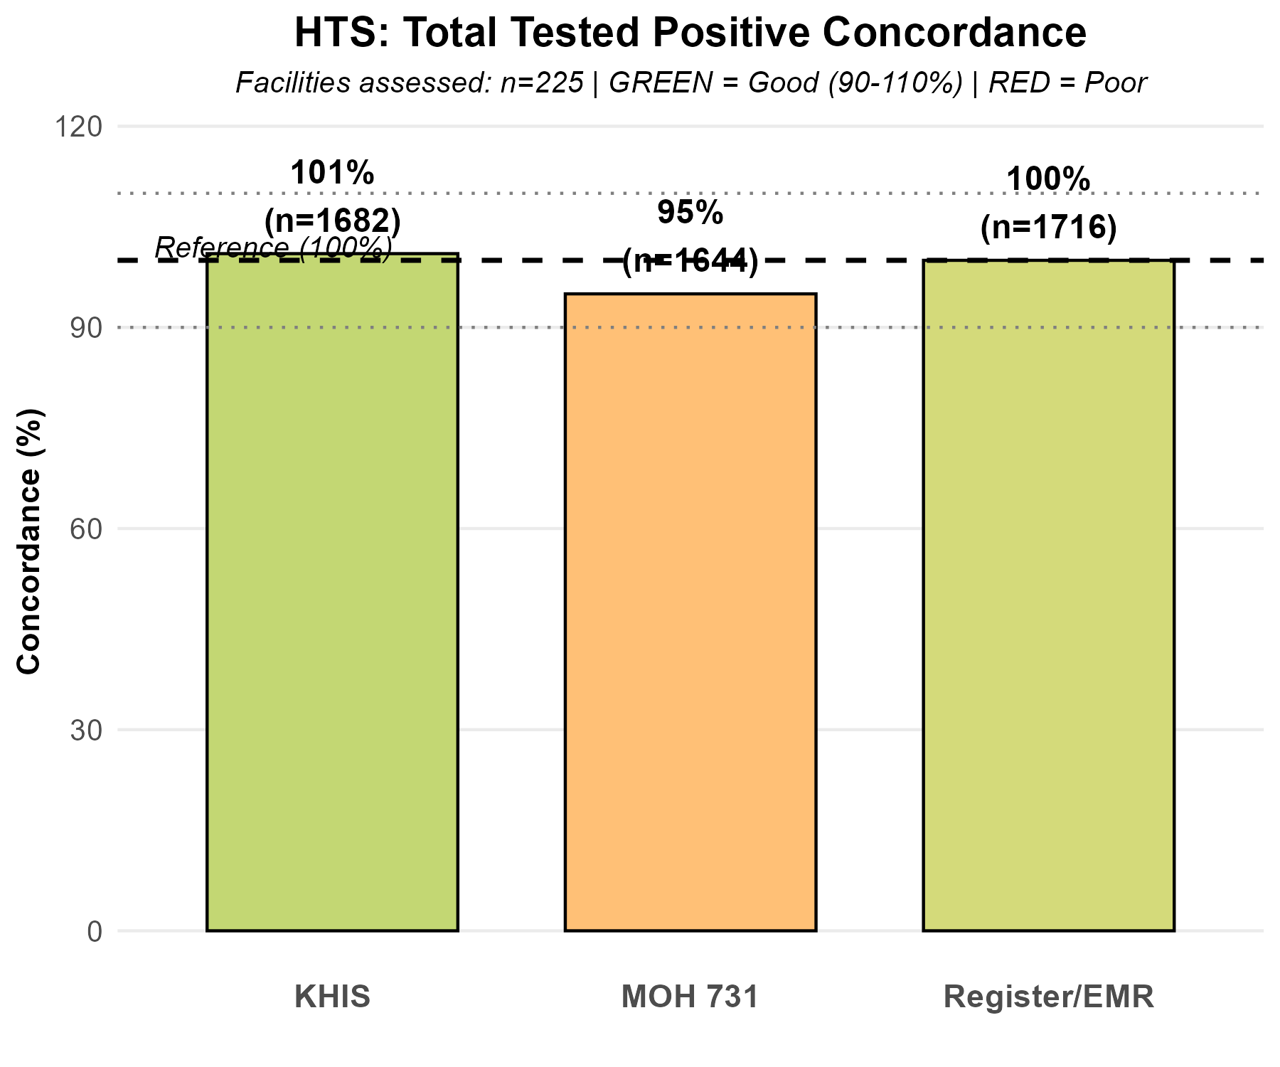
HTS: Total Tested Positive Concordance
🟢 Excellent (95-105%) 🟢 Good (90-94% or 106-110%) 🟠 Moderate (80-89% or 111-120%) 🔴 Poor (<80% or >120%)
📊 HTS CONCORDANCE SUMMARY • Facilities assessed: 225 • Total tested positive: 1,716 ✅ Register/EMR: 1,716 (100%) - Baseline 🟠 MOH 731: 1,644 (95%) - Moderate under-reporting 🟢 KHIS: 1,682 (101%) - Excellent concordance ⚠️ 74 facilities excluded due to missing data • EMR facilities: 69 • Paper-based facilities: 156 🔑 KEY FINDING: KHIS shows strong alignment, MOH 731 underreports by 5%

Slide 2
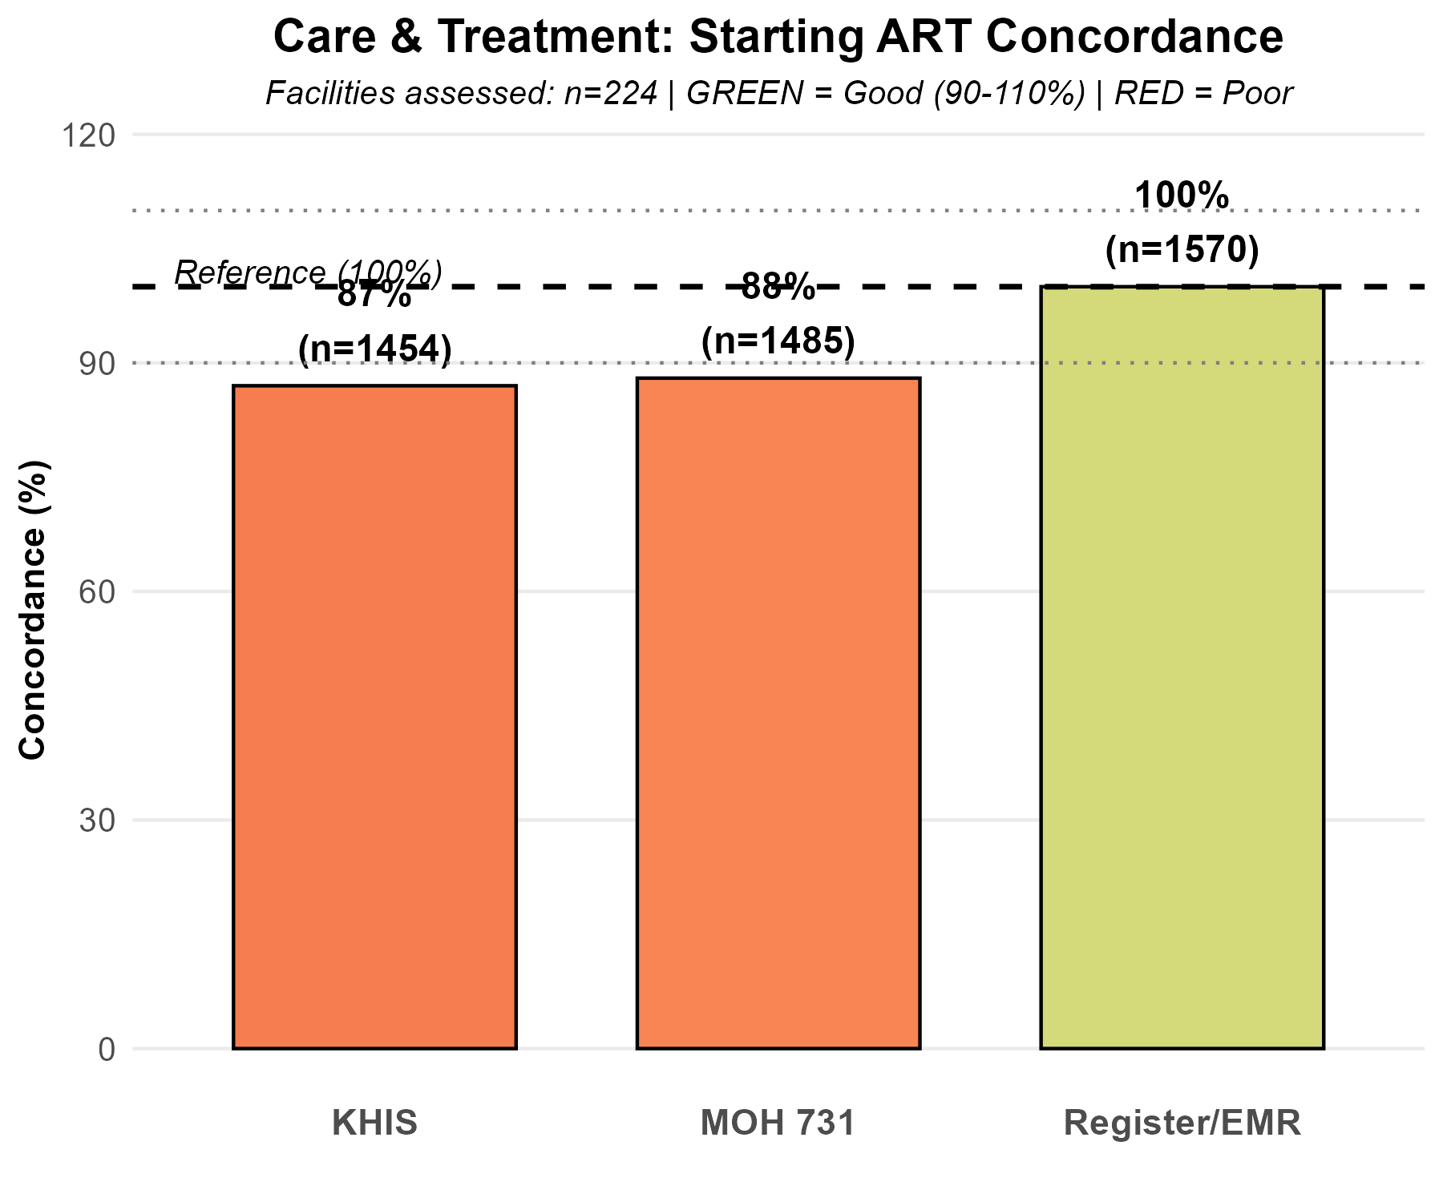
Care & Treatment: Starting ART Concordance
🟢 Excellent (95-105%) 🟢 Good (90-94% or 106-110%) 🟠 Moderate (80-89% or 111-120%) 🔴 Poor (<80% or >120%)
📊 STARTING ART CONCORDANCE SUMMARY • Facilities assessed: 224 • Total starting ART: 1,570 ✅ Register/EMR: 1,570 (100%) - Baseline 🔴 MOH 731: 1,485 (88%) - Poor under-reporting 🔴 KHIS: 1,454 (87%) - Poor under-reporting ⚠️ 76 facilities excluded due to missing data • EMR facilities: 67 (25.8%) • Paper-based facilities: 157 (70.1%) 🔑 KEY FINDING: Both reporting systems underreport starting ART by 12-13%

Slide 3
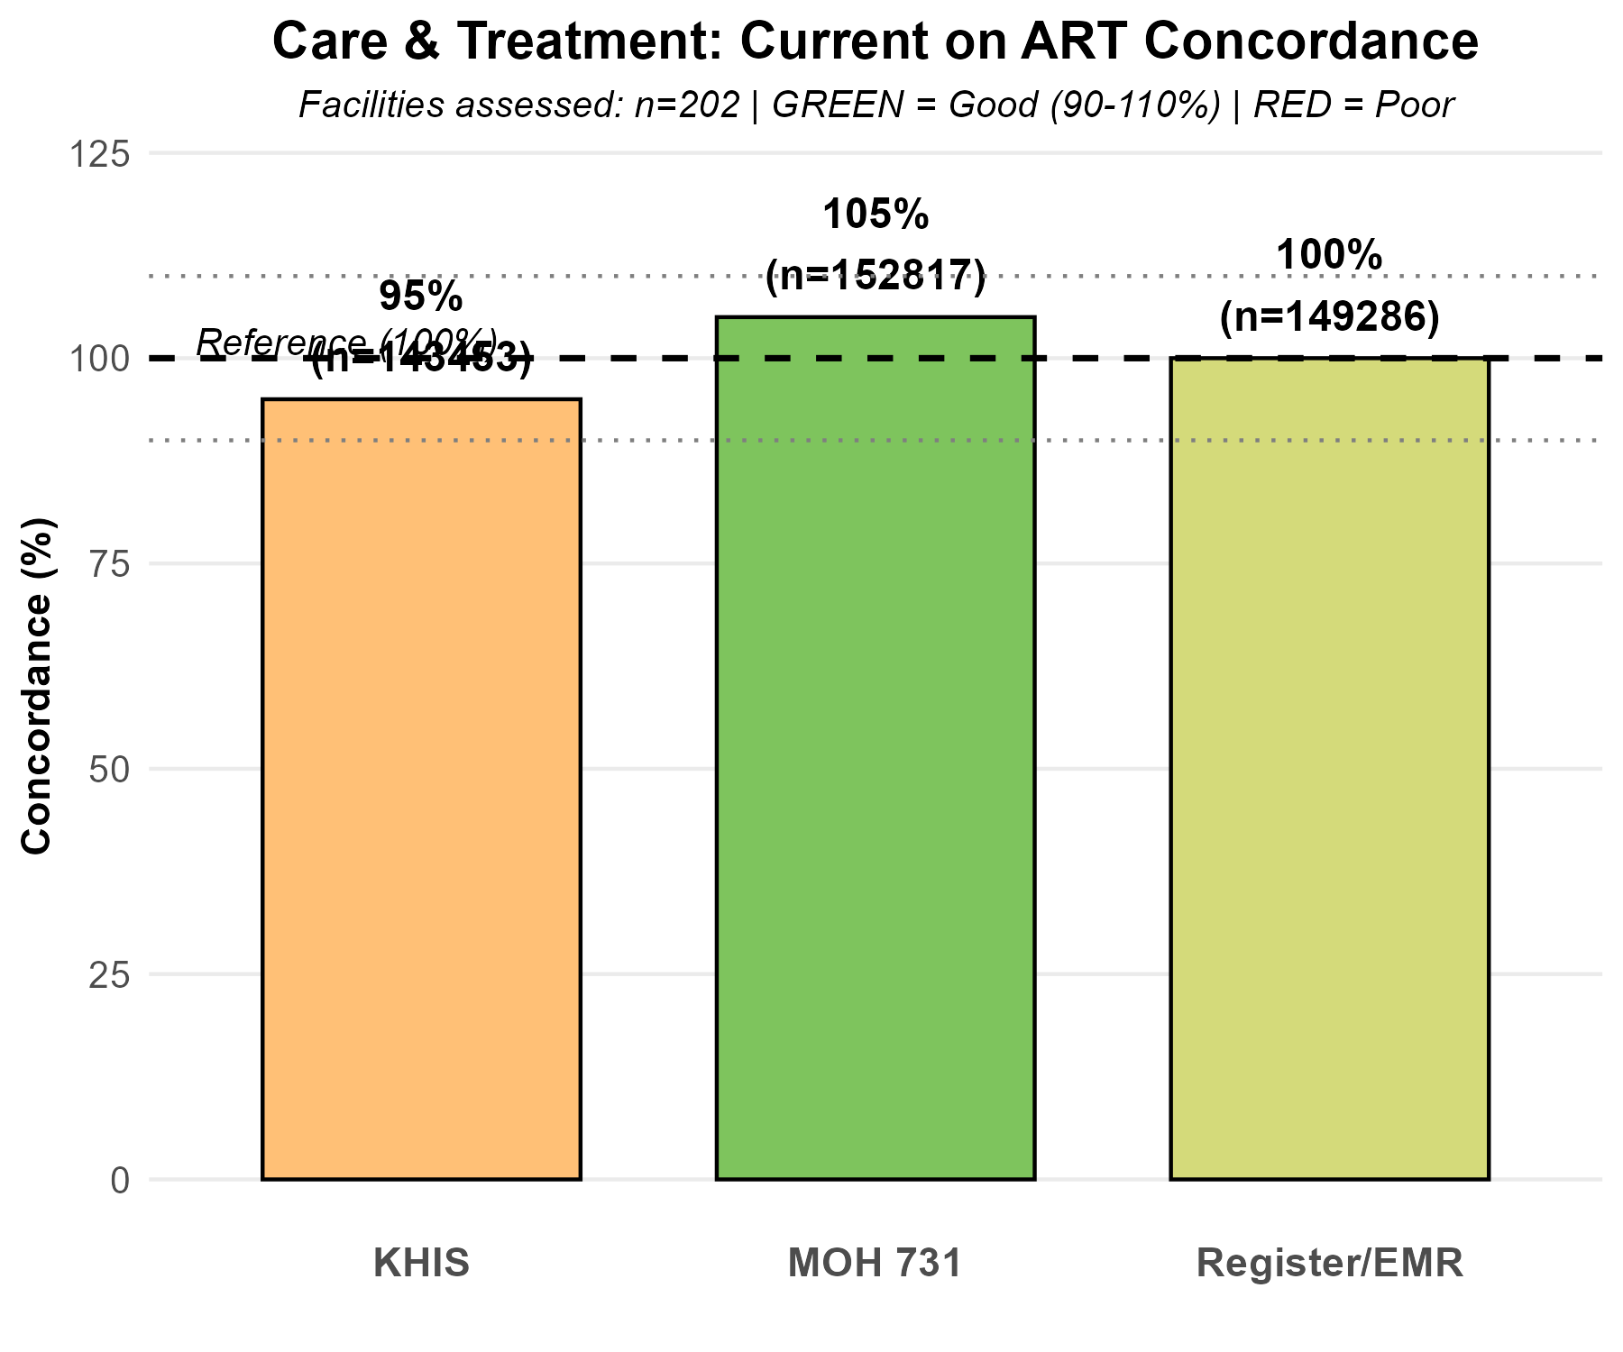
Care & Treatment: Current on ART Concordance
🟢 Excellent (95-105%) 🟢 Good (90-94% or 106-110%) 🟠 Moderate (80-89% or 111-120%) 🔴 Poor (<80% or >120%)
📊 CURRENT ON ART CONCORDANCE SUMMARY • Facilities assessed: 202 • Total current on ART: 149,286 ✅ Register/EMR: 149,286 (100%) - Baseline 🟢 MOH 731: 152,817 (105%) - Excellent concordance 🟢 KHIS: 143,453 (95%) - Excellent concordance ⚠️ 98 facilities excluded due to missing data • EMR facilities: 134 (66.3%) • Paper-based facilities: 68 (33.7%) 🔑 KEY FINDING: Near perfect concordance MOH 731 over-reports by 5%, KHIS under-reports by 5%

