Slide 1
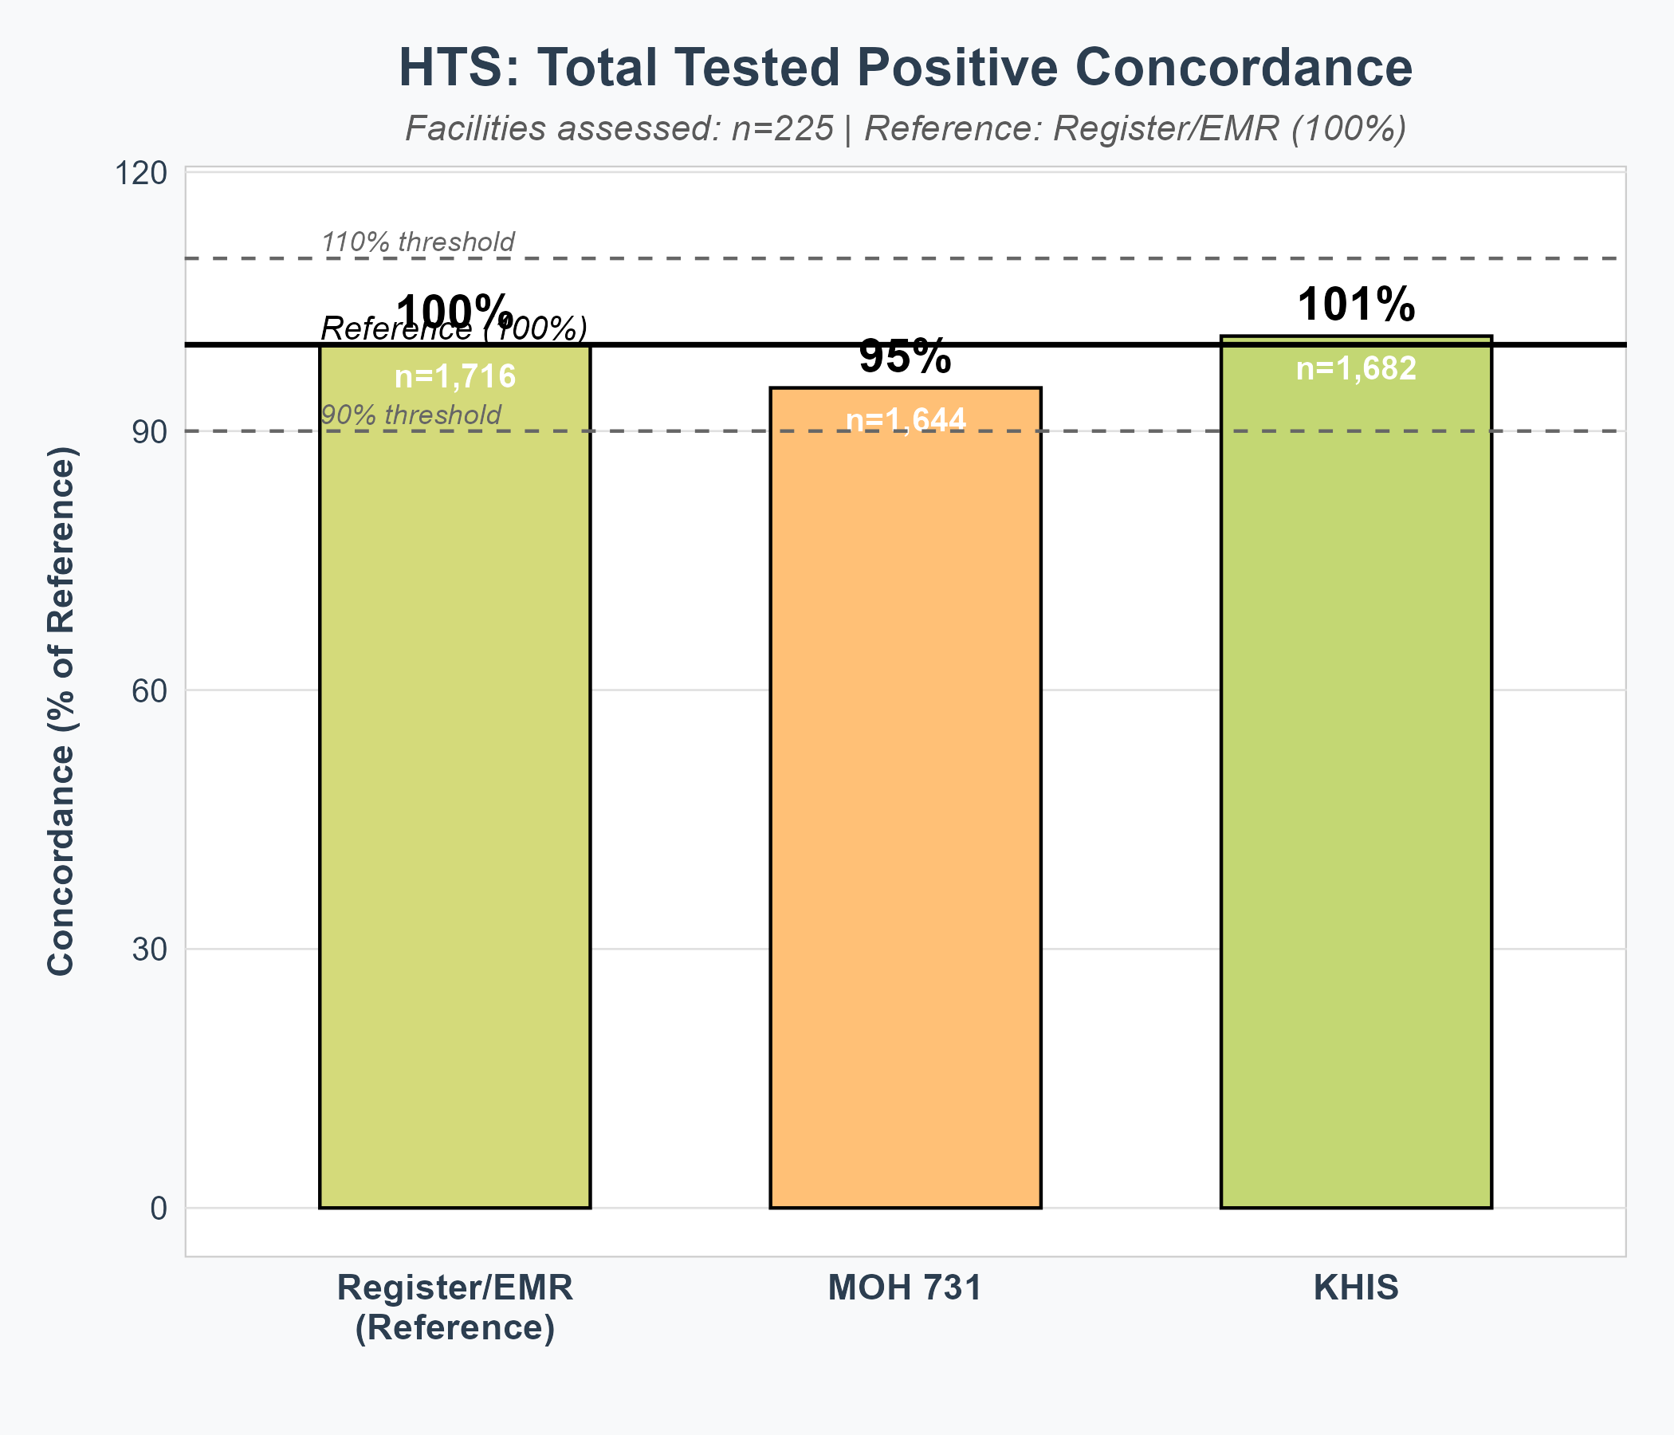
HTS: Total Tested Positive Concordance
Level
🟢 EXCELLENT (95-105%)
🟢 GOOD (90-94% or 106-110%)
🟠 MODERATE (80-89% or 111-120%)
🔴 POOR (<80% or >120%)
═══════════════════════════════════ 📊 HTS CONCORDANCE SUMMARY ═══════════════════════════════════ 📌 REFERENCE: Register/EMR • 1,716 patients (100%) • 225 facilities assessed 📊 REPORTING SYSTEMS: ━━━━━━━━━━━━━━━━━━━━━━━ 🟢 KHIS: 1,682 (101%) → EXCELLENT concordance 🟠 MOH 731: 1,644 (95%) → MODERATE under-reporting ⚠️ 74 facilities excluded: • 69 EMR facilities • 156 paper-based 🔑 KEY FINDING: KHIS shows strong alignment, MOH 731 underreports by 5%

Slide 2
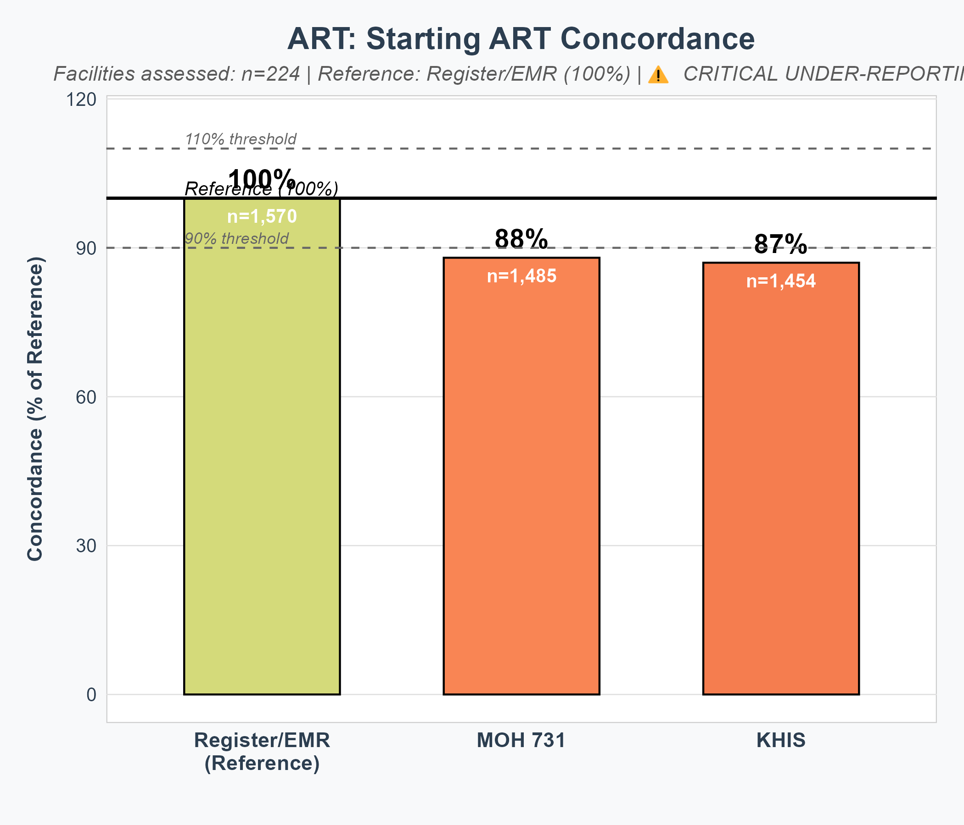
ART: Starting ART Concordance - ⚠️ CRITICAL GAPS
Level
🟢 EXCELLENT (95-105%)
🟢 GOOD (90-94% or 106-110%)
🟠 MODERATE (80-89% or 111-120%)
🔴 POOR (<80% or >120%)
═══════════════════════════════════ 📊 STARTING ART CONCORDANCE ═══════════════════════════════════ 📌 REFERENCE: Register/EMR • 1,570 patients (100%) • 224 facilities assessed 📊 REPORTING SYSTEMS: ━━━━━━━━━━━━━━━━━━━━━━━ 🔴 MOH 731: 1,485 (88%) → POOR under-reporting 🔴 KHIS: 1,454 (87%) → POOR under-reporting ⚠️ 76 facilities excluded: • 67 EMR (25.8%) • 157 paper-based (70.1%) 🔑 CRITICAL FINDING: BOTH systems underreport starting ART by 12-13%

Slide 3
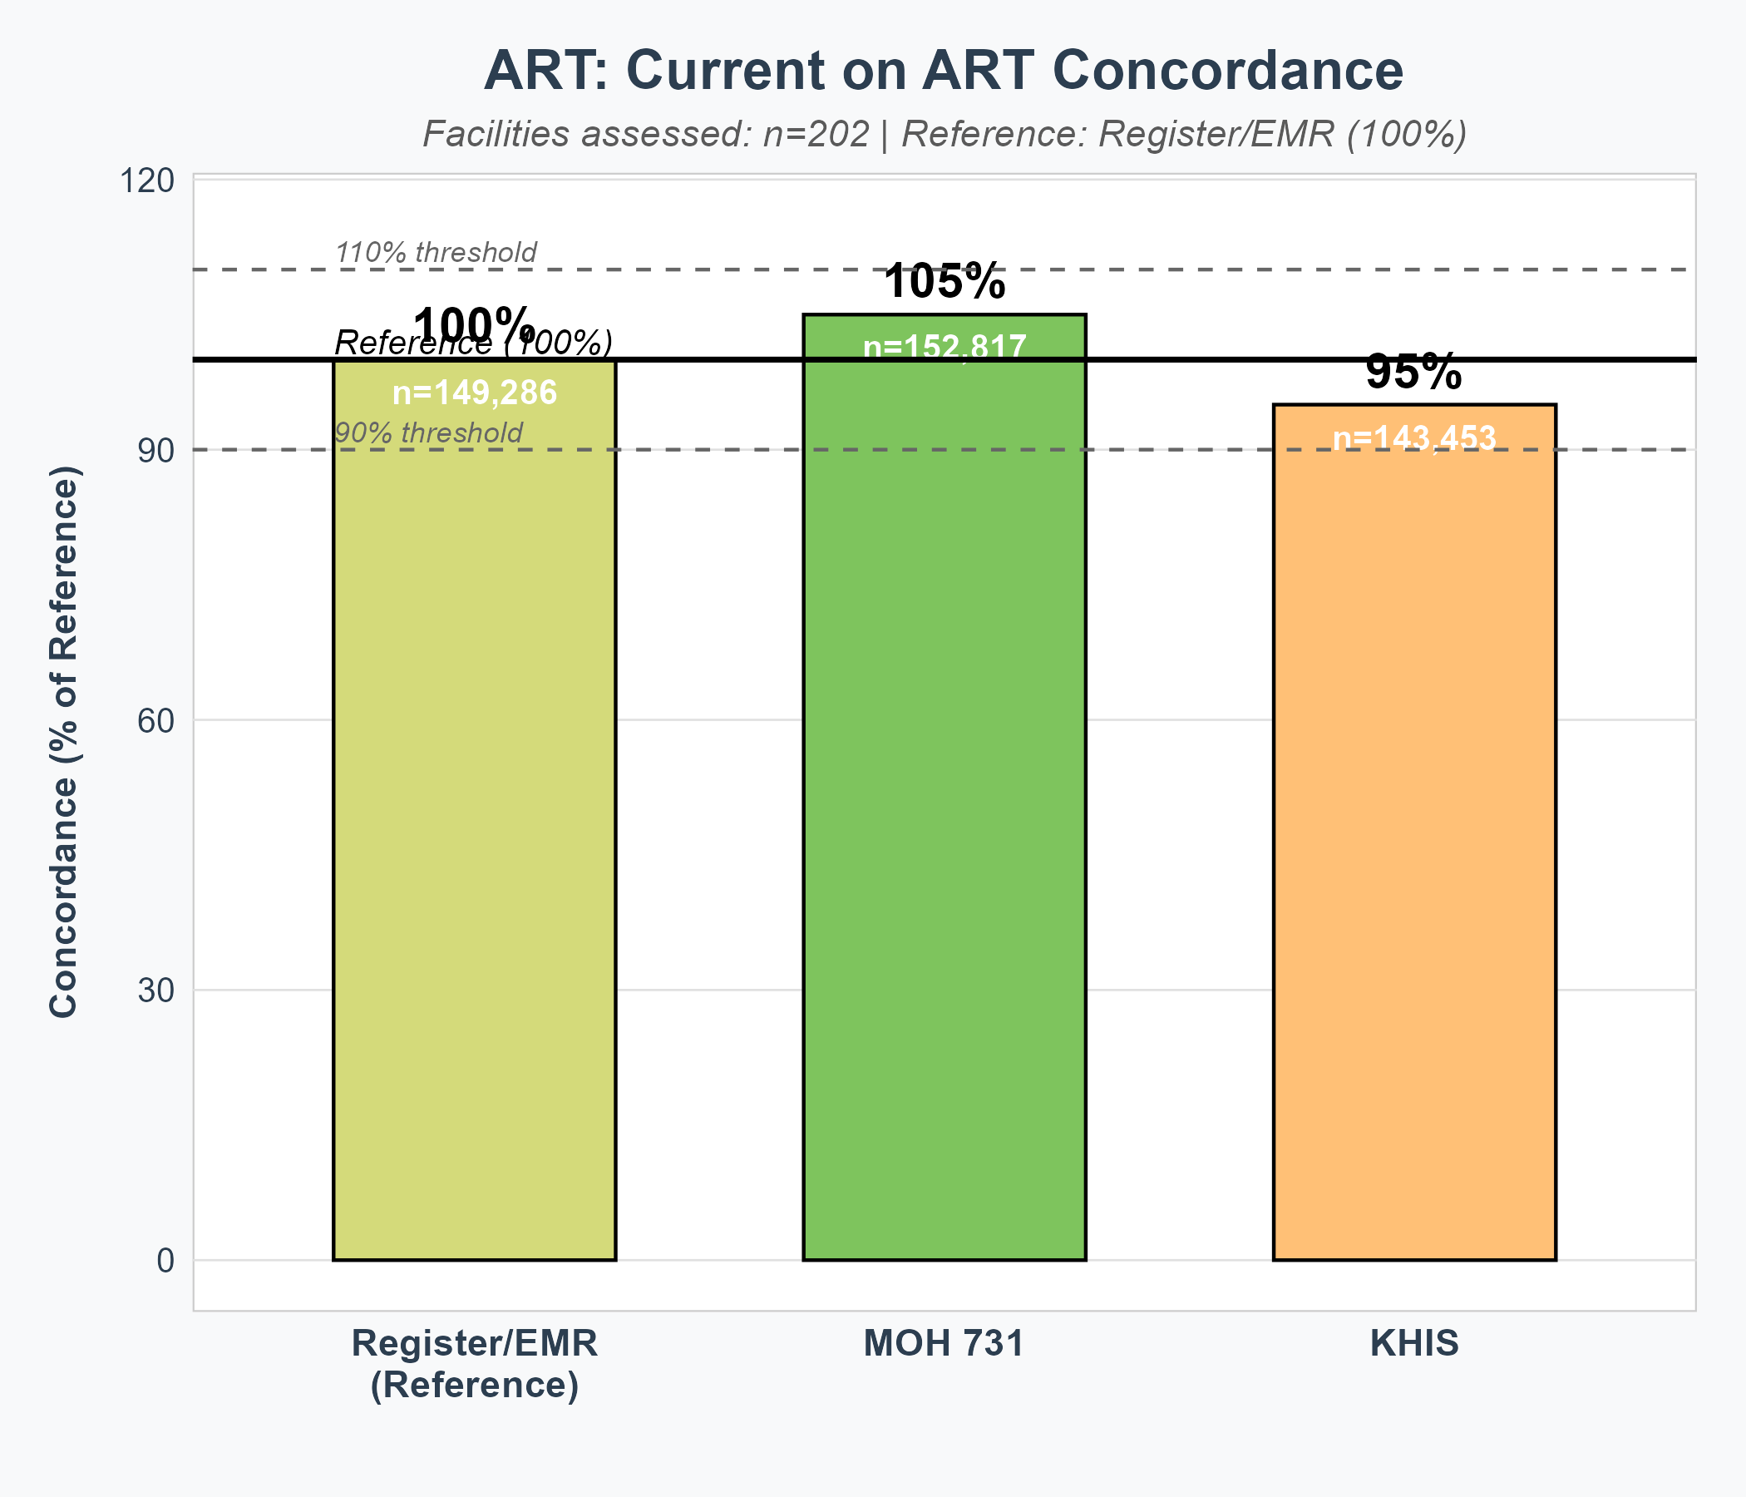
ART: Current on ART Concordance - ✅ GOOD PERFORMANCE
Level
🟢 EXCELLENT (95-105%)
🟢 GOOD (90-94% or 106-110%)
🟠 MODERATE (80-89% or 111-120%)
🔴 POOR (<80% or >120%)
═══════════════════════════════════ 📊 CURRENT ON ART CONCORDANCE ═══════════════════════════════════ 📌 REFERENCE: Register/EMR • 149,286 patients (100%) • 202 facilities assessed 📊 REPORTING SYSTEMS: ━━━━━━━━━━━━━━━━━━━━━━━ 🟢 MOH 731: 152,817 (105%) → EXCELLENT concordance 🟢 KHIS: 143,453 (95%) → EXCELLENT concordance ⚠️ 98 facilities excluded: • 134 EMR (66.3%) • 68 paper-based (33.7%) 🔑 KEY FINDING: Near perfect concordance (both within 5% of reference)

