Slide 1
2025 National HIV Data Quality Assessment: Executive Summary
SCOPE • 300 health facilities across 47 counties • Focus: Low-volume, GOK, Faith-Based, Private facilities • Systems reviewed: Paper-based & Electronic Medical Records (EMRs) KEY METRICS • Overall System Performance: 59.4% • Historical Trend: 82% (2023) → 63.4% (2024) → 59.4% (2025) • Best Domain: Commodities (78.8%) • Lowest Domain: Leadership & Governance (49.0%) TOP PERFORMERS (>75%) • Siaya (85.4%), Busia (82.3%), Bungoma (81.8%), Nyeri (82.1%), Embu (79.7%) CRITICAL GAPS (<50%) • 10 counties including Tharaka-Nithi (34.8%), Homa Bay (35.0%), Meru (38.4%)
Category | County | Score
Top Performers | Siaya | 85.4%
 | Busia | 82.3%
 | Bungoma | 81.8%
 | Nyeri | 82.1%
Bottom Performers | Tharaka-Nithi | 34.8%
 | Homa Bay | 35.0%
 | Meru | 38.4%
 | Kisii | 43.2%

Slide 2
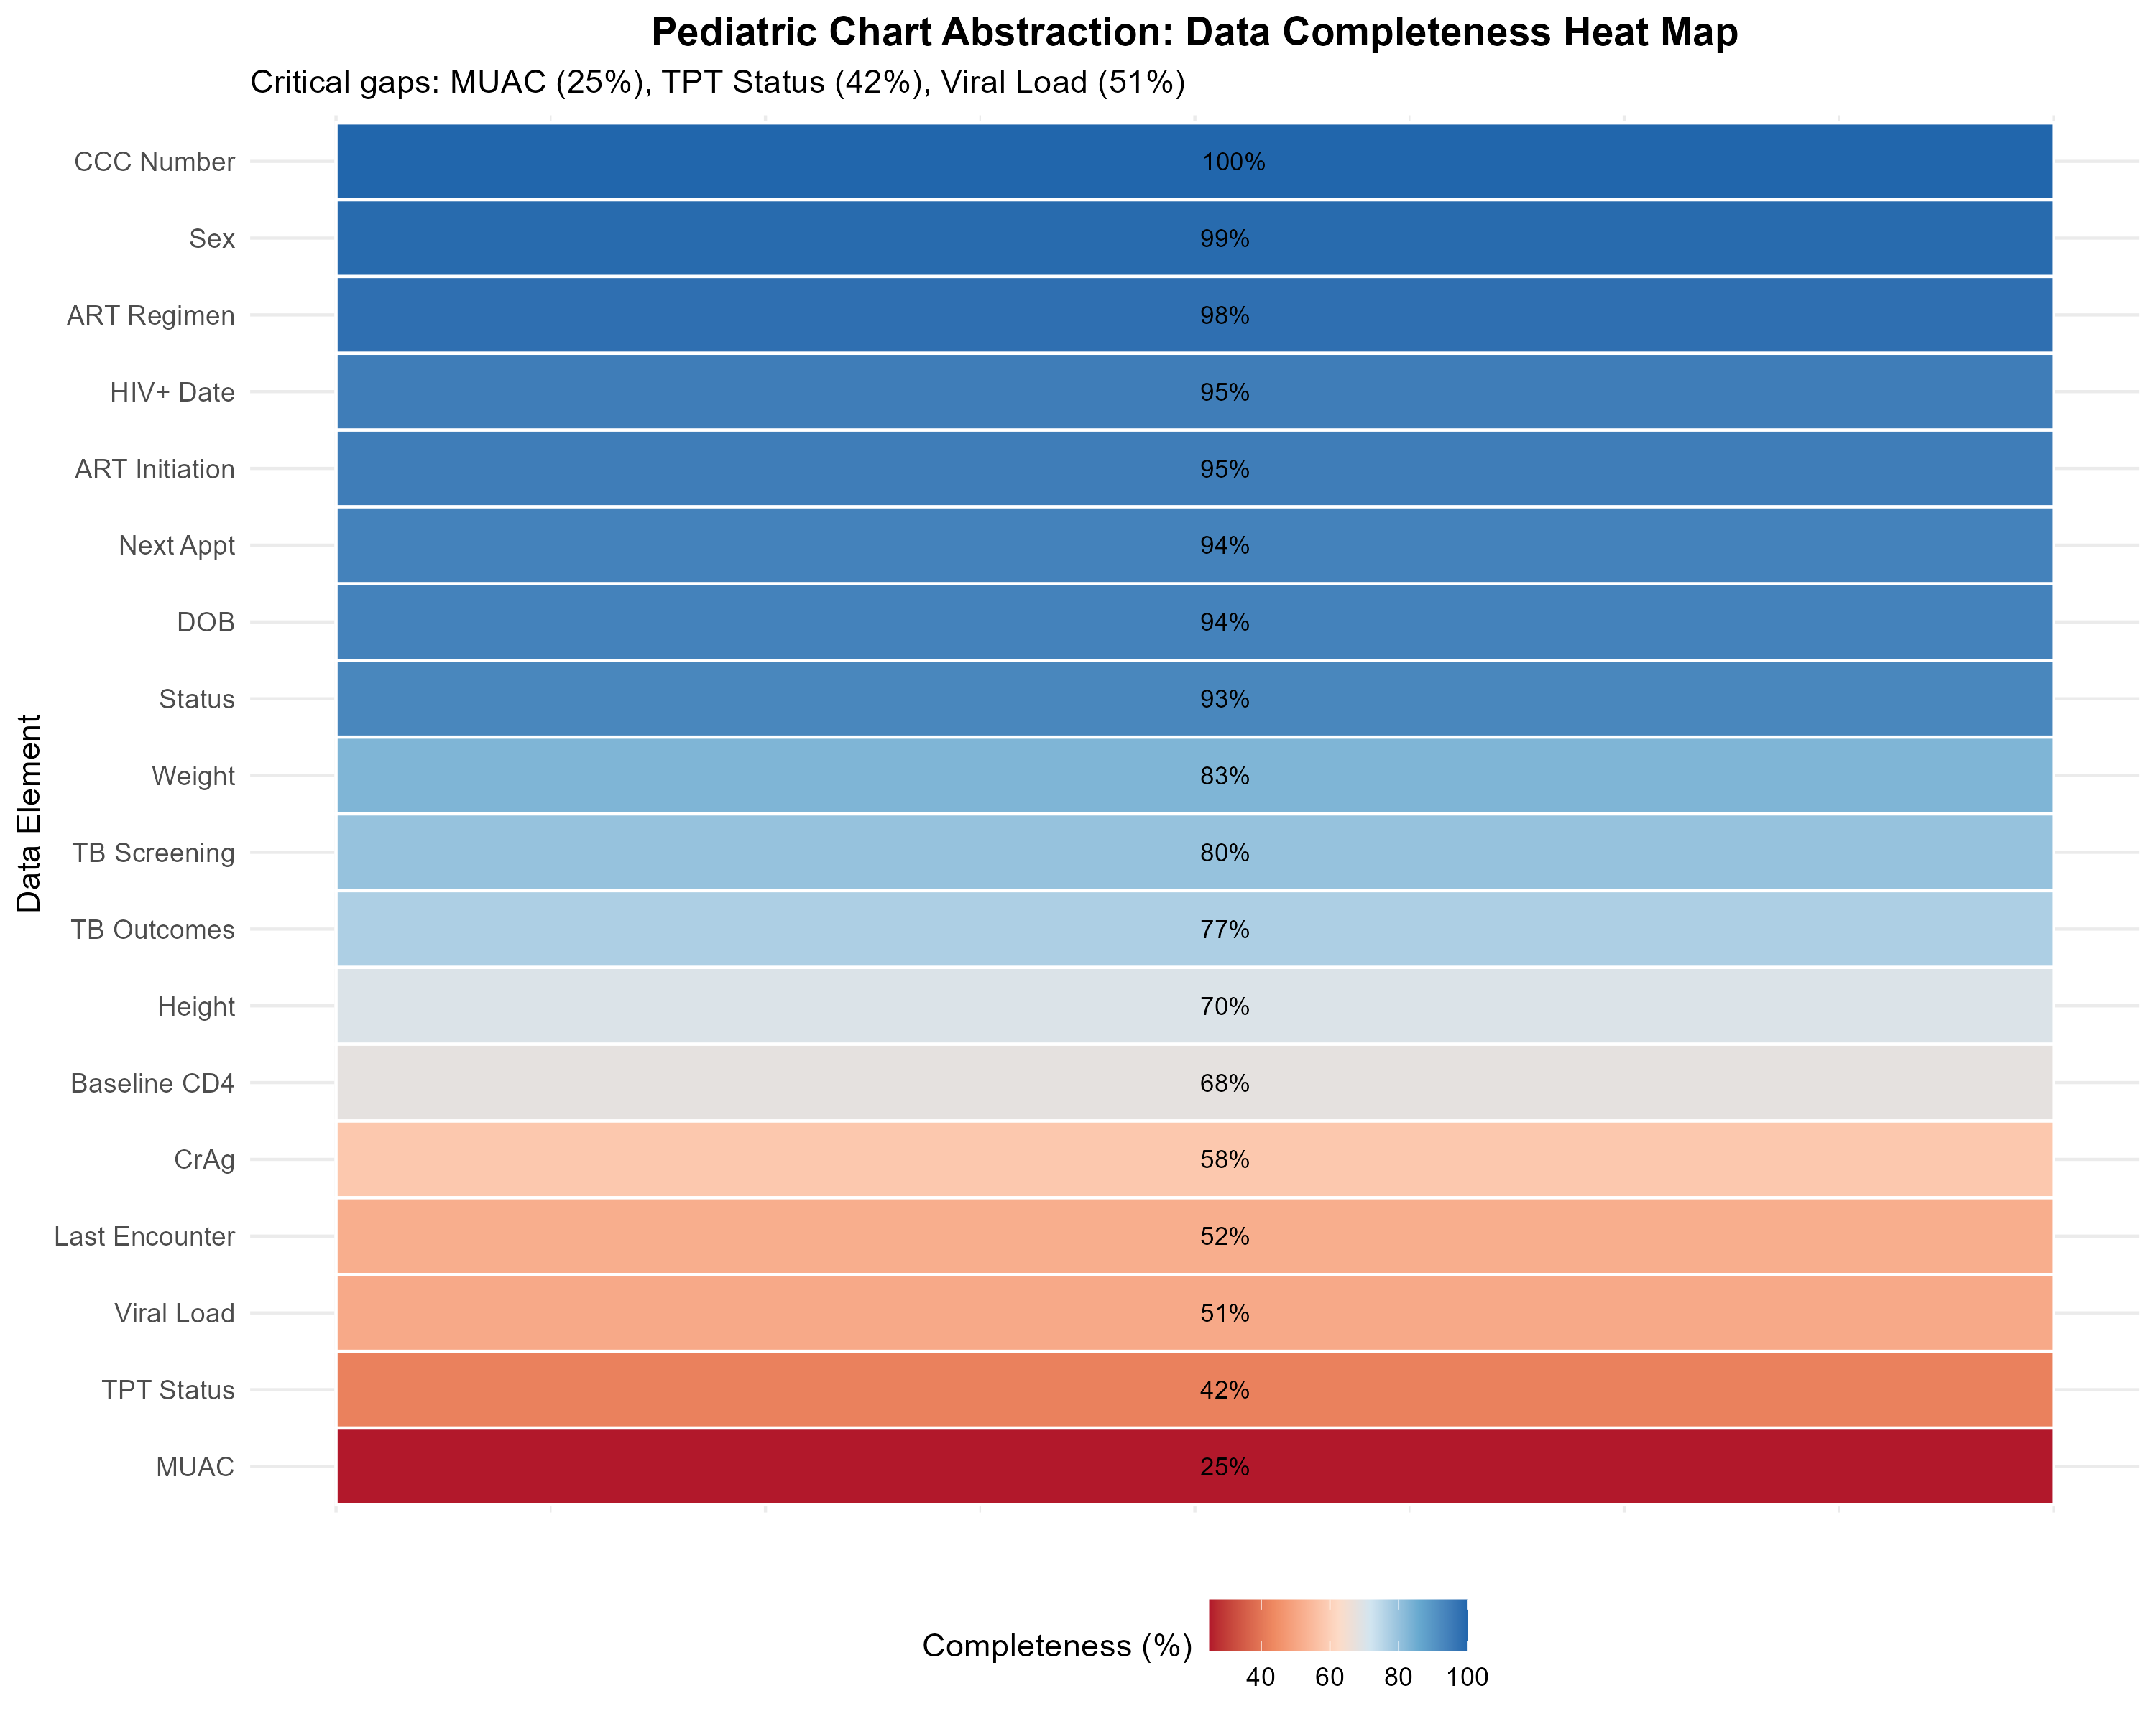
Critical Data Quality Gaps: Focus on Pediatric Care
TOP 5 CRITICAL GAPS: 1. MUAC at last visit: 25% (Nutrition monitoring missing for 3 in 4 children) 2. TPT Status: 42% (TB prevention opportunities missed) 3. Valid Viral Load Result: 51% (Treatment outcomes not monitored) 4. BMI at last visit: 35% (Adult nutrition gap) 5. Leadership & Governance: 49% (Policies/standards missing in half of facilities)

Slide 3
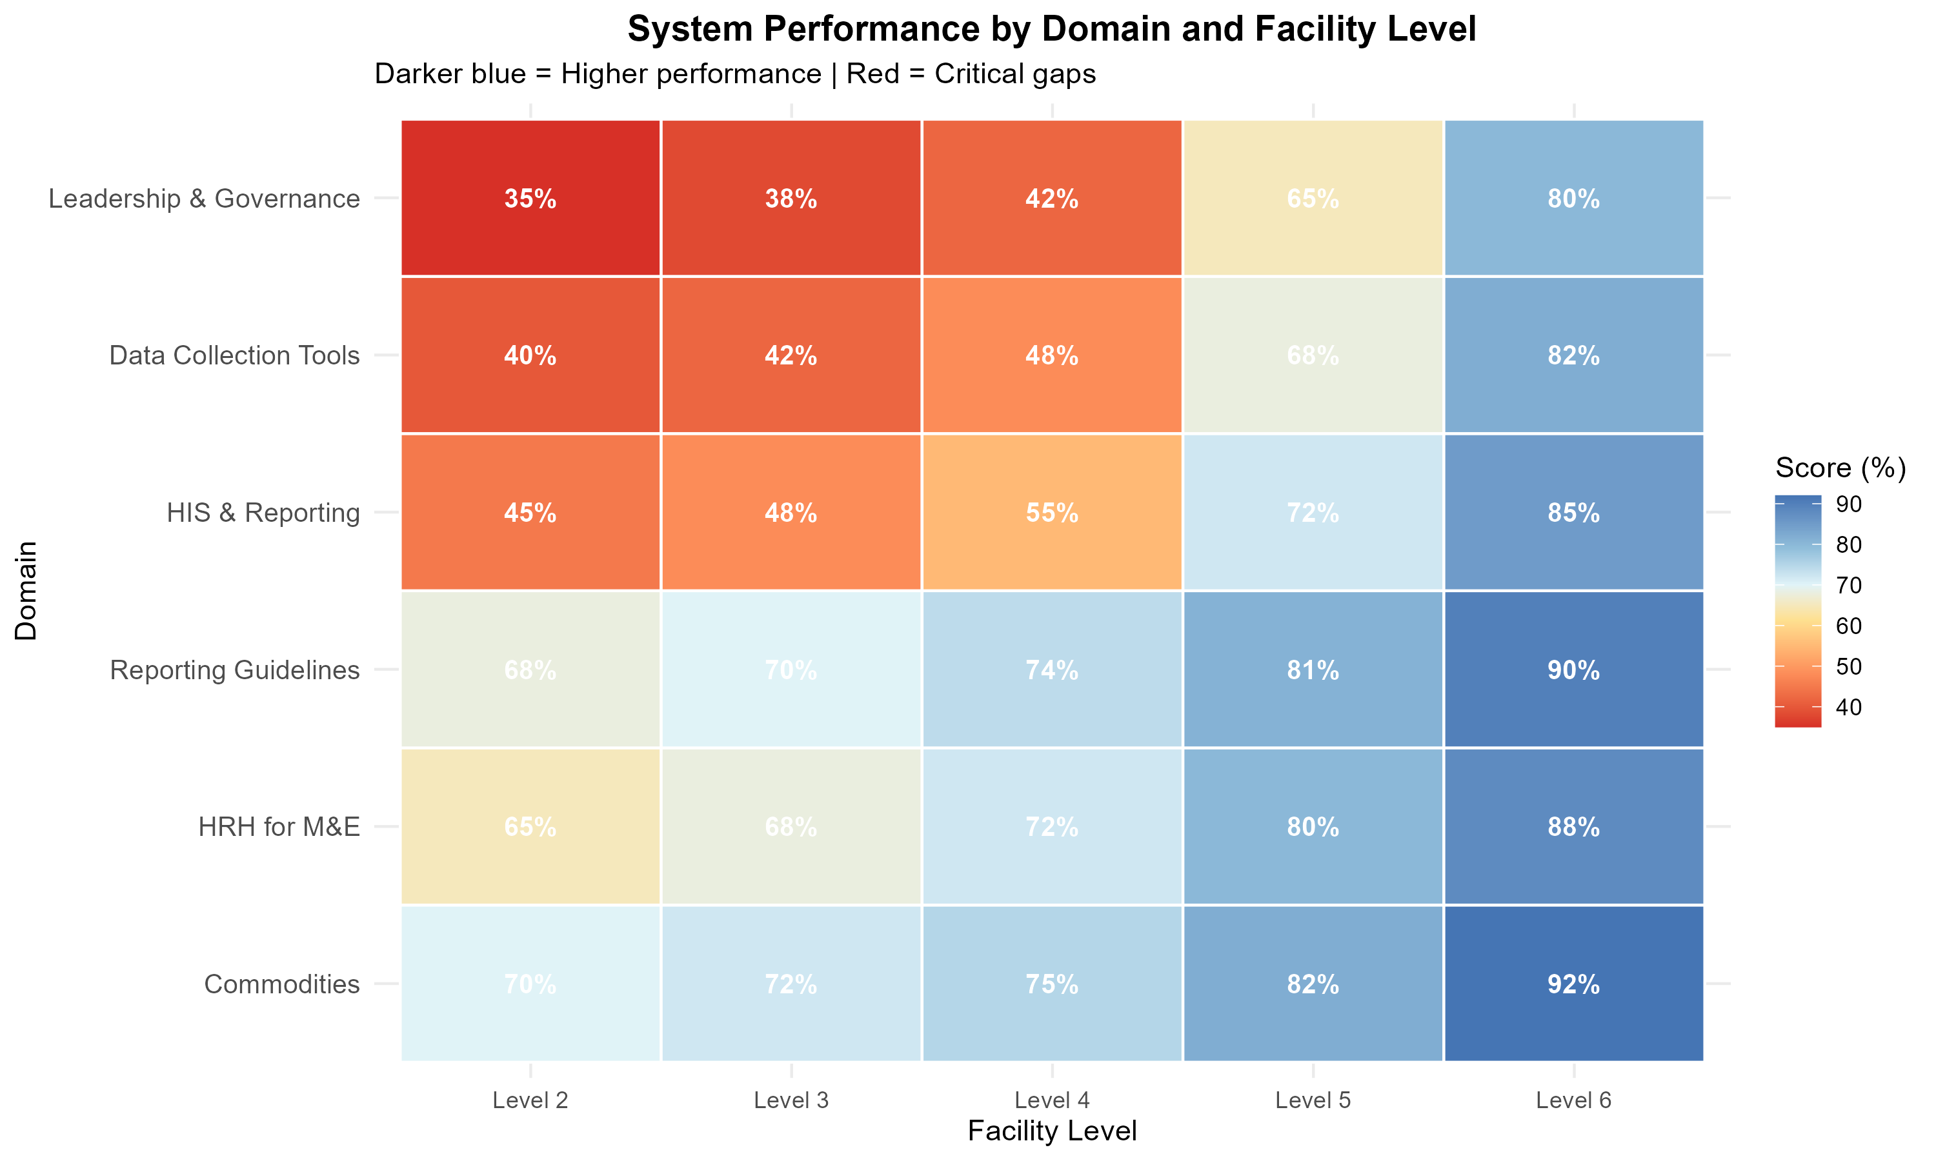
Action Priorities for Global Fund Mission
PRIORITY 1: ACCELERATE IMPLEMENTATION • Year 2 performance at 35% - 65% activities pending • Must complete by 30 June 2026 • Focus on Prevention (46%) and Care/Treatment (40%) PRIORITY 2: STRENGTHEN DATA SYSTEMS • Scale up EMR modules in all DICES • Enforce mandatory fields for Viral Load and TPT • Institutionalize routine data quality checks PRIORITY 3: TARGETED MENTORSHIP • Deploy support to 10 low-performing counties (<50%) • Focus on pediatric nutrition (MUAC) and TB prevention • Conduct regular OJT, CME, refresher trainings
Area | Action
HTS | Training on e-data entry
Care/Treatment | Scale up EMR coverage
Prevention | Strengthen documentation
Nutrition | Ensure therapeutic food documentation
KVP | Strengthen EMR utilization
HPT | Strengthen routine reconciliation

