Slide 1
2025 National HIV Data Quality Assessment: Executive Summary
📊 SCOPE • 300 health facilities across 47 counties • Focus: Low-volume, GOK, Faith-Based, Private facilities • Systems reviewed: Paper-based & Electronic Medical Records (EMRs) 📈 OVERALL SYSTEM PERFORMANCE • Current Score: 59.4% • Historical Trend: 82% (2023) → 63.4% (2024) → 59.4% (2025) ✅ BEST PERFORMING DOMAIN • Commodities: 78.8% (GREEN) ❌ LOWEST PERFORMING DOMAINS (RED ALERT) • Leadership & Governance: 49.0% • Data Collection Tools: 51.0% • HIS & Reporting: 50.9%
Category | County | Score
🌟🌟 TOP PERFORMERS | Siaya | 85.4%
🌟🌟 TOP PERFORMERS | Busia | 82.3%
🌟🌟 TOP PERFORMERS | Bungoma | 81.8%
🌟🌟 TOP PERFORMERS | Nyeri | 82.1%
🌟🌟 TOP PERFORMERS | Embu | 79.7%
⚠️ CRITICAL COUNTIES | Tharaka-Nithi | 34.8%
⚠️ CRITICAL COUNTIES | Homa Bay | 35.0%
⚠️ CRITICAL COUNTIES | Meru | 38.4%
⚠️ CRITICAL COUNTIES | Kisii | 43.2%
⚠️ CRITICAL COUNTIES | Migori | 45.5%

Slide 2
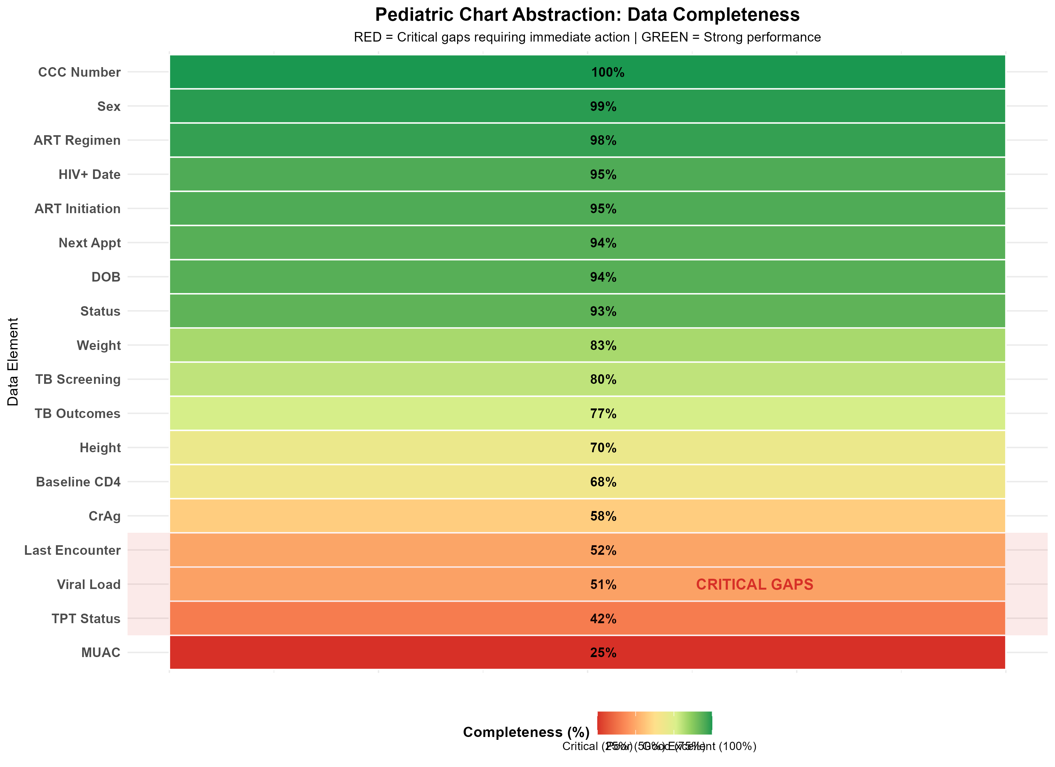
Critical Data Quality Gaps: Focus on Pediatric Care
🔴 TOP 5 CRITICAL GAPS (RED ALERT - Below 60%): 1. MUAC at last visit: 25% (Nutrition monitoring missing for 3 in 4 children) 2. TPT Status: 42% (TB prevention opportunities missed) 3. Valid Viral Load Result: 51% (Treatment outcomes not monitored) 4. Last Clinical Encounter Date: 52% (Poor visit adherence tracking) 5. Baseline CD4 Screening: 68% (Advanced HIV disease monitoring gap) 🟢 STRONG PERFORMANCE AREAS (GREEN - Above 90%): • Demographics (CCC, Sex, DOB): 94-100% • ART Regimen & Initiation Dates: 95-98%

Slide 3
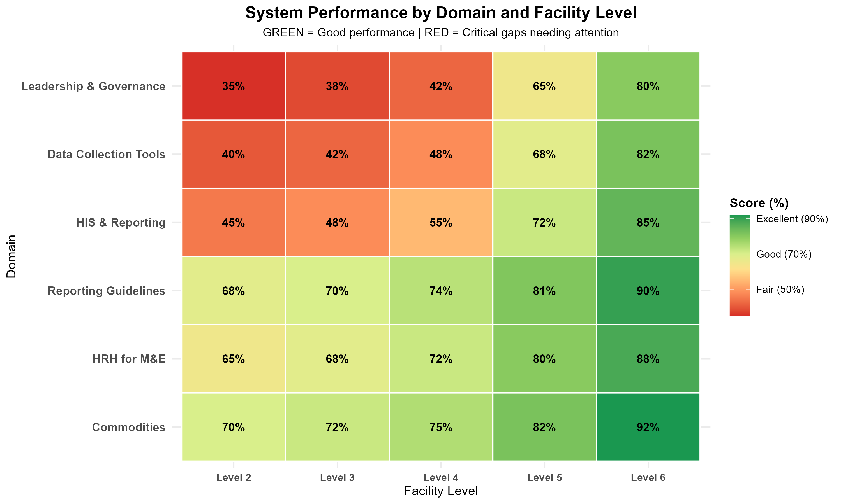
Action Priorities for Global Fund Mission
🔴 PRIORITY 1: ACCELERATE IMPLEMENTATION • Year 2 performance at 35% - 65% activities pending • Must complete by 30 June 2026 • Focus on Prevention (46%) and Care/Treatment (40%) 🟡 PRIORITY 2: STRENGTHEN DATA SYSTEMS • Scale up EMR modules in all DICES • Enforce mandatory fields for Viral Load and TPT • Institutionalize routine data quality checks 🟢 PRIORITY 3: TARGETED MENTORSHIP • Deploy support to 10 low-performing counties (<50%) • Focus on pediatric nutrition (MUAC) and TB prevention • Conduct regular OJT, CME, refresher trainings
Area | Status | Action
HTS | 🟡 Moderate | Training on e-data entry
Care/Treatment | 🔴 Critical | Scale up EMR coverage
Prevention | 🔴 Critical | Strengthen documentation
Nutrition | 🔴 Critical | Ensure therapeutic food documentation
KVP | 🟡 Moderate | Strengthen EMR utilization
HPT | 🟡 Moderate | Strengthen routine reconciliation
⚠️ CRITICAL DEADLINE: Complete 65% pending Year 2 activities by 30 June 2026

