Slide 1
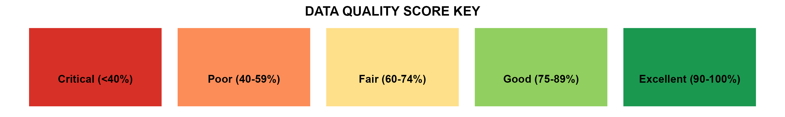
2025 National HIV Data Quality Assessment: Executive Summary
📊 SCOPE • 300 health facilities across 47 counties • Total files reviewed: n=1,092 (Adult) | n=366 (Pediatric) • Focus: Low-volume, GOK, Faith-Based, Private facilities 📈 OVERALL SYSTEM PERFORMANCE: 59.4% (⬇️ from 82% in 2023) ✅ BEST DOMAIN: Commodities (78.8%) - GOOD ❌ LOWEST DOMAINS (CRITICAL - RED): • Leadership & Governance: 49.0% • Data Collection Tools: 51.0% • HIS & Reporting: 50.9%
Category | Score
🟢 TOP PERFORMERS (GREEN ≥75%)
Adult: Sex (n=1092) | 100%
Adult: ART Initiation (n=1070) | 98%
Peds: CCC Number (n=366) | 100%
Peds: Sex (n=362) | 99%
🔴 CRITICAL GAPS (RED <60%)
Peds: MUAC (n=92/366) | 25%
Peds: TPT (n=154/366) | 42%
Peds: Viral Load (n=187/366) | 51%
Adult: BMI (n=546/1092) | 50%

Slide 2
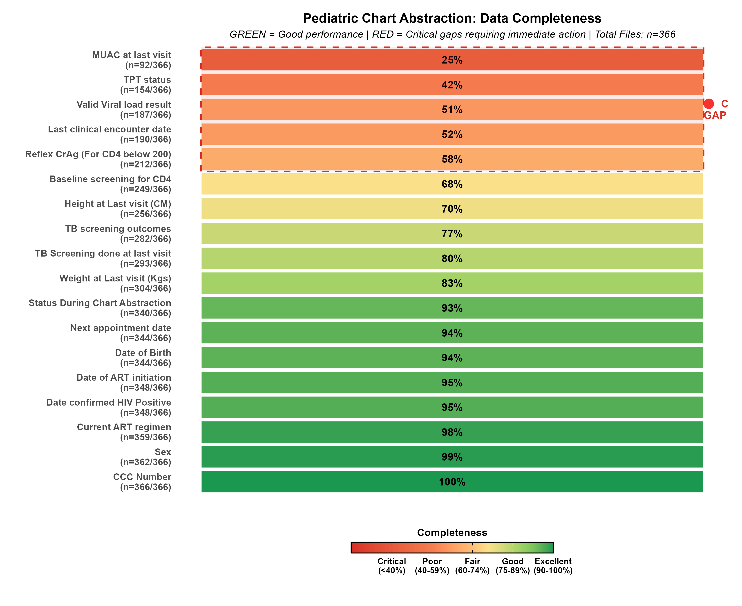
Pediatric Care Data Quality Gaps (n=366)
🔴 CRITICAL GAPS (<60%): MUAC (25%, n=92), TPT (42%, n=154), Viral Load (51%, n=187), CrAg (58%, n=212) 🟢 STRONG AREAS (≥90%): Demographics (94-100%, n=344-366), ART Regimen (98%, n=359)

Slide 3
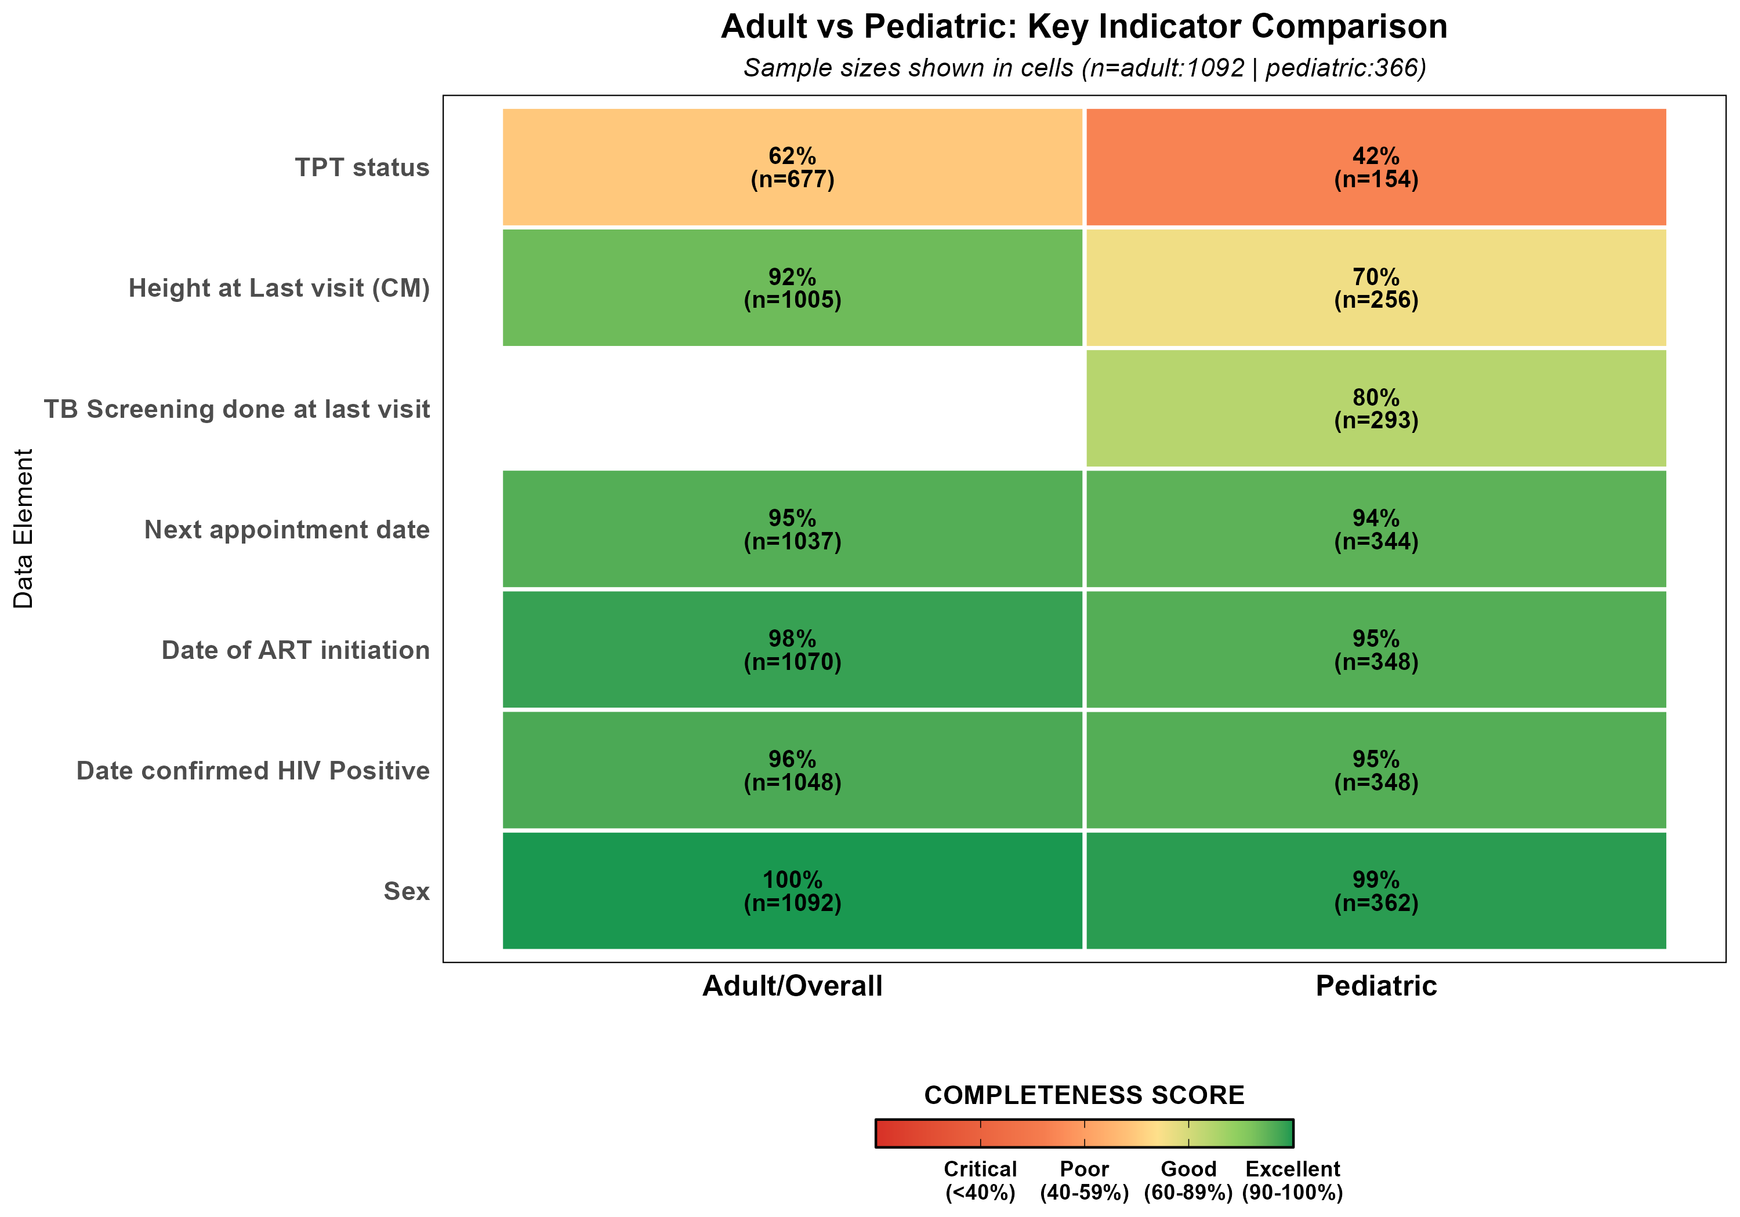
Action Priorities for Global Fund Mission
🔴 PRIORITY 1: ADDRESS CRITICAL PEDIATRIC GAPS (RED) • MUAC: Only 92/366 children (25%) - NUTRITION • TPT: Only 154/366 children (42%) - TB PREVENTION • Viral Load: Only 187/366 children (51%) - MONITORING 🟡 PRIORITY 2: STRENGTHEN SYSTEMS (YELLOW/ORANGE) • Scale up EMR in 300 facilities • Enforce mandatory fields (Viral Load, TPT) • Adult gaps: BMI (50%), TPT (62%) 🟢 PRIORITY 3: TARGETED MENTORSHIP (GREEN) • Support 10 low-performing counties (<50%) • Focus on facilities with MUAC <25% • Train staff on 1,092 adult & 366 pediatric files
Indicator | Completeness | Sample | Status
MUAC (Pediatric) | 25% | 92/366 | 🔴 CRITICAL
TPT (Pediatric) | 42% | 154/366 | 🔴 CRITICAL
Viral Load (Pediatric) | 51% | 187/366 | 🔴 CRITICAL
BMI (Adult) | 50% | 546/1092 | 🟡 POOR
TPT (Adult) | 62% | 677/1092 | 🟡 POOR
⚠️ CRITICAL DEADLINE: Complete 65% pending Year 2 activities by 30 June 2026

