Slide 1
2025 National HIV Data Quality Assessment: Executive Summary
📊 SCOPE • 300 health facilities across 47 counties • Total files reviewed: n=1,092 (Adult/Overall) | n=366 (Pediatric) • Focus: Low-volume, GOK, Faith-Based, Private facilities 📈 OVERALL SYSTEM PERFORMANCE • Current Score: 59.4% • Historical Trend: 82% (2023) → 63.4% (2024) → 59.4% (2025) ✅ BEST PERFORMING DOMAIN • Commodities: 78.8% (GREEN) ❌ LOWEST PERFORMING DOMAINS (RED ALERT) • Leadership & Governance: 49.0% • Data Collection Tools: 51.0% • HIS & Reporting: 50.9%
Category | Score
🟢 TOP PERFORMERS (Adult)
Sex (n=1,092) | 100%
ART Initiation (n=1,070) | 98%
HIV+ Date (n=1,048) | 96%
🟢 TOP PERFORMERS (Pediatric)
CCC Number (n=366) | 100%
Sex (n=362) | 99%
ART Regimen (n=359) | 98%
🔴 CRITICAL GAPS (Adult)
BMI (n=546) | 50%
TPT Status (n=677) | 62%
Baseline Screening (n=852) | 78%
🔴 CRITICAL GAPS (Pediatric)
MUAC (n=92) | 25%
TPT Status (n=154) | 42%
Viral Load (n=187) | 51%

Slide 2
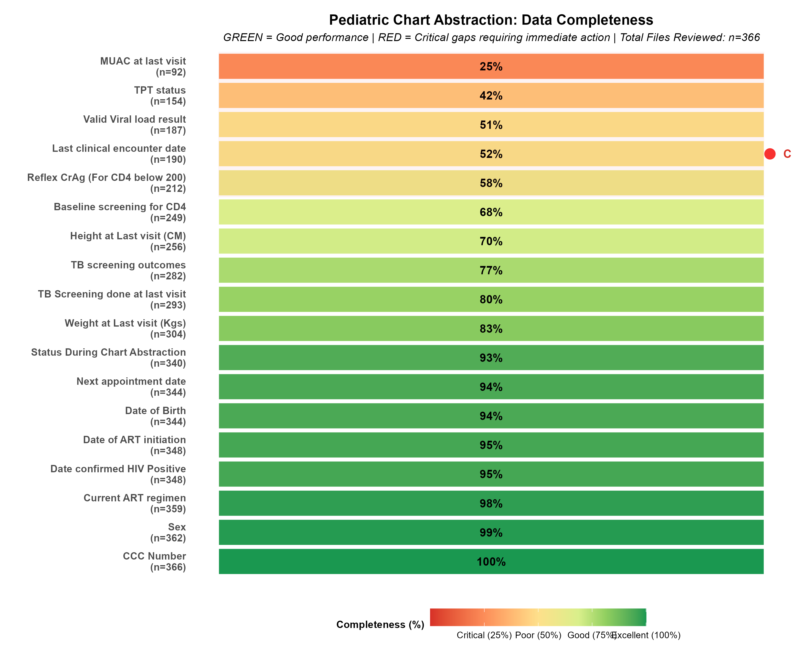
Pediatric Care Data Quality Gaps (n=366)
🔴 TOP 5 CRITICAL GAPS (RED ALERT - Below 60%): 1. MUAC at last visit: 25% (n=92/366) - Nutrition monitoring missing for 3 in 4 children 2. TPT Status: 42% (n=154/366) - TB prevention opportunities missed 3. Valid Viral Load Result: 51% (n=187/366) - Treatment outcomes not monitored 4. Last Clinical Encounter Date: 52% (n=190/366) - Poor visit adherence tracking 5. Reflex CrAg: 58% (n=212/366) - Advanced HIV disease monitoring gap 🟢 STRONG PERFORMANCE AREAS (GREEN - Above 90%): • Demographics (CCC, Sex, DOB): 94-100% (n=344-366) • ART Regimen & Initiation Dates: 95-98% (n=348-359)

Slide 3
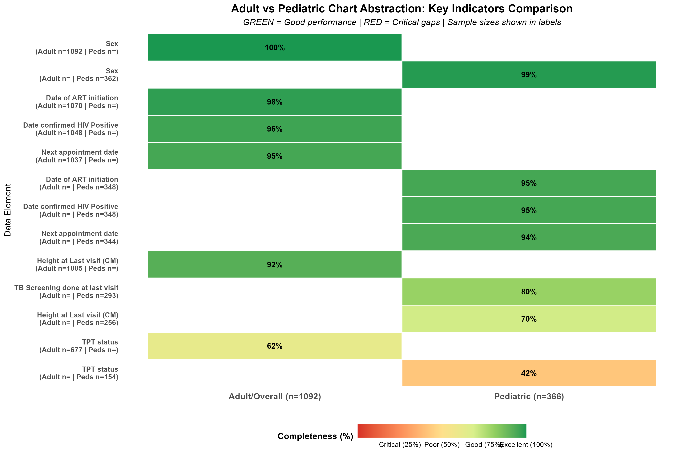
Action Priorities for Global Fund Mission
🔴 PRIORITY 1: ADDRESS CRITICAL PEDIATRIC GAPS (n=366) • MUAC documentation: Only 92/366 children (25%) • TPT initiation: Only 154/366 children (42%) • Viral load monitoring: Only 187/366 children (51%) 🟡 PRIORITY 2: STRENGTHEN DATA SYSTEMS • Scale up EMR modules in all 300 facilities • Enforce mandatory fields for Viral Load and TPT • Target adult gaps: BMI (50%, n=546) and TPT (62%, n=677) 🟢 PRIORITY 3: TARGETED MENTORSHIP • Deploy support to 10 low-performing counties (<50%) • Focus on facilities with MUAC documentation <25% • Conduct regular OJT for 1,092 adult & 366 pediatric files
Indicator | Completeness | Sample | Priority
MUAC (Pediatric) | 25% | n=92/366 | CRITICAL
TPT Status (Pediatric) | 42% | n=154/366 | CRITICAL
Viral Load (Pediatric) | 51% | n=187/366 | CRITICAL
BMI (Adult) | 50% | n=546/1092 | HIGH
TPT Status (Adult) | 62% | n=677/1092 | HIGH
Baseline Screening (Adult) | 78% | n=852/1092 | MEDIUM
⚠️ CRITICAL DEADLINE: Complete 65% pending Year 2 activities by 30 June 2026

