Slide 1
HIV Situation in Kenya

Slide 2
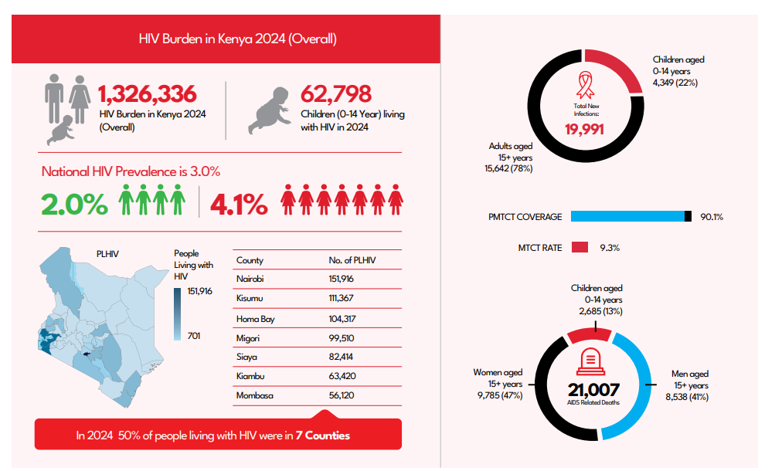
60% (800,009) of people living with are aged 30-54 years
Females account for 65% (867,530) of all people living with HIV
Source: HIV Estimates 2025

Slide 3
Kenya 95-95-95 Cascade , December 2025

Slide 4
Adults cascade

Slide 5
Young Adults cascades 15-24-

Slide 6
Adolescent cascade 10-19

Slide 8
HIV situation in Kenya
Basic Facts on HIV and AIDS.
Kenya HIV Prevention and Treatment Guidelines, 2022
Standard Package of Care of HIV infected people
HIV and NCD

Slide 9
What does HIV stand for?
Human: Infecting human beings
Immunodeficiency: Decrease or weakness in the body’s ability to fight off infections and illnesses
Virus: A pathogen having the ability to replicate only inside a living cell
Notes:
HIV stands for Human Immunodeficiency Virus. It is the virus that causes AIDS.

Slide 10
What is HIV?
An RNA ( Ribonucleic acid) based virus that causes AIDS
Attacks the Immune System
Mother to Child transmission of HIV is the Most common way babies contract HIV from the mother during pregnancy, birth or breastfeeding
The virus compromises the body’s ability to handle disease and causes AIDS.

Slide 11
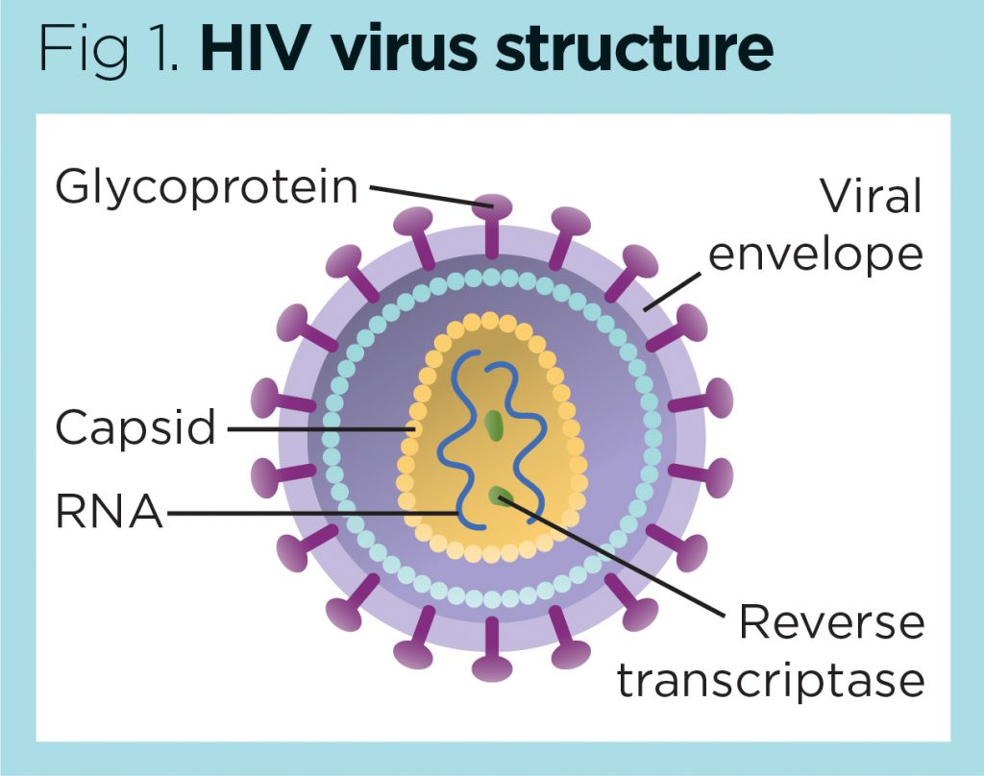
What does HIV look like?
Notes:
The RNA present in a virus is protected by a protein coat called a capsid. Outside the capsid are enzymes the virus uses to infect its host and replicate. These structures are surrounded by an envelope comprising glycoproteins, which help the virus identify and bind to its target

Slide 12
Two Key Parts of the Immune System
T4 or CD4 Cell:
T4 cell are particularly important in the adaptive immune system. These cells help suppress or regulate immune responses
Antibodies

Slide 13
HIV Transmission Requires:
Infected body fluid
Entry into body

Slide 14
Human Body Fluids
Four Fluids, if infected, can transmit HIV
Blood
Semen
Vaginal Secretions
Breast Milk
Four Fluids that can’t transmit HIV
Saliva
Urine
Sweat
Tears

Slide 15
Risk factors To HIV infection
Understanding HIV risk factors is the gateway to implementation of prevention interventions
Some of the circumstances that put individuals at risk of contracting HIV include;
Unprotected sex (anal or vaginal)
Presence of STI i.e. syphilis, herpes, Chlamydia, gonorrhea, bacterial vaginosis
Sharing IV drug equipment and solutions
Receiving unsafe injections, blood transfusions, tissue transplantation, medical procedures that involve unsterile cutting or piercing
Accidental needle stick injuries – Health care workers
HIV positive mother to child at pregnancy, birth, breastfeeding

Slide 16
How Does HIV get into a T Cell?
HIV attaches to infection fighting T4 cell
Locks on to two entry areas of the T4 cell at once. (Keys in lock)
Tricks T4 cell to allow Virus RNA to enter

Slide 17
What Does HIV do inside a T Cell?
Virus’s RNA changes into DNA
Enters Cell nucleus & becomes part of Host’s DNA!
Programs T cell to produce virus in abundance
New viruses bud off Host T cell, killing T cell, & enters bloodstream
New HIV viruses infect more T cells

Slide 18
What is the “Window Period?”
The time period between a person’s exposure & actual infection with HIV and until antibodies are detectable in the body.
After three months there are usually enough antibodies to show on an AIDS test.
Nearly all people (99%) develop antibodies by THREE months.

Slide 19
HIV and the Immune System
A person can be HIV infected and not have AIDS if the person’s immune system is intact.
Often this period is from 8-10 years. Has no symptoms, person is a carrier.
After this period, the immune system begins to lose the fight. At this point the person has AIDS

Slide 20
What does AIDS stand for?
A. Acquired
I. Immune
D. Deficiency
S. Syndrome

Slide 21
WHAT IS AIDS ?
The Late stage of HIV infection
A group of symptoms & signs of disease that occur together.
Severe immune system breakdown
Less than 200 T cells (or CD4 cells). Normal 1000

Slide 22
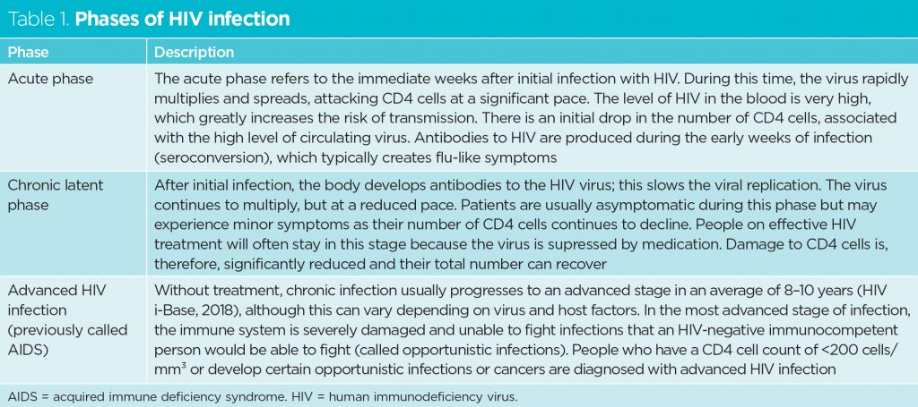

Slide 23
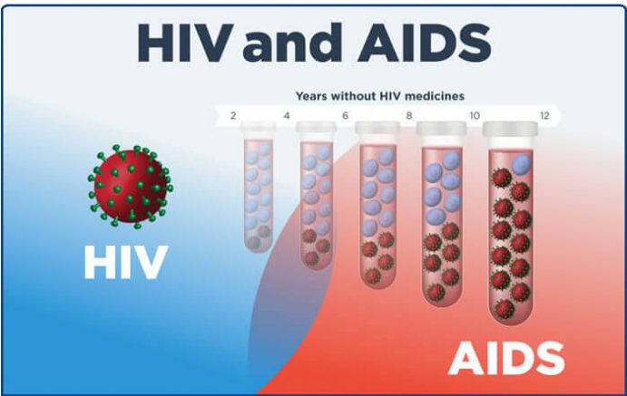
Understanding HIV
Notes:
A structured treatment plan designed to improve and maintain health. Recommended regimens for the initial treatment of HIV include a combination of three or more antiretroviral (ARV) drugs from at least two different HIV drug classes.

Slide 24
What happens to someone with full blown AIDS?
Immune system breaks down => frequent Hospitalization
Cause of death - a variety of normally preventable diseases( Opportunistic Infections) such as;
Pneumonia
Toxoplasmosis
Kaposi’s sarcoma
Mycobacterium Avium complex
Invasive cervical cancer
A person has AIDS only in the final stages of HIV, after the immune system becomes unable to defend itself against foreign invaders like bacteria, other viruses, and allows the development of certain cancers

Slide 25
HIV situation in Kenya
Basic Facts on HIV and AIDS.
Kenya HIV Prevention and Treatment Guidelines, 2022
Standard Package of Care of HIV infected people
HIV and NCD

Slide 26
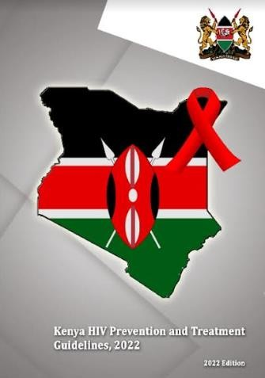
https://app.box.com/s/3ox5vm885qamwloah6sciljvmxcle4oq

Slide 27
HIV situation in Kenya
Basic Facts on HIV and AIDS.
Kenya HIV Prevention and Treatment Guidelines, 2022
Standard Package of Care of HIV infected people
HIV and NCD

Slide 28
Standard Package of Care for PLHIV
8 Components
Antiretroviral therapy
Positive Health, Dignity and Prevention, GBV/IPV & HIV Education and Counseling
Screening for and prevention of specific OIs
Reproductive heath services
Screening for and Management of Non-communicable Diseases
Mental health Screening and Management
Nutrition services
Prevention of other infections
11

Slide 29
ART in Infants, Children, Adolescents, and Adults
1st Line ART
Age | Weight | Preferred Regimen (1st Line ART) | Dosing (Correct weight-based dosing must be confirmed at every visit)
Birth to 4 weeks | Any | AZT + 3TC + NVP | Weight-based dosing
> 4 weeks to < 15 years | < 30 kg | ABC + 3TC + DTG | Weight-based dosing
 | ≥ 30 kg | TDF + 3TC + DTG | TDF/3TC/DTG (300/300/50mg): 1 tab once daily
≥ 15 years | Any | TDF + 3TC + DTG | TDF/3TC/DTG (300/300/50mg): 1 tab once daily

Slide 30
ART in Infants, Children, Adolescents, and Adults
2nd Line ART
Weight/Scenario | First-line ART | Second-line ART
< 30 kg | ABC (or AZT) + 3TC + DTG | DRT-based second-line PI/r
 | ABC + 3TC + LPV/r | Take sample for DRT and change to AZT +3TC + DTG
 | AZT + 3TC + LPV/r | Take sample for DRT and change to ABC +3TC + DTG (DRT based
 | ABC + 3TC + EFV | AZT + 3TC + DTG
 | AZT + 3TC + EFV | ABC + 3TC + DTG
≥ 30 kg or ≥ 15 years old | TDF (or ABC) + 3TC + DTG (or PI/r) | DRT-based second-line
 | TDF (or ABC) + 3TC + EFV | TDF + 3TC + DTG
 | AZT + 3TC + EFV | TDF + 3TC + DTG
DRT Based 2nd Line Switch from 1st Line DTG Based Regimens

Slide 31
ART in Infants, Children, Adolescents, and Adults
Viral Load Monitoring Intervals
Population | First VL | Follow Up
0 - 24 Years | 3 Months after ART Initiation | 6 Monthly
25 Years and Older | 3 Months after ART Initiation | At 12 months, then Annually
Pregnant & BF Women (New Pos) | 3 Months after ART Initiation | 6 Monthly
Pregnant & BF Women (On ART) | At Baseline (Pg Diagnosis) | 6 Monthly
Regimen Switch | N/A | 3 Months after Switch

Slide 32
ART in Infants, Children, Adolescents, and Adults
Viral Load Cut-Offs & Recommended Management
Clinical Definition | Category | Lab Value | Interpretation | Guidance
Suppressed | LDL | <50 Copies/mL | Treatment Goal | Continue management
 | Low Risk LLV | 50 – 199 Copies/mL | Suppressed, Untransmissible | Continue management, Enrol in DSD
Unsuppressed | High Risk LLV | 200-999 Copies/ML | Increased risk of progression to treatment failure | Institute is EAC, repeat VL after 3 months
 | Suspected Treatment Failure | ≥1000 copies/mL | Client at increased risk of morbidity and mortality | Conduct EAC, Repeat VL after 3 months, 2nd Line if 2nd Line VL is >1,000 copies

Slide 33
HIV situation in Kenya
Basic Facts on HIV and AIDS.
Kenya HIV Prevention and Treatment Guidelines, 2022
Standard Package of Care of HIV infected people
HIV and NCD

Slide 34
Screening of NCDs: Hypertension (HTN)
Data Source: National Data Warehouse
Period: Apr - Jun 2024

Slide 35
Management of Diabetic Clients on Care
Data Source: National Data Warehouse Period: Apr - Jun 2024

Slide 36
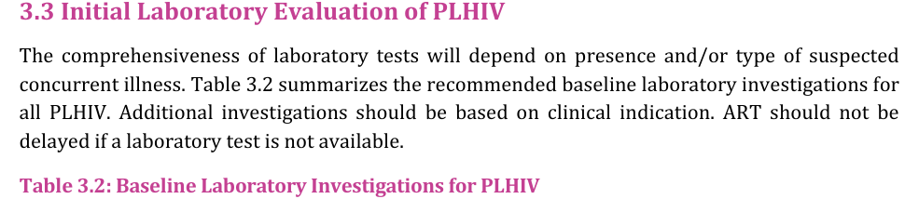
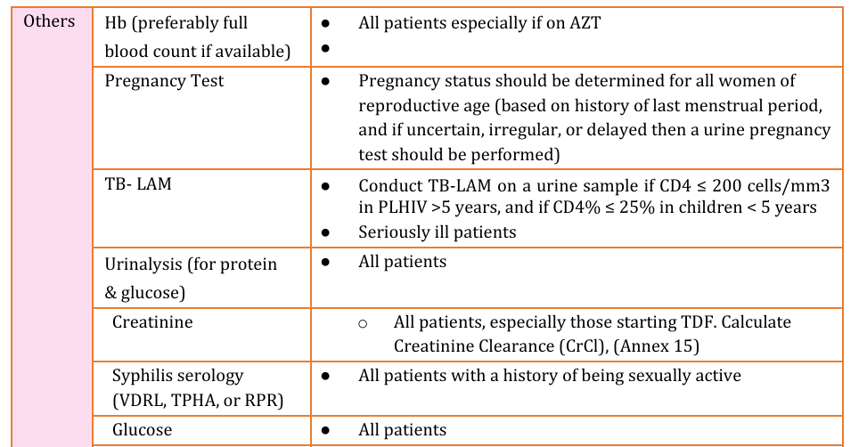
Renal Monitoring of PLHIV on Care
Only 1.59 % of clients who started treatment in the last 1 year had a baseline creatinine document

Slide 37
Excellent Viral Suppression (95.8%) BUT Poor HTN Control (56.4%) Amongst Clients with HIV/HTN Co-morbidity
Data Source: National Data Warehouse, Period: Apr - Jun 2024

Slide 38
Program Gaps
Sub-optimal screening of NCD’s
Access to/cost of Anti-HTN treatment
Capacity of HCWs
Screening
Management
Quality of care for clients with HIV/HTN Comorbidity
Approach to integration of HIV/HTN and other chronic diseases

Slide 39
Program plans for NCD:
Improved documentation and management of clients with high blood pressure and diabetes
Enrollment of clients to SHIF to increase access to non-PEPFAR lab tests (e.g Creatinine ) and NCD medicines ( e.g DM and HTN)
PEN HIV collaboration with NCD
The Package of Essential Non-communicable Diseases (PEN)- Priority activity in GC7.
Aim-strengthen equity and efficiency of primary health care in low resource settings for the integrated management of Non communicable and infectious diseases.
Baseline assessment in 14 counties
Notes:
PEN HIV Focus in 14 counties (Kiambu, Kwale, Taita Taveta, Embu, Makueni, Mandera, Migori, Siaya, Laikipia, Kericho, Nyeri, Uasin Gishu, Kakamega, and Nairobi)

Slide 40
Thank you.

