Slide 1
ASFC
Data Management System
Micah Richards
Connor Manning

Slide 2
Problem
ASFC uses an iPad to track data about their facility
Currently, data is recorded in an excel sheet on the device
An app is needed to provide a frontend to data recording

Slide 3
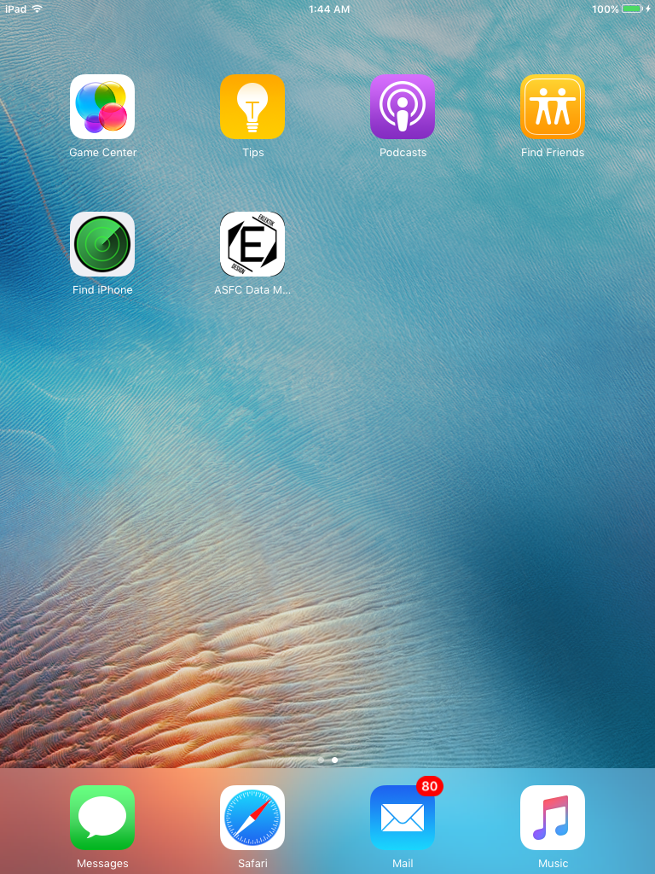
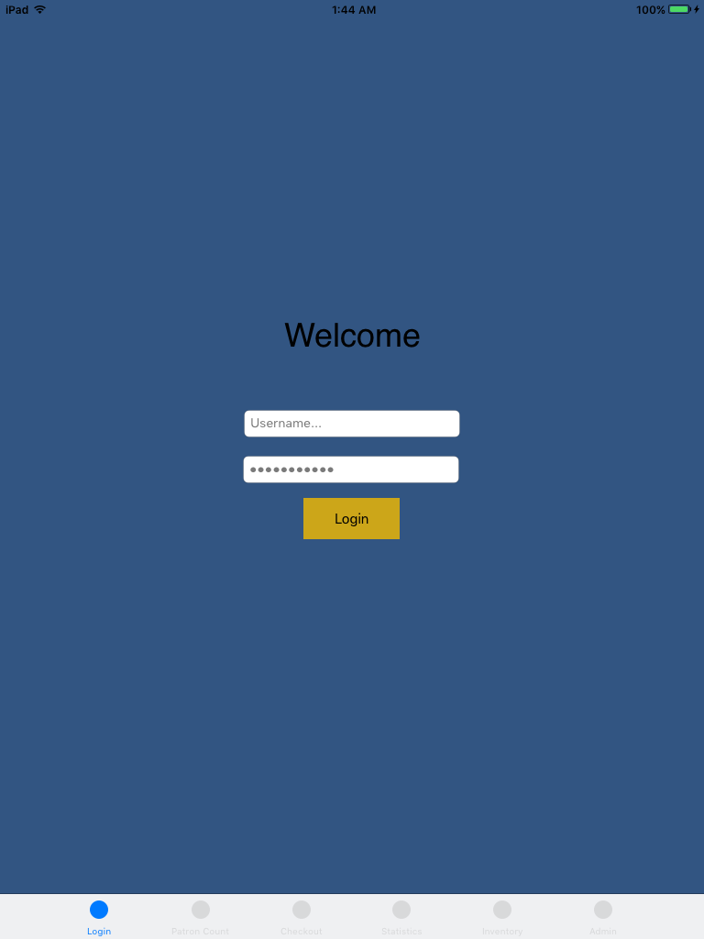
ASFC Data Management System

Slide 4
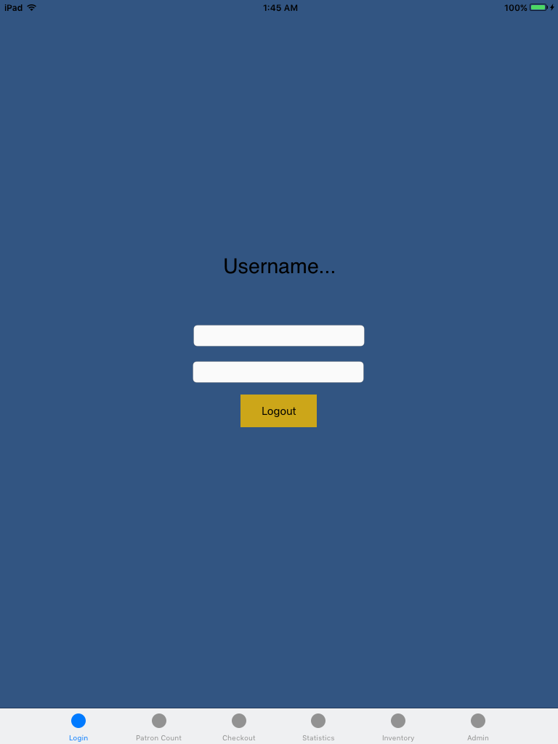
Login
Prompts for Username and Password
Updates to Logout Page when clicked

Slide 5
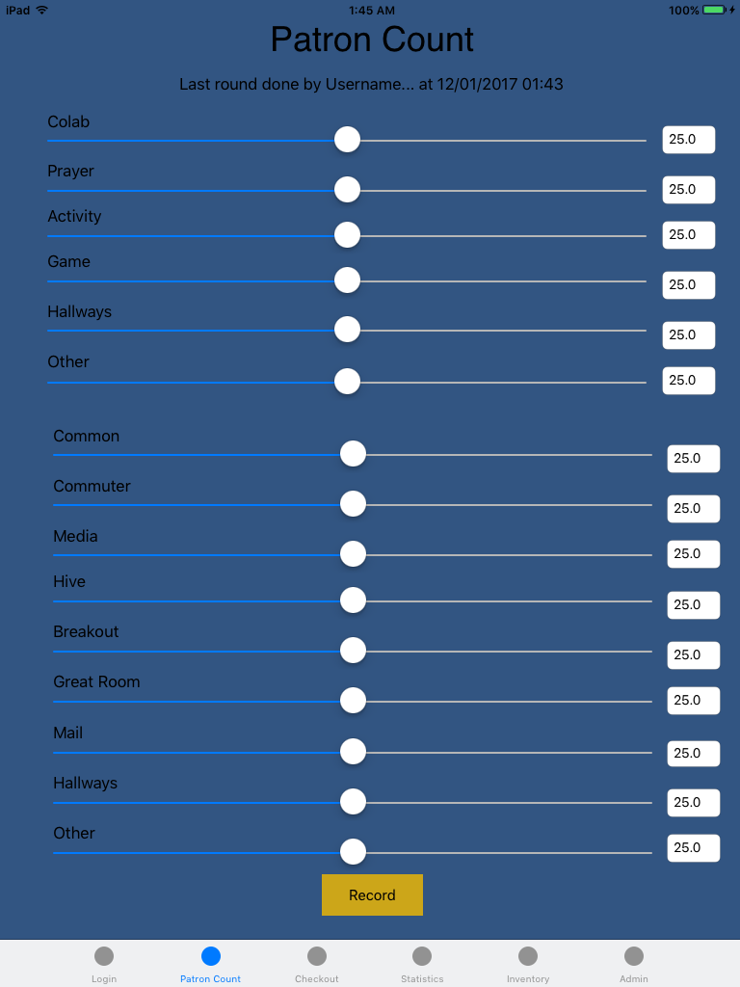
Patron
Sliders adjust value for each room
Editing text updates the sliders
Record saves the data and resets the page

Slide 6
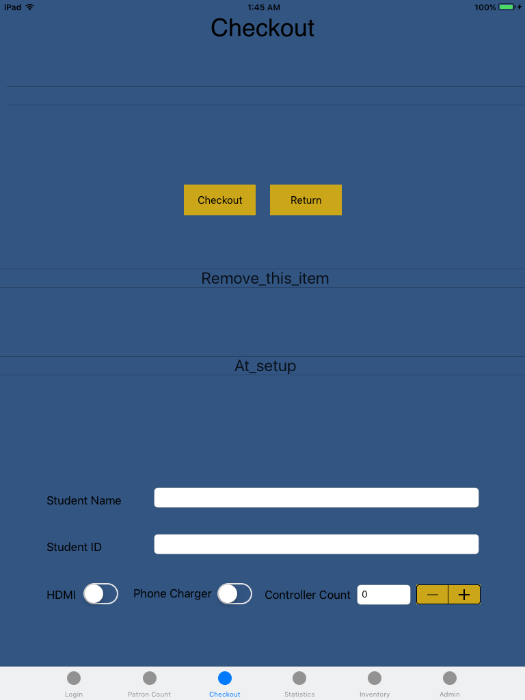
Checkout
Checkout will store the information entered
Item requires ID at minimum to be checked out
List of items checked out listed at top
Return removes item from list
Persistent record of all checked out items is kept

Slide 7
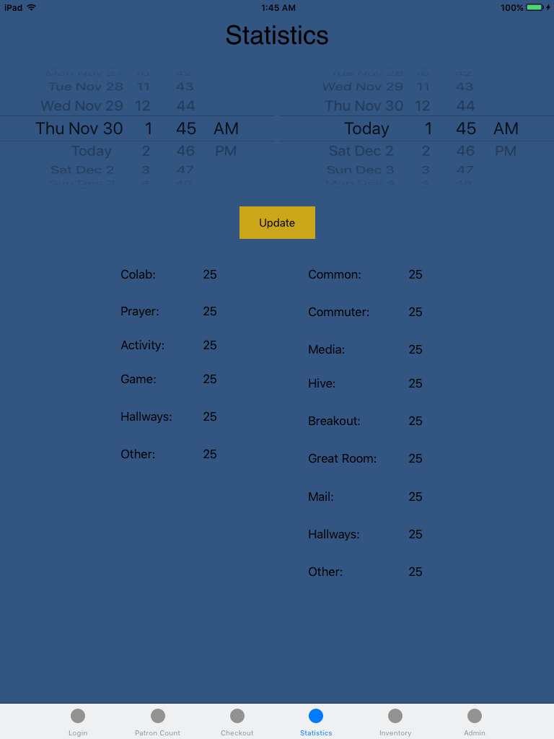
Statistics
Displays average number of people in the room for a given time
An error is displayed if there is no data for a given time period

Slide 8
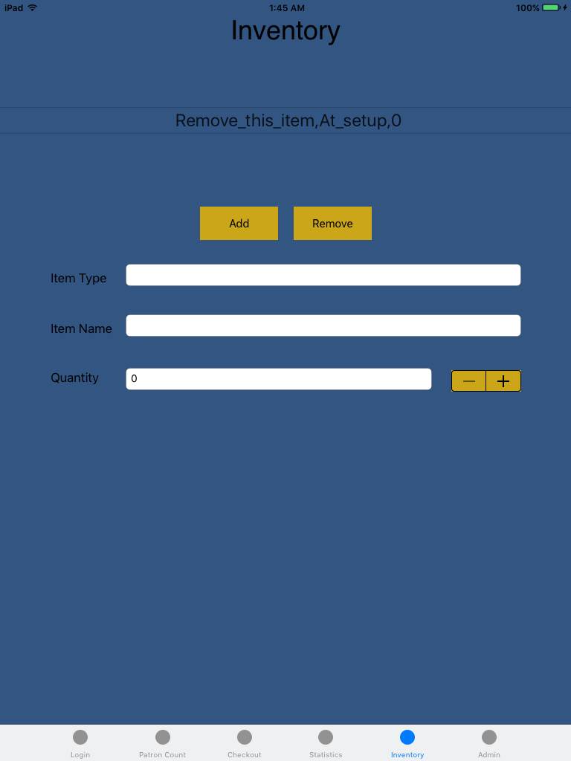
Inventory
Requires admin privileges to access
Add will store the information given
List of items displayed at the top
Remove button clears record

Slide 9
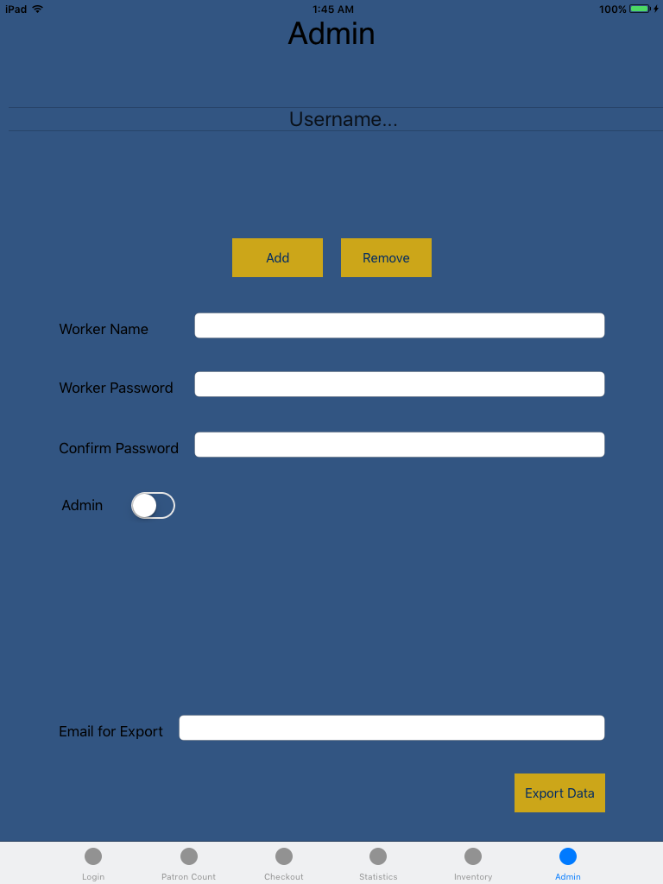
Admin
Requires admin privileges to access
Add will store the information given
List of items displayed at the top
Remove button clears record
Export prepares email for export

Slide 10
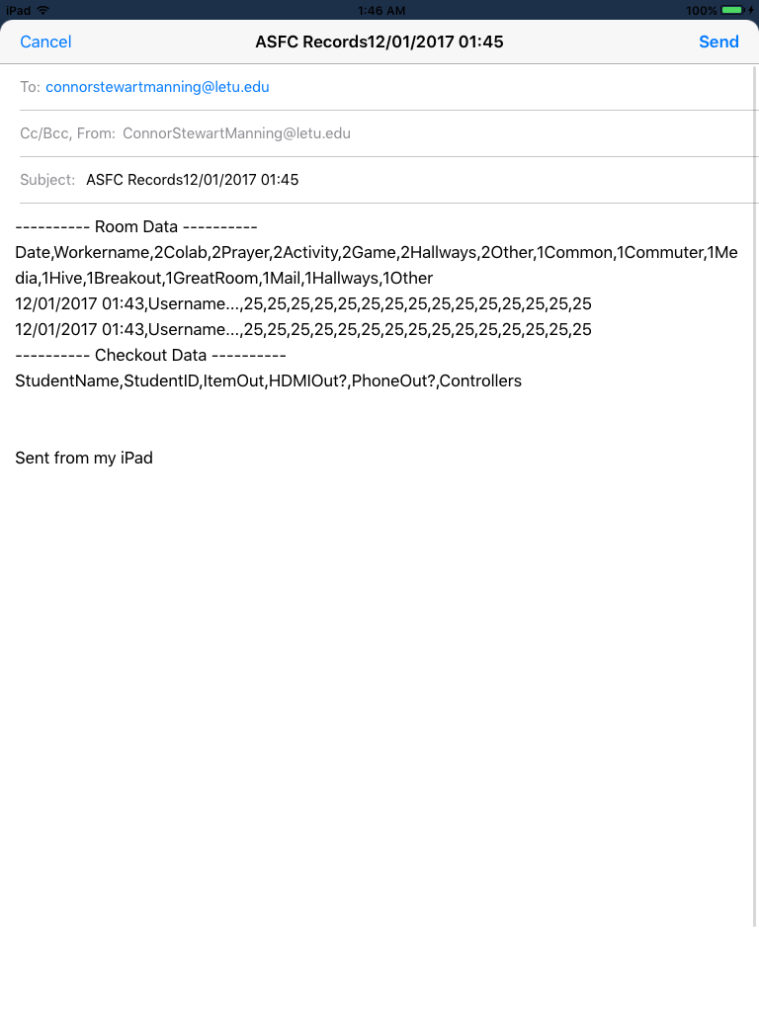
Email
Creates an email with contents of Patron records and Checkout records
Canceling the email does nothing
Sending the email clears local data

Slide 11
Questions?

