Slide 1
DITTO
Dual Iteration TeleTransmission Operator
(It’s a smart house)
Micah Richards (Lead/Linux Guru)
Shimon Rigdon (Master Servo)
Daniel Stephenson (Major Lazer)

Slide 2
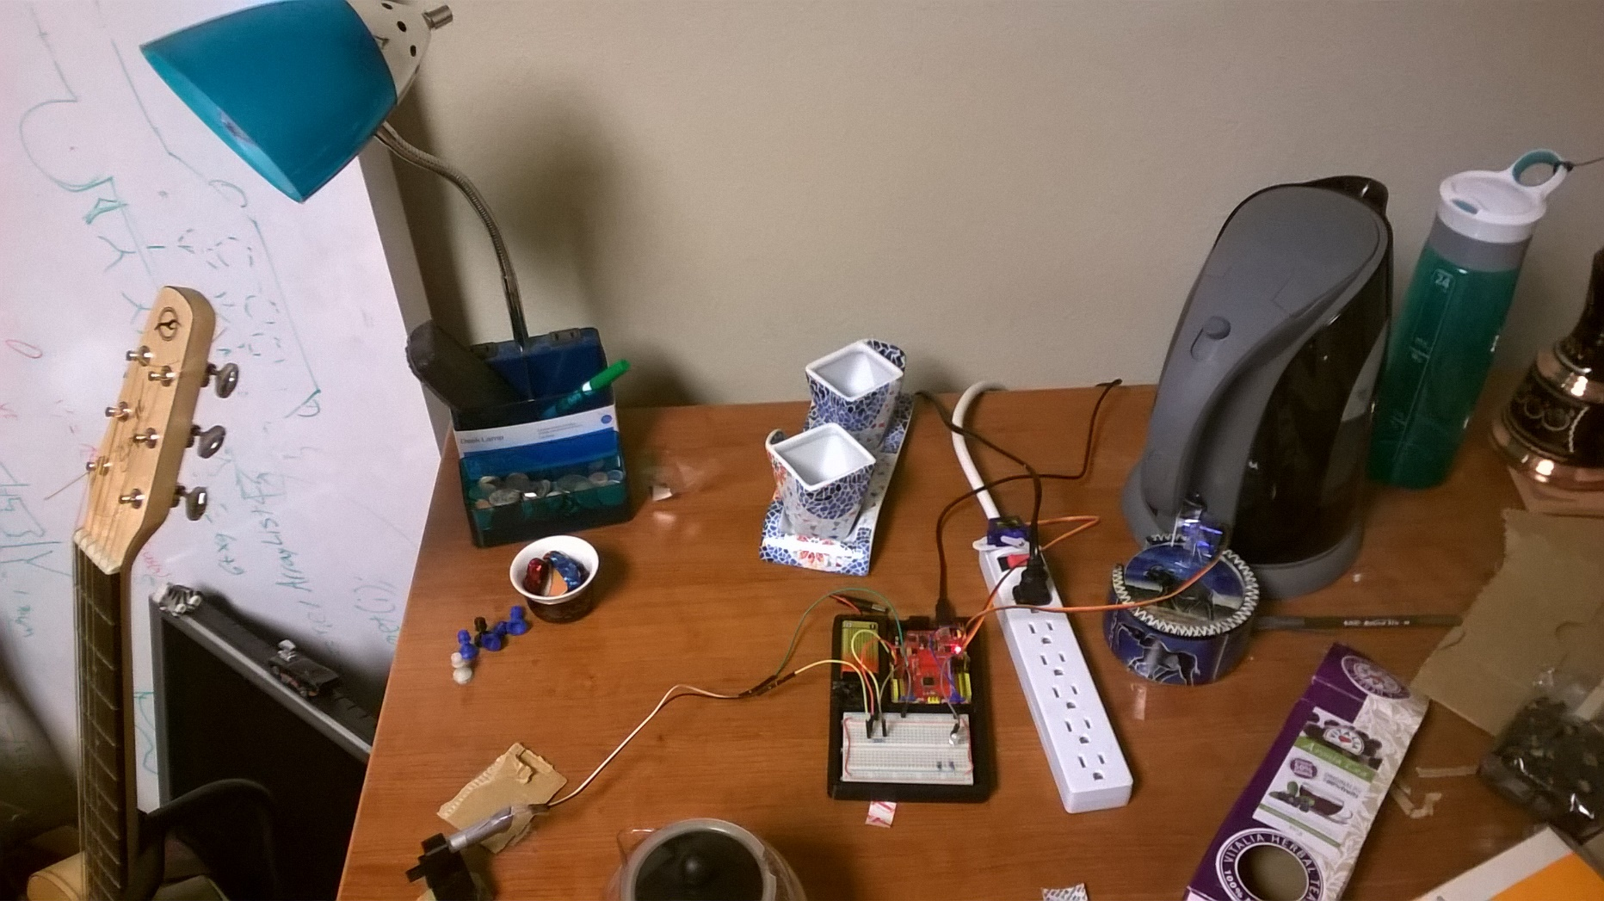
Lamp / Teapot

Slide 3
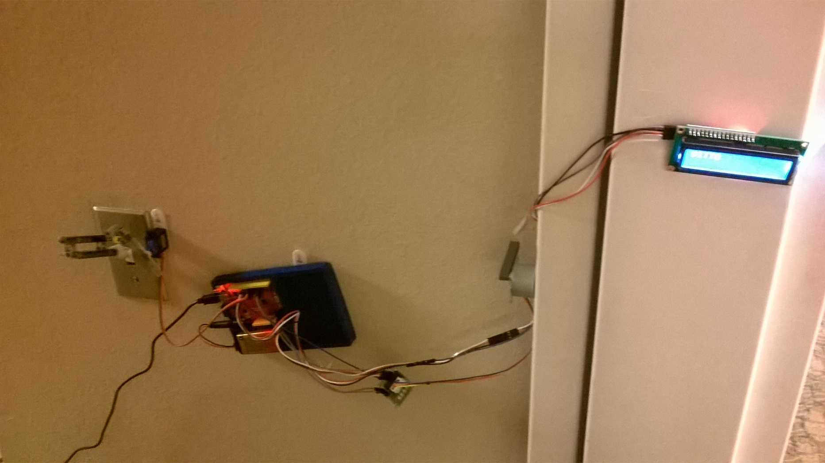
LCD / Light Switch / Door Lock

Slide 4
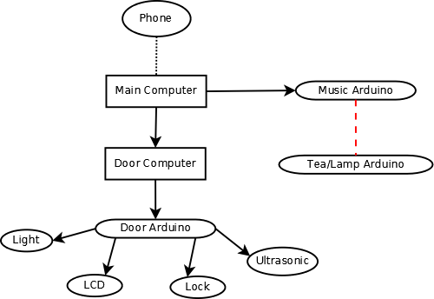
Block Diagram

Slide 5
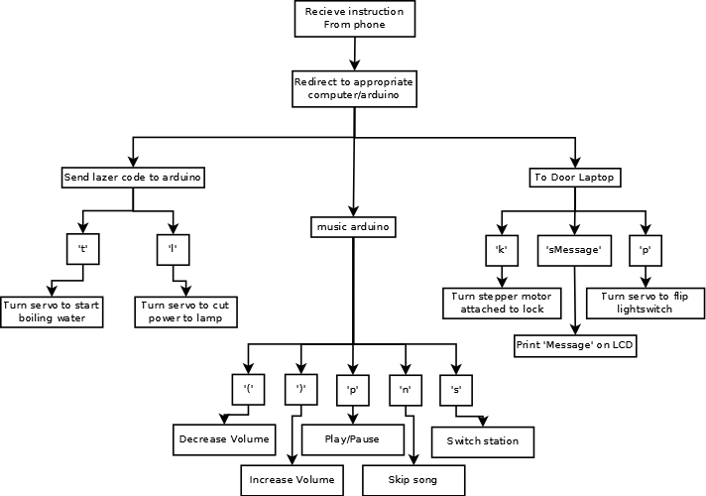
Flowchart

Slide 6
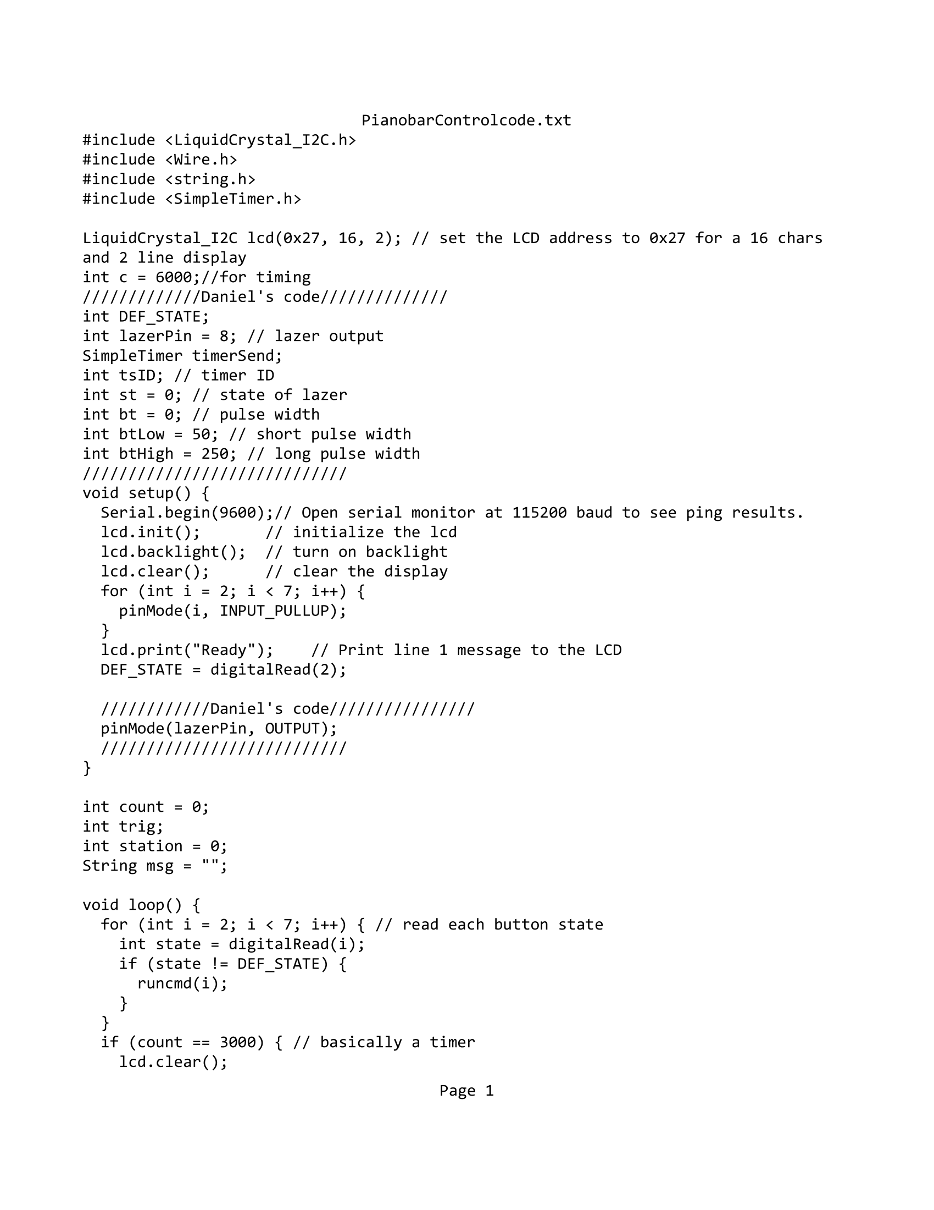
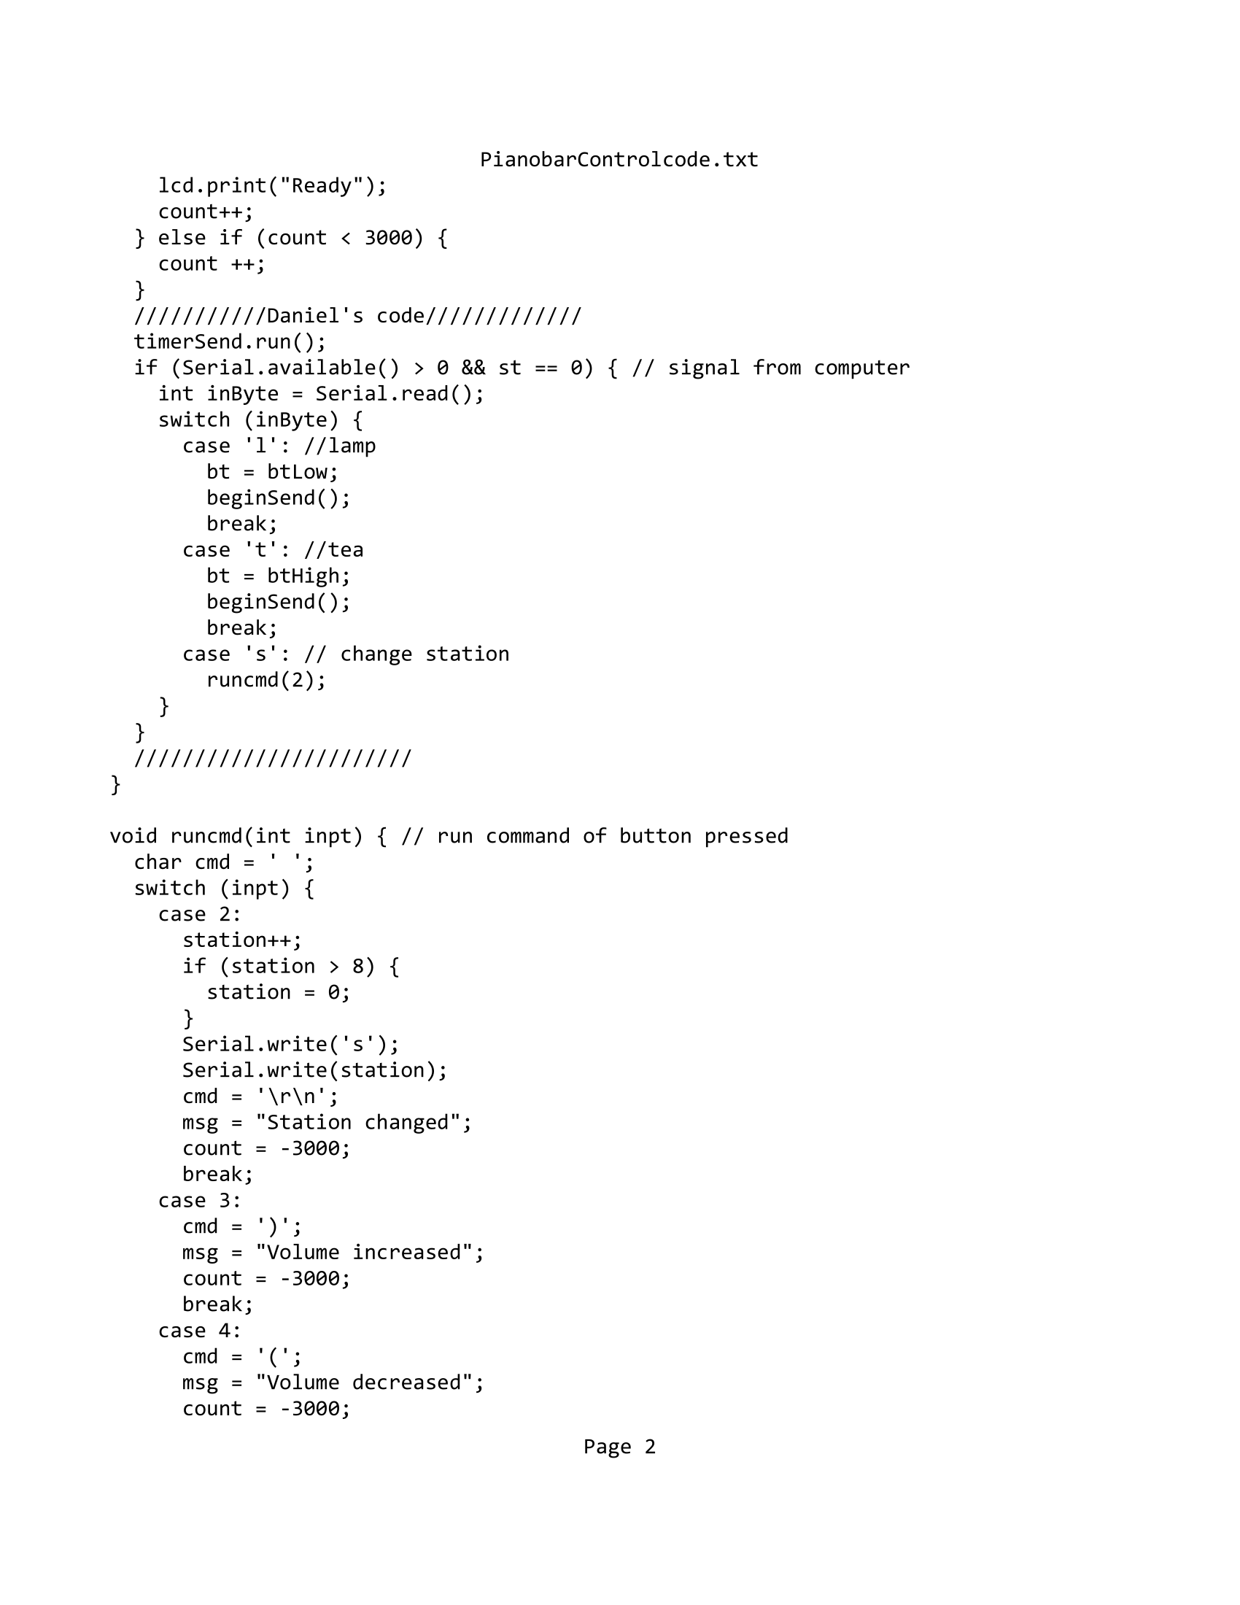
Music/Laser Arduino

Slide 7
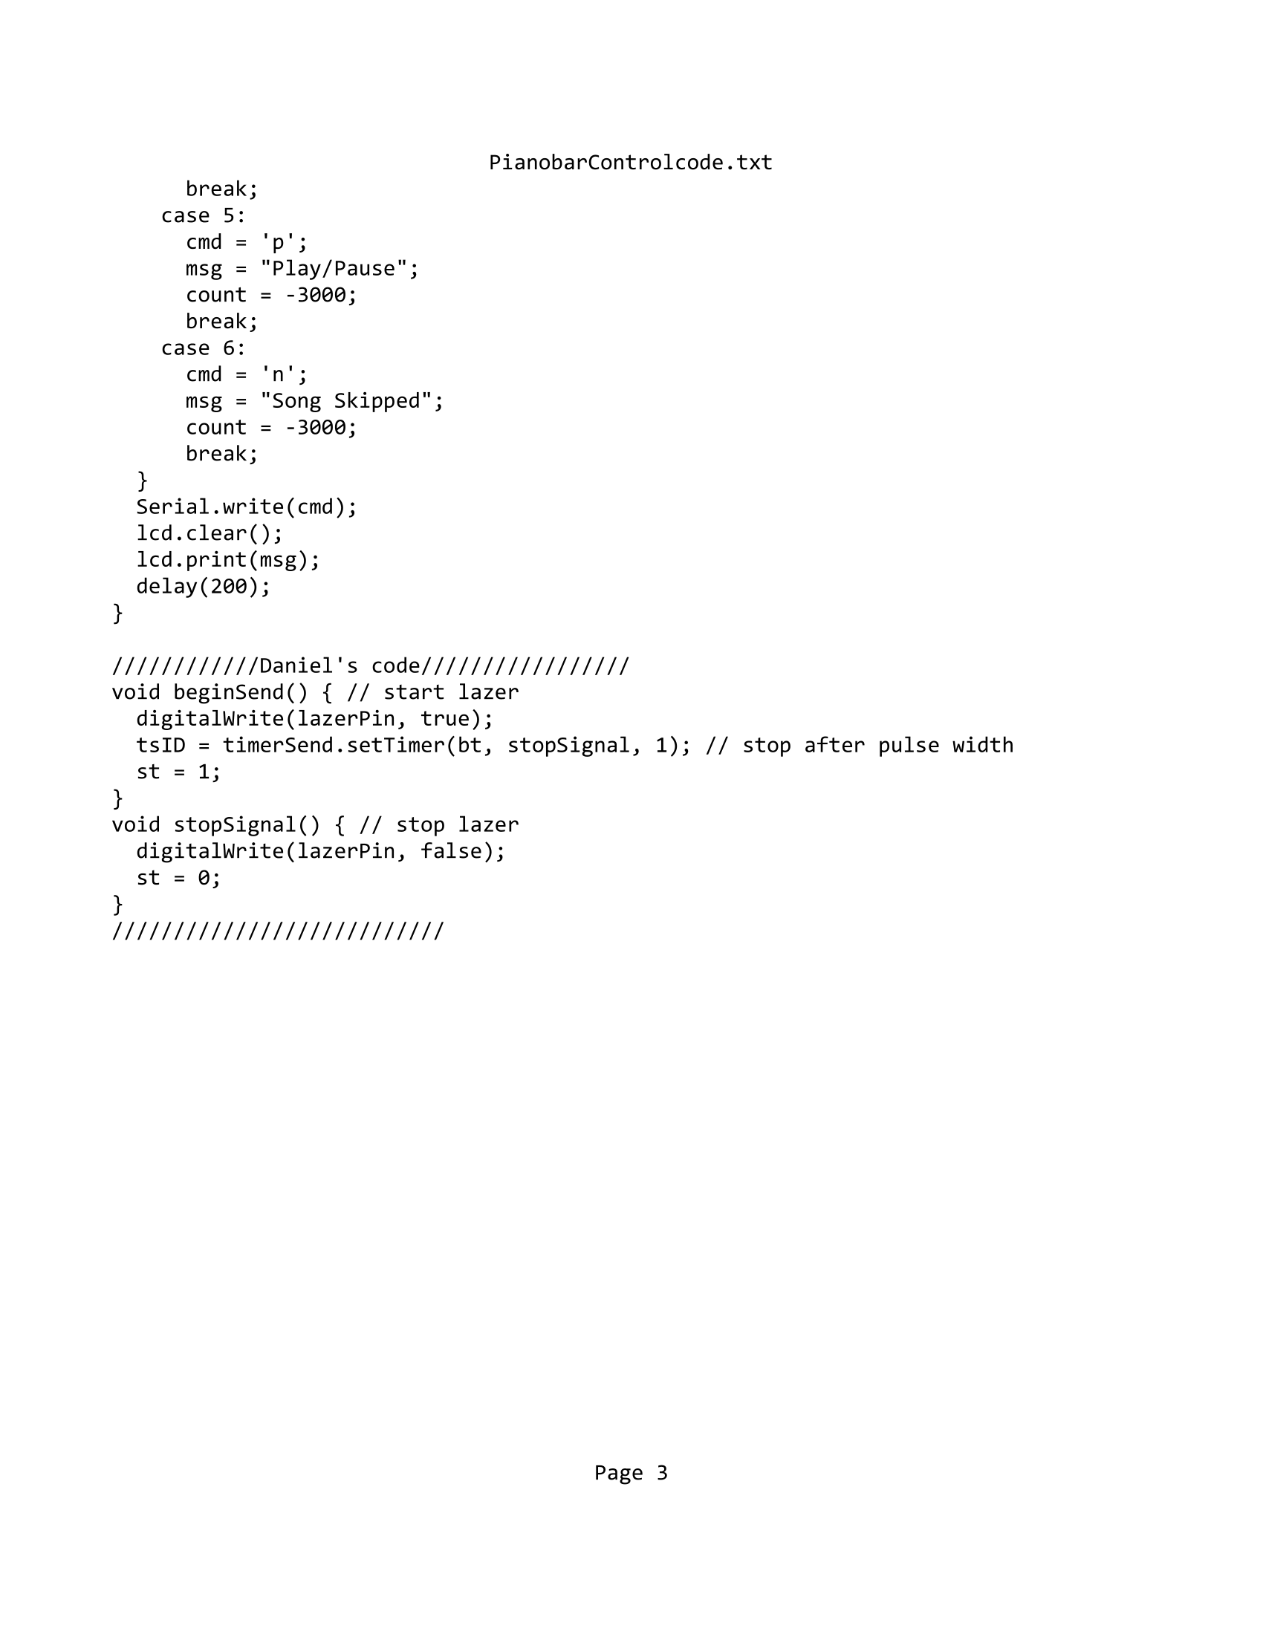
Music/Laser Arduino

Slide 8
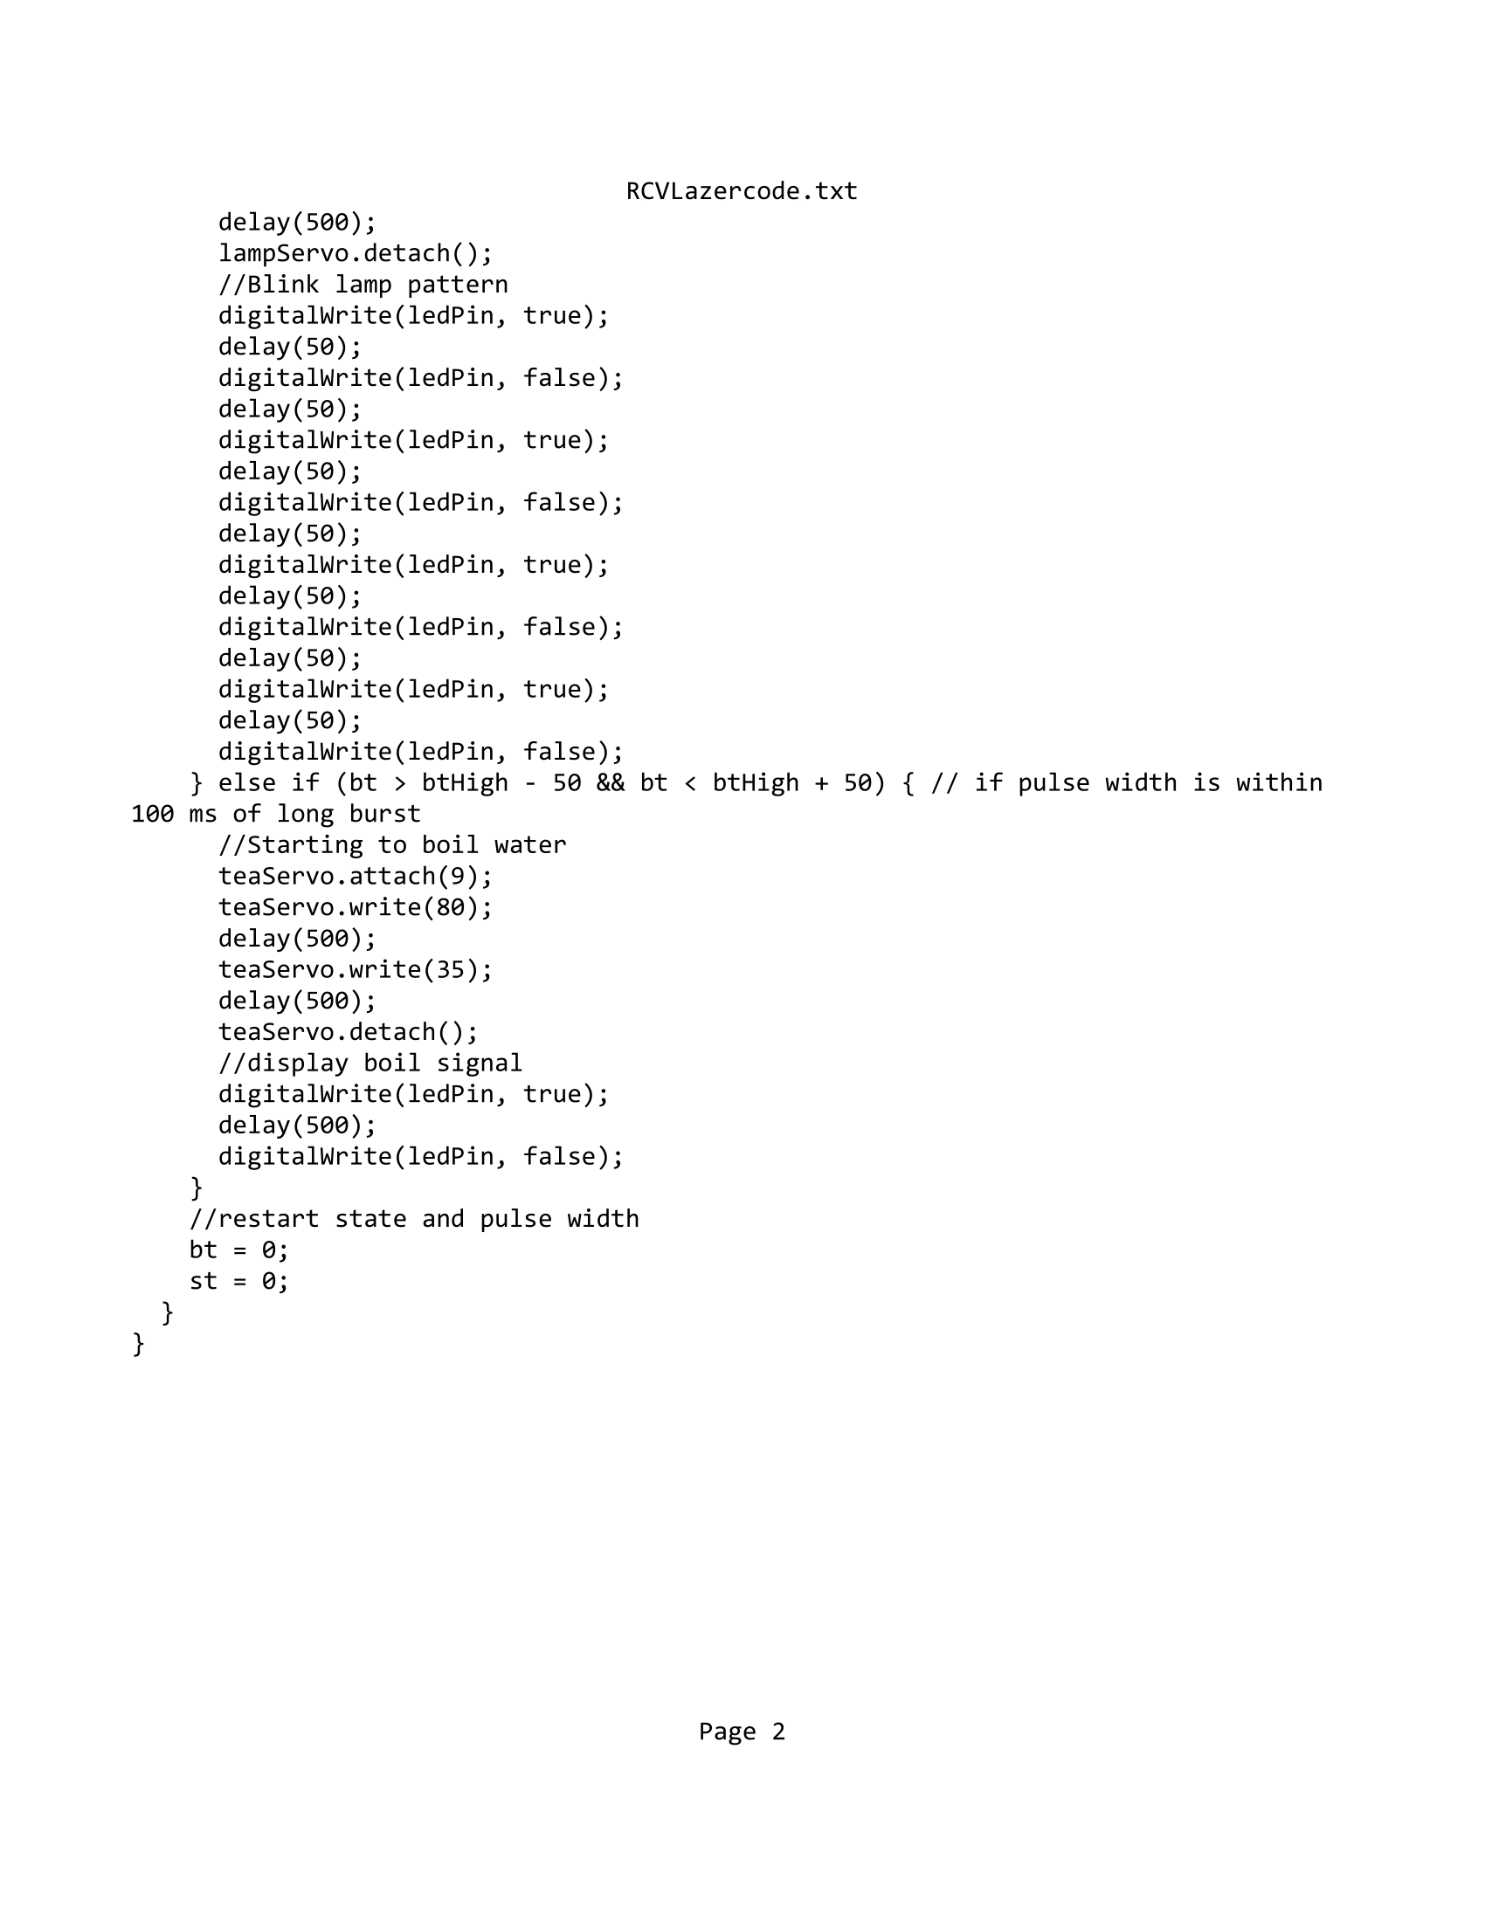
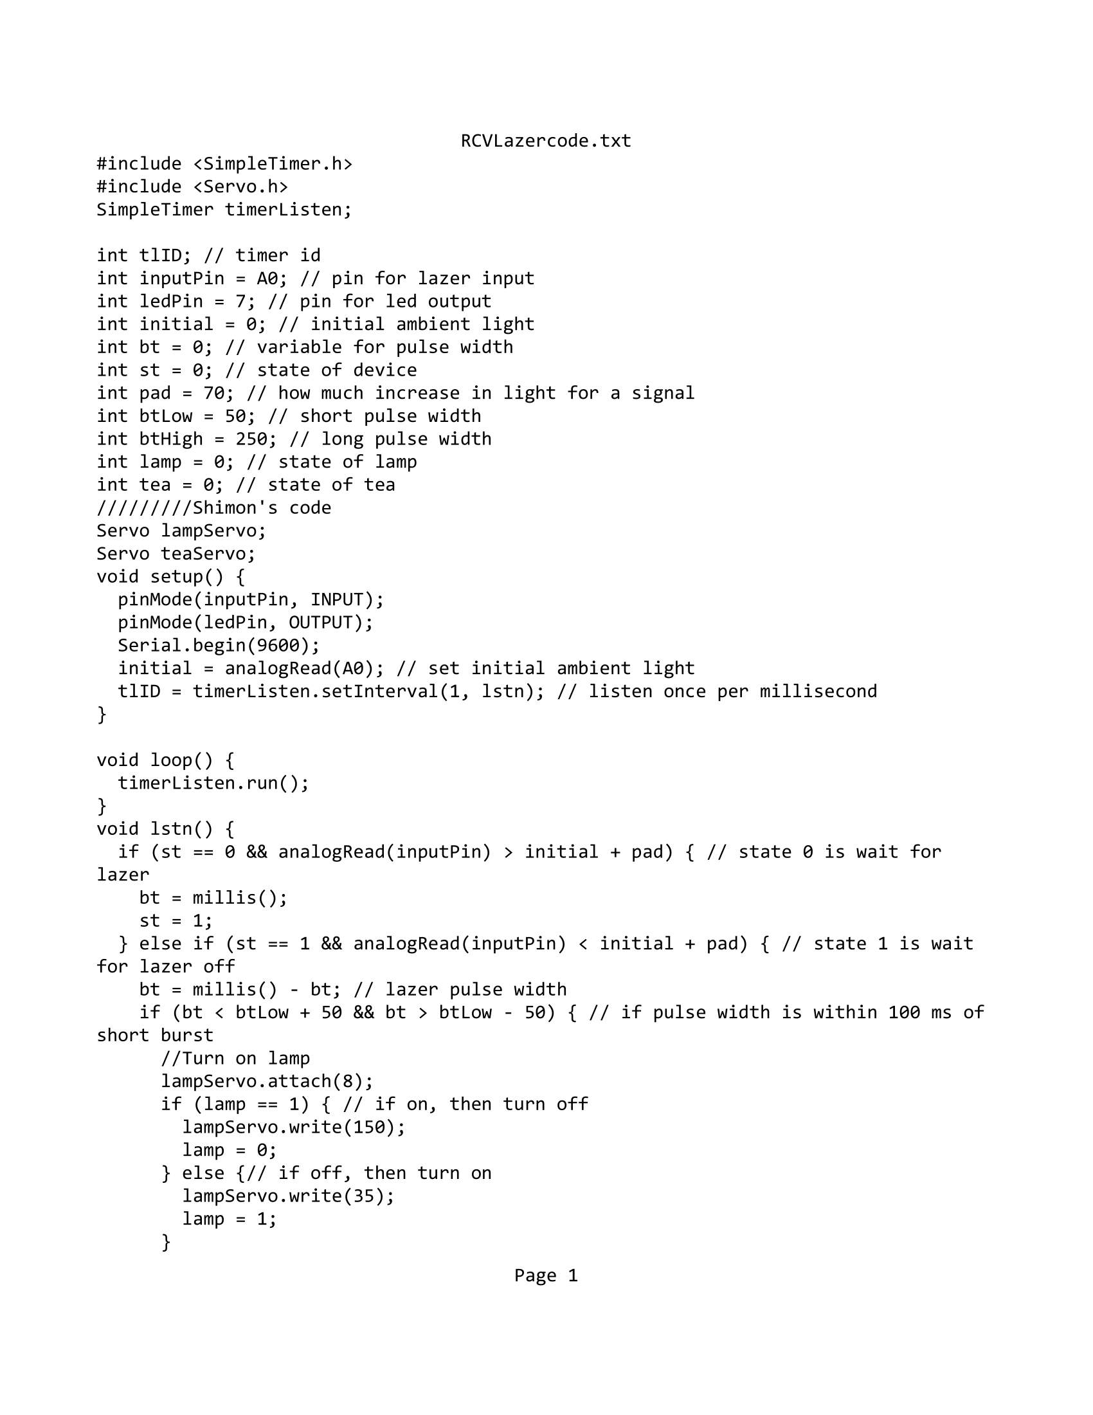
Lamp/Tea Arduino

Slide 9
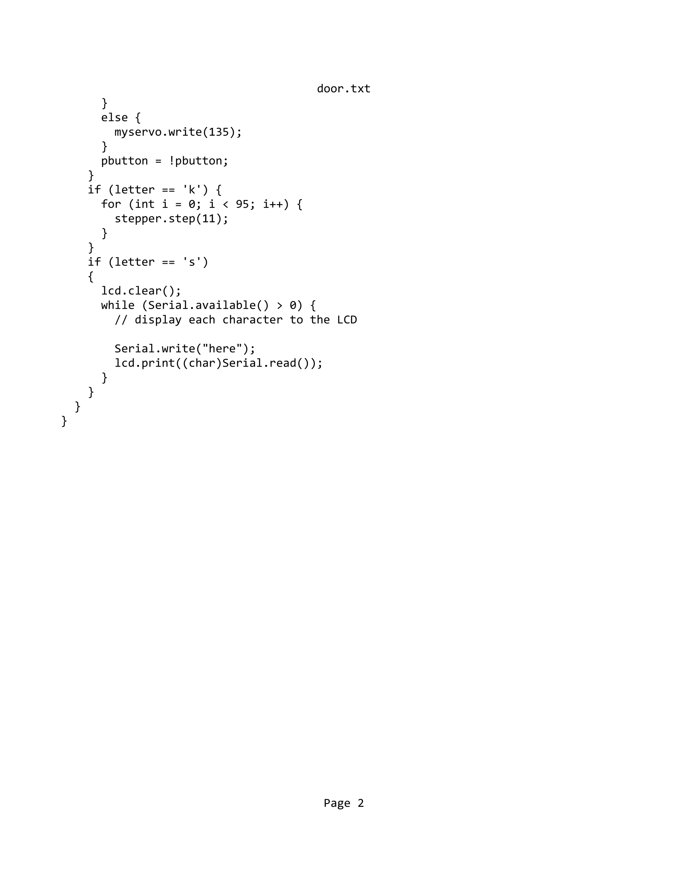
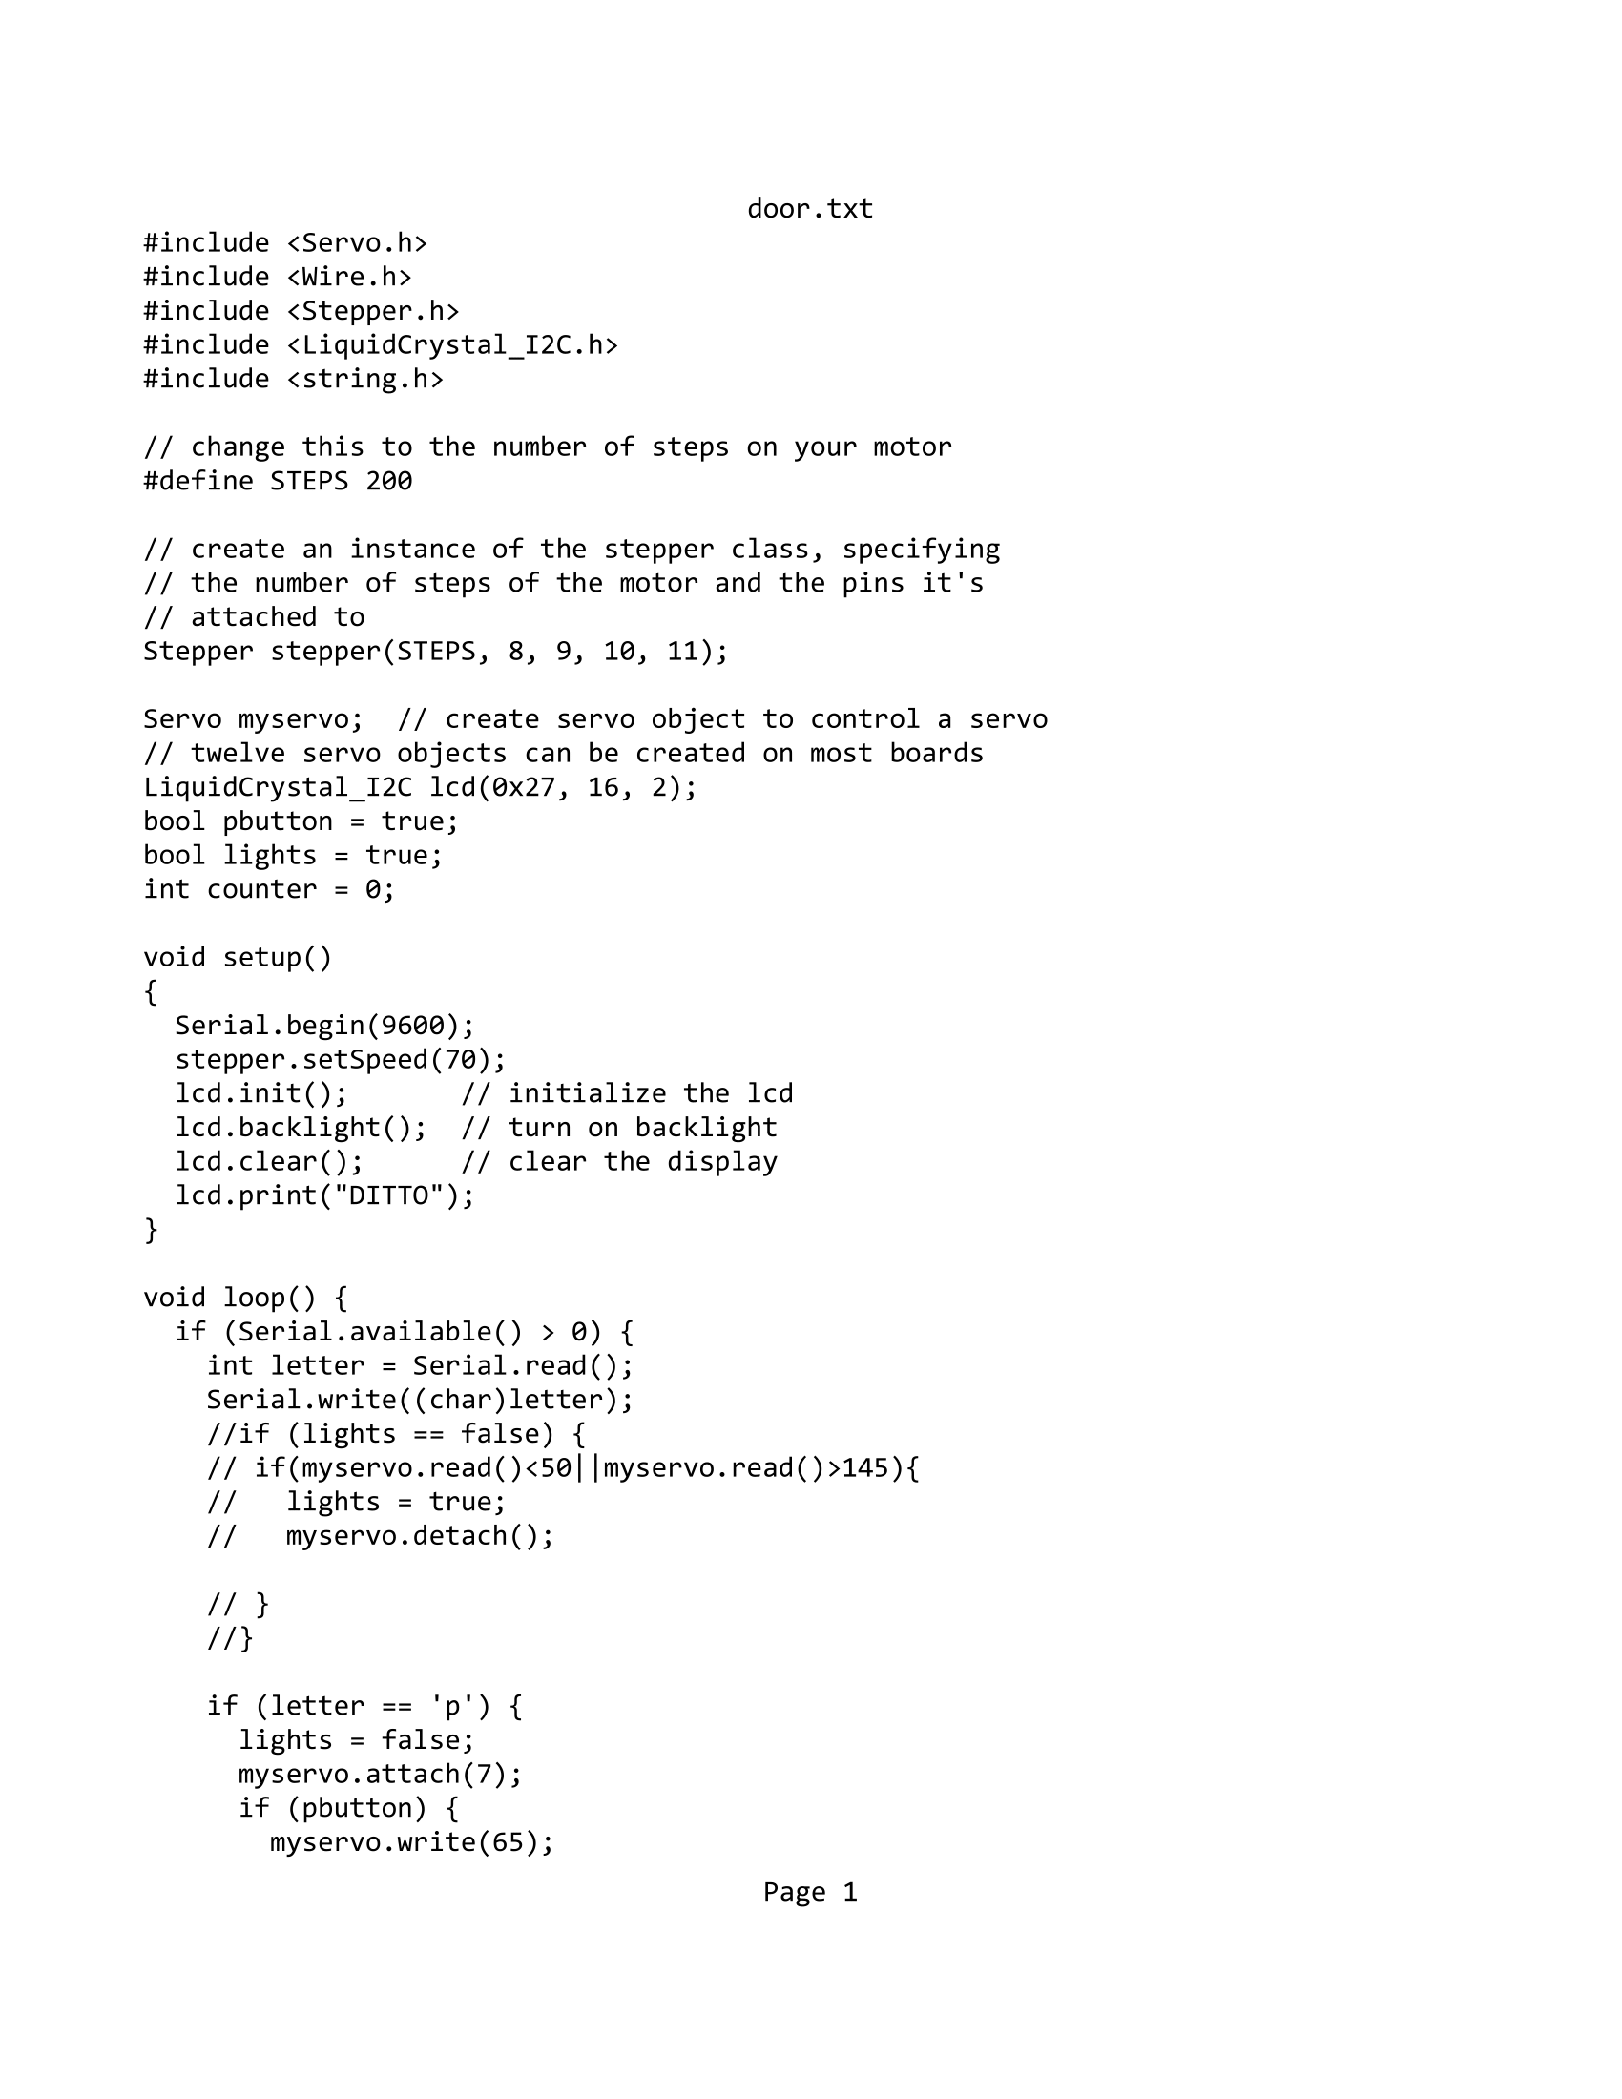
Door Arduino

Slide 10
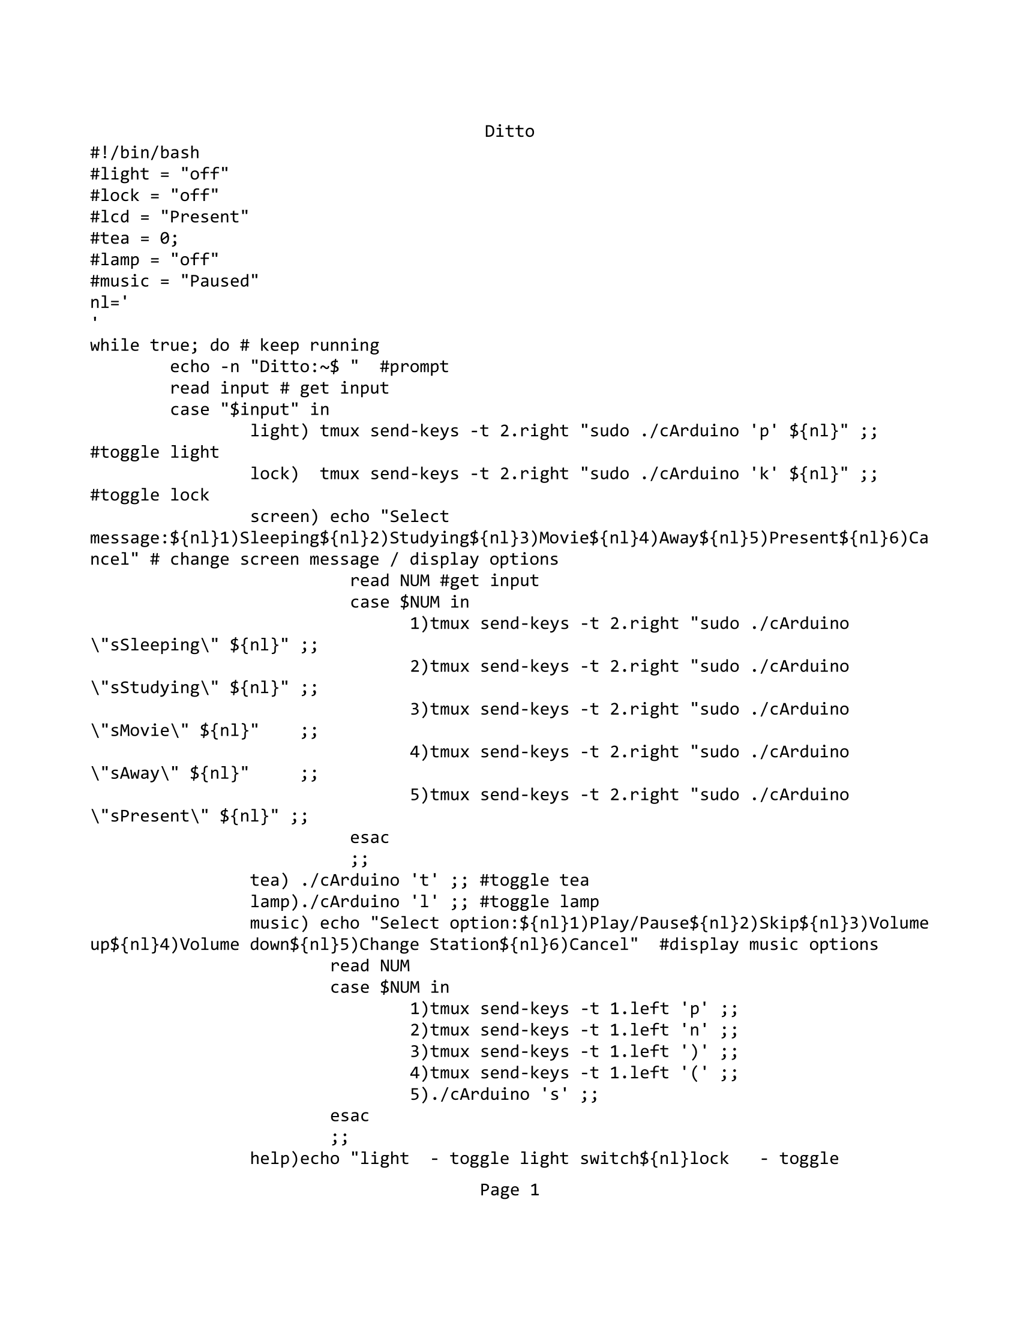
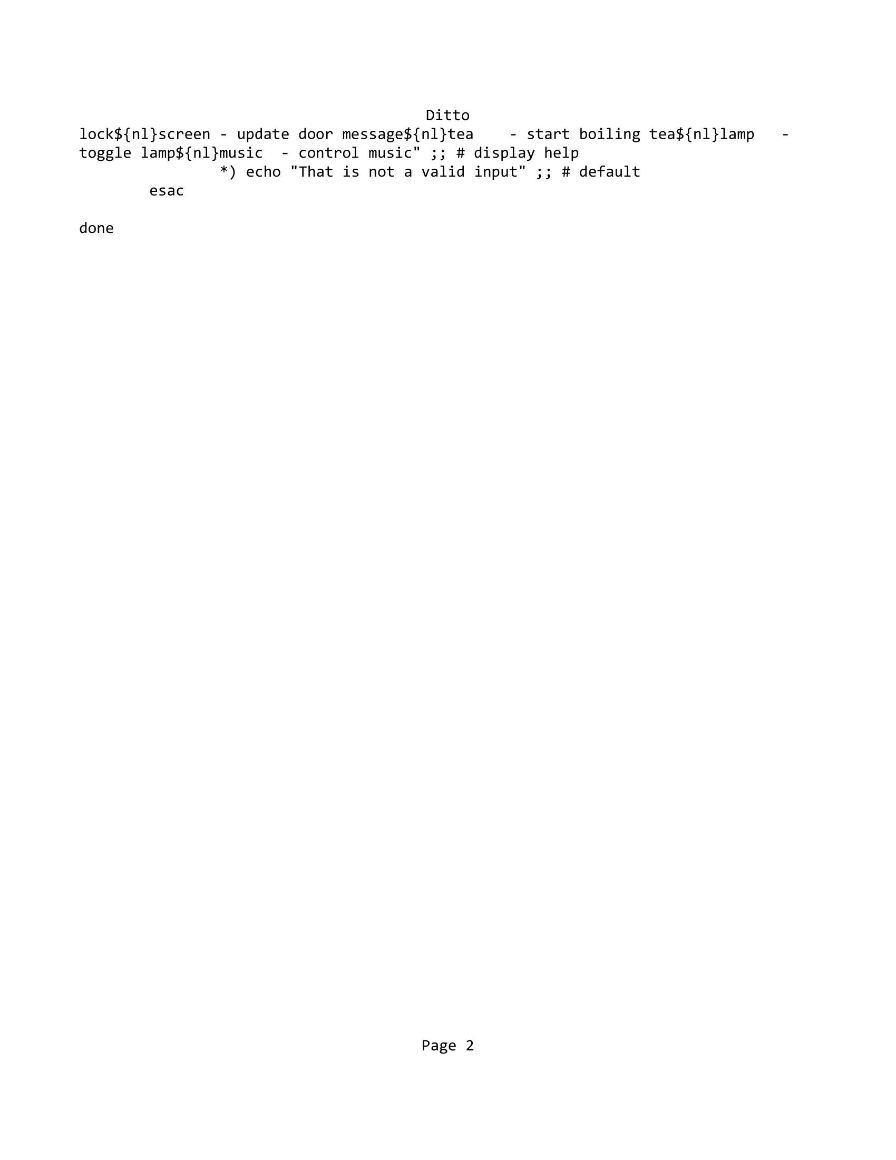
DITTO

Slide 11
References/Inspiration
Previous laser project
Smart houses
LiquidCrystal_I2C Library
SimpleTimer Library
Stepper Library
Servo Library

Slide 12
Future Ideas
Ultrasonic sensor for entry and exit
Notifications
Alarms
Modes
Integrated lock

