Slide 1

Micah Richards
Micro-Computer Design Project
04/24/2018

Slide 2
Project Description
The microcomputer design project is a task requiring the production of a single board computer from scratch. The project necessitates the selection of IC chips, designing of a printed circuit board, programming of chip communication procedures, and the programming of a monitor program for user interactions.

Slide 3
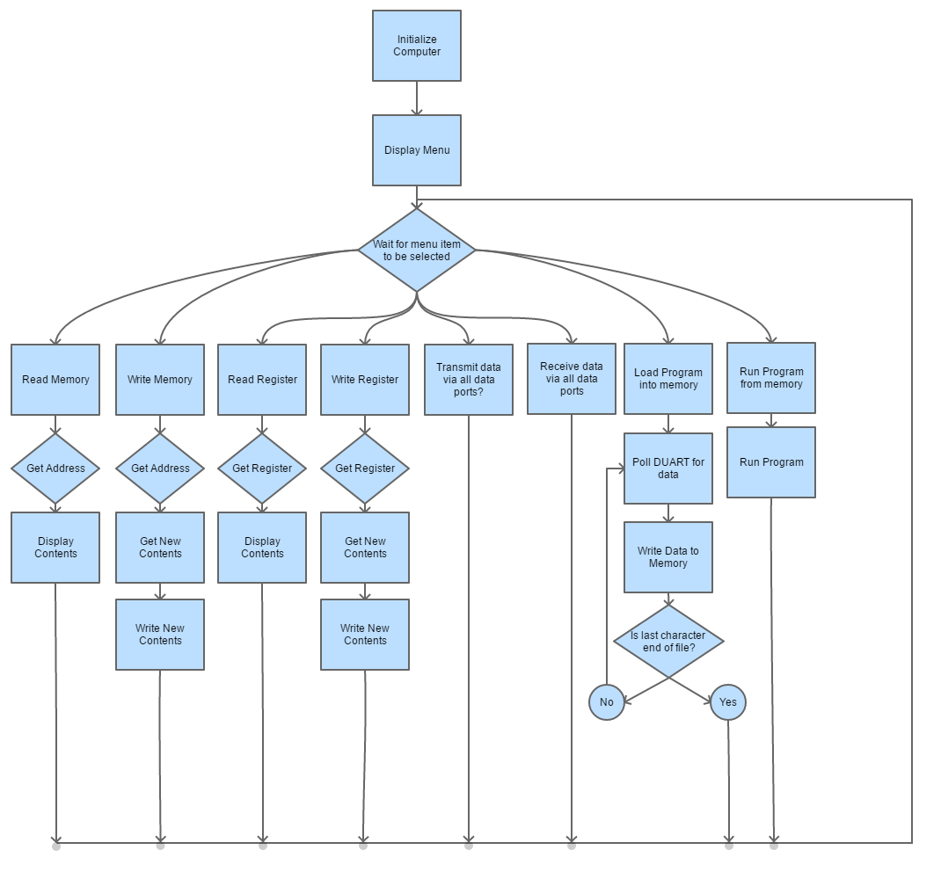
Operating System Flowchart

Slide 4
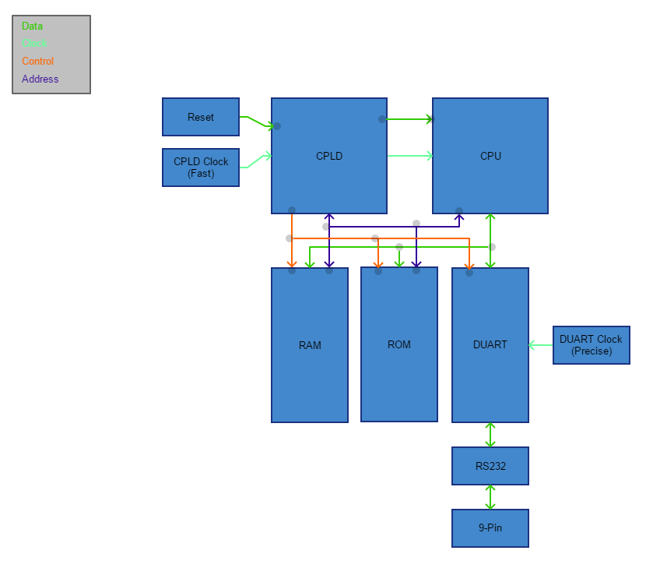
Block Diagram Of Hardware

Slide 5
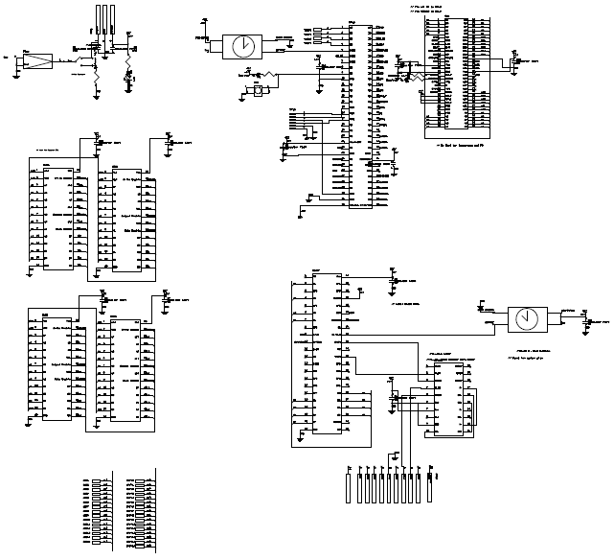
Computer Schematics

Slide 6
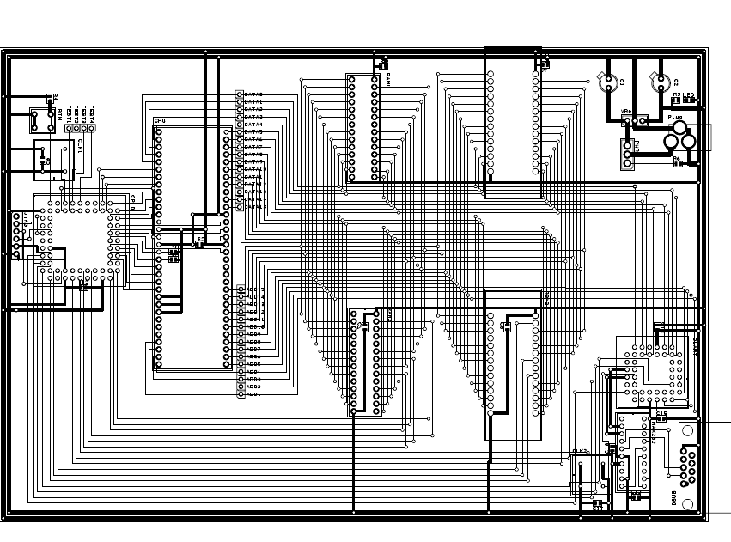
Printed Circuit Board

Slide 7
Parts and Costs

Slide 8
Technical Specifications
RS-232 compatible data port at 19,200 baud
64K of RAM and ROM
Monitor program capable of:
Examining the contents of any memory location within the memory space
Changing the contents of any random-access memory location within the memory space
Examining and changing the contents of any of the registers within the MPU
Transmitting and receiving data via all data ports
Allowing a machine-coded program to be loaded into RAM from a data port
Executing a program that has been loaded into RAM

Slide 9
Time Spent

