Slide 1


J.N.N INNOVOTHAN 2K26
Problem Statement ID-JNN26009
Problem Statement Title- CrowdShield (Smart Safety Wristband for Crowd Emergencies)
Theme- IoT-Based Emergency Response System for Large Public Events.
PS Category- Hardware + Software (IoT Based System)
Team Name- ResQNodes

Slide 2
CrowdShield
ResQNodes
Proposed Solution
CrowdShield –
Smart Emergency Wristband
Proposed Solution:
• SOS emergency button on wearable wristband.
• Works in two modes
Online Mode (GPS through phone)
Offline Mode (BLE Mesh network)
How the System Works?
Online Mode:
Wristband →Phone Application→ Cloud Server →
Security Dashboard
Offline Mode:
Wristband → BLE Mesh → Receivers → Dashboard
Key Features:
• Instant SOS alert
• Live location tracking
• Works even without internet
• Low-cost wearable device
• Scalable for large events
Innovation:
• Dual-mode emergency system
• IoT + mesh networking + mobile app integrated
• Customized specifically for crowd safety scenarios

Slide 3
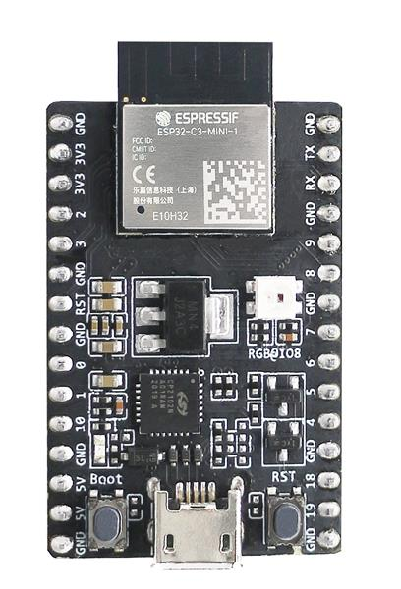
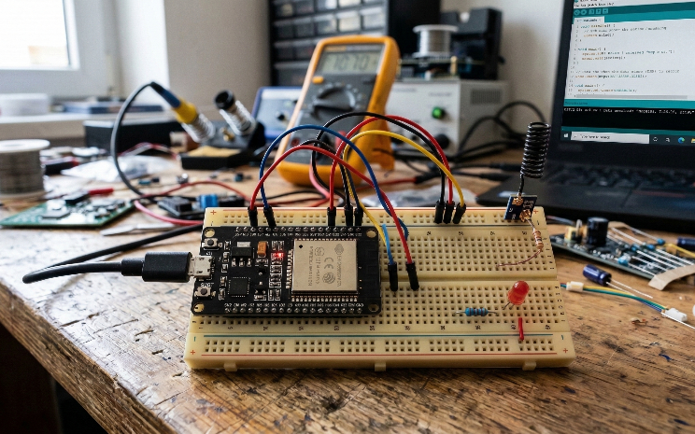
TECHNICAL APPROACH
ResQNodes
Your
Team
Name
Implementation Steps:
Build wristband prototype
2. Implement BLE communication
3. Develop mobile application
4. Setup receiver gateways
5. Create dashboard for security monitoring
Technologies Used:
Hardware
• ESP32-C3 microcontroller • BLE (Bluetooth Low Energy) • Push button SOS trigger • LED indicator
Software
• Web Application • Backend server using Node.js • Database using Firebase
Mapping
• Web dashboard using Leaflet Map
ESP32-C3
Receiver Module

Slide 4

FEASIBILITY AND VIABILITY
ResQNodes
Feasibility
The idea is practical because it uses simple and affordable hardware components that are already widely available.
The prototype can be built using ESP32 boards, buttons, and batteries, which makes it cost-effective.
Possible Challenges
• Wireless signals may get weaker in very dense crowds • Battery life of the wristband • Maintaining stable connections between devices
Possible Solutions
• Using BLE mesh networking so signals can hop through nearby devices • Using low-power modes to save battery • Installing multiple receivers across the event area
Scalability
This system can support large events with thousands of participants by adding more receivers.

Slide 5
IMPACT AND BENEFITS
ResQNodes
Target Users
• Concert organizers • Festival event managers • Stadium security teams • Large public gatherings
Social Impact
This system can help improve safety during crowded events.
If someone is lost, injured, or in danger, security teams can quickly locate them and provide help.
Economic Benefits
• Helps organizers manage safety more efficiently • Reduces the risk of serious incidents during events • Provides a low-cost safety solution
Possible Applications
• Music concerts • Marathons • Religious gatherings • College festivals • Sports stadiums

Slide 6
RESEARCH AND REFERENCES
ResQNodes
1. Crowd Disaster Monitoring using Wireless Sensor Networks
M. V. Ramesh, S. Anjitha, P. Rekha. https://www.researchgate.net/publication/259162446_A_Novel_Wireless_Sensor_Network_Architecture_for_Crowd_Disaster_Mitigation
2. BLE Indoor Positioning System
Song Chai, Renbo An, Zhengzhong Du https://www.researchgate.net/publication/306325749_An_Indoor_Positioning_Algorithm_using_Bluetooth_Low_Energy_RSSI
3. Bluetooth Low Energy Indoor Positioning System
V. C. Paterna et al. https://pmc.ncbi.nlm.nih.gov/articles/PMC5750706/
4. IoT and Wireless Sensor Networks for Disaster Management
Ahsan Adeel et al. https://arxiv.org/pdf/1909.10353
5. BLE Indoor Positioning using RSSI
Jeremy R. et al. https://www.mdpi.com/2076-3417/11/13/6107

