Slide 1

Ekow asante

Slide 2
Intro
- Entity Relationship Diagrams (ERDs) - User Stories and Use Cases - Any and all wire-frames (hand drawn WFs are just as acceptable as digital ones) - What went well / what didn't - Things that had had to be abandoned this sprint, and therefore pushed to the next sprint (with supporting reasoning) - Estimated work effort (time spent) of the project - What you would do differently if asked to start again - Any other documentation / information that can help justify your decisions

Slide 3
Design doc

Slide 4
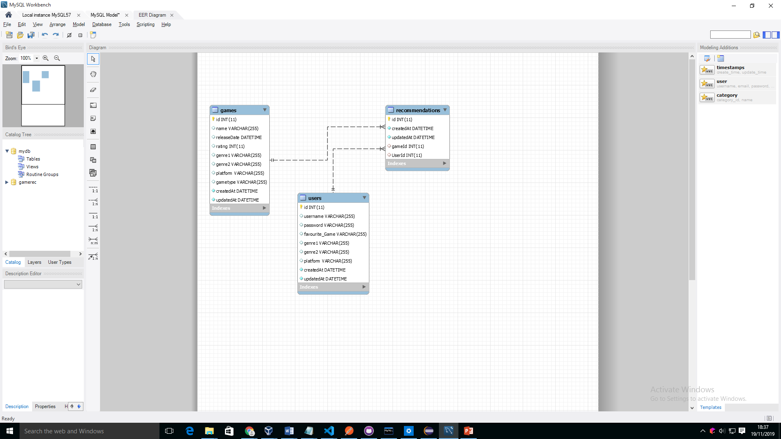
ERD

Slide 5
User Stories

Slide 6
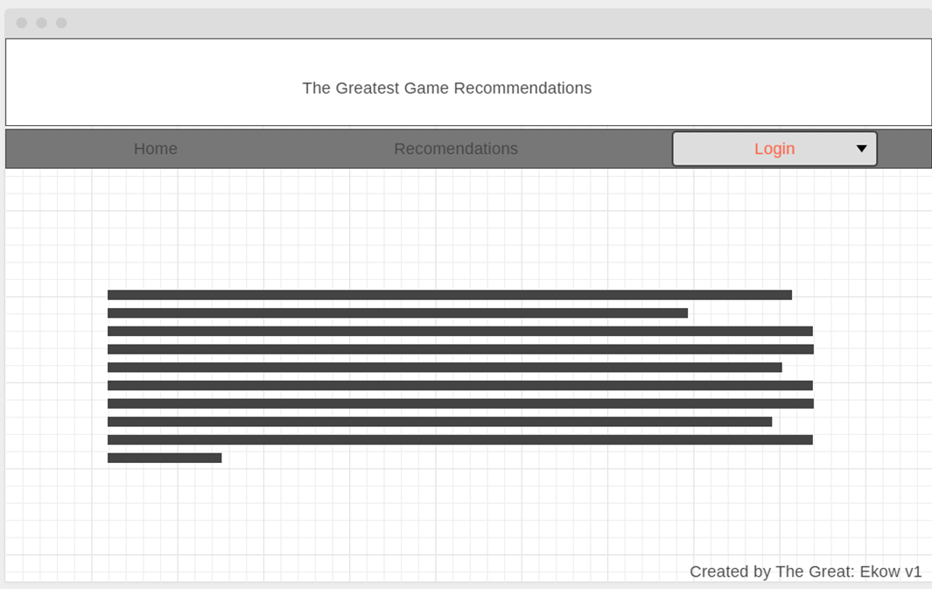
Wireframe

Slide 7
What went well

Slide 8
What could go better

Slide 9
Next sprint
Mobile
Connect to imdb
Better recommendation
Show trailer
Game page
purchase

Slide 10
Work effort

Slide 11
Next time

