Slide 1


Created by: Ekow asante

Slide 2
Introduction
Ekow Asante
The Great Game Recommender
A new way to find your next game
Recommendations based on user preferences

Slide 3
Design doc
- What went well / what didn't - Things that had had to be abandoned this sprint, and therefore pushed to the next sprint (with supporting reasoning) - Estimated work effort (time spent) of the project - What you would do differently if asked to start again - Any other documentation / information that can help justify your decisions

Slide 4
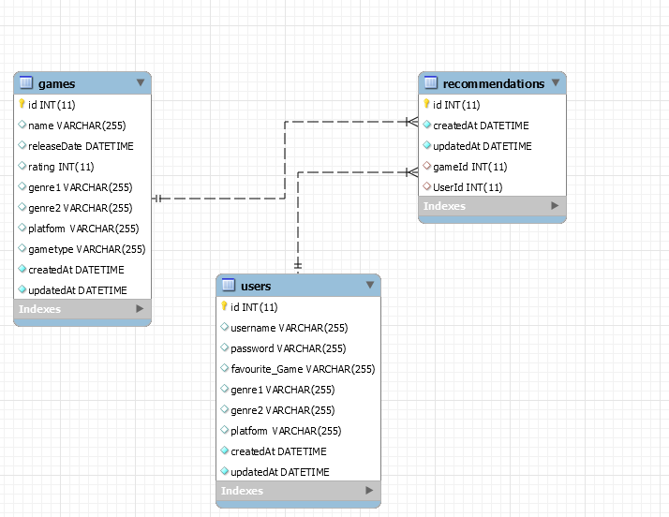
ERD
3 Tables
Full CRUD on users
Games has one to many recommendations
Users has one to many recommendations

Slide 5
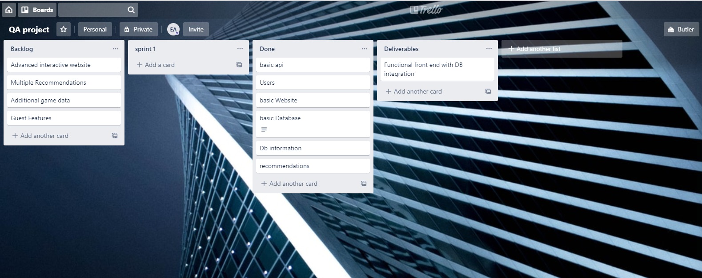
Trello Board

Slide 6
User Stories
As a user I want to register so that I can become a member
As a member I want to fill in the form so that I can get a recommendation
As a member I want to edit my details so I can feel better about myself
As a member I want to delete my account so that my information is not stored

Slide 7



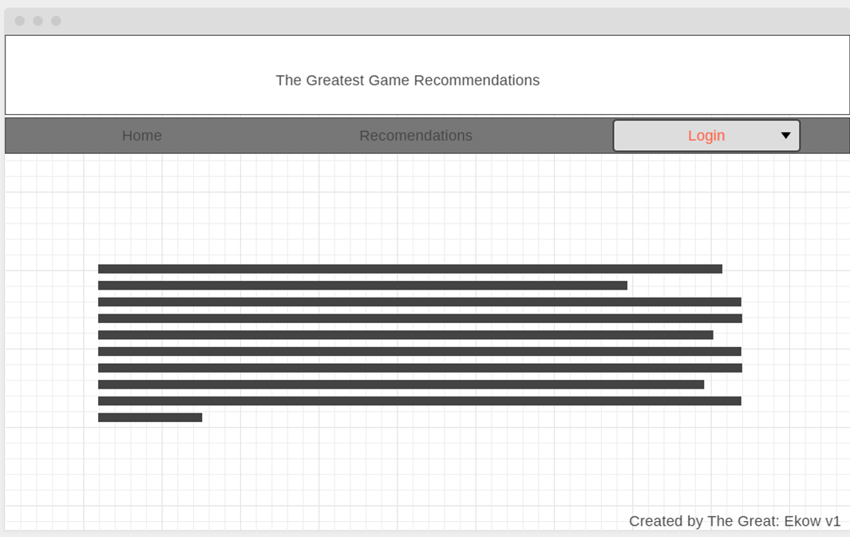


Wireframes
Homepage

Slide 8
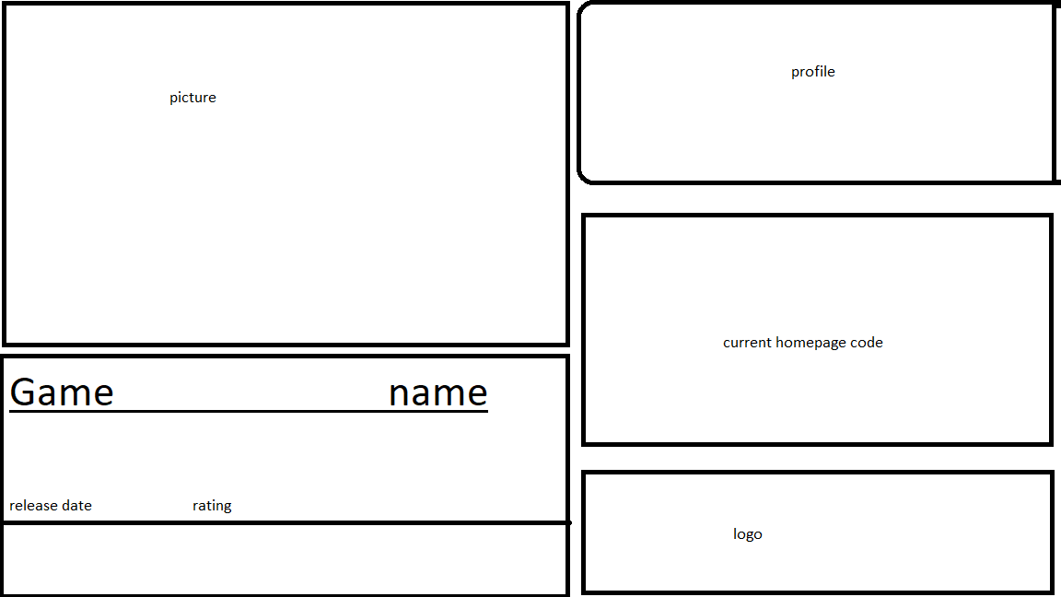
Wireframes
Recommendations Page

Slide 9
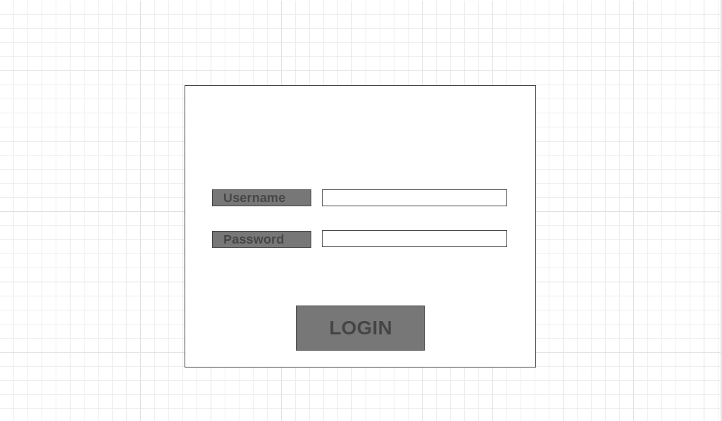
Wireframes
Login Page

Slide 10
What didn’t make it to the final build
Multiple recommendations displayed
Guest recommendations
Deeper user customisation
Game box art display
Game additional data

Slide 11
Retrospective
What went well
What could go better
Database and testing was straightforward
Website was functional early
More intuitive website design
Better time management
More features

Slide 12
Retrospective continued
What could’ve been done differently
Games with one general genre
Games page showing all games in the database
Recommendations not tied to members
Homepage with links to other pages only

Slide 13
Next sprint
Improved Mobile support
Connect to IMDB
Better recommendations(more options)
Show trailer
Game page
Purchase
Community recommended games
Upcoming games

Slide 14
Work effort
Majority of the time was spent on the front end design and functionality.60%
Adequate time was spent on the back end to reach its MVP state.20%
Automated Testing had the lowest time allocation 10%
Integration of complete system. 10%

Slide 15
Thank You For Your Time
Any questions?

