Slide 1

Ekow asante

Slide 2
Intro

Slide 3
Design doc

Slide 4
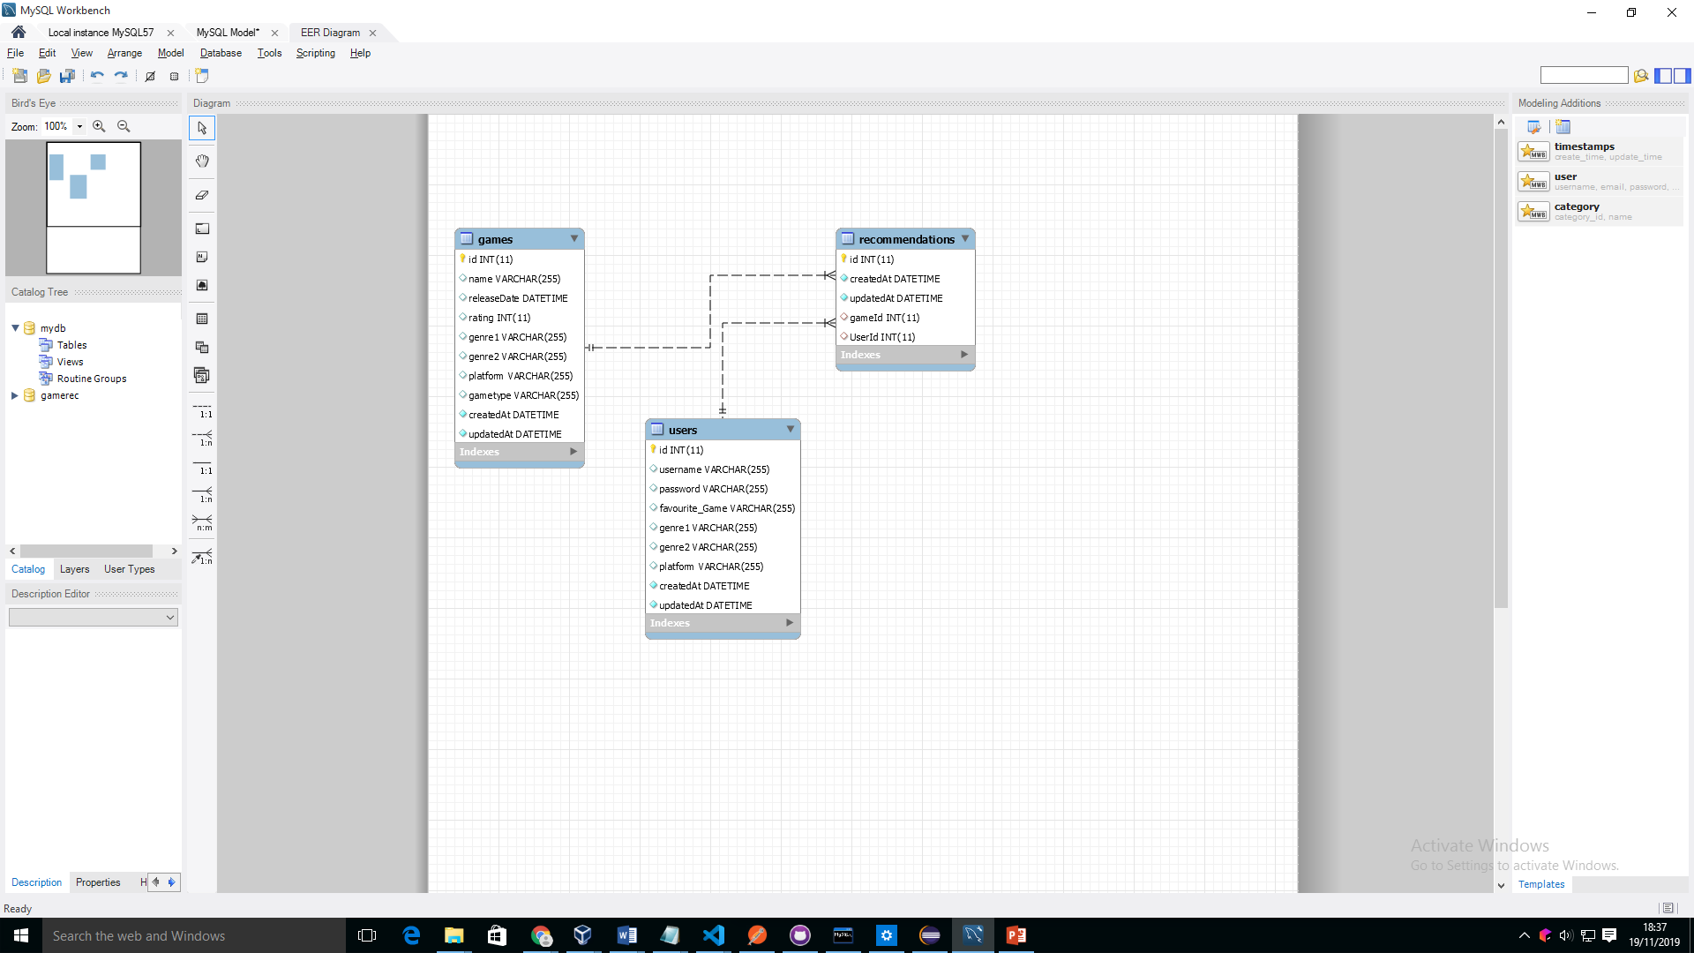
ERD

Slide 5
User Stories

Slide 6
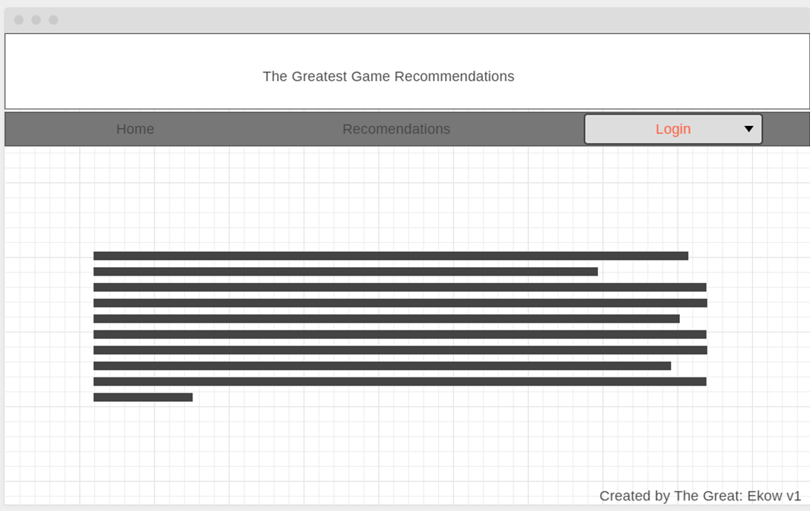
Wireframe

Slide 7
What went well

Slide 8
What could go better

Slide 9
Next sprint
Mobile
Connect to imdb
Better recommendation
Show trailer
Game page
purchase

Slide 10
Work effort

Slide 11
Next time

